Slide 1
Wilhelmina Jashemski
1910-2007
Olivia Darveau

Slide 2
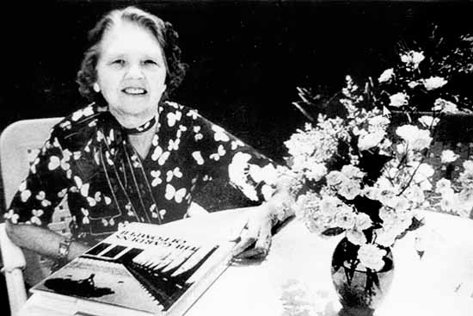
Before Archaeology
Born in York, Nebraska – July 10, 1910
Graduated from:
York College, 1931
University of Nebraska, 1933
University of Chicago, 1942
Taught at colleges and University of Maryland
Focused on Roman Law

Slide 3
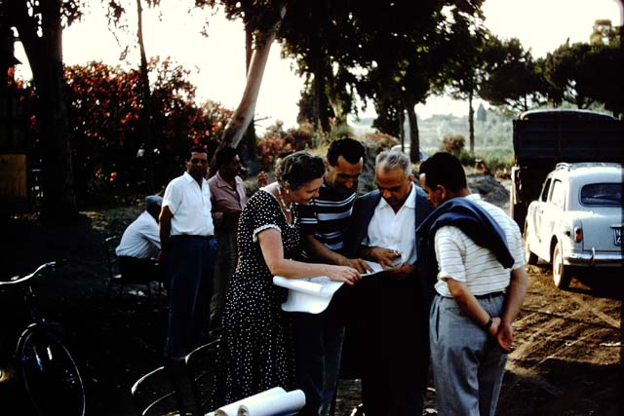
Archaeological Experience
First travelled to Pompeii in 1955
Began excavations there in 1961
Directed University of Maryland’s excavations
Focused on the gardens of the city

Slide 4

Contributions
Developed archaeological investigations in horticulture
Researched the importance of gardens in ancient life
Wrote many books on Roman gardens

Slide 5
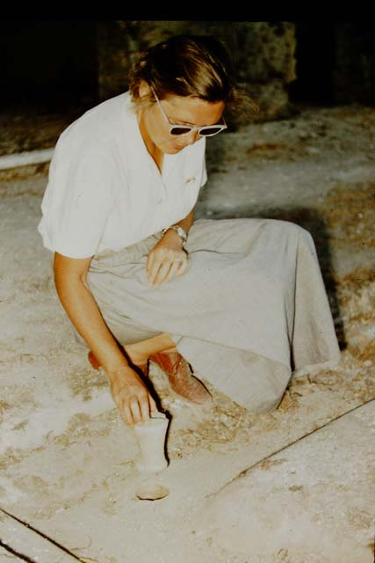
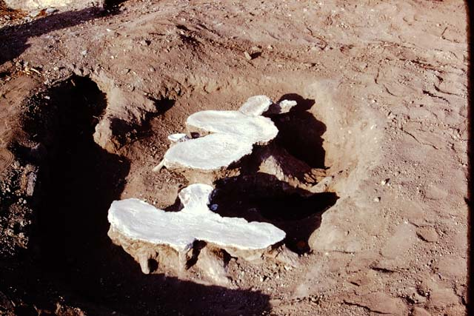
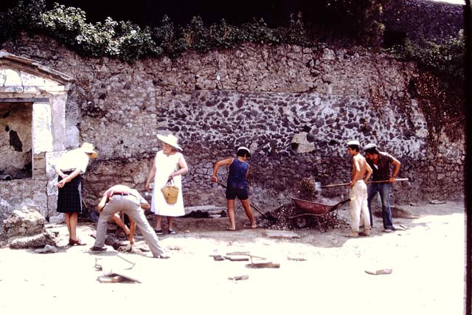

Slide 6
Bibliography
Holley, Joe. “Pompeian Historian Wilhelmina Jashemski,” January 14, 2008. http://www.washingtonpost.com/wp-dyn/content/article/2008/01/13/AR2008011302806.html.
“Jim McKee: Wilhelmina Jashemski Is a Nebraska Author You’ve Never Heard of.” JournalStar.com. Accessed March 12, 2018. http://journalstar.com/news/local/education/jim-mckee-wilhelmina-jashemski-is-a-nebraska-author-you-ve/article_407280f6-75b1-11df-a990-001cc4c002e0.html.
Kohl, Amber. “LibGuides: Pompeii Resources in University of Maryland Libraries: Dr. Wilhelmina Jashemski.” Accessed March 12, 2018. http://lib.guides.umd.edu/c.php?g=326514&p=2193250.
“Pompeiiinpictures Home Page.” Accessed March 13, 2018. http://www.pompeiiinpictures.com/pompeiiinpictures/index.htm.
“Wilhelmina and Stanley Jashemski Lecture - Archaeological Institute of America.” Accessed March 12, 2018. https://www.archaeological.org/giving/endowments/231.
“Wilhelmina F. Jashemski— 1996 Gold Medal Award for Distinguished Archaeological Achievement - Archaeological Institute of America.” Accessed March 12, 2018. https://www.archaeological.org/wilhelminafjashemski%E2%80%941996goldmedalawarddistinguishedarchaeologicalachievement.

