Slide 1
Israel Finkelstein
Biblical Archaeologist
Kass Mattingly

Slide 2

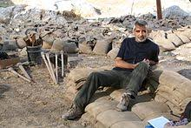
Background info
Born March 29, 1949 in Tel Aviv
Graduated from Tel Aviv University and received PhD in 1983
Current professor of the Archaeology of Israel at Tel Aviv University

Slide 3
Biblical Archaeology
“Biblical archaeology involves the recovery and scientific investigation of the material remains of past cultures that can illuminate the periods and descriptions in the Bible, be they from the Old Testament (Tanakh) or from the New Testament, as well as the history and cosmogony of the Judeo-Christian religions.”

Slide 4
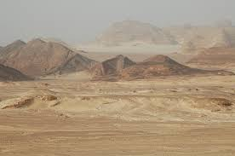
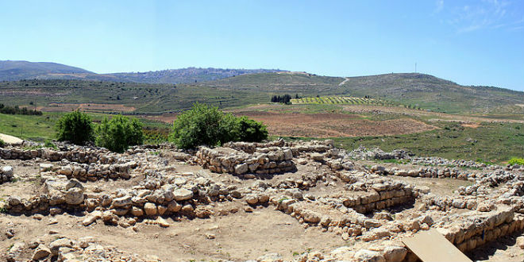
excavations

Slide 5
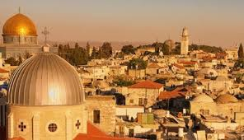
Major Contributions
The cyclical nature of Ancient Israel civilization
Low Chronology
Jerusalem archaeology
Palestine in the Persian and Hellenistic periods

Slide 6
Bibliography
“Biblical Archaeology.” Wikipedia, Wikimedia Foundation, 27 Mar. 2018, en.wikipedia.org/wiki/Biblical_archaeology.
“Israel Finkelstein.” Wikipedia, Wikimedia Foundation, 16 Mar. 2018, en.wikipedia.org/wiki/Israel_Finkelstein.
Silberman, Neil Asher., and Israel Finkelstein. Unearthing the Bible: Archeology's New Vision of Ancient Israel and the Origin of Its Sacred Texts. Free Press, 2001.

