Slide 1
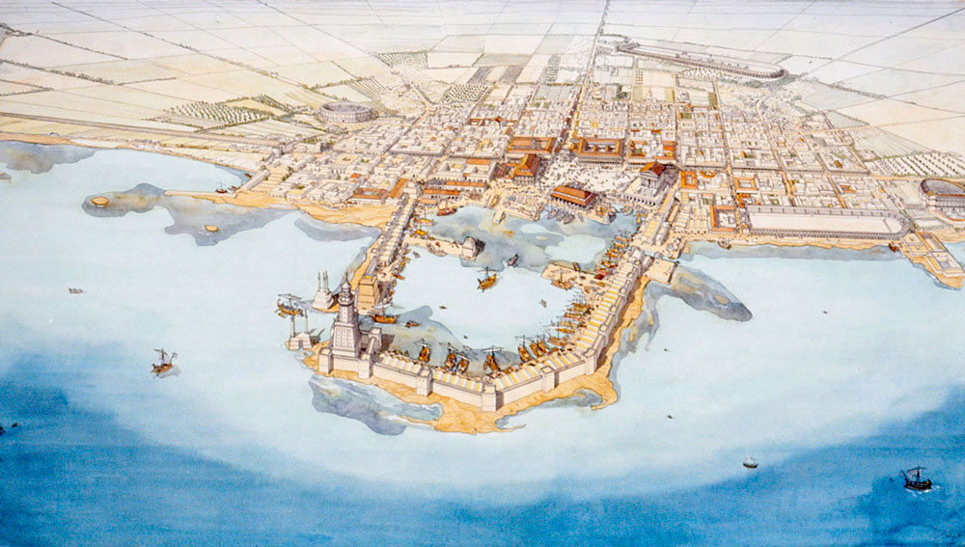
Caesarea Maritima
Olivia Darveau

Slide 2
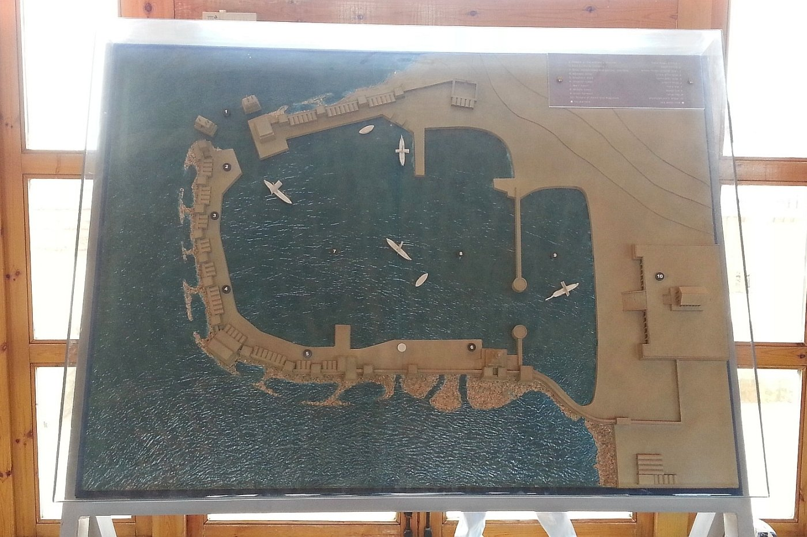
What is it?
In northern Israel
Roman port city
Elaborate harbor
Built on model grid

Slide 3
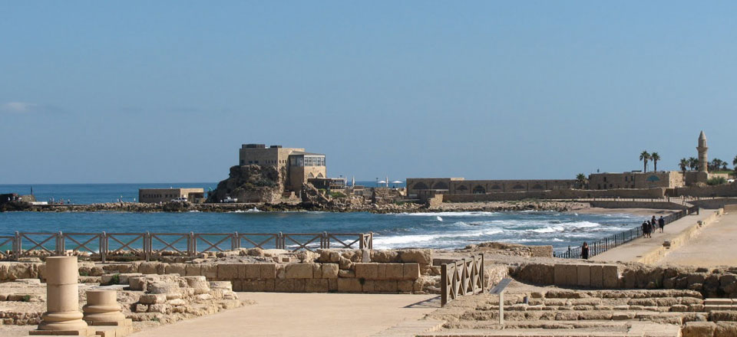
Timeline
22 BCE – Foundation by Herod
358 CE – Beginning of Decline
69 CE – Declared a colony
500s – Decrepit but not deserted
132-135 CE – Second Jewish Revolt
303-311 CE – Christians persecuted

Slide 4
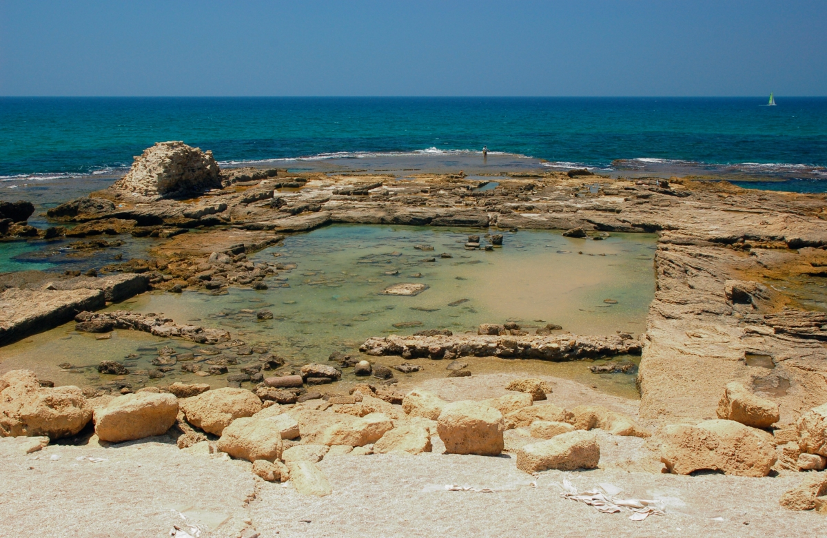
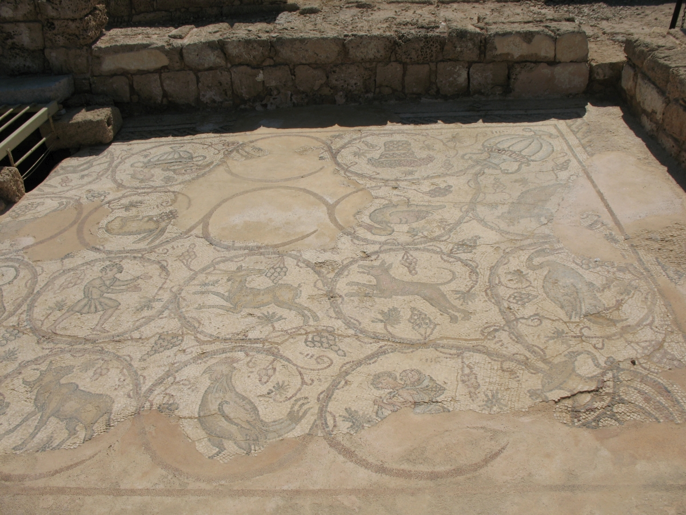
Excavations
Harbor in 1976-79
Ongoing excavation of palace
Many time periods
Roman concrete

Slide 5
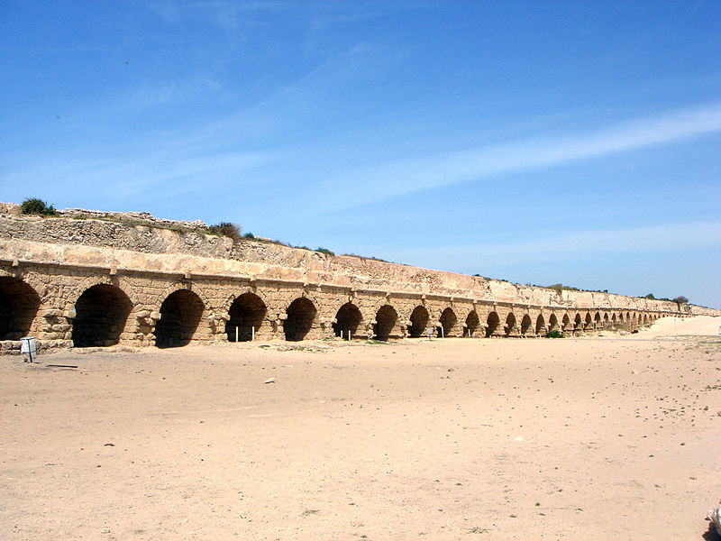
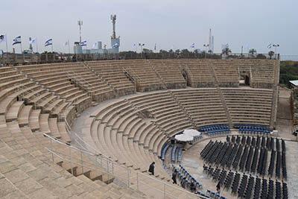
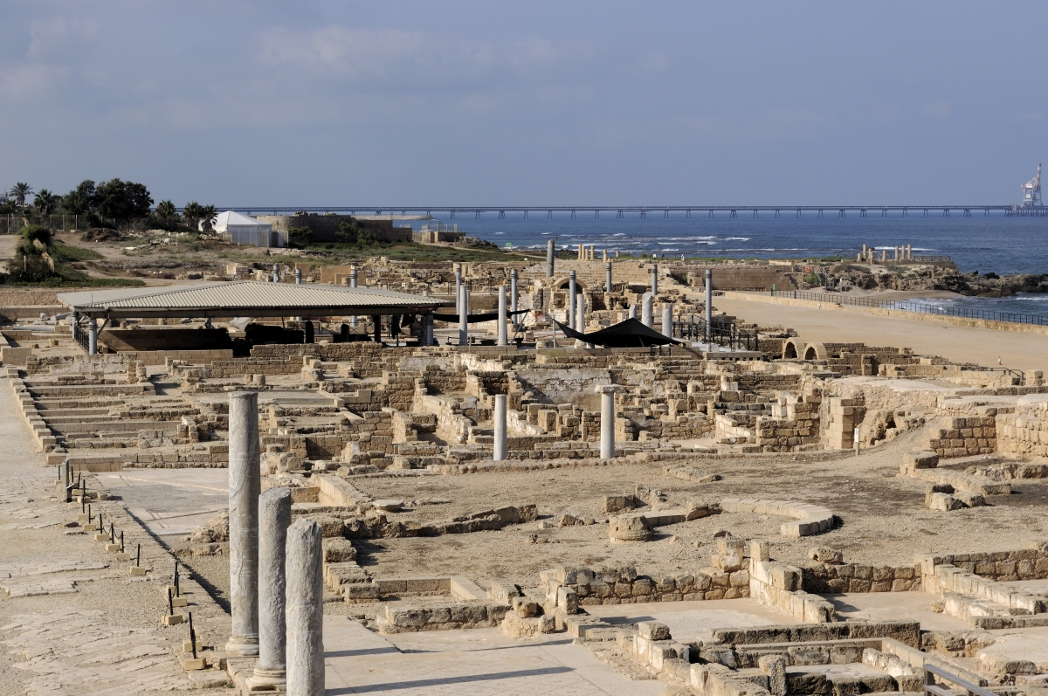

Slide 6
Bibliography
“About Caesarea.” Accessed April 10, 2018. http://www.caesarea.landscape.cornell.edu/about.html.
“Caesarea in Israel - Ancient Ruins, Harbor & Beach.” Accessed April 10, 2018. http://www.israel-travel-and-tours.com/caesarea-in-israel.html.
“Caesarea Maritima | City | FRONTLINE | PBS.” Accessed April 10, 2018. https://www.pbs.org/wgbh/pages/frontline/shows/religion/maps/arch/caesarea.html.
“Caesarea Maritima | Nativity Tours And Travel.” Accessed April 10, 2018. http://nativitytravel.com/2016/12/17/caesarea-maritima/.
“Israel - Caesarea Maritima (Caesarea) - Overview.” Jean-Claude Golvin (blog). Accessed April 10, 2018. http://jeanclaudegolvin.com/en/project/middle-east/israel-cesarea-vue-generale-jc-golvin-2/.
“New Discoveries Unveiled at Caesarea Maritima - Biblical Archaeology Society.” Accessed April 10, 2018. https://www.biblicalarchaeology.org/daily/biblical-sites-places/biblical-archaeology-sites/new-discoveries-unveiled-at-caesarea-maritima/.
“Roman Aqueduct Bringing Water to Caesarea Maritima.” Center for Online Judaic Studies (blog), December 3, 2015. http://cojs.org/roman-aqueduct-bringing-water-to-caesarea-maritima/.
Travel, Nativity Tours &. “Caesarea Maritima.” Nativity Tours And Travel (blog), December 17, 2016. http://nativitytravel.com/2016/12/17/caesarea-maritima/.

