Slide 1
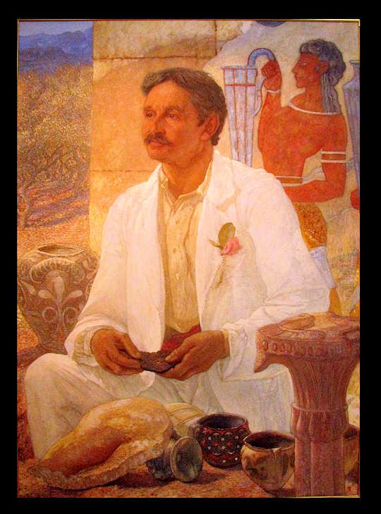
Sir Arthur John Evans
(1851-1941)

Slide 2
Early Life
John Evans – Arthur’s father – Latin – Interest in Numismatics, Geology and Archaeology.
Arthur graduated from Oxford at the age of 24 in 1874, but his career at that time was more close to the modern history.
In 1884, Arthur Evans, at the age of 34, became the Keeper of the Ashmolean Museum.

Slide 3
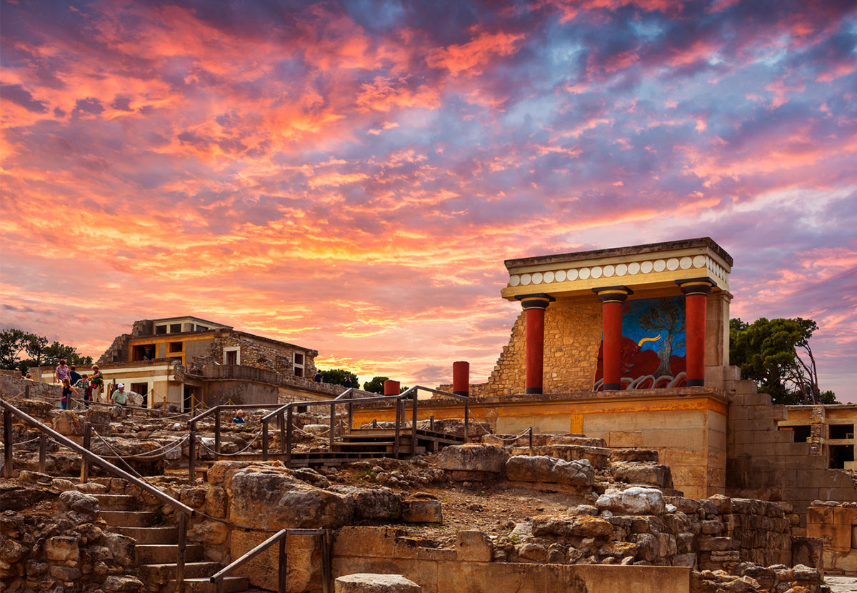
The most important finding
of Arthur Evans –
The palace of Knossos
on the Greek island of Crete

Slide 4
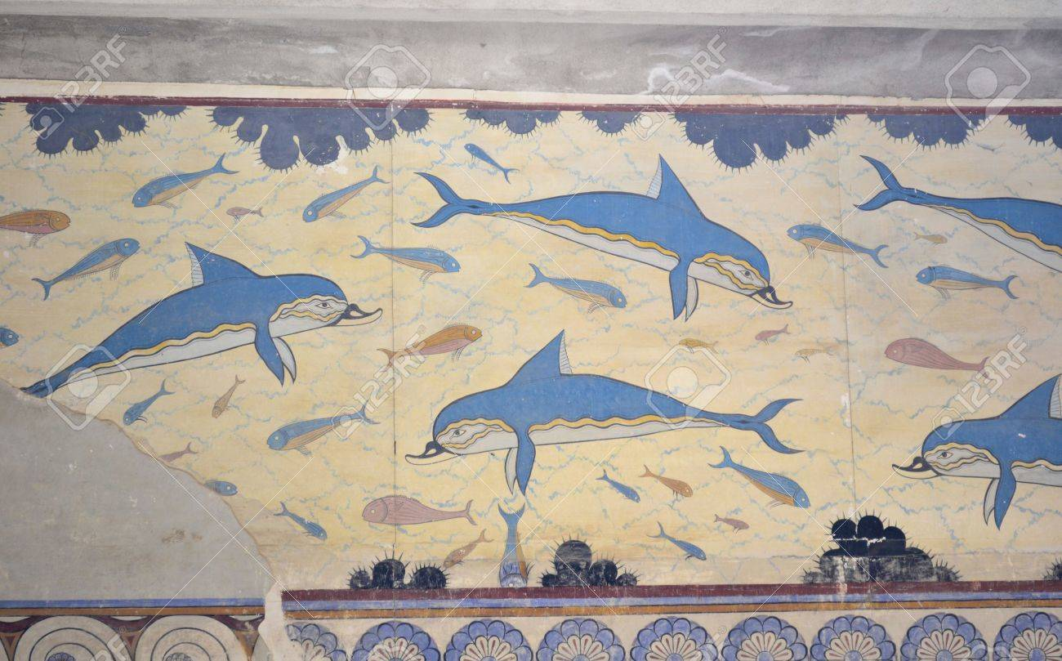
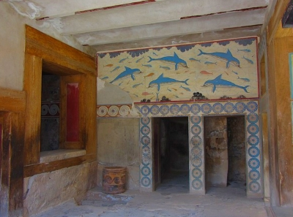
The significance of Evans’ finding
In the beginning, Evans continued the concept of a Mycenaean civilization, but later he found that it is needed to distinguish another civilization, the Minoan, from the structures and artifacts found there and throughout the eastern Mediterranean.

Slide 5
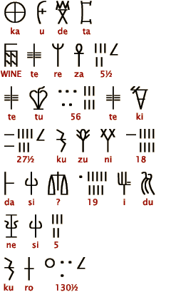
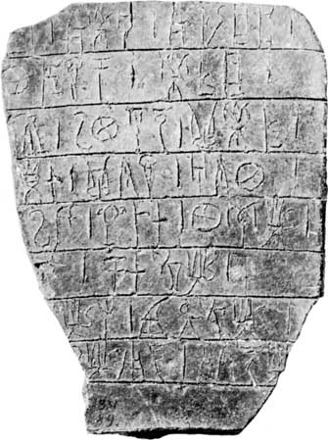
Evans also found the Cretan scripts Linear A and Linear B from the site.
A
B

Slide 6
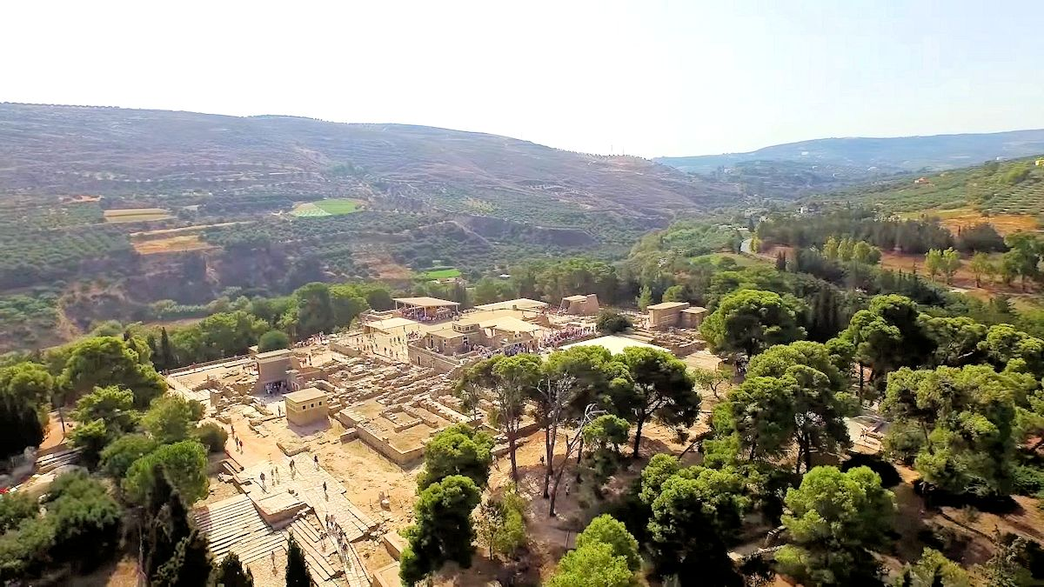
Fun Facts about Evans
He bought the land of the site (1894-1899) before he starts his excavation.
He found the site by analyzing scripts engraved on the stones which he had purchased before and later found out the scripts may come from Cretan.

Slide 7
Bibliography

Slide 8
Thanks for watching

