Slide 1
Kent Vaughn Flannery
Lynette Crews

Slide 2
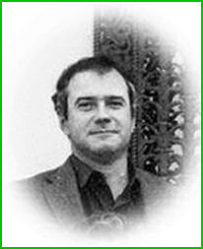
Born : Philadelphia 1934
Original interests in zoology, ecology, and evolution
B.A. degree ->1954;
1957–1958- Flannery spent the year in Mexico
M.A. -> 1961
Ph.D. -> 1964.
Notes:
University of Chicago’s “early entrant” program to enroll after his sophomore year of high school

Slide 3
MesoAmerica and Mesopotamia
1966 to 1980 -- “Prehistory and Human Ecology of the Valley of Oaxaca, Mexico.
origins of agriculture at Guilá Naquitz Cave
the origins of village life and social inequality at
San José Mogote,
HuitzoAbasolo
Oaxaco
Notes:
University of Michigan
investigated the Abasolo in Oaxaca, Mexico.

Slide 4
Importance of herding and farming
Transitions from hunting gathering lifestyles to sedentary ones
Domestication of plants and animals
Currently a professor at the University of Michigan

Slide 5
https://en.wikipedia.org/wiki/Kent_V._Flannery
https://link.springer.com/referenceworkentry/10.1007%2F978-1-4419-0465-2_308
https://lsa.umich.edu/anthro/people/faculty/archaeological-faculty/kflanner.html

