Slide 1
Maritime Archaeology
Demi-lee Pretorius
Final Project

Slide 2
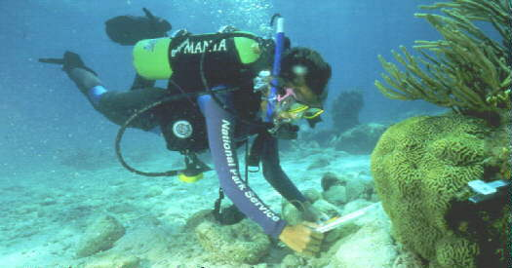
What is Maritime Archaeology
Also Known as Underwater Archaeology
Material Culture
It Includes the study of numerous objects
Obstacles and challenges

Slide 3

Tools
In underwater excavations metal is replaced by a plastic
Scuba Gear
Stationary
Side Scan Sonar
Plastic Hand Trowel
Square Units
Magnetometer

Slide 4
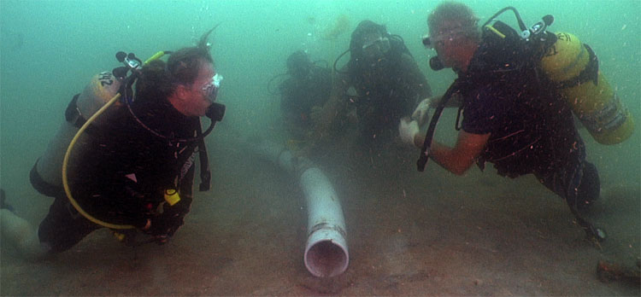
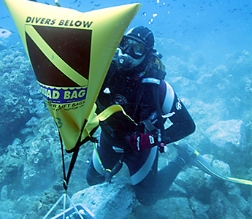
Methods
Depend on Environment- Salt Water vs. Fresh Water
Process of Excavation
Dredge Removal vs. fine removal and surfacing

Slide 5
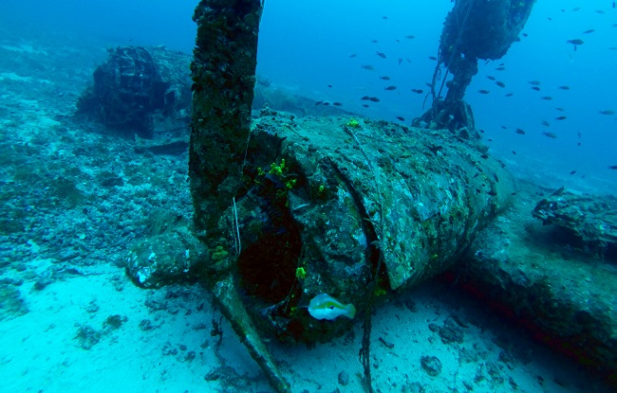
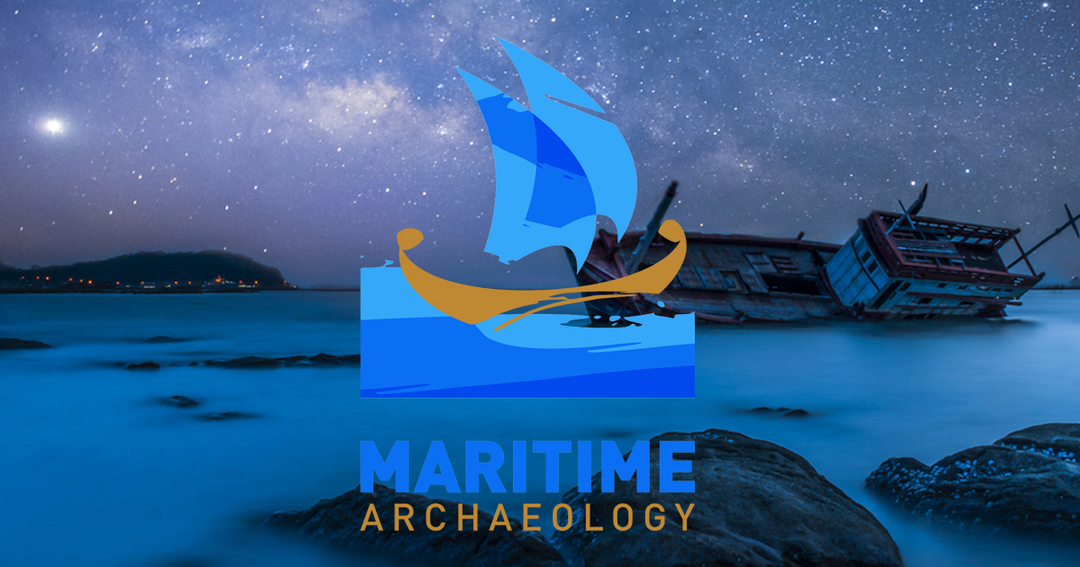
Preservation
cultural or historic properties
new windows of archaeological discoveries
careful approach to data collection that protects and preserves the resource
Resource Management Agencies
Threats include:
- Biochemical deterioration
- Coastal development
- Illegal looting
- Inadvertent site damage.

Slide 6
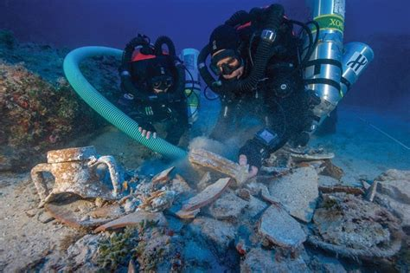
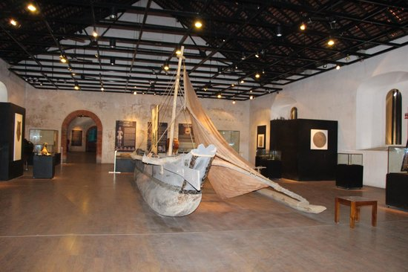
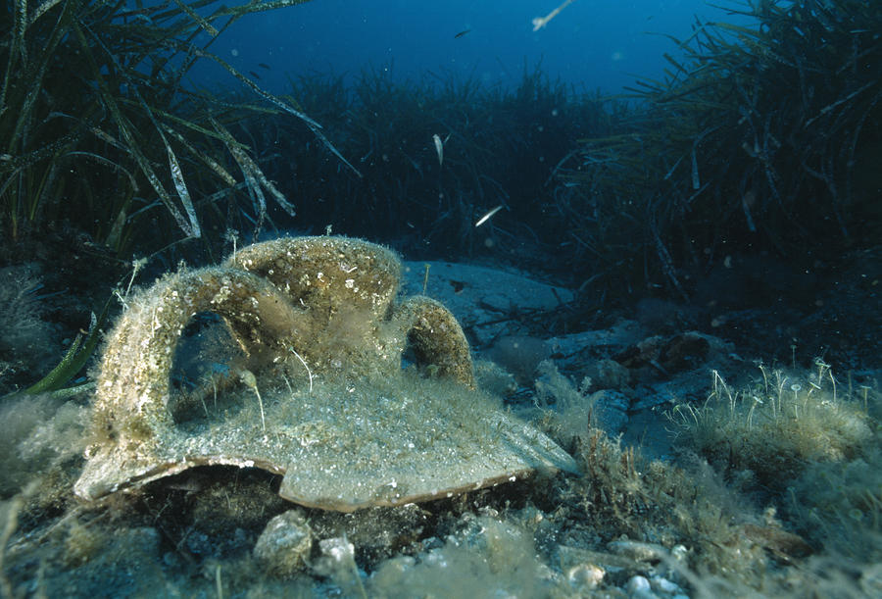
Conservation Efforts
2 Categories
corrosion and erosion
Salt and Artifacts
Field Conservation
Laboratory Conservation

Slide 7
Works Cited
“Underwater.” Florida Department of State, dos.myflorida.com/historical/archaeology/underwater/https://oceanexplorer.noaa.gov/edu/themes/archaeology/welcome.html
https://oceanexplorer.noaa.gov/facts/marinearch-tools.jpg
“Overview of Conservation in Archaeology; Basic Archaeological Conservation Procedures.” Overview of Conservation in Archaeology; Basic Archaeological Conservation Procedures - Conservation Manual - Conservation Research Laboratory - Center for Maritime Archaeology and Conservation - Texas A&M University, nautarch.tamu.edu/CRL/conservationmanual/File1.htm.
“Maritime Archaeology.” Maritime Archaeology.com, www.maritimearchaeology.com/
“Maritime Archaeology.” Archaeology: National Marine Sanctuaries Maritime Heritage Program, National Oceanic and Atmospheric Administration, 31 July 2017, sanctuaries.noaa.gov/maritime/arch.html.
“Institute of Nautical Archaeology.” Institute of Nautical Archaeology, nauticalarch.org/.
US Department of Commerce, and National Oceanic and Atmospheric Administration. “What Excavation Tools Do Marine Archaeologists Use?” NOAA Ocean Explorer Podcast RSS, 15 Oct. 2012, oceanexplorer.noaa.gov/facts/marinearch-tools.html.

