Slide 1
Roman Armor
Tristan Navarro

Slide 2
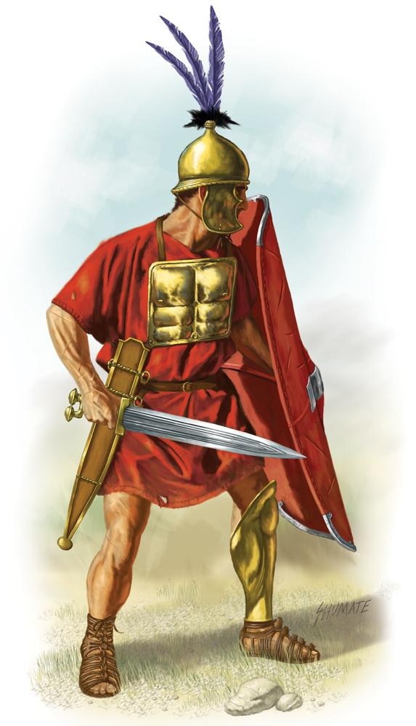
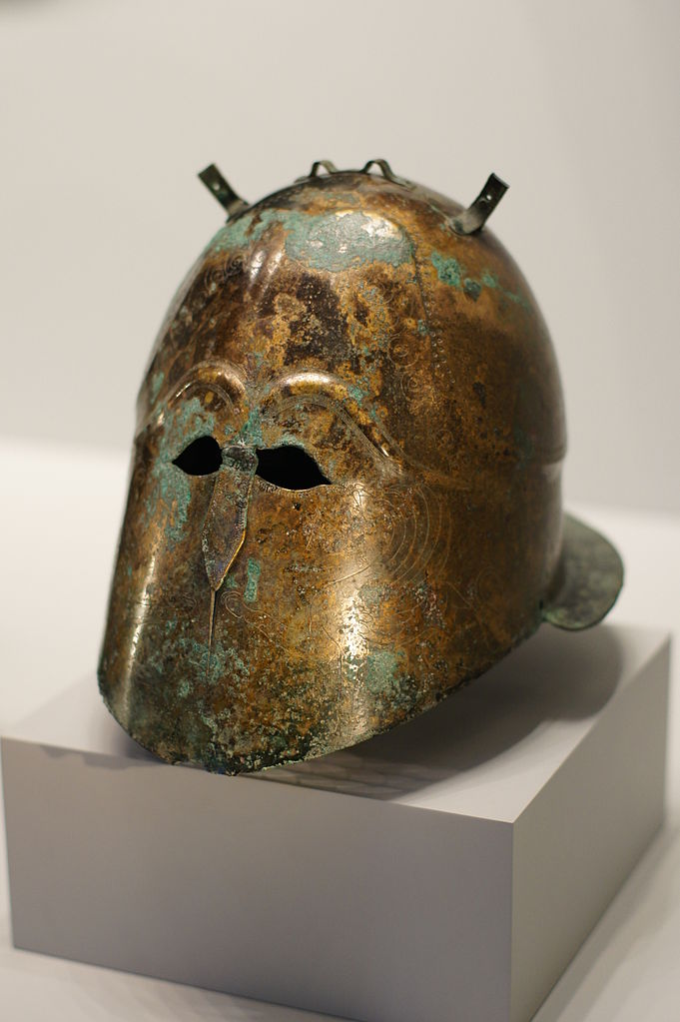
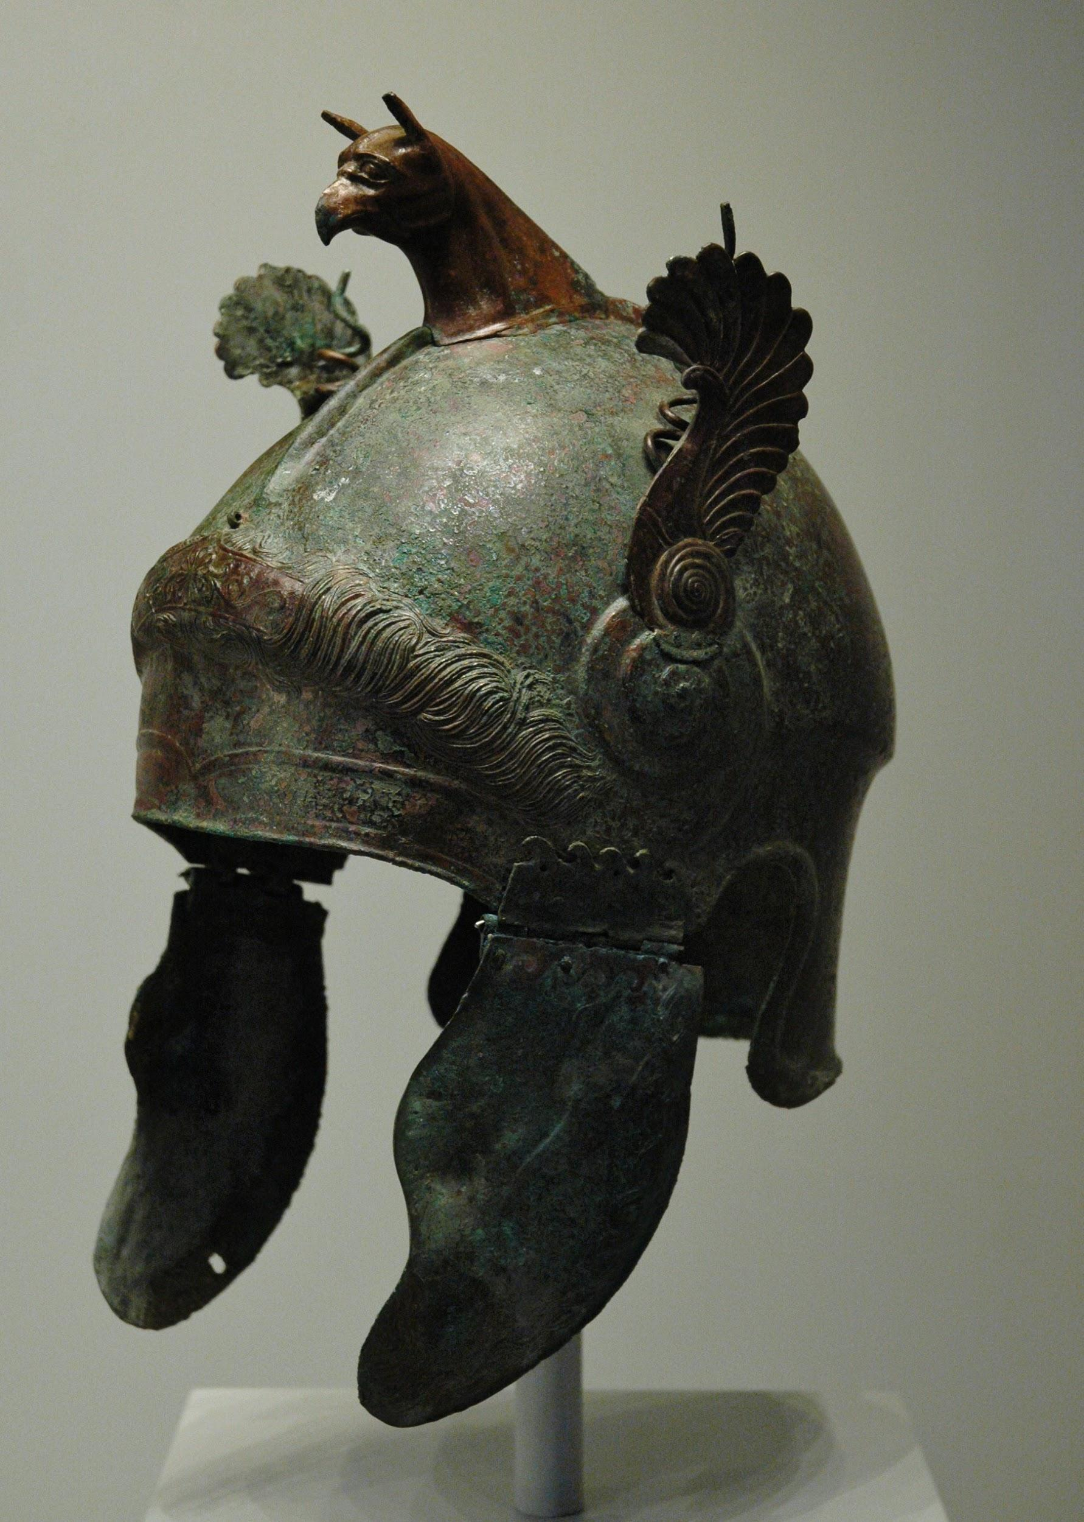
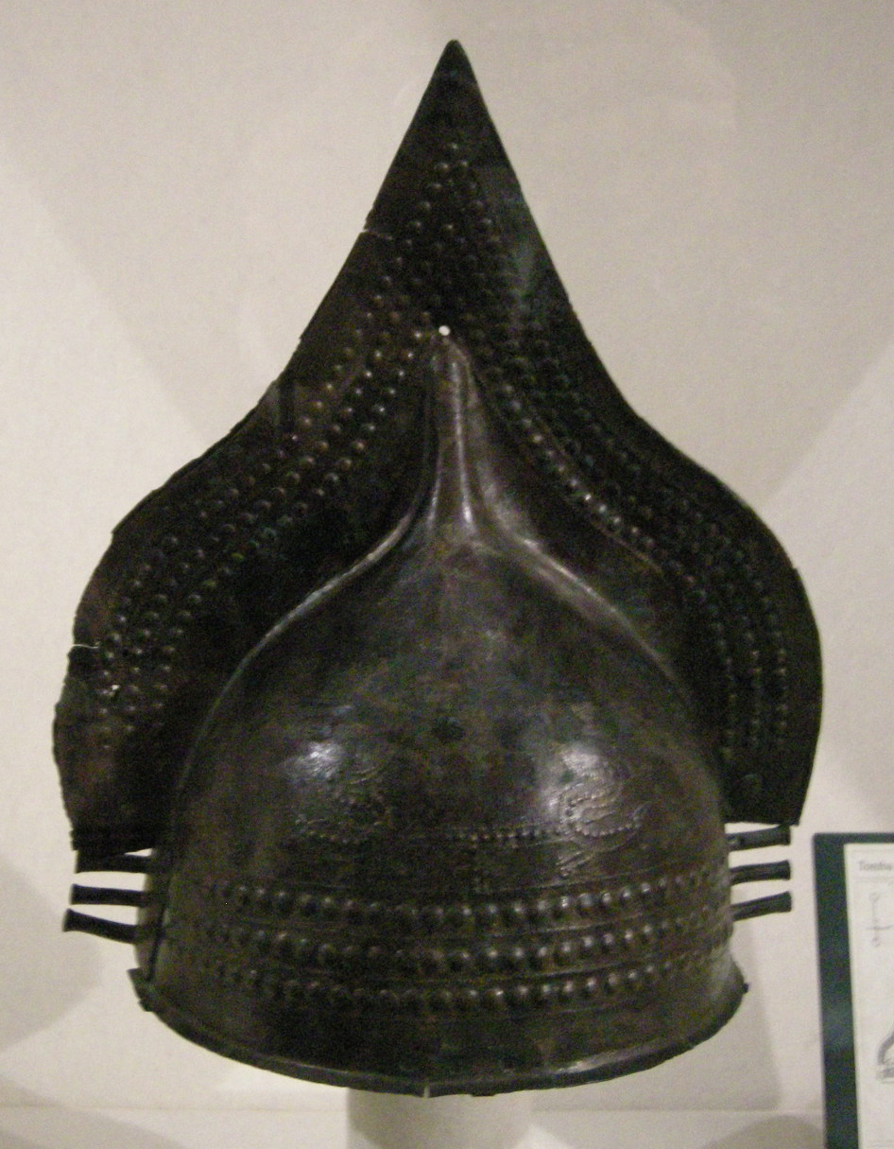
Early Roman Armor
-Little more than a Bronze breastplate
-Bronze Pot-Type or Greek Influenced Helmet

Slide 3
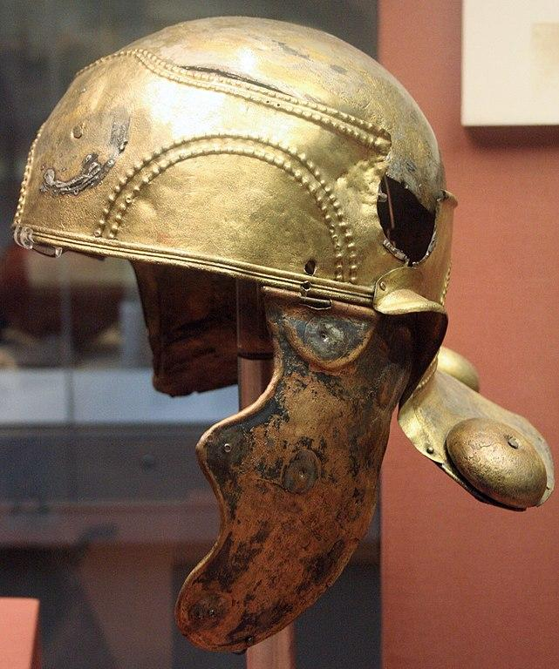
Helmets
-Predominantly made of bronze until Imperial times -Some can stay in service for over 2 centuries -Bronze available to Romans was brittle
-Evolved off of Italian Pot-Type later incorporating: -Gaulic, Persian, and Germanic influences
-Two methods of manufacture -Forging ie. beating into shape (Iron & Bronze) -Spinning: use tool to roll into shape (Bronze)
-After 3rd century, newer mold helmets, -Heavy Cavalry helmets used by infantry -Cheap Ridge type helmets became norm.

Slide 4
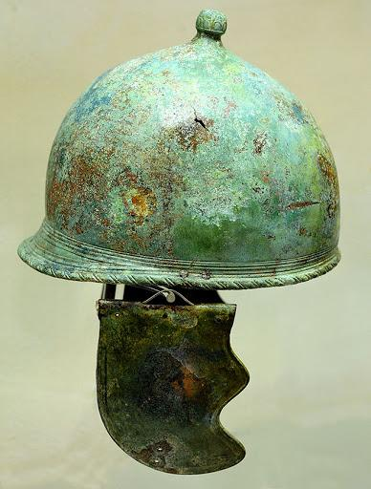
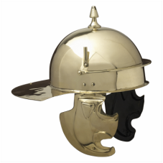
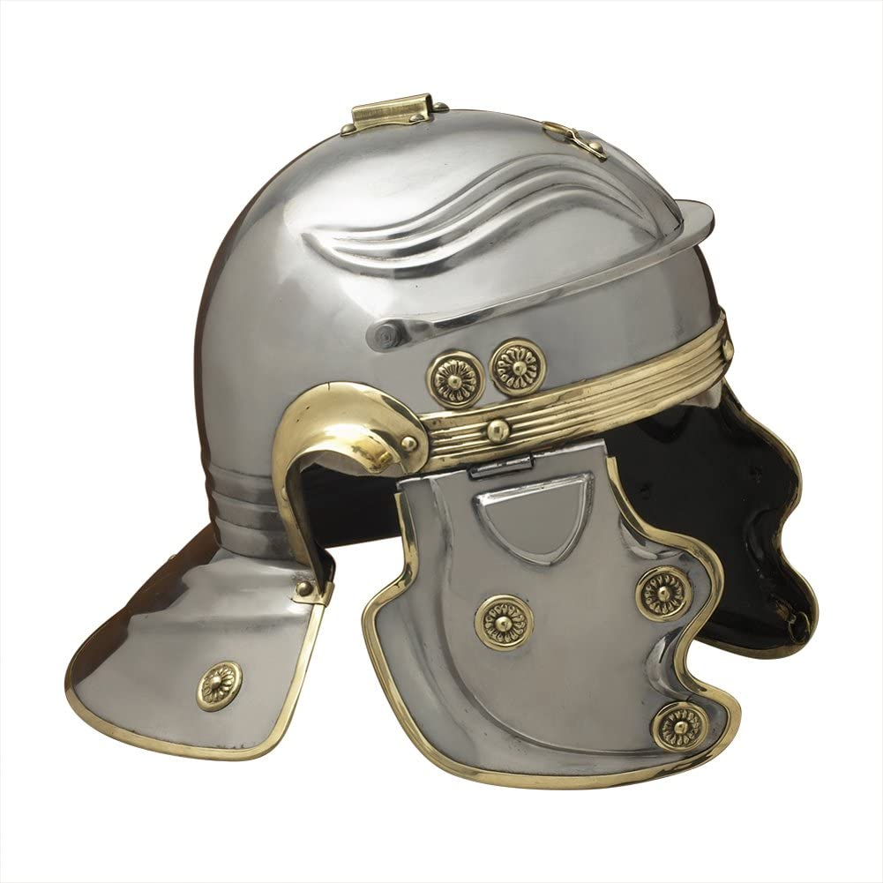
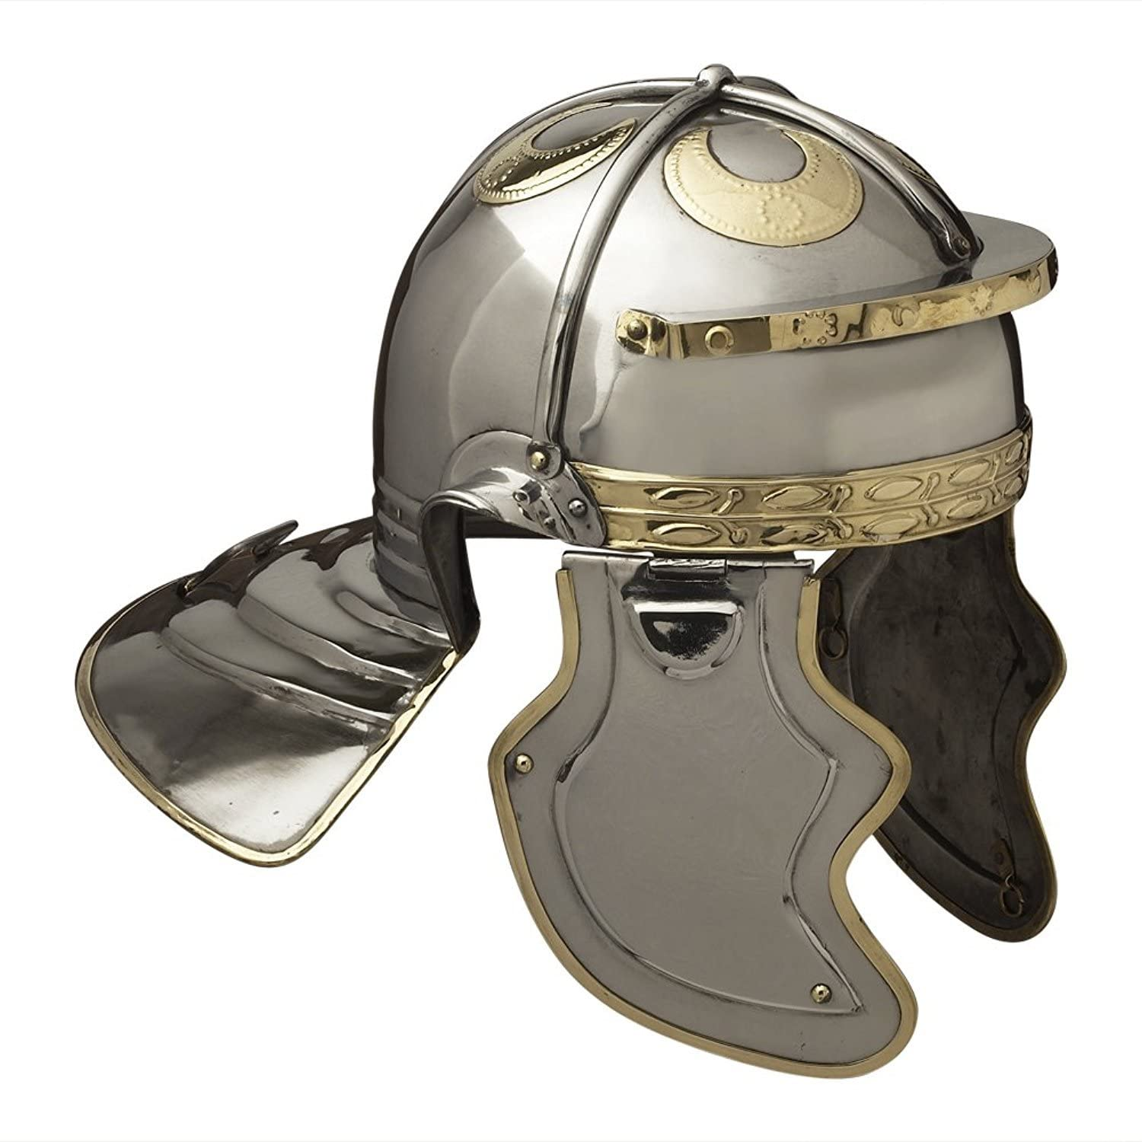
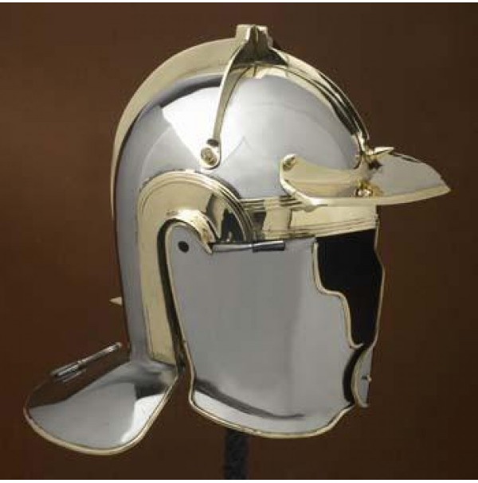
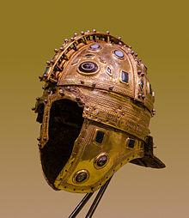
From left to Right:
Montefortino
-3rd-1st Century BC
Coolus Pattern
-1st Century BC & AD, Caesar’s Helmet
Imperial Gallic
1st-2nd Century AD
Imperial Italic
1st-3rd Century AD
Heddernheim
3rd Century AD
Ridge Type
3rd Century AD+

Slide 5
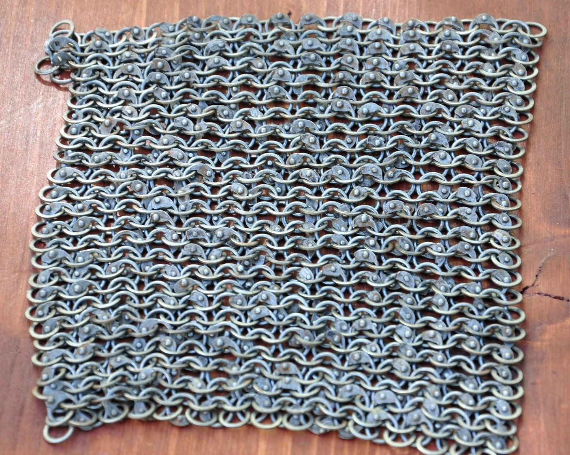
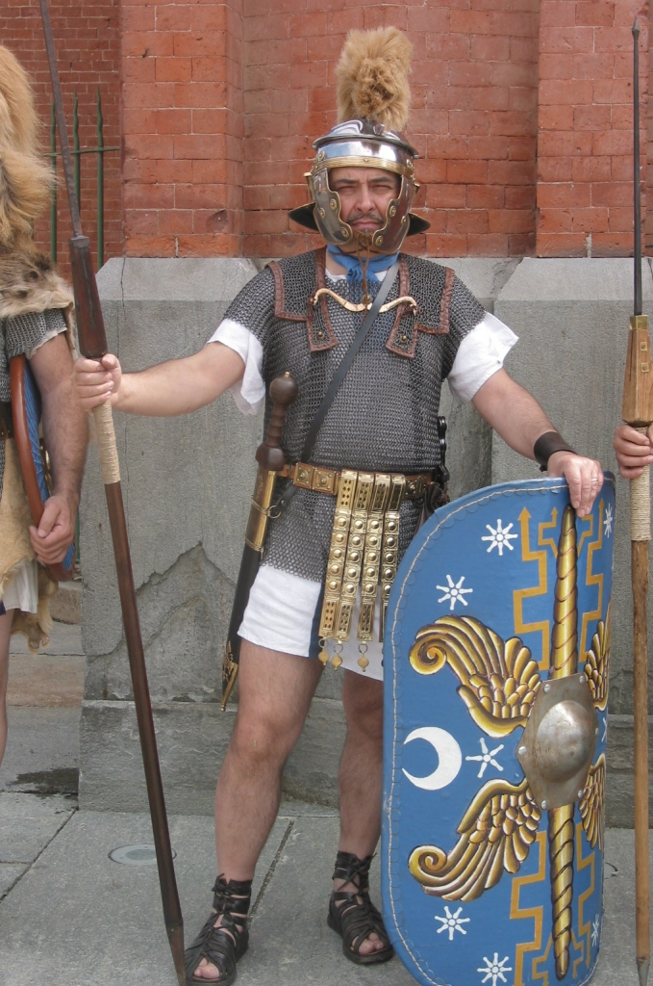
Lorica Hamata-Mail
Weight: 10-15kg (22-33lbs)
-Most Popular -Easy to maintain -Comfortable to wear
-Expensive to make -Iron/Copper wire 1mm thick -Rings about 7mm diameter -Alternating punched and riveted rings -Each ring connected to 4 others
-Downsides -Takes full force of impact -Can be penetrated by arrows at close range

Slide 6
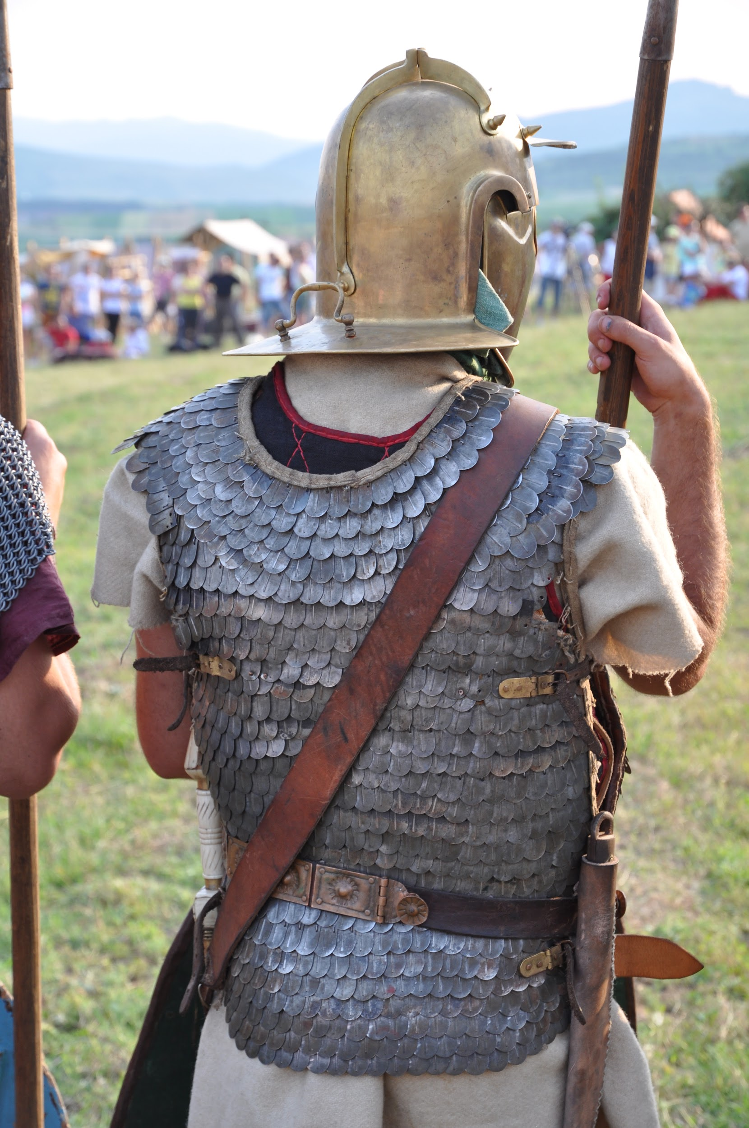
Lorica Squamata-Scale
-Oldest form of metal armor
-Small overlapping sheets of metal sewn to fabric -Only a few cm wide and extremely thin -Copper alloy or Iron composition
-Cheap & easy to produce
-Damaged easily, but easy to repair
-Popular with Cavalry -Prefered for horse barding
-Some varieties vulnerable to upwards thrust -One variety (Lorica Plumata?) used mail

Slide 7
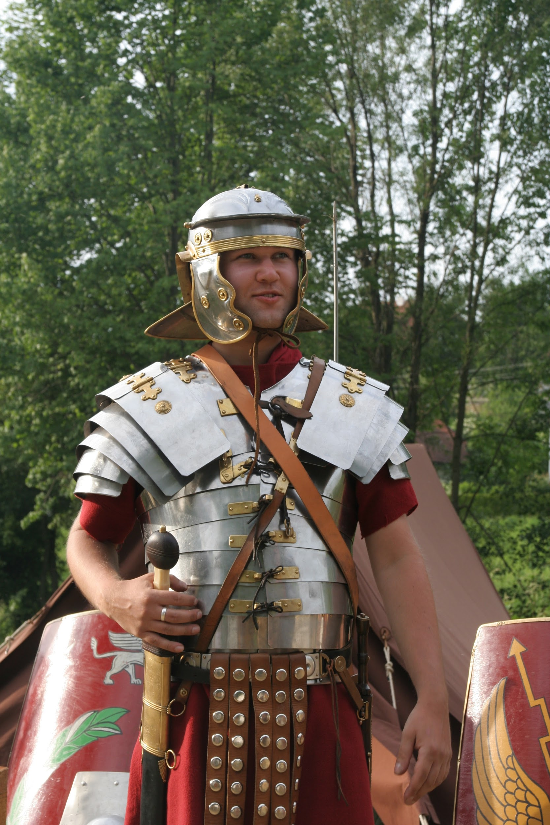
Lorica Segmentata-Laminar
-Most Iconic
-Good Shoulder Protection
-Used mostly during the Principate -Disappears after 3rd century
-Strips of unhardened iron bound together
-Lighter then mail (20kg)
-Easy to Produce, Nightmare to Maintain -Bronze fittings prone to corrosion -Leather bindings prone to rotting
-Never used by Cavalry

Slide 8
Sources
“Equipment.” The Complete Roman Army, by Adrian Goldsworthy, Thames &amp; Hudson, 2003, pp. 118–141.
“Military Equipment .” Warriors of Rome: an Illustrated Military History of the Roman Legions, by Michael Simkins, Blandford, 1993, pp. 121–155.
Peterson, Daniel. The Roman Legions Recreated in Color Photographs. Windrow &amp; Greene, 1996.

