Slide 1
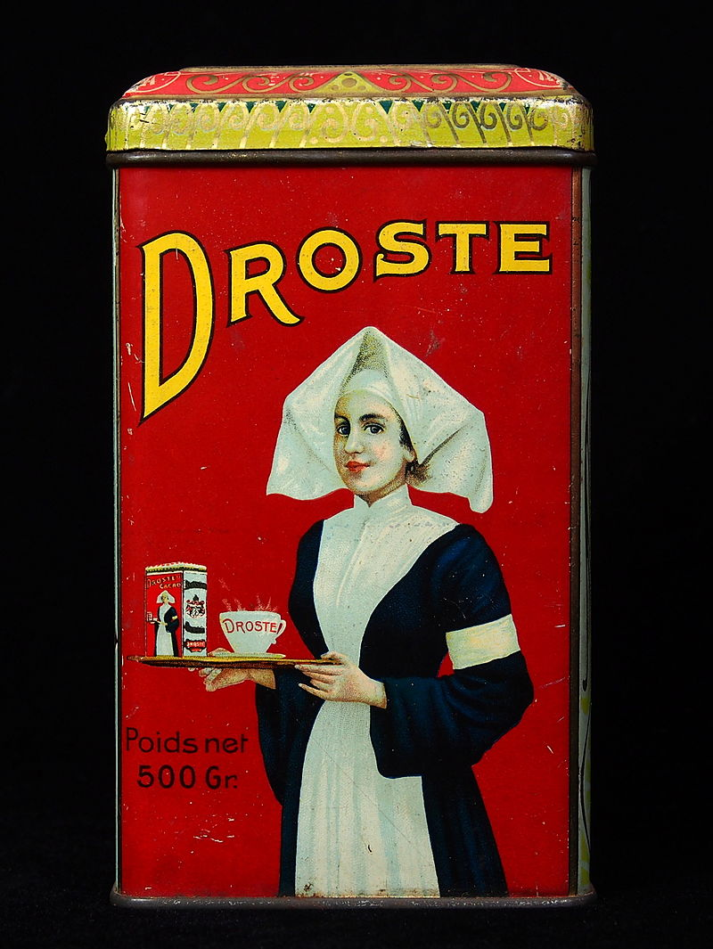
Recursion with AutoHotkey
The Automator AHK Webinar
Jean Lalonde 2019-03-19
Developer of Quick Access Popup
www.QuickAccessPopup.com
The Droste effect (1904 )

Slide 2
Functions and recursion
In computer science, recursion is the invocation of a function from within itself (https://en.wikipedia.org/wiki/Recursion)
While this apparently defines an infinite number of instances, it must be done in such a way that no infinite loop can occur.
Table of content
Functions primer
A « real-life » recursion analogy
Example #1: recursion with folders and files
Example #2: recursion to build a menu

Slide 3
Functions primer
Two types of functions
Built-in functions: commands like StrLen() that returns the length of a string
Example: MsgBox, % StrLength("My String")
Custom function: like MyFunction()
A function receives one or more values between parenthesis
Processes the value(s) in a « black box » with local variables
Returns a value
Example:
The function « Obfuscate » returns a given number of « x » instead of the characters of a string
Example: Obfuscate(strIn) { Loop, % StrLen(strIn) strOut .= "X" return strOut }
Calling the function: MsgBox, % Obfuscate("My String")

Slide 4
A “real life” recursion analogy
First day at your new job: garbage collection in a underground parking garage.
Your new boss takes you to a stairway leading down to the first parking floor and gives you these simple instructions:
Go down to the next floor.
Collect all garbage at this level.
When (and if) you find a stairway going down to a another floor, repeat these instructions starting at #1.
There may be zero, one or many stairways going down to different floors.
When there are no more stairways going down, return to the above floor with all the garbage you collected in this level and the ones below it (if any).
When you are back at the top floor, put all the garbage in the big trash can and go take your break.

Slide 5
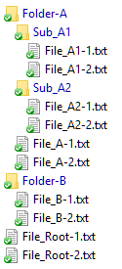


Simple folder structure
i
Root
File_Root-1.txt
File_Root-2.txt
r
o
j
Folder-A
File_A-1.txt
File_A-2.txt
l
k
Sub_A1
File_A1-1.txt
File_A1-2.txt
m
Sub_A2
File_A2-1.txt
File_A2-2.txt
n
p
Folder-B
File_B-1.txt
File_B-2.txt
q

Slide 6
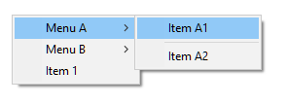
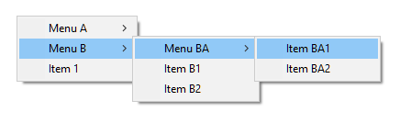
Simple menu
Menu|MAIN
Menu|Menu A
Item|Item A1|Action1
Item
Item|Item A2|Action2
Z
Menu|Menu B
Menu|Menu BA
Item|Item BA1|Action1
Item|Item BA2|Action2
Z
Item|Item B1|Action1
Item|Item B2|Action2
Z
Item|Item 1|Action1
Z

