Slide 1


DevOps
Presented By:
Jnanavi BA

Slide 2
What is DevOps ?
DevOps is a software development methodology which improves the collaboration between developers and operations team using various automation tools.
DevOps is a set of practices that combines Software development (Dev) and IT operations (Ops) to shorten the life cycle and deliver high quality software continuously.

Slide 3
Benefits of DevOps ?
Increased Deployment Frequency:
DevOps facilitates frequent and reliable software releases, allowing teams to deploy updates more frequently and respond rapidly to changing requirements.
2. Faster Time-to-Market:
DevOps accelerates the development lifecycle, reducing the time it takes to bring new features and products to market.
Enhanced Reliability and Stability:
Automation of testing, integration and deployment processes in DevOps helps ensure more reliable and stable systems.
DevOps

Slide 4
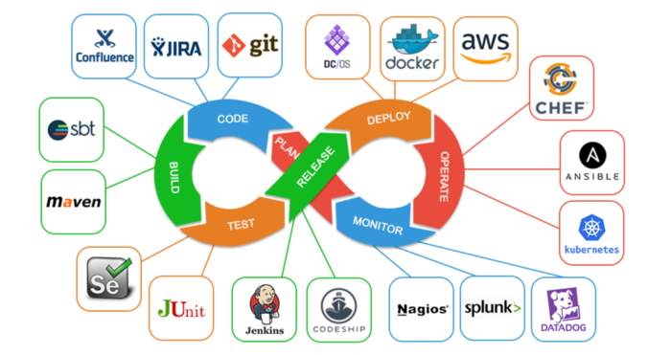
DevOps Phases and Tools
DevOps

Slide 5
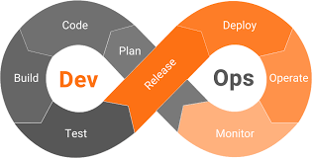
DevOps Lifecycle
Planning
Coding
Building
Testing
Deployment
Monitoring
DevOps

Slide 6

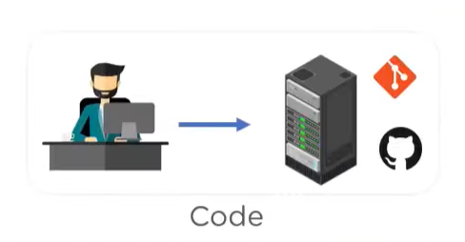
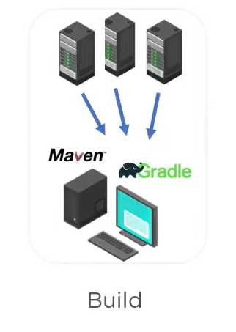
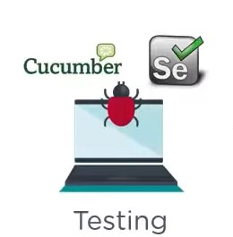

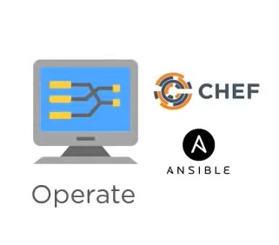
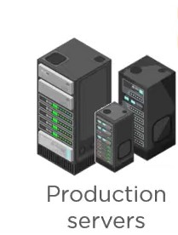




Integrate
Deploy
DevOps

Slide 7
Step 1: Planning
In plan stage, business owners and software development team discuss project goals and create a plan.
Step 2: Coding
Programmers then design and code the application and use tools like Git to store application code.
Step 3: Building
Build tools like Maven and Gradle, take code from different repositories and combine them to build the complete application.
DevOps

Slide 8
Step 4: Testing
Application is tested using automation testing tools like Selenium and Junit to ensure software quality.
Step 5: Deployment
When testing is complete, new features are integrated automatically to the already existing codebase.
Step 6: Monitoring
Monitoring allows IT organization to identify specific issues of specific releases and understand the impact on end-users.
DevOps

Slide 9
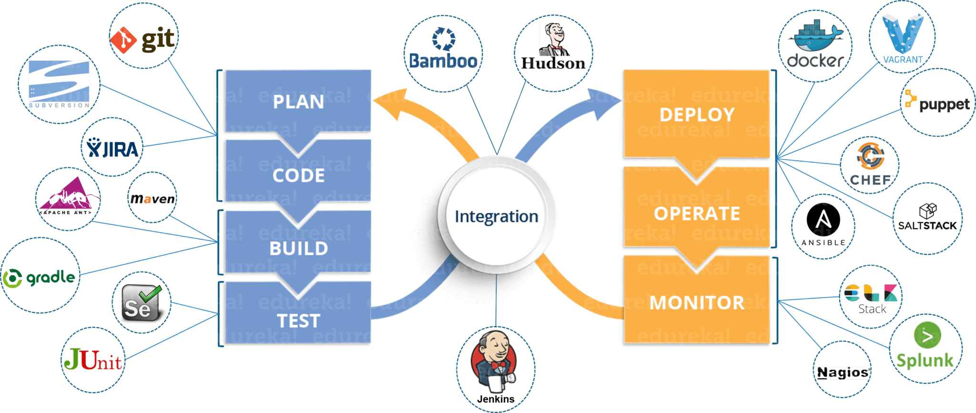
DevOps Tools
DevOps

Slide 10
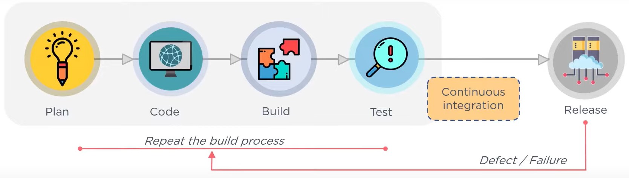
DevOps Processes
Continuous Delivery :
This includes Plan, Code, Build and Teste environment.
2. Continuous Integration :
Files are sent to build and are the code is tested. We can Quickly identify whether or not there are any defects within the code. If there are any defects, we can send that code back to the developer and the developer can fix that.
DevOps

Slide 11
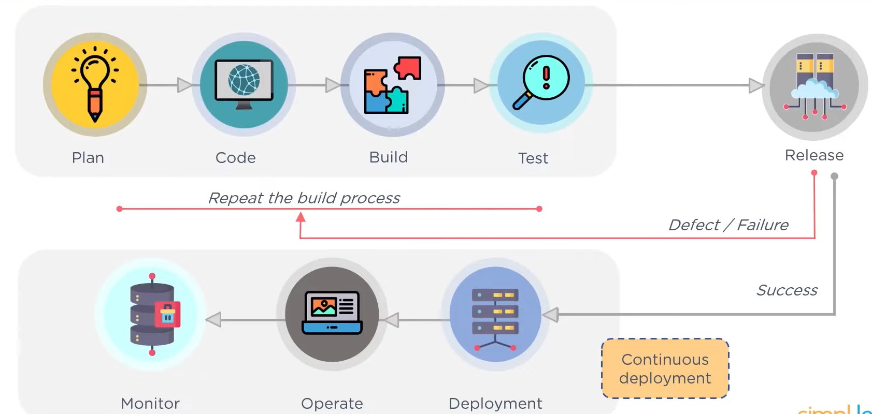
3. Continuous Deployment :
If the code passes the scripting test, it can then be deployed. After deployment, you can start monitoring.
DevOps

Slide 12
DevOps Advantages
Companies which follow DevOps, release more products and features within short amount of time. For ex: Netflix, Facebook, Google.
Time taken to create and deliver software is reduced.
Complexity of maintaining an application is reduced.
Improved collaboration between developers and operations team.
Continuous integration and delivery ensure faster time to market.
DevOps

Slide 13
Conclusion
In conclusion, DevOps represents a transformative approach that seamlessly integrates development and operations teams, fostering collaboration, efficiency, and continuous improvement.
Embracing DevOps principles empowers organizations to deliver high-quality software at an accelerated pace, adapt to changing market demands, and ultimately achieve greater business success.
DevOps

Slide 14
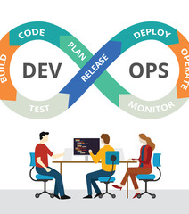
THANK YOU

