Slide 1

Human Computer Interaction-HCI
Unit-4
Jayashree R
Department of Computer Science and Engineering

Slide 2

Human Computer Interaction-HCI
Task Model
Jayashree R
Department of Computer Science and Engineering

Slide 3
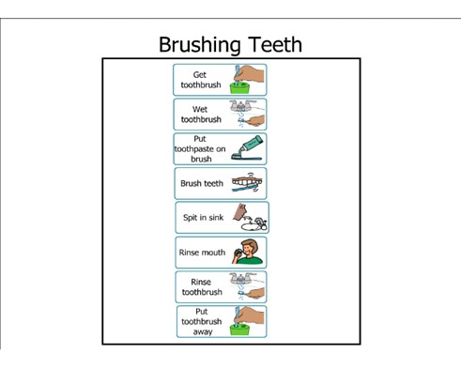
HCI-Concepts
Task Analysis
Methods to analyse people's jobs:
what people do
what things they work with
what they must know

Slide 4
HCI-Concepts
An Example
in order to clean the house
get the vacuum cleaner out
fix the appropriate attachments
clean the rooms
when the dust bag gets full, empty it
put the vacuum cleaner and tools away
must know about:
vacuum cleaners, their attachments, dust bags, cupboards, rooms etc.

Slide 5

HCI-Concepts
Approaches to Task Analysis
Task decomposition
splitting task into (ordered) subtasks
Knowledge based techniques
what the user knows about the task and how it is organised
Entity/object based analysis
relationships between objects, actions and the people who perform them
lots of different notations/techniques

Slide 6
HCI-Concepts
General Method
observe
collect unstructured lists of words and actions
organize using notation or diagrams

Slide 7
HCI-Concepts
Differences from other Techniques
Systems analysis vs. Task analysis
system design - focus - the user
Cognitive models vs. Task analysis
internal mental state - focus - external actions
practiced `unit' task - focus - whole job

Slide 8
HCI-Concepts
Task Decomposition
Aims: describe the actions people do structure them within task subtask hierarchy describe order of subtasks
Variants: Hierarchical Task Analysis (HTA) most common CTT (CNUCE, Pisa) uses LOTOS temporal operators

Slide 9
HCI-Concepts
Textual HTA description
Hierarchy description ...
0. in order to clean the house
1. get the vacuum cleaner out
2. get the appropriate attachment
3. clean the rooms
3.1. clean the hall
3.2. clean the living rooms
3.3. clean the bedrooms
4. empty the dust bag
5. put vacuum cleaner and attachments away
... and plans
Plan 0: do 1 - 2 - 3 - 5 in that order. when the dust bag gets full do 4
Plan 3: do any of 3.1, 3.2 or 3.3 in any order depending on which rooms need cleaning
N.B. only the plans denote order

Slide 10
HCI-Concepts
Generating the Hierarchy
1 get list of tasks
2 group tasks into higher level tasks
3 decompose lowest level tasks further
Stopping rules How do we know when to stop? Is “empty the dust bag” simple enough? Purpose: expand only relevant tasks Motor actions: lowest sensible level

Slide 11
HCI-Concepts
Tasks as Explanation
imagine asking the user the question: what are you doing now?
for the same action the answer may be: typing ctrl-B making a word bold emphasising a word editing a document writing a letter preparing a legal case

Slide 12
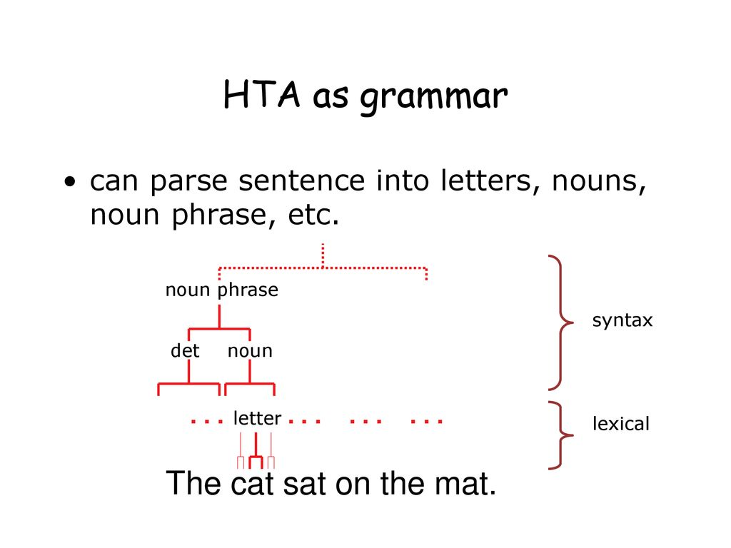
HCI-Concepts
HTA as Grammar
can parse sentence into letters, nouns, noun phrase, etc.

Slide 13
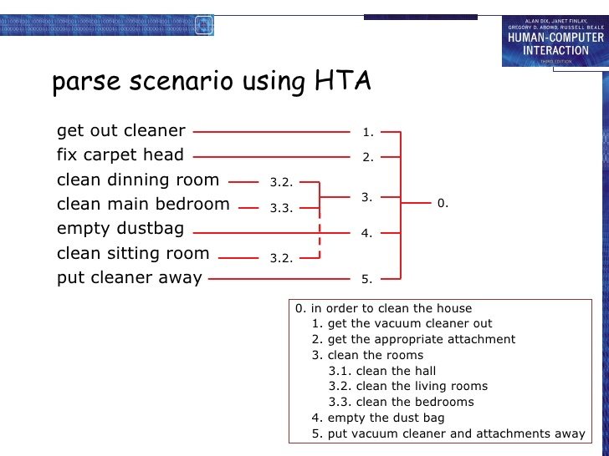
HCI-Concepts
Parse scenario using HTA

Slide 14
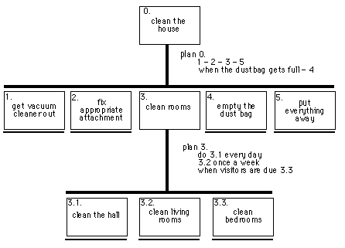
HCI-Concepts
Diagrammatic HTA
.

Slide 15
HCI-Concepts
Refining the Description
Given initial HTA (textual or diagram)
How to check / improve it?
Some heuristics:
paired actions e.g., where is `turn on gas'
restructure e.g., generate task `make pot'
balance e.g., is `pour tea' simpler than making pot?
generalise e.g., make one cup ….. or more

Slide 16
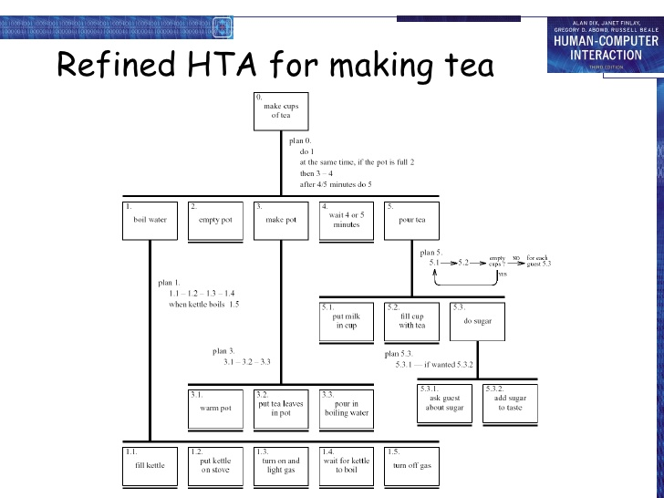
HCI-Concepts
Refining HTA for making Tea

Slide 17
HCI-Concepts
Types of Plan
fixed sequence - 1.1 then 1.2 then 1.3
optional tasks - if the pot is full 2
wait for events - when kettle boils 1.4
cycles - do 5.1 5.2 while there are still empty cups
time-sharing - do 1; at the same time ...
discretionary - do any of 3.1, 3.2 or 3.3 in any order
mixtures - most plans involve several of the above

Slide 18
HCI-Concepts
Waiting
is waiting part of a plan? … or a task?
generally
task – if ‘busy’ wait
you are actively waiting
plan – if end of delay is the event
e.g. “when alarm rings”, “when reply arrives”
in this example …
perhaps a little redundant …
TA not an exact science

Slide 19
HCI-Concepts
Knowledge Based Analysis
Focus on:
Objects – used in task
Actions – performed
+ Taxonomies – represent levels of abstraction

Slide 20
HCI-Concepts
Knowledge Based Example…….
motor controls
steering steering wheel, indicators
engine/speed
direct ignition, accelerator, foot brake
gearing clutch, gear stick
lights
external headlights, hazard lights
internal courtesy light
wash/wipe
wipers front wipers, rear wipers
washers front washers, rear washers
heating temperature control, air direction, fan, rear screen heater
parking hand brake, door lock
radio numerous!

Slide 21
HCI-Concepts
Task Description Hierarchy
Three types of branch point in taxonomy:
XOR – normal taxonomy object in one and only one branch
AND – object must be in both multiple classifications
OR – weakest case can be in one, many or none
wash/wipe AND
function XOR
wipe front wipers, rear wipers
wash front washers, rear washers
position XOR
front front wipers, front washers
rear rear wipers, rear washers

Slide 22
HCI-Concepts
Larger TDH example
kitchen item AND
/____shape XOR
/ |____dished mixing bowl, casserole, saucepan,
/ | soup bowl, glass
/ |____flat plate, chopping board, frying pan
/____function OR
{____preparation mixing bowl, plate, chopping board
{____cooking frying pan, casserole, saucepan
{____dining XOR
|____for food plate, soup bowl, casserole
|____for drink glass
N.B. ‘/|{’ used for branch types.

Slide 23
HCI-Concepts
More on TDH
Uniqueness rule:
can the diagram distinguish all objects?
e.g., plate is:
kitchen item/shape(flat)/function{preparation,dining(for food)}/
nothing else fits this description
Actions have taxonomy too:
kitchen job OR
|____ preparation beating, mixing
|____ cooking frying, boiling, baking
|____ dining pouring, eating, drinking

Slide 24
HCI-Concepts
Abstraction and Cuts
After producing detailed taxonomy ‘cut’ to yield abstract view
That is, ignore lower level nodes e.g. cutting above shape and below dining, plate becomes: kitchen item/function{preparation,dining}/
This is a term in Knowledge Representation Grammar (KRG)
These can be more complex:
e.g. ‘beating in a mixing bowl’ becomes:
kitchen job(preparation) using a kitchen item/function{preparation}/

Slide 25
HCI-Concepts
Entity Relationship Techniques
Focus on objects, actions and their relationships
Similar to OO analysis, but …
includes non-computer entities
emphasises domain understanding not implementation
Running example
‘Vera's Veggies’ – a market gardening firm
owner/manager: Vera Bradshaw
employees: Sam Gummage and Tony Peagreen
various tools including a tractor `Fergie‘
two fields and a glasshouse
new computer controlled irrigation system

Slide 26
HCI-Concepts
Objects
Start with list of objects and classify them:
Concrete objects:
simple things: spade, plough, glasshouse
Actors:
human actors: Vera, Sam, Tony, the customers
what about the irrigation controller?
Composite objects:
sets: the team = Vera, Sam, Tony
tuples: tractor may be < Fergie, plough >

Slide 27
HCI-Concepts
Attributes
To the objects add attributes:
Object Pump3 simple – irrigation pump
Attributes:
status: on/off/faulty
capacity: 100 litres/minute
N.B. need not be computationally complete

Slide 28
HCI-Concepts
Actions
List actions and associate with each:
agent – who performs the actions
patient – which is changed by the action
instrument – used to perform action
examples:
Sam (agent) planted (action) the leeks (patient)
Tony dug the field with the spade (instrument)

Slide 29
HCI-Concepts
Actions-continued
implicit agents – read behind the words
`the field was ploughed' – by whom?
indirect agency – the real agent?
`Vera programmed the controller to irrigate the field'
messages – a special sort of action
`Vera told Sam to ... '
rôles – an agent acts in several rôles
Vera as worker or as manager

Slide 30
HCI-Concepts
Example : Objects and Actions
Object Sam human actor
Actions:
S1: drive tractor
S2: dig the carrots
Object Vera human actor – the proprietor
Actions: as worker
V1: plant marrow seed
V2: program irrigation controller
Actions: as manager
V3: tell Sam to dig the carrots
Object the men composite
Comprises: Sam, Tonyion
Object glasshouse simple
Attribute:
humidity: 0-100%
Object Irrigation Controller non-human actor
Actions:
IC1: turn on Pump1
IC2: turn on Pump2
IC3: turn on Pump3
Object Marrow simple
Actions:
M1: germinate
M2: grow

Slide 31
HCI-Concepts
Events
… when something happens
performance of action
‘Sam dug the carrots’
spontaneous events
‘the marrow seed germinated’
‘the humidity drops below 25%’
timed events
‘at midnight the controller turns on’

Slide 32
HCI-Concepts
Events and Relations
Events:
Ev1: humidity drops below 25%
Ev2: midnight
Relations: object-object
location ( Pump3, glasshouse )
location ( Pump1, Parker’s Patch )
Relations: action-object
patient ( V3, Sam )
– Vera tells Sam to dig
patient ( S2, the carrots )
– Sam digs the carrots ...
instrument ( S2, spade )
– ... with the spade
Relations: action-event
before ( V1, M1) – the marrow must be sown before it can germinate
triggers ( Ev1, IC3 ) – when humidity drops below 25%, the controller turns on pump 3
causes ( V2, IC1 )
– the controller turns on the pump because Vera programmed it

Slide 33
HCI-Concepts
Sources of Information
Documentation
N.B. manuals say what is supposed to happen but, good for key words and prompting interviews
Observation
formal/informal, laboratory/field (see Chapter 9)
Interviews
the expert: manager or worker? (ask both!)

Slide 34
HCI-Concepts
Early Analysis
Extraction from transcripts
list nouns (objects) and verbs (actions)
beware technical language and context: `the rain poured’ vs. `I poured the tea’
Sorting and classifying
grouping or arranging words on cards
ranking objects/actions for task relevance (see ch. 9)
use commercial outliner
Iterative process:
data sources  analysis
but costly, so use cheap sources where available

Slide 35
HCI-Concepts
Uses : Requirements and Design
Requirements capture and systems design
lifts focus from system to use
suggests candidates for automation
uncovers user's conceptual model
Detailed interface design
taxonomies suggest menu layout
object/action lists suggest interface objects
task frequency guides default choices
existing task sequences guide dialogue design
NOTE. task analysis is never complete
rigid task based design ⇒ inflexible system

Slide 36
THANK YOU
Jayashree R
Department of CSE,
jayashree@pes.edu
+91 9845897074

