Slide 1

Human Computer Interaction-HCI
Basic Concepts and
Definitions
Jayashree R
Department of Computer Science and Engineering

Slide 2

Human Computer Interaction-HCI
Dialogue Notations and Design
Jayashree R
Department of Computer Science and Engineering

Slide 3
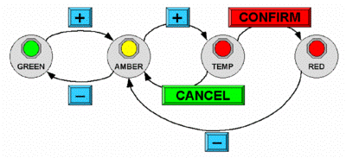
HCI-Concepts
Dialogue Notations and Design
Dialogue Notations
Diagrammatic
state transition networks, JSD diagrams, flow charts
Textual
formal grammars, production rules, CSP
Dialogue linked to
the semantics of the system – what it does
the presentation of the system – how it looks
Formal descriptions can be analysed
for inconsistent actions
for difficult to reverse actions
for missing actions
for potential miskeying errors

Slide 4
HCI-Concepts
What is Dialogue??
conversation between two or more parties
usually cooperative
in user interfaces
refers to the structure of the interaction
syntactic level of human–computer ‘conversation’
levels
lexical – shape of icons, actual keys pressed
syntactic – order of inputs and outputs
semantic – effect on internal application/data

Slide 5

HCI-Concepts
What is Dialogue??

Slide 6

HCI-Concepts
Structures Human Dialogue
Minister: do you man’s name take this woman …
Man: I do
Minister: do you woman’s name take this man …
Woman: I do
Man: With this ring I thee wed (places ring on womans finger)
Woman: With this ring I thee wed (places ring ..)
Minister: I now pronounce you man and wife

Slide 7
HCI-Concepts
Lessons about Dialogue
wedding service
sort of script for three parties
specifies order
some contributions fixed – “I do”
others variable – “do you man’s name …”
instructions for ring concurrent with saying words “with this ring …”
if you say these words are you married?
only if in the right place, with marriage licence
syntax not semantics

Slide 8

HCI-Concepts
And More…
what if woman says “I don’t”?
real dialogues often have alternatives:
Judge: How do you plead guilty or not guilty?
Defendant: either Guilty or Not guilty
the process of the trial depends on the defendants response
focus on normative responses
doesn’t cope with judge saying “off with her head”
or in computer dialogue user standing on keyboard!

Slide 9
HCI-Concepts
Dialogue Design Notations
dialogue gets buried in the program
in a big system can we:
analyse the dialogue:
can the user always get to see current shopping basket
change platforms (e.g. Windows/Mac)
dialogue notations helps us to
analyse systems
separate lexical from semantic
… and before the system is built
notations help us understand proposed designs

Slide 10
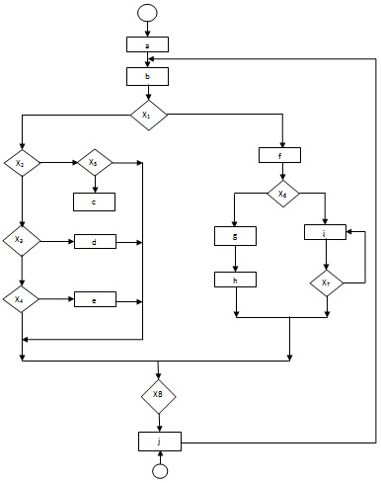
HCI-Concepts
Graphical notations
state-transition nets (STN) Petri nets, state charts flow charts, JSD diagrams

Slide 11
HCI-Concepts
State Transition Networks
circles - states
arcs - actions/events
circles - states
arcs - actions/events

Slide 12
HCI-Concepts
State Transition Networks-Events
arc labels a bit cramped because:
notation is `state heavy‘
the events require most detail

Slide 13
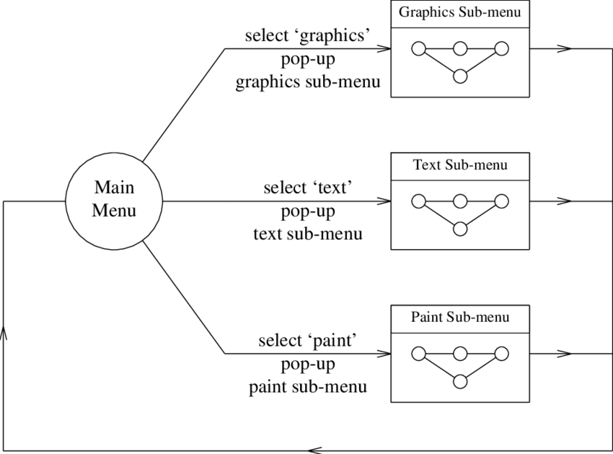
HCI-Concepts
STNs -States
labels in circles a bit uninformative:
states are hard to name
but easier to visualise

Slide 14
HCI-Concepts
Hierarchical STNs
managing complex dialogues
named sub-dialogues
Graphics Submenu
select ‘graphics’
Main Menu
select ‘text’
Text Submenu
Paint Submenu
select ‘paint’

Slide 15
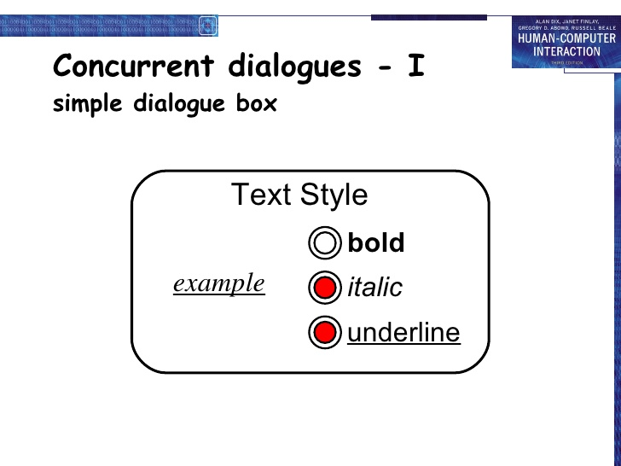
HCI-Concepts
Concurrent Dialogue Box-Simple Dialogue Box
.

Slide 16
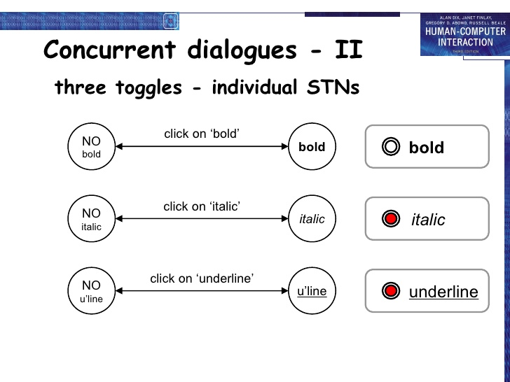
HCI-Concepts
Concurrent Dialogues-II

Slide 17
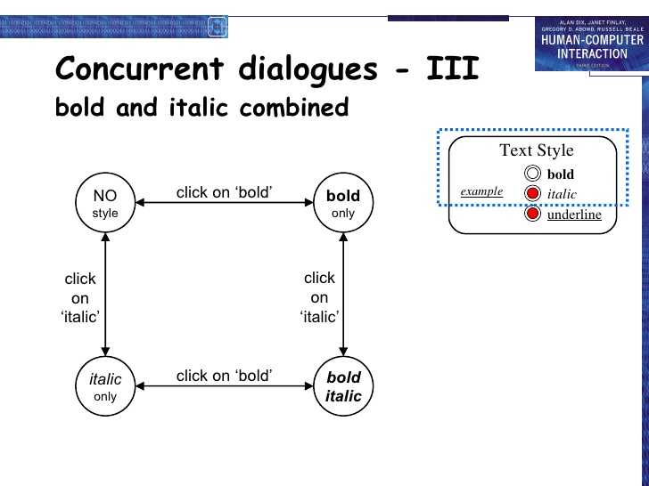
HCI-Concepts
Concurrent dialogues-III

Slide 18
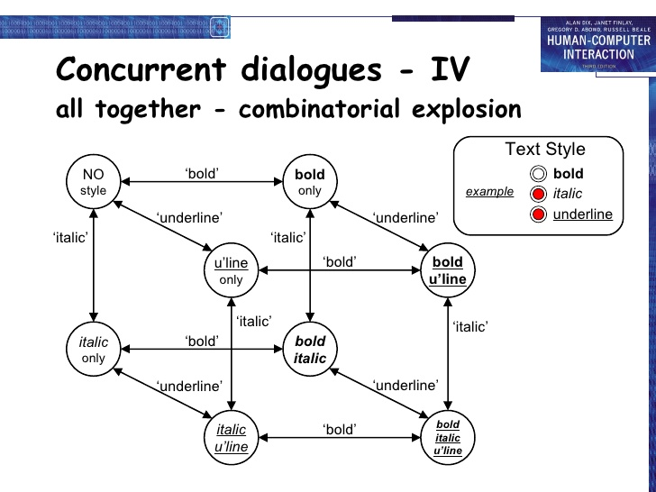
HCI-Concepts
Concurrent Dialogues-IV

Slide 19
HCI-Concepts
Escapes
‘back’ in web, escape/cancel keys
similar behaviour everywhere
end up with spaghetti of identical behaviours
try to avoid this
e.g. on high level diagram
‘normal’ exit for each submenu
plus separate escape arc active ‘everywhere’ in submenu
Graphics Submenu
ESC
select ‘graphics’
normal
finish
Main Menu
select ‘text’
Text Submenu
ESC
normal
finish
Paint Submenu
ESC
select ‘paint’
normal
finish

Slide 20
HCI-Concepts
Help Menus
similar problems
nearly the same everywhere
but return to same point in dialogue
could specify on STN … but very messy
usually best added at a ‘meta’ level
Circle 1
click on centre
Circle 2
click on circumference
Finish
from
Menu
rubber band
draw circle
press HELP button
press HELP button
Help Subsystem
Help Subsystem

Slide 21

HCI-Concepts
Persona
description of an ‘example’ user
not necessarily a real person
use as surrogate user
what would Betty think
details matter
makes her ‘real’

Slide 22
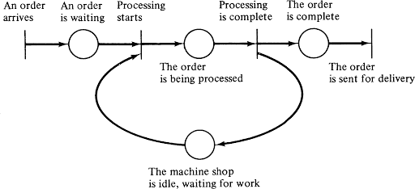
HCI-Concepts
Petrinets
one of the oldest notations in computing!
flow graph:
places – a bit like STN states
transitions – a bit like STN arcs
counters – sit on places (current state)
several counters allowed
concurrent dialogue states
used for UI specification (ICO at Toulouse)
tool support – Petshop

Slide 23
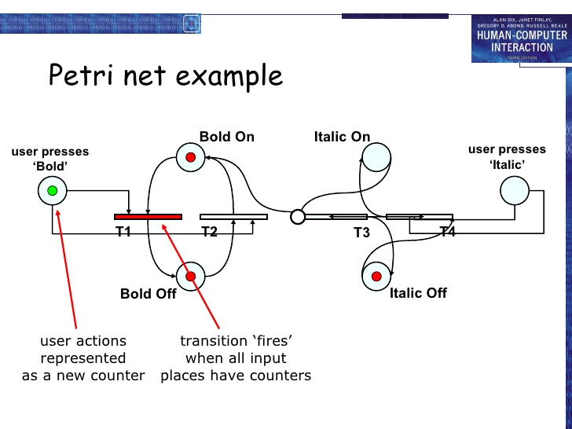
HCI-Concepts
Petri net-Example

Slide 24
HCI-Concepts
State charts
Standby
used in UML
extension to STN
hierarchy
concurrent sub-nets
escapes
OFF always active
history
link marked H goes back to last state on re-entering subdialogue
ON
OFF
RESET
Sound
Channel
1
H
On
SEL
2
MUTE
SEL
SEL
Off
3
SEL
4

Slide 25
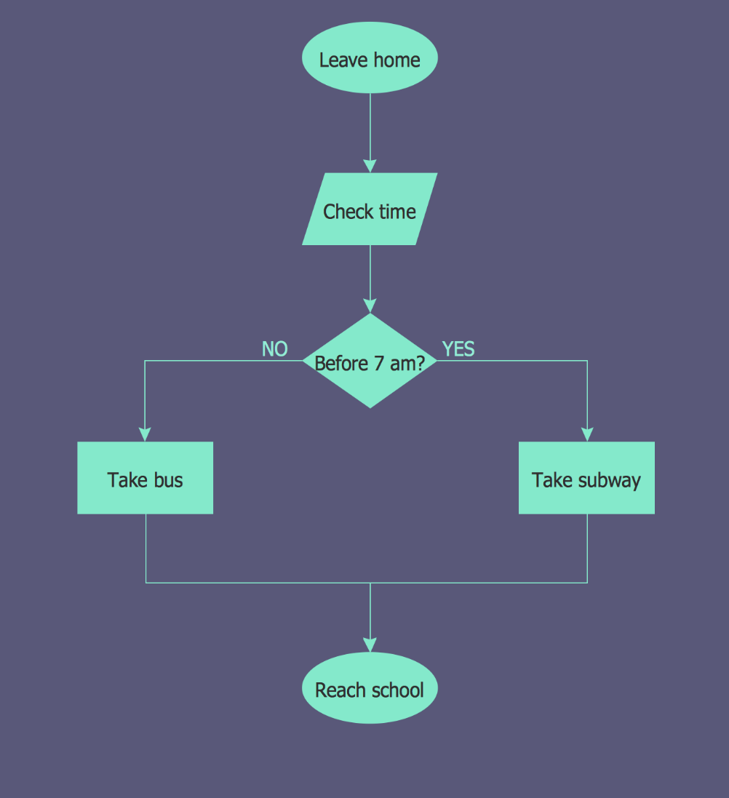
HCI-Concepts
Flowcharts
familiar to programmers
boxes - process/event - not state
use for dialogue (not internal algorithm)

Slide 26
HCI-Concepts
It works
formal notations – too much work?
COBOL transaction processing
event-driven – like web interfaces
programs structure ≠ dialogue structure
used dialogue flow charts
discuss with clients
transform to code
systematic testing
1000% productivity gain
formalism saves time!!

Slide 27
HCI-Concepts
JSD diagrams
for tree structured dialogues
less expressive
greater clarity
Personnel Record System
login
transaction
*
logout
add employee record
change employee record
display employee record
delete employee record

Slide 28
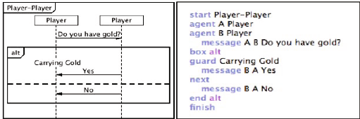
HCI-Concepts
Textual Notations
grammars production rules
CSP and event algebras

Slide 29
HCI-Concepts
Textual-Grammars
Regular expressions
sel-line click click* dble-click
compare with JSD
same computational model
different notation
BNF
expr ::= empty
| atom expr
| '(' expr ')' expr
more powerful than regular exp. or STNs
Still NO concurrent dialogue

Slide 30
HCI-Concepts
Production Rules
Regular expressions
sel-line click click* dble-click
compare with JSD
same computational model
different notation
BNF
expr ::= empty
| atom expr
| '(' expr ')' expr
more powerful than regular exp. or STNs
Still NO concurrent dialogue

Slide 31
HCI-Concepts
Event Based Production Rules
Sel-line → first
C-point first → rest
C-point rest → rest
D-point rest → < draw line >
Note:
events added to list of pending events
‘first’ and ‘rest’ are internally generated events
Bad at state!

Slide 32
HCI-Concepts
Prepositional Production system
State based
Attributes:
Mouse: { mouse-off, select-line, click-point, double-click }
Line-state: { menu, first, rest }
Rules (feedback not shown):
select-line → mouse-off first
click-point first → mouse-off rest
click-point rest → mouse-off
double-click rest → mouse-off menu
Bad at events!

Slide 33
HCI-Concepts
CSP and Process Algebras
used in Alexander's SPI, and Agent notation
good for sequential dialogues
Bold-tog = select-bold? → bold-on → select-bold? → bold-off → Bold-tog
Italic-tog = . . .
Under-tog = . . .
and concurrent dialogue
Dialogue-box = Bold-tog || Italic-tog || Under-tog
but causality unclear

Slide 34
HCI-Concepts
Dialogue Notations -Summary
Diagrammatic
STN, JSD, Flow charts
Textual
grammars, production rules, CSP
Issues
event base vs. state based
power vs. clarity
model vs. notation
sequential vs. concurrent

Slide 35
HCI-Concepts
Semantics Alexander-SPI
Two part specication:
EventCSP - pure dialogue order
EventISL - target dependent semantics
dialogue description - centralised
syntactic/semantic trade-off - tollerable

Slide 36
HCI-Concepts
Semantics Alexander SPI-ii
EventCSP
Login = login-mess -> get-name -> Passwd
Passwd = passwd-mess -> (invalid -> Login [] valid -> Session)
EventISL
event: login-mess
prompt: true
out: “Login:”
event: get-name
uses: input
set: user-id = input
event: valid
uses: input, user-id, passwd-db
wgen: passwd-id = passwd-db(user-id)

Slide 37
HCI-Concepts
Semantics-Raw Code
event loop for word processor
dialogue description - very distributed
syntactic/semantic trade-off - terrible!
switch ( ev.type ) {
case button_down:
if ( in_text ( ev.pos ) ) {
mode = selecting;
mark_selection_start(ev.pos);
}
...
case button_up:
if ( in_text ( ev.pos )
&& mode == selecting ) {
mode = normal;
mark_selection_end(ev.pos);
}
...
case mouse_move:
if (mode == selecting ) {
extend_selection(ev.pos);
}
...
} /* end of switch */

Slide 38
HCI-Concepts
Action Properties
completeness
missed arcs
unforeseen circumstances
determinism
several arcs for one action
deliberate: application decision
accident: production rules
nested escapes
consistency
same action, same effect?
modes and visibility

Slide 39
HCI-Concepts
State Properties
reachability
can you get anywhere from anywhere?
and how easily
reversibility
can you get to the previous state?
but NOT undo
dangerous states
some states you don't want to get to

Slide 40
HCI-Concepts
Dangerous States
word processor: two modes and exit
F1 - changes mode
F2 - exit (and save)
Esc - no mode change
but ... Esc resets autosave
Esc
edit
F1
menu
F2
exit

Slide 41
HCI-Concepts
Dangerous States-II
exit with/without save ⇒ dangerous states
duplicate states - semantic distinction
F1-F2 - exit with save
F1-Esc-F2 - exit with no save
edit
F1
menu
F2
exit
any update
Esc
edit
F1
menu
F2
exit
Esc

Slide 42
HCI-Concepts
Lexical Issues
visibility
differentiate modes and states
annotations to dialogue
style
command - verb noun
mouse based - noun verb
layout
not just appearance ...

Slide 43
HCI-Concepts
Layout Matters
word processor - dangerous states
old keyboard - OK
edit
F1
menu
F2
exit
any update
Esc
Esc
1
...
edit
F1
menu
F2
exit
tab
F1
F2
...
F3
F4
Esc
...
...

Slide 44
HCI-Concepts
Layout Matters
new keyboard layout
intend F1-F2 (save)
finger catches Esc
...
Esc
F1
F2
F3
edit
F1
menu
F2
exit
any update
Esc
edit
F1
menu
F2
exit
Esc

Slide 45
HCI-Concepts
Dialogue Analysis-Summary
Semantics and dialogue
attaching semantics
distributed/centralised dialogue description
maximising syntactic description
Properties of dialogue
action properties: completeness, determinism, consistency
state properties: reachability, reversibility, dangerous states
Presentation and lexical issues
visibility, style, layout
N.B. not independent of dialogue

Slide 46
THANK YOU
Jayashree R
Department of CSE,
jayashree@pes.edu
+91 9845897074

