Slide 1

Human Computer Interaction-HCI
Basic Concepts and
Definitions
Jayashree R
Department of Computer Science and Engineering

Slide 2

Human Computer Interaction-HCI
Modelling Rich Interactions
Jayashree R
Department of Computer Science and Engineering

Slide 3
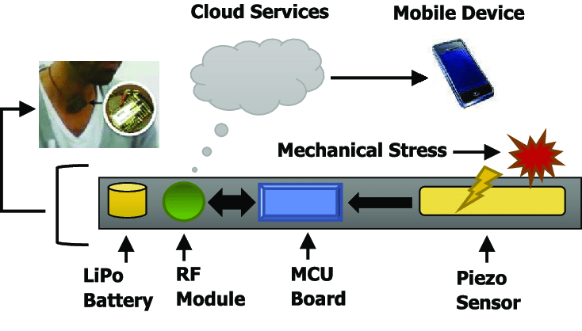
HCI-Concepts
Modelling rich interactions
status–event analysis
rich environments in task analysis
sensor-based systems

Slide 4
HCI-Concepts
Status Events Analysis
events – things that happen
e.g. alarm bell, beeps, keystrokes
status – things that are
e.g. screen display, watch face, mouse position
unifying framework – system (formal analysis) – user (psychology & heuristics)
time behaviour – detect delays, select feedback
transferable phenomena e.g. polling – active agent discovers status change

Slide 5
HCI-Concepts
Rich set of Phenomena
events status
input keypress mouse position
output beep display
internal interrupt document state
external time temperature
Most notations only deal with subset of these
e.g. STNs: event-in/event-out
⇒ may need awkward work-arounds

Slide 6
HCI-Concepts
Rich set of Behavior
1 actions:
state change at (user initiated) event
❷ status change events:
e.g. stock drops below re-order level
❸ interstitial behaviour:
between actions – e.g. dragging an icon
standard notations: ❶ usually, ❷ sometimes, ❸ never!

Slide 7
HCI-Concepts
Properties of Events
status change event
the passing of a time
actual and perceived events
usually some gap
polling
glance at watch face
status change becomes perceived event
granularity
birthday – days
appointment – minutes

Slide 8
HCI-Concepts
Design implications
actual/perceived lag… matches application timescale?
too slow
response to event too late e.g., power plant emergency
too fast
interrupt more immediate task e.g., stock level low

Slide 9
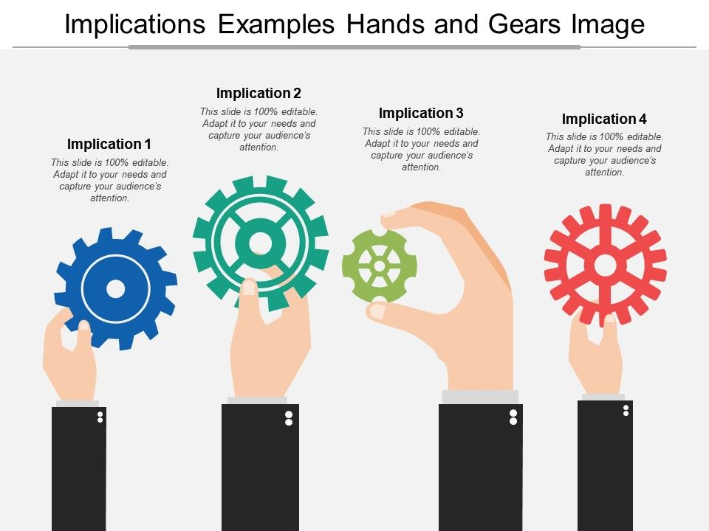
HCI-Concepts
Design implications

Slide 10
HCI-Concepts
Naïve Psychology
Predict where the user is looking
mouse – when positioning
insertion point – intermittently when typing
screen – if you're lucky
Immediate events
audible bell – when in room (and hearing)
peripheral vision – movement or large change
Closure
lose attention (inc. mouse)
concurrent activity

Slide 11
HCI-Concepts
Email Delivery

Slide 12
HCI-Concepts
Screen Budget Widget
screen button often missed, … but, error not noticed
a common widget, a common error: Why?
Closure
mistake likely – concurrent action
not noticed – semantic feedback missed
Solution
widget feedback for application event
a perceived event for the user
N.B. an expert slip – testing doesn't help

Slide 13
HCI-Concepts
Screen Button Hit
screen button often missed, … but, error not noticed
a common widget, a common error: Why?
Closure
mistake likely – concurrent action
not noticed – semantic feedback missed
Solution
widget feedback for application event
a perceived event for the user
N.B. an expert slip – testing doesn't help

Slide 14
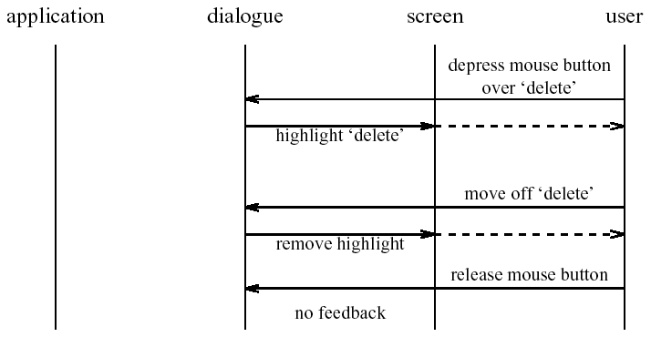
HCI-Concepts
Screen Button Miss

Slide 15
HCI-Concepts
Rich Context- The Problem
task models
formal description
situatedness
unique contexts
ethnography
rich ecologies
bringing
them together?

Slide 16

HCI-Concepts
Collaboration
already in several notations
e.g. CTT, GTA
add artefacts too ?

Slide 17
HCI-Concepts
Concur Task Trees
book holiday
abstract task
user task
>>
holiday idea
make booking
computer task
user and computer
>>
||
>>
cooperative task
email advert
decide destination
( customer :)
book flights
( travel agent:)
choose hotel
( customer :)
book hotel
( travel agent:)

Slide 18
HCI-Concepts
Groupware Task Analysis
GTA
conceptual framework, tools, elicitation techniques
rich model of task world
rich ontology
human roles for collaboration
physical and electronic objects

Slide 19
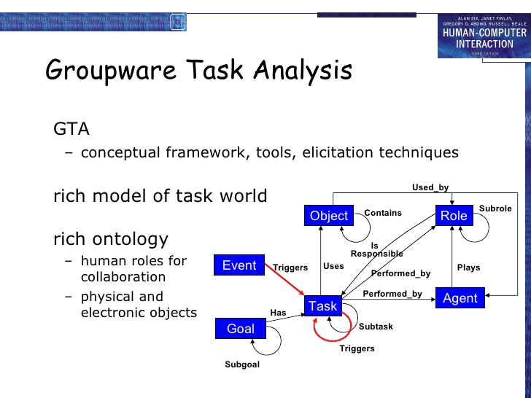
HCI-Concepts
Groupware Task Analysis

Slide 20

HCI-Concepts
Information
pre-planned cognitive model
goal  action
situated action
environment  action

Slide 21

HCI-Concepts
Control
open loop control
no feedback
fragile

Slide 22
HCI-Concepts
Control
open loop control
no feedback
fragile
closed loop control
uses feedback
robust
feedback
control system
environment
actions

Slide 23
HCI-Concepts
Adding Information

Slide 24
HCI-Concepts
Adding Information
information required when
subtask involves input (or output)
some kind of choice (how to know what to do)
subtask repeated (but iterations unspecified)
sources of information
part of existing task (e.g. phone number entered)
user remembers it (e.g. recall number after directory enquiry)
on device display (e.g. PDA address book, then dial)
in the environment
pre-existing (e.g. phone directory)
created in task (e.g. write number down on paper)
GUI easy (lots of space) mobile/PDA need to think

Slide 25
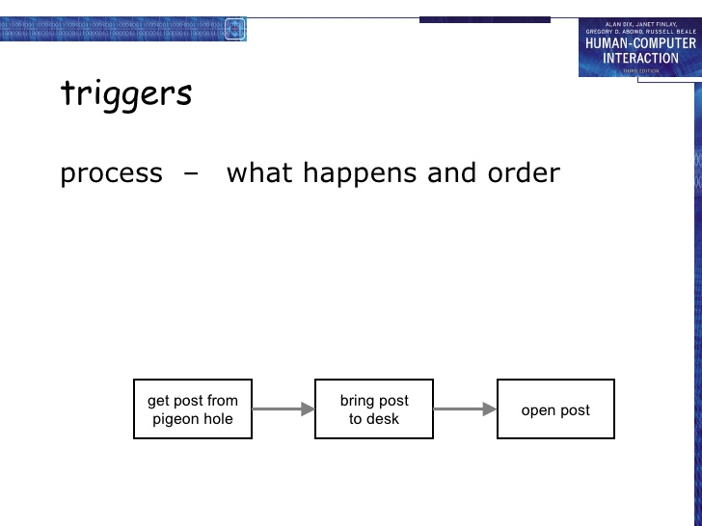
HCI-Concepts
Triggers

Slide 26
HCI-Concepts
Common Triggers
immediate
straight after previous task
temporal
at a particular time
sporadic
when someone thinks of it!
external event
when something happens, e.g. phone call
environmental cue
something prompts action … artefacts

Slide 27
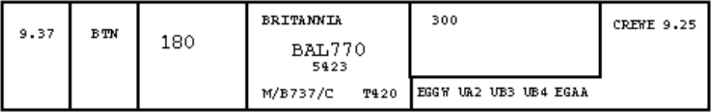
HCI-Concepts
Artefacts
ethnographic studies
as shared representation
as focus of activity
act as triggers, information sources, etc.

Slide 28
HCI-Concepts
Where are you?

Slide 29
HCI-Concepts
Tracing Placeholders
a form of information, may be …
in people’s heads
remembering what to do next
explicitly in the environment
to-do lists, planning charts, flight strips, workflow
implicitly in the environment
location and disposition of artefacts
electronic environments …
fewer affordances for artefacts
danger for careless design!

Slide 30

HCI-Concepts
Low intention and sensor based interaction
turn on
when doors unlocked/open
turned off
after time period
when engine turned on
driver's purpose is to get into the car
incidentally the lights come on

Slide 31

HCI-Concepts
Pepys
Xerox Cambridge (RIP)
active badges
automatic diaries
Allan's purpose to visit Paul’s office
incidentally diary entry created

Slide 32
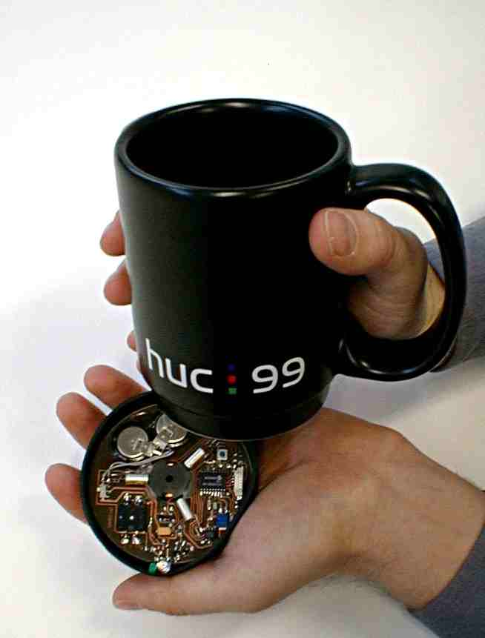
HCI-Concepts
MediaCup
cup has sensors
heat, movement, pressure
broadcasts state (IR)
used for awareness
user is moving, drinking, …
Han's purpose to drink coffee
incidentally colleagues are aware

Slide 33

HCI-Concepts
Shopping cart
goods in shopping cart analysed
e.g. Amazon books
used to build knowledge about books
people who like X also like Y
used to give you suggestions
“you might like to look at …”, “special offer …”
my purpose to buy a book
incidentally shown related titles

Slide 34

HCI-Concepts
OnCue
‘intelligent’ toolbar
appropriate intelligence
make it good when it works
don’t make it hard of it doesn’t
analyses clipboard contents
suggests things to do with it

Slide 35
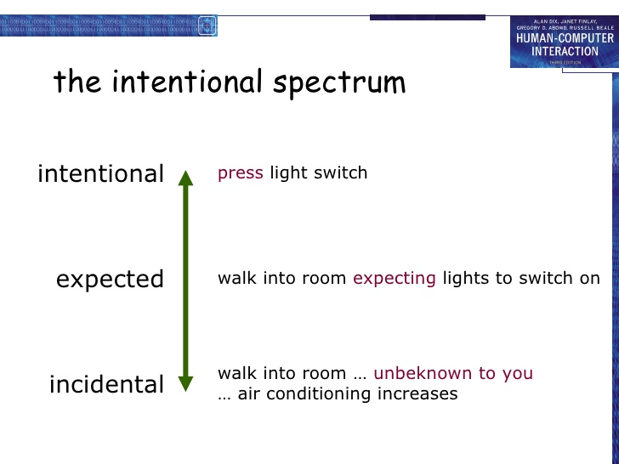
HCI-Concepts
Intentional Spectrum

Slide 36
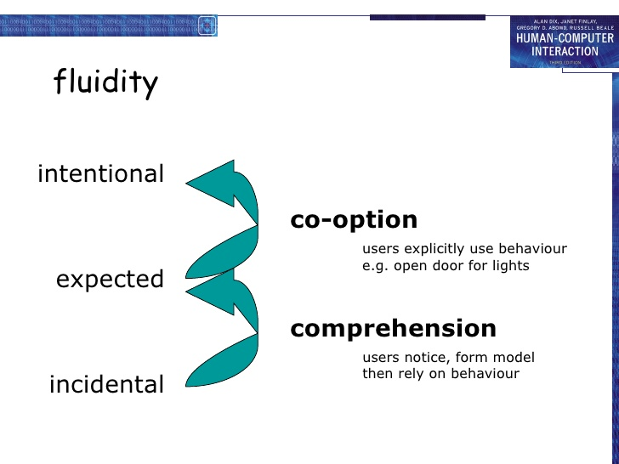
HCI-Concepts
Fluidity

Slide 37
HCI-Concepts
Interaction Models
intentional cycle
Norman execution/evaluation loop
some exceptions
multiple goals, displays, opportunistic
guidelines
feedback, transparency
goal
execution
evaluation
system

Slide 38
HCI-Concepts
Cognition
physical things (inanimate)
directness of effect
locality of effect
visibility of state
computational things (also animate)
complex effects
non locality of effect
distance – networks; time – delays, memory
large hidden state

Slide 39
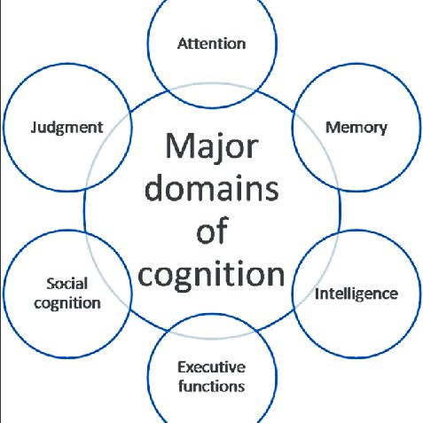
HCI-Concepts
Cognition

Slide 40
HCI-Concepts
Cognition
understanding
innate intelligences
physical, natural/animal, social, physiological
rational thought
imagination
interfaces
GUI, VR, AR, tangible
recruit physical/tangible intelligence
ubicomp, ambient, incidental
? ? ?

Slide 41
HCI-Concepts
Designing Incidental Interaction
need richer representations
of the world, of devices, of artefacts
wider ecological concerns
two tasks
purposeful task – for interpretation
supported task – for actions

Slide 42

HCI-Concepts
Designing Incidental Interaction

Slide 43
HCI-Concepts
Issues and Process
no accepted methods but … general pattern
uncertainty
traditional system due to errors
sensor-based intrinsic to design
uncertain readings, uncertain inference
usually control non-critical aspects of environment
process … identify
input – what is going to be sensed
output – what is going to be controlled
scenarios – desired output and available input

Slide 44
HCI-Concepts
Issues and Process

Slide 45
THANK YOU
Jayashree R
Department of CSE,
jayashree@pes.edu
+91 9845897074

