Slide 1
SOFTWARE MAINTENANCE

Slide 2
Software Maintenance Introduction

Slide 3
Introduction :
Software today are large, complex and they are built to last for a long time.
Typically, the software delivered to the public will go through a large number of modification & enhancements as a result of:
Fixing defects reported from the field
Correcting requirement and design errors
Implementing enhancements
Improving performance
Adapting the system in response to the environmental changes such as:
Hardware changes
Software changes within programs that it interface with
Network/telecommunication changes
Changes in standards (government, industry)
Retiring outdated systems
Interfacing with other software

Slide 4
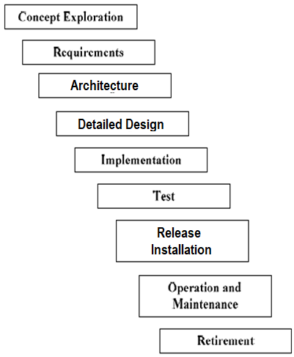
Introduction :
As discussed in Unit 1, a software system as part of a SDLC progresses through a series of phases as seen
Maintenance is typically the largest portion of the total life cycle as products are used for a long period of time and this also includes retirement or discontinuance.
Waterfall Model of Software Life Cycle

Slide 5
Introduction : Formal Definition of Terminology
‘Maintenance’ – is the sustaining process of modifying a software system or component after delivery to correct faults, improve performance or other attributes, or adapt to a changed environment [IEEE Std. 610.12-1990]
Other definitions of maintenance:
“the totality of activities required to provide cost-effective support to software” [SWEBOK]
Software maintenance is defined as the modification of a software product after delivery to correct faults, to improve performance or other attributes, or to adapt the product to a modified environment [IEEE 12119

Slide 6
Why and who maintains Software
To ensure that a software product continues to satisfy its users needs.
Commitment to customers to support software systems which they have invested into
Maintainer could be an organization or a person responsible for carrying out maintenance activities. E.g. Lot of product organizations outsource maintenance to other service organizations like TCS, Wipro, Infosys etc. Engineers who are assigned to maintain.

Slide 7
Maintenance Activities expected and Actions which can help towards it
Activities Expected
Maintaining control over the software’s day to day functions
Maintaining control over software modifications
Perfecting existing functions
Preventing software performance from degrading to unacceptable levels
Actions which will support it
Understanding the product, module which needs to be maintained by studying the architecture, design, code, test cases and documentation
Discussion with architects and developers
Enhance documentation, Create branches, instrumentation and debug code
Look at present and the change request at hand, to identify how to satisfy the task at hand
Look at future and analyze the consequences of its solution as to how it affects any other future maintenance activities

Slide 8
Maintenance Costs
Maintenance consumes a major share of software lifecycle financial resources
Typically ~70% of the total effort spent on the product would be on Maintenance and the rest 30% on Development. The total costs involved would also follow this.
Some of the technical and non-technical factors affecting software maintenance costs are:
Application type.
Software novelty.
Software maintenance staff availability.
Software lifespan.
Hardware characteristics.
Quality of the software design, construction, documentation, and testing

Slide 9
Categories of Maintenance
Maintenance is
Modification of a software product after delivery to detect and correct latent faults in the software product before they become effective faults
Modification of a software product after delivery to improve performance or maintainability
Can be for
or for
Modification of Software
Correction
Enhancement
When done Proactively
Preventive
Maintenance
Perfective
Maintenance
When done Reactively
Corrective
Maintenance
Adaptive
Maintainance
Reactive modification of a software product performed after delivery to correct discovered problems
Modification of a software product performed after delivery to keep a software product usable in a changed or changing environment

Slide 10
Key Issues in Software Maintenance : Technical Issues
Code and Documentation Quality
Limited Understanding as potentially newer lower skilled people
Testing in terms of balance between what and how much to test for regression and the changes
Impact Analysis on whether the change is scoped & understood properly
Support tools

Slide 11
Key Issues in Software Maintenance : Management Issues
Staffing finding people with right skill levels and retaining them
Alignment with economic objectives since this in most cases do not produce as much direct RoI.
Organizational aspect with respect to structure who and their priority
Outsourcing the maintenance project to either another organization within the development company or organizations outside the development company produces challenges which include:
Protection of the intellectual property
Control over the development process and quality control
Learning curve for the product under maintenance
Scope of maintenance
..

Slide 12
Key Issues in Software Maintenance : Maintenance Cost Estimation
These could be in terms of the following factors
Application type, Real-time product or products that has a very rigid data format typically costs more to maintain
System novelty, special design and implementation (unfortunate side affect of the developers artistic capabilities), will cause program understandability harder, which results into a higher maintenance cost
Staff availability and their availability will have an impact on the cost
System life span in terms of older products means more complexity which makes it more expensive.
Hardware characteristics, unreliable hardware and different vendors make it more difficult to track the source of the problem
Quality of software artifacts since poor quality means higher cost

Slide 13
Key Issues in Software Maintenance : Maintenance Measurements
Measurement can help to understand our project progress and ensure if our quality goals are reached to and are similar to our development process. These could be measures related to
Schedule and effort
Maintainability like the time needed to analyse the problem, time needed to make the change and time needed to verify the changes
Quality which could be in terms of increase/decrease in program complexity, number of unresolved problems, percentage of changes that produce new faults
Internal to the product in terms of control for complexity, number of inputs/outputs in the program, number of modules in the program

