Slide 1
SOFTWARE MAINTENANCE

Slide 2
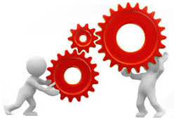
Software Maintenance techniques and approaches

Slide 3
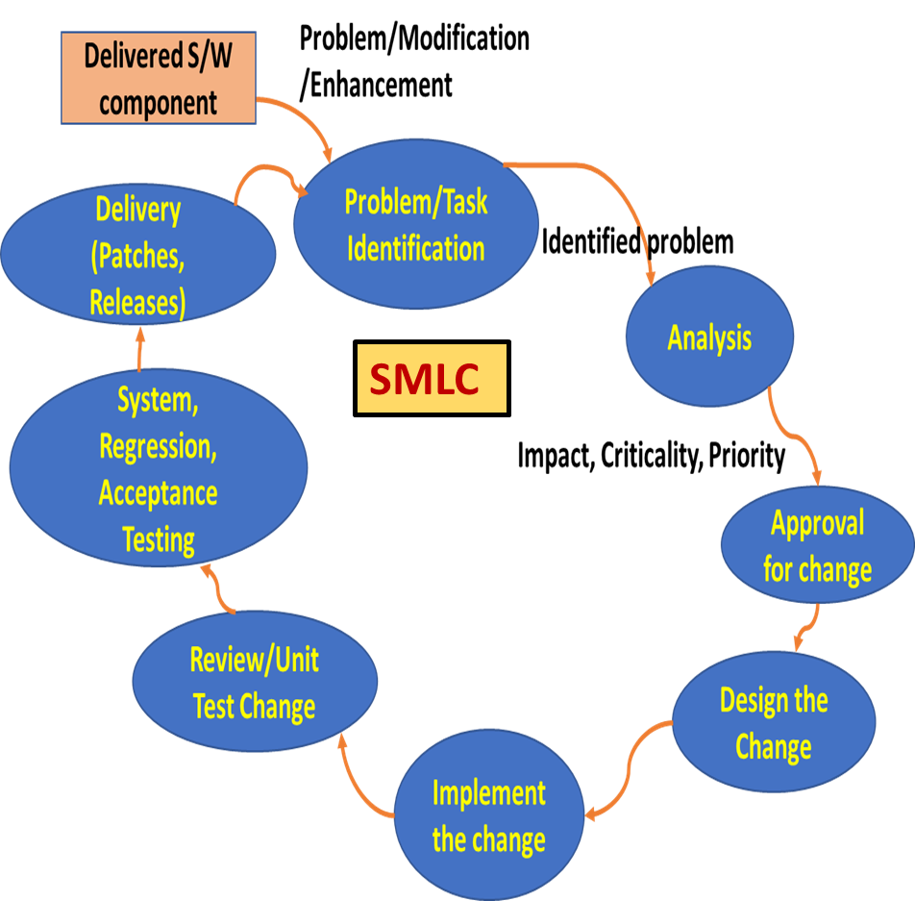
Maintenance Process Activities
Process implementation
Execute maintenance activities (track problem reports, respond to users etc.)
Software Maintenance Lifecycle (SMLC)
Following the 8 Steps involved in the Software Maintenance lifecycle (SMLC) as discussed earlier.
Migration
Develop a migration plan and execute that plan
Software retirement
Develop a retirement plan for the system and execute that plan

Slide 4
1. Process implementation
Develop, document, and execute maintenance process plans and procedures
Establish procedures for handling user reports and modification requests
Implement or establish an organizational interface with the configuration management process

Slide 5
2. Software Maintenance Life Cycle
Identify the requests for modifications or the defect
Replicate the problem or verify its existence
Identify all affected configuration items
Consider modification options
Analyze the impact of problem reports and modification requests
Document the request, the analysis, and the suggested options
Obtain approval for the modification selected from the options

Slide 6
2. Software Maintenance Life Cycle (Cont.)
Design the change and determine and document the components that need to be modified
Check out the items, make the changes, execute the required tests, and prepare for checking-in
Enter the development process to make the modifications
Conduct a review with the organization that authorized the modification
Determine the integrity of the modified system
Check in the approved, changed material to the CM system
Create the patch or the delivery vehicle

Slide 7
3. Migration
Migration to the new version of the product could be
Notifying and simply replacing the product and restart
Applying the patch and may need restart or no restart based on the product and the kind of patch
If this is more for a complex product with impactful changes, it might need a more elaborate set of steps as below.
Planning for migration including migration plans, white papers, collaterals like benefits, tools etc.
Building tools, documentation and plans to support the old and the new for the same
Notifying users of the timelines for migration and setting expectations on the levels of support to be expected on the old

Slide 8
3. Migration (Cont.)
Potential steps as part of migration (Cont.)
Execute the migration and verify the migration
Make available data from the older product accessible according to contract requirements
Provide future support for the previous environment along with the new

Slide 9
4. Software Retirement
This may have the following activities
Plan and execute retirement
Notify users of plan, timeline
Run retiring of the older version and running of the new in parallel
Make the retired data available
Dispose of superseded hardware and software
Hardware disposal includes sanitization or removal of sensitive data from retired storage devices and the environmentally safe disposal of equipment that may contain toxic or hazardous material
Software disposal may include the termination of software licenses or contracts for software services

Slide 10
Tips for Maintenance
Reproduce the problem.... Before you start fixing it
Understand the stack traces
Check your environment variables
Write a test case that reproduces the problem .. Even better ..Convert the problem into an automated test. ...
Know your error codes
Don't assume things work the way they're meant to. ...
Be clear in your mind about correct behavior. ...
Pair program whenever possible .. Two pairs of eyes helps
Guess and check
Get your code to help you. ...
Print
Use logs
Comment out code and check
Learn your debugger's capabilities
Take breaks to get your mind off and restart
Fix one problem at a time. ...
Test, Test and Test
Consider the bigger picture

Slide 11
Techniques or Approaches for Maintenance
Reverse engineering
Reverse engineering is a passive technique that is used to understand a piece of software prior to re-engineering.
Reverse engineering is the process of recovering specification and design information about the software system from its source code
Over time, an application may have been corrected, adapted and enhanced. As a result, the application can become complex, unstable with changes having unexpected and serious side effects and reverse engineering addresses it.
Reverse engineering identifies the components of a software product and the interrelationships between the components.
The purpose of reverse engineering is to create a representation of the software in a different format than the existing code or documentation.
It does not modify the existing product, nor does it result in a new product.
Some of the typical products created during the reverse engineering process are called graphs and control flow graphs.

Slide 12
Techniques or Approaches for Maintenance
Re-Engineering
Re-engineering is the process of modifying the software to make it easier to understand and change
Reengineering involves modifying existing legacy software that is aged to the point where it is no longer viable to employ standard maintenance techniques.
Computer-aided software is utilized to understand and document the existing structure of the product. Once this has been accomplished, the legacy software can be rewritten so that it will run on a modern platform.

Slide 13
Techniques or Approaches for Maintenance
Re-Structuring
Restructuring involves the transformation of unstructured code into structured code thereby making it easier to understand and change.

