Slide 1
SOFTWARE TESTING

Slide 2
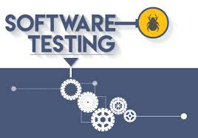
Introduction to Testing & Test Terminologies

Slide 3
Context : Some Quotes on Testing
“Testing is the process of executing a program with the intention of finding errors.” – Myers
“Testing can show the presence of bugs but never their absence.” – Dijkstra
“Good testing at the minimum is as difficult as good design”
Testing is executing software in a simulated or real environment, using inputs selected somehow.
Testing does NOT guarantee a completely defect free product

Slide 4
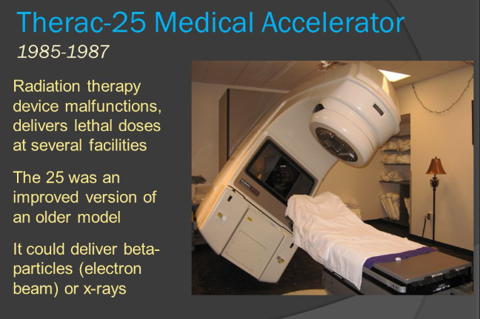
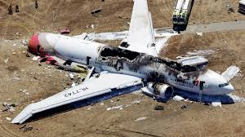

Why test
Inadequate or Incomplete testing can lead to

Slide 5
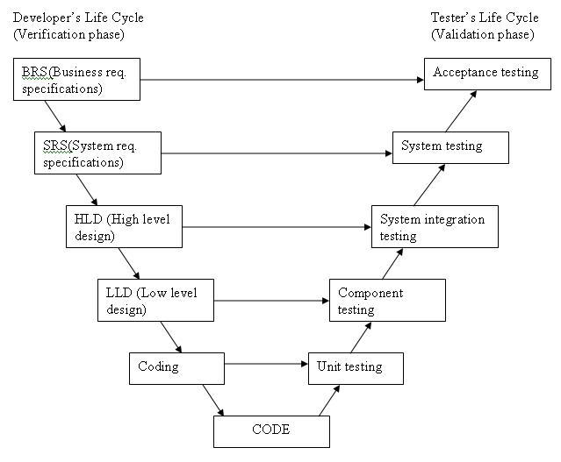
Generics
In an typical plan driven SDLC, Testing is a phase which follows Requirements, Architecture, Design and Implementation.
User req

Slide 6
Generics
Testing is expected to do Verification and Validation of the Software. Verification is the process of evaluating a product to determine if it is built according to the specified requirements. Validation is the process of evaluating a system or component to determine if it satisfies specified requirements.
Testing establishes that the software developed, performs as per the expectations specified in the requirements & exposes deviations if any
Involves measuring attributes, such as performance or usability, estimating the operational reliability, and so on
Testing builds confidence in the software that, it is good enough for its intended use. The planned usage of the software will determine the degree of confidence that is needed and the degree and type of testing.

Slide 7
Objectives of testing
Demonstration
Detection
Prevention
Show that the system can be used with acceptable risk
Demonstrate functions under special conditions
Show the products are ready for integration or use
Discover defects, errors and deficiencies
Determine system capabilities and limitations
Determine quality of components, work products, and the system
Provide information to prevent or reduce the number of errors
Reduce the number of early errors propagated through to later phases
Clarify system specifications and performance
Identify ways to avoid risks and problems in the future

Slide 8
VERIFICATION
"Are we building the product right”
It’s the process of checking that the software achieves its goals to ensure that the products and deliverables meet specified requirements before final testing
Typically does not include the execution of the code
Verification finds the bugs early in the development cycle
It is Static testing – includes checking documents, design, code (reviews, walkthroughs, Inspections ..)
Verification process targets on software architecture, design, database, etc.
Mostly happens before validation

Slide 9
VALIDATION
"Are we building the right product”
Focuses on product related activities that attempt to determine if the system or project deliverables meet the customer or clients expectation
Validation is predominantly done through Dynamic testing
Execution of code (Exercising and observing the behaviour )
Testing validates if the system has all the capabilities & features defined in the projects scope and requirements definition
Typically done by the Testing team
Its done again mostly after Verification
Methods used in validation are Black Box Testing, White Box Testing and non-functional testing.

Slide 10
Terminologies : Defect, Bug, Failure, Issue
Defect
Is a deviation from the requirements.
A shortcoming/fault or imperfection found and may be due to a design mistake or a code mistake.
Bug
Is typically a coding error that that prevents it from working as intended, or produces an incorrect result
Typically a programmers mistake
Typically found during testing

Slide 11
Terminologies : Defect, Bug, Failure, Issue
Failure
Is the resulting state of a system due to a defect, where its unable to perform its function as expected
occurs during the development lifecycle or later as a result of a defect, or a bug
Issue
It is typically raised by the end user/customer when the product does not meet with expectation on functionality/performance etc.
This is usually tracked.

