Slide 1
SOFTWARE TESTING

Slide 2

Characterizing Testing and Testing Types

Slide 3
Characterizing Testing
Testing always consists of observing a sample of executions, and giving a verdict over them. Characterizing these observations
Why are we making these observations will be based on test objective (are we looking for faults, is it for determining that the release is fit for use, or for looking at usability)
How did we arrive at these test executions would be based on the test strategy or approach which will be followed
Which of the samples should we observe would be based on the test selection (Random, Ad-hoc, using some algorithm, using statistics ….)
Random testing may not work most times if you want to find significant errors

Slide 4
Characterizing Testing
Characterizing these observations (Cont.)
How Much – How big a sample to be used for testing (coverage analysis or reliability measures)
Exhaustive testing most often is not feasible
What is it we execute – whole product or part of the product (Unit/Component …)
Where do we test – Specifically in Embedded system
When do we test – in the lifecycle
Besides, the whole of testing activity needs to be carried on according to a controlled formal procedure, requiring rigorous planning and documentation
How do we manage this would be based on a plan

Slide 5
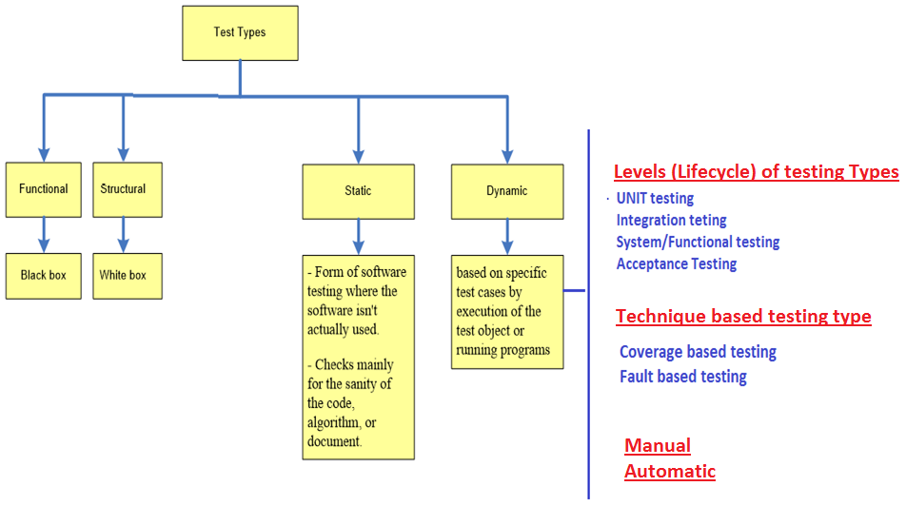
Testing Types
Testing can be looked at from different perspectives

Slide 6
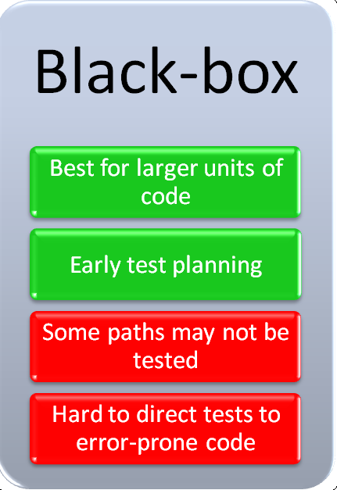
Testing Types : Block Box, White Box and Grey Box testing
Testing can be categorized based on the Functional or Structural approaches taken towards testing.
Requirements
Black Box Testing (Functional)
Treats the software as a black box without regard to the internal structure or logic involved in the implementation.
Concerned with the external behavior of the product.
Objective is to identify defects in the output, which are generated as a result of valid and invalid input.
It is testing from a user’s point of view
Typically test cases need to be provided to the tester, who then verifies that for a given input
Inputs
?
Outputs

Slide 7
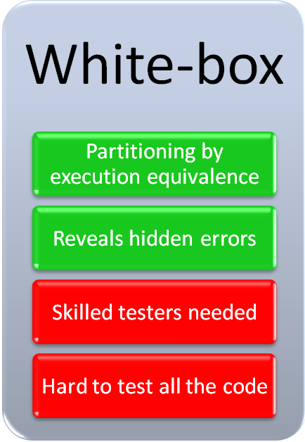
Testing Types : Block Box, White Box and Grey Box testing
White Box Testing (Structural)
Factors in the internal logic and structure of the code
The test specifier uses knowledge of the internal structure of the software to derive test cases
The test cases cannot be determined until the code has actually been written
It is testing from a user’s point of view
Typically needs testers to have programming skills
Requirements
Inputs
Internal Logic
Outputs
Structure

Slide 8
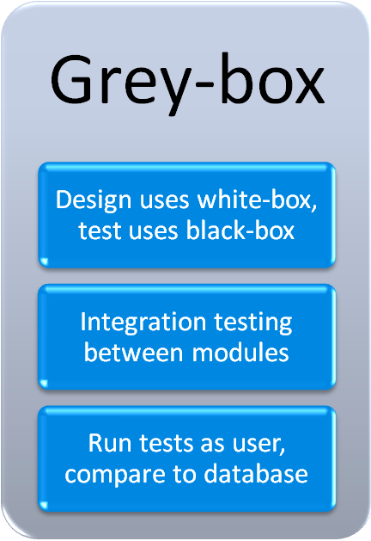
Testing Types : Block Box, White Box and Grey Box testing
Grey Box (Hybrid) Testing (Mix of Functional & Structural)
Involves having access to internal data structures and algorithms for purposes of designing the test cases
Testing is done at the user or black-box level
Requirements
Inputs
Outputs

Slide 9
Testing Types
Testing can also be looked at as Static and Dynamic based on the testing techniques used

Slide 10
Testing Types : Static and Dynamic Testing
Static Testing
In this approach you check for defects in the software without actually executing the code of the software/application.
Static testing is performed in early stage of development to avoid errors as it is easier to find sources of failures and it can be fixed easily
Static Testing
Review
Static Analysis
Informal
Walkthrough
Peer Review
Inspection
Evaluation of code quality
Data Flow
Control Flow
Cyclomatic Complexity

Slide 11
Testing Types : Static and Dynamic Testing
Dynamic testing involves execution of the code for analyzing the dynamic behavior.
This involves providing input values for the software under test, observation of the output values, which are then analyzed
Has the advantage of being able to find difficult and complex defects which are not easily detectable by static testing
Typically time and Budget consuming
There can be different kinds of dynamic testing like
1. Testing based on the techniques (Code or Fault based)
2. Testing based on how the testing is done (Manual or Automatic)
3. Testing based on the levels of testing (will be discussed in the next session)

Slide 12

Testing Types : Testing Technique Based
Code Based
Control-flow-based criteria
Data-flow-based criteria
Path testing
All definition-use paths
Graph of a system
Statement, branch, and condition testing
All definitions or all uses
Branch coverage
Statement coverage
Executes every path at least once
Executes all statements at least once
No branching leads to abnormal behavior?
No side effects?

Slide 13
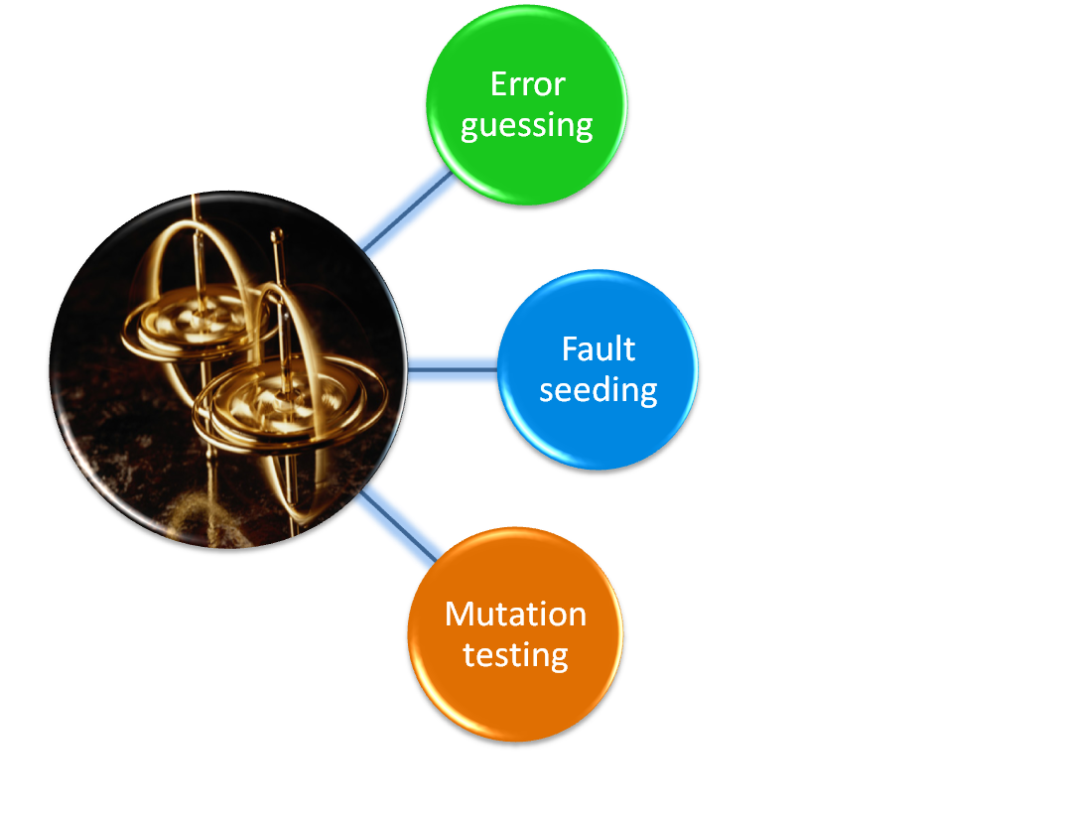
Testing Types : Testing Technique Based
Fault Based
Most plausible faults
Historical information
Experience
Single fault injected into each of several copies
Run against correct version
Fault tolerance?
What happens in failure?
Risk artificial faults may not be removed but it might be delivered to the customer
Test seldom-executed code
Well-defined mutation operators
Tests run against original and mutants
All mutants should fail
Syntactic faults may reveal more complex, real faults
13

Slide 14
Testing Types : Testing Technique based approaches
Specification Based
Test the functionality of the system, according to the stated requirements. They test the behavior of the system (system output) given specific input.
Equivalence Partitioning and Boundary Value Analysis are important approaches in specification based because they can uncover entire classes of errors and reduce the total number of test cases that must be developed and executed.
Equivalence partitioning divides input data of a software unit into partitions of data from which test cases can be derived. Test cases are designed to cover each partition.
Boundary value analysis tests are designed to include representatives of boundary values and since boundaries are common locations for errors, that can result in software faults.
14

Slide 15
Testing Types : Testing Technique based approaches
SE Intuition Based
Generally rely on the tester’s experience to design test cases for the product.
Usage Based
Usage is concerned with finding defects which could be revealed by user as they interact with the product.
Application Domain
Special testing techniques that use specific knowledge about the product domain in order to design test cases. (e.g., GUI, Web-based, real-time, Object-oriented, etc.)
15

Slide 16
Testing Types : Mode of testing (Manual or Automated)
Manual Testing
Manual testing involves a human performing the tests step by step, without test scripts.
Typically used for testing complex tests where automation can be very expensive
Slow and Tedious
Hard to get test coverage
Automated Testing
Automated testing involves tests which are executed without human assistance, often via test automation frameworks, along with other tools and software
Needs coding, test framework maintenance but fast and repeatable
Most efficient for tests which need periodic regular running

