Slide 1
SOFTWARE TESTING

Slide 2
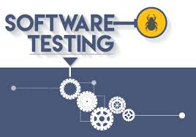
Levels of Testing

Slide 3
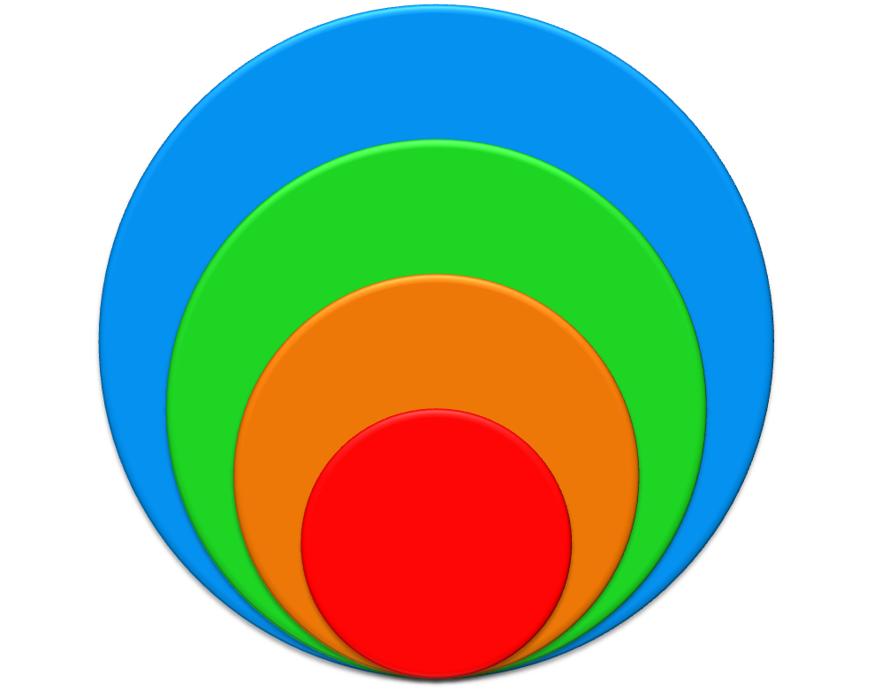
Levels of Testing
Done by Provider and customer
Determines if system meets needs
Acceptance
Assessment of whole system
behavior
Collecting information that will help
direct the product release
Discovering bugs that cannot be
attributed to individual components
System
Reviews
Regression
Integration
Unit
Component
Focuses on finding interface errors between units or components
Focus is on the bugs that cannot be seen in unit testing
Unit
Verifies proper functioning of that unit
No interaction between units

Slide 4
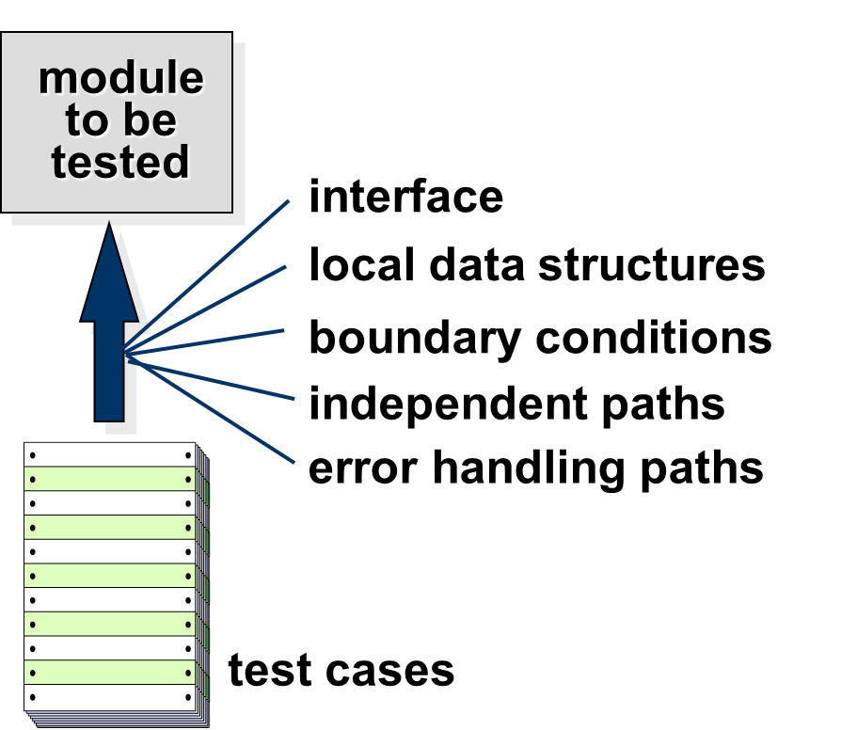
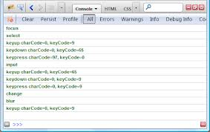
Unit Testing
Focus: Test for coding/construction errors before it goes to QE.
Tests the smallest individually executable code units. Usually done by programmers.
Tests cases could be for
Algorithms and logic
Data structures (global and local)
Interfaces
Independent paths
Boundary conditions
Error handling
In OO environment these could be at the class level & minimally constructors/destructors
Test Log

Slide 5

Integration Testing
Focus: Test to verify the interfaces between components against a software design.
Usually done by programmers & can find issues like timing problems (in real-time systems) & Resource contention problems which are not detectable by unit testing
Approach:
Software components corresponding to elements of the architectural design are integrated in an iterative way (since it allows interface issues to be localised more quickly) either as top down or bottoms up and tested until the software works as a system.

Slide 6
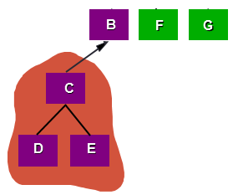
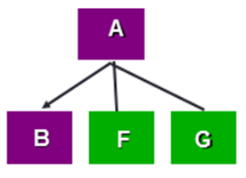
Integration Testing - Strategies
Options:
• The “big bang” approach
- Everything Integrated and then you run to see if the system is functioning as expected
• An incremental construction strategy
A top down integration Approach
A Bottoms up integration Approach

Slide 7
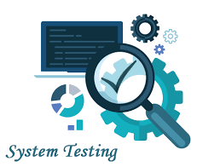
System Testing
System testing tests a completely integrated system to verify that its compliant with its specified requirements.
It seeks to detect defects both within the "inter-assemblages" and also within the system as a whole
Testing in the context of a Functional Requirement Specification(s) (FRS) and/or a System Requirement Specification (SRS).
Things like the following are tested as part of system testing

Slide 8
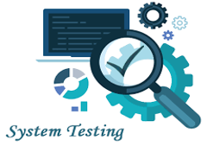
System Testing – Varieties of System Testing
Smoke and Sanity testing
Regression testing
Installation testing
Functional & Non functional
Destructive testing
Software Performance testing
Usability
Localization
Boundary tests
Startup/shutdown tests
Platform tests
Load/stress tests
Security testing
Recovery tests
Cloud Testing
..

Slide 9
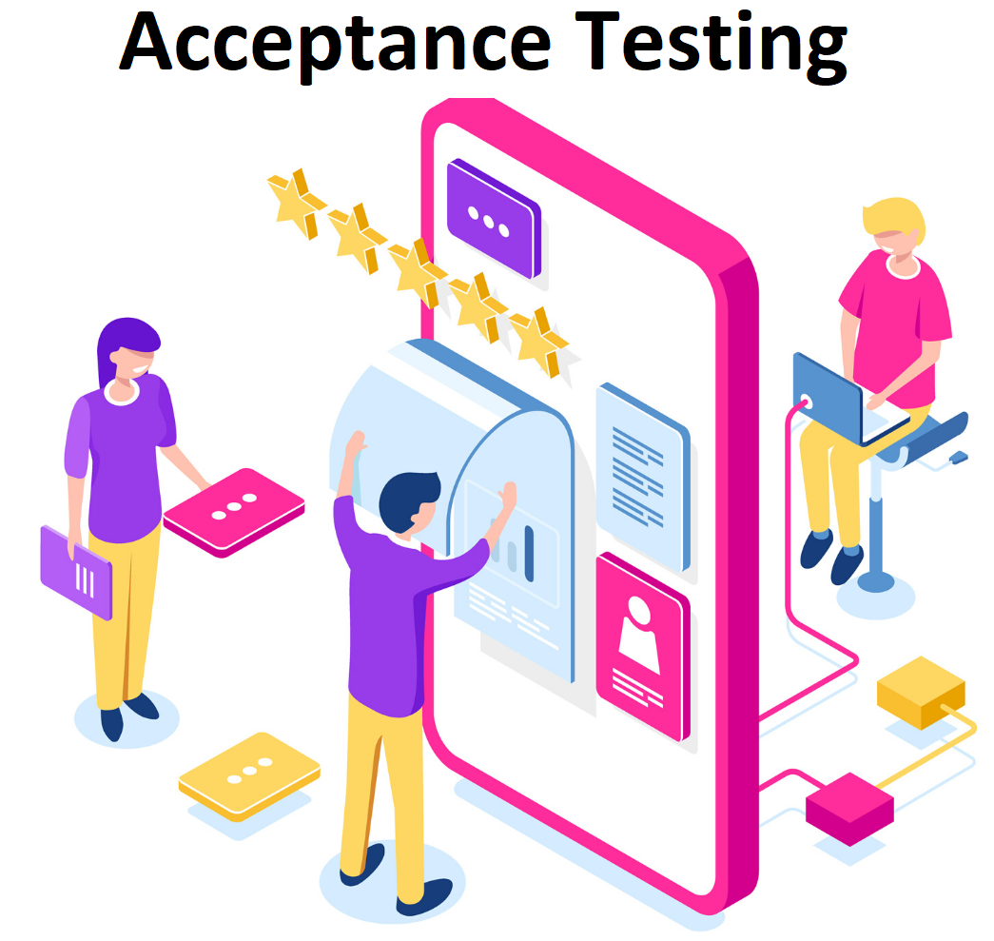
Acceptance Testing
Acceptance testing generally involves running a suite of tests on the completed system.
Each individual test, known as a case, exercises a particular operating condition of the user's environment or feature of the system, and will result in a pass or fail outcome
The test environment is usually designed to be identical, or as close as possible, to the anticipated user's environment, including extremes of such
These tests are created ideally through collaboration between business customers, business analysts, testers, and developers. It's essential that these tests include both business logic tests as well as UI validation elements

Slide 10
Acceptance Testing (Cont.)
These are high-level tests to verify the completeness of a user story or stories 'played' during any sprint/iteration.
The objective is to provide confidence that the delivered system meets the business requirements of both sponsors and users. The acceptance phase may also act as the final quality gateway, where any quality defects not previously detected may be uncovered. The contractual payment terms are only considered done after the passing of the acceptance test

