Slide 1
SOFTWARE TESTING

Slide 2
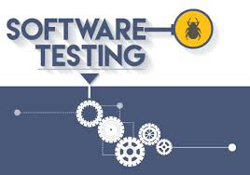
Testing Roles and Testing Process

Slide 3
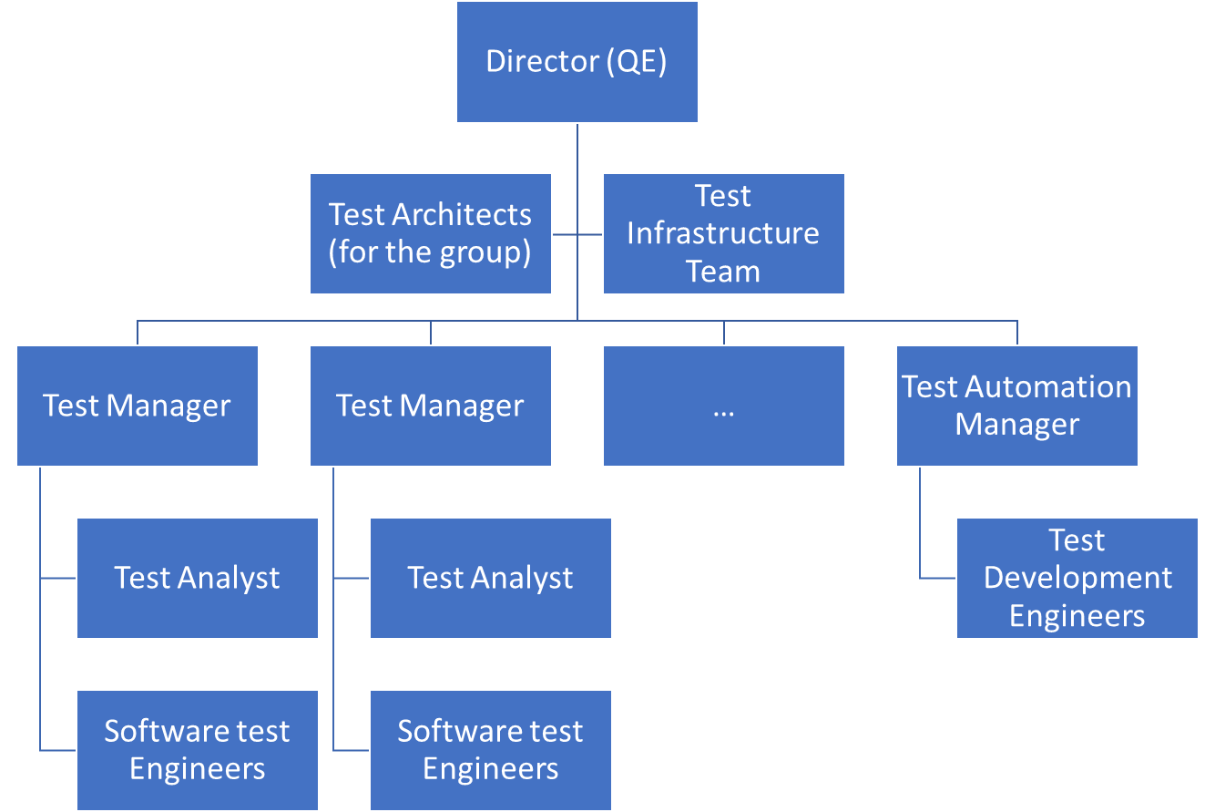
Structure of Testing Organization
Software testing typically is considered as being part of QE (Quality Engineering) and typically is executed from the QE organization
Given that the roles, responsibilities and the skills for the QE activity is different from the other groups, QE us typically organized as shown (some of the roles may/may not exist and they can be called differently too)
Notes:
https://www.testbytes.net/blog/software-testing-process/

Slide 4
Roles and Responsibilities
Role | Responsibilities
Test Director | Provide oversight, Co-ordination, Provide Strategic vision, High level Customer and stake holder connect
Test Manager | Prepare test strategy, plans for the project (or product) and monitor and control the testing process
Test Infrastructure Manager | Manages all of the infrastructure for the testing teams, capacity planning, maintenance, support, configurations
Test Automation Manager | Manages the development of tools when planned for and scripts for automating the tests as per plans.
Test Architect | Designs test infrastructure, helps picking the appropriate tools or helps driving the requirements for tools, supports, validates the test strategy being planned as part of test planning
Test Analyst | Supports mapping of customer environment and test conditions and features to testing conditions and documentation
Software Test Engineer | Tests the product or project system outcomes using the appropriate planned testing techniques and tools
Test Development Engineer | Develops tools and scripts for automating the tests planned
Notes:
https://www.testbytes.net/blog/software-testing-process/

Slide 5
Test Process
Testing is a process and goes through a Lifecycle with different steps
The activities of testing would have the following steps
Planning and Control
Analysis and Design
Implementation and Execution
Evaluate exit criteria & Reporting
Test Closure activities
Involves creating the Test Strategy
Creating Test Sufficiency criteria
Planning for resources and building a Schedule
Setup review points, status reporting mechanisms, approval boards ..
Analyze test requirements, product architecture and interfaces
Identify test conditions and design tests and test environment
Develop test cases, test data, test automation
Setting up the test completion/stopping criteria based on the application functionality and objectives E.g. Test cases, Pass percentage, Bug rate, Deadlines, RTM
Done when the testing is complete or project is cancelled
Verify all planned deliverables are completed, issues resolved
Archive all test scripts, environment and formally close with reports and do a retrospective
Execute tests, collect metrics, log results & compare with expected values.
Notes:
https://www.testbytes.net/blog/software-testing-process/

Slide 6
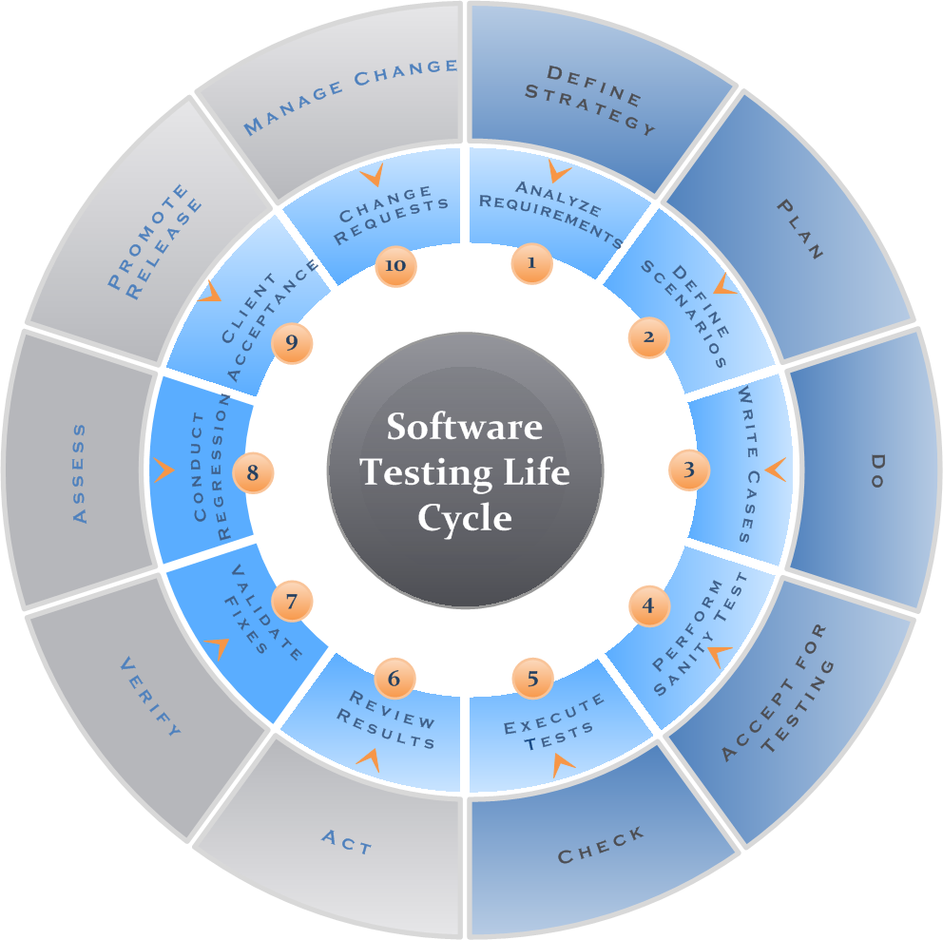
Software test life cycle
Picture : https://reqtest.com/testing-blog/the-a-to-z-guide-to-the-software-testing-process/
Notes:
https://www.testbytes.net/blog/software-testing-process/

Slide 7
Software test Execution
It’s the process of executing the code and comparing the actual observations of results to the predicted expected values.
The following are the actions typically taken for test execution:
Based on the context a subset of test cases is selected for execution in that test this cycle.
These test cases are then assigned to testers for execution.
Environment is setup-configured-test data is setup-steps for execution is noted, expected output looked at
Tests are executed, results logged, status captured and bugs logged.
In case testing is blocked, they are worked around or resolved and then continued. Bugs/issues are triaged and passed on to respective teams
Results reported, measurements done, metrics & test results analyzed
Notes:
https://www.testbytes.net/blog/software-testing-process/

Slide 8
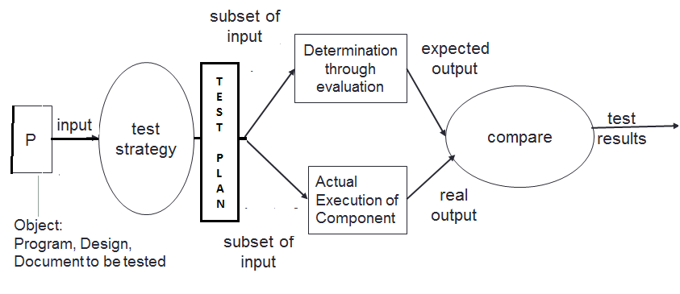
Test Execution Process

Slide 9
Test Execution Process (an example)

Slide 10
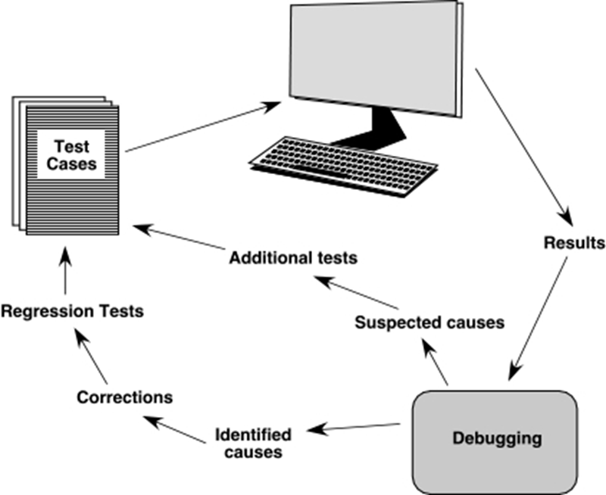
Process for debugging an issue during testing

Slide 12
Structure of Testing Organization
Software testing typically is considered as being part of QE (Quality Engineering) and typically is executed from the QE organization
Given that the roles, responsibilities and the skills for the QE activity is different from the other groups, QE us typically organized as below (some of the roles may/may not exist and they can be called differently too)
Director (QE)
Test Architects (for the group)
Test Manager
Test Manager
…
Test Analyst
Software test Engineers
Test Infrastructure Team
Test Analyst
Software test Engineers
Test Automation Manager
Test Development Engineers
Notes:
https://www.testbytes.net/blog/software-testing-process/

