Slide 1
SOFTWARE TESTING

Slide 2
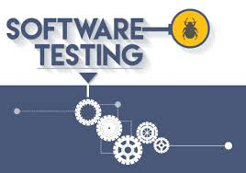
Software Test Measures, Metrics & Reliability
Test Tools and Practices

Slide 3
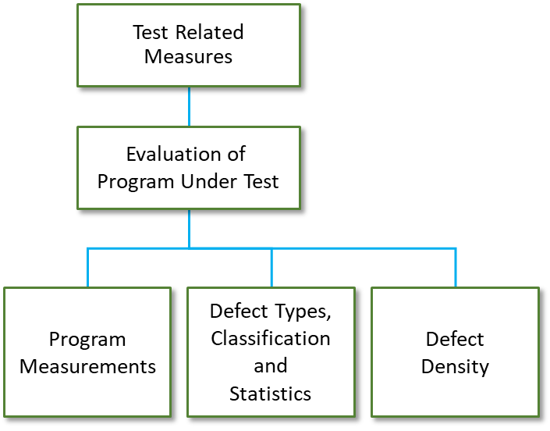
Software Test Measures and Metrics
Software Test Metric is a quantitative measure of the testing process indicating the progress, quality, productivity and the degree to which a system, system components possesses a given attribute.
The goal of software testing metrics is to improve the efficiency and effectiveness in the software testing process and to help make better decisions for further testing process by providing reliable data about the testing process
A program under test may be evaluated by gathering information on how many defects of a certain type are discovered and removed

Slide 4
Software Test Related Measurements
Measurements play a critical role in software quality assurance and testing.
Measurements are used as part of the project planning and monitoring for the optimization of planning, executing and monitoring of the test activities.
Data collected as a result of the measurements is used to evaluate the quality of the product under test and help achieve the quality standards, goals and objectives that are defined for the software product.
It can support defect analysis, which can help in improving the quality of the product in future phases of activities such as, estimate the cost & schedule of future projects
Measurements can be
Measures which represent the quality of the product
Measures towards test coverage which represent the thoroughness of the test set.

Slide 5
Software Test Related Measurements
There are other test-related measures that are used to support the testing activities
Product measures (e.g. size, complexity)
Process measures targeted to improve the efficiency of processes (e.g. number of test cases designed/phase)
Project progress related measures (e.g. Time spent/number of test cases developed)
Program measurements indicate the size and complexity of the product under test

Slide 6
Software Test Related Measurements
Defects are categorized according to severity and by type within each severity level. The severity ranges from causing the system to crash to a spelling mistake in an error message. The range of severity levels is often seen as Critical, Major, Minor, Low
Defect density is a measure of the total known defects divided by the size of the software entity being measured.

Slide 7
Software Test Related Measures – Product Related
Metrics | Description
SLOC | Size in lines of code
Fault Density | The ratio of # of faults found to the size of the programs(bugs/LOC). Higher density represents lower quality
MTBF | Mean time between failure measured in hours. Based on statistical analysis that indicate the probability of failure
Failure Rate | Inverse of MTBF
Defect Distribution | % of defects attributed to a specified phases in SDLC
Defect Density of modules | The ration of # of faults found in the module to the total faults found in the product
Defect Leakage | Indicates test efficiency = (Total Number of Defects Found in UAT/ Total Number of Defects Found Before UAT) x 100

Slide 8
Software Test Coverage Metrics – Product Related
Metrics | Description
Percent Test Coverage | Includes: Statement Coverage, Branch/Decision Coverage, Condition Coverage, Loop Coverage, Path Coverage, Data Flow Coverage, etc.
Percent Injected Fault Discovered | Number of defects injected found, compared to total number of faults injected.
Mutation Score | Number of killed mutants to the total number of mutants. Again, any mutant left alive points to the weakness in the testing effort.
Percent completed and Percent Defects corrected | # of test cases executed and closed compared to total # of test cases & # of defects fixed/closed compared to total # of defects
Defect Removal Effectiveness | % of defects found at the later phase of development.
Requirement Compliance Factor | Using the traceability matrix, the RCF measures the coverage provided by a test case to one or set of requirements.
Defect Discovery Rate | Number of defects found per line of code (LOC).
Defect Removal Cost | The cost associated with finding and fixing a defect.
Cost of Quality | Total cost of prevention, appraisal, rework/failure, to the total cost of the project.

Slide 9
Software Reliability
Software reliability is the probability of failure-free software operation for a specified period of time in a specified environment

Slide 10
Test Driven Development (TDD)
Prevention Model
First write the tests, then do the design/implementation
Could be done as part of some of the agile approaches like XP
Supported by tools, e.g. JUnit
Is more than a mere test technique; it subsumes part of the design work

Slide 11
Steps of TDD
Add a test
Run this and the earlier tests, and see that the system fails
Make a small change to make the test work
Run all tests again, and see they all run properly
Refactor the system to improve its design and remove redundancies

Slide 12
Tools - Selenium
Selenium automation suite has four main offerings:
Selenium IDE
Selenium RC
Selenium WebDriver
Selenium Grid

Slide 13
Tools - Why Selenium?
1: Open source
2. Highly extensible
3. Can run tests across different browsers
4. Supports various operating systems
5. Supports mobile devices
6. Can execute tests in parallel.

Slide 14
Tools - Short Comings of Selenium
1: Can only test web applications
2. Has no built-in object repository
3. Automates at a slower rate because it does not have a native IDE and only third party IDE can be used for development
4. Data-driven testing is more cumbersome since you have to rely on the programming language's capabilities for setting values for your test data
5. Cannot access elements outside of the web application under test
6. No official user support is being offered.

Slide 15
Tools - Junit
JUnit is a simple framework to write repeatable tests. It is an instance of the xUnit architecture for unit testing frameworks.
JUnit is a unit testing framework for Java programming language.
No need to manually verify and tally results. Saves vital man hours and faster product deployment.
JUnit test framework provides the following important features −
Fixtures
Test suites
Test runners
JUnit classes

Slide 16
Tools - Some Annotations used in Junit
@Before Used to execute some statement such as a precondition before each test case
@BeforeClass Used to execute some statements before all the test cases.
@After Used to execute some statements after each test case ; eg. resetting variables, deleting variables.
@AfterClass Used to execute some statements after all the testcases ; eg. releasing resources.
@Ignore Used to ignore some statements during test execution; eg. to ignore a particular test case during test execution.

Slide 17
Tools - Advantages of Junit
Alternate front ends to display results of tests are available
Separate class loaders for each unit test to avoid side effects
Provides methods like setUp and tearDown for standard resource initialization
Set of assert methods to check results of tests
Integration with popular tools such as Ant and Maven and IDEs like Eclipse and Jbuilder

Slide 18
Tools - Shortcomings of Junit
Cannot do, dependency testing
Not suitable for high level testing
Large test suites
Cannot test various JVMs at the same time

Slide 19
Tools - Apache JMeter
The Apache JMeter™ application is open source software, a 100% pure Java application designed to load test functional behavior and measure performance.
It was originally designed for testing Web Applications but has since expanded to other test functions.
Run on any environment /workstation that accepts a JVM
JMeter simulates a group of users sending requests to a target server, and return statistics information of target server through graphical diagrams

Slide 20
Tools - Elements in Apache JMeter
The different components of JMeter are called Elements:
Thread Group
Samplers
Listeners
Configuration

Slide 21
Tools - Advantages Apache JMeter
Open source
Friendly UI
Platform Independent
Multi-threading framework
Highly extensible
Visualize test result
Unlimited testing capabilities, Easy installation, Support multi protocol

Slide 22
Tools – Shortcomings of JMeter
Scripting in JMeter requires some level of expertise and understanding of JMeter elements, regular expressions, session handling etc.
It does not have a network visualization feature unlike other performance testing tools like Loadrunner.
A single normal configuration machine is not sufficient for carrying out load test with a large number of users. In such cases either a very high configuration cloud machine is required or distributed testing is performed.
It does not support ajax, javascript and flash, neither it renders web elements like a browser.
It provides very limited real-time test monitoring capability as compared to other tools.

