Slide 1

Simulation Based Assignment
Student Name: Jnanesh Vavilala
Student ID : 11612652
Email Address: jnaneshvavilala007@gmail.com
GitHub Link:
Faculty Name: Shivali Chopra
Course Code : CSE 316
Lovely Professional University , Punjab

Slide 2
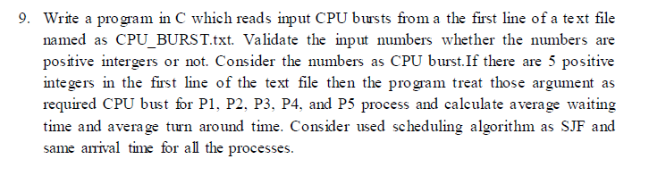
Question 1:
Description :
Shortest job first is a scheduling algorithm in which the process
with the smallest execution time is selected for execution next
Shortest job first depends on the average running time of the processes. The accurate estimates of these measures help in the implementation of the shortest job first in an environment.
This is because often the execution burst of processes does not happen beforehand. It can be used in interactive environments where past patterns are available to determine the average time between the waiting time and the commands

Slide 3
These are completion times of the processes:
1.The process P1 finished at 7.
2.The process P2 finished at 3.
3.The process P3 finished at 6.
4.The process P4 finished at 9.
5.The process P5 finished at 1.
Gantt Chart :
P5 | P2 | P1 | P3 | P4
0 1 3 7 13 22
Avg Turn Around Time=([1-0]+[3-0]+[7-0]+[13-0]+[22-0])/5
= 9.20
Avg Waiting Time=([1-1]+[3-2]+[7-4]+[13-6]+[22-9])/5
=(24)/5 = 4.80
Constraints :
Arrival Time Burst Time
0 1
0 2
0 4
0 6
0 9

Slide 4
Code Snippet :
#include<stdio.h>
main()
{ starting :
printf("1.SJF\n2.Change values in file\n3.Exit\nEnter your choice : ");
int x,y,z,i,j;
float avg_tt,avg_wt;
FILE *ptr;
scanf("%d",&x);
switch(x)
{
case 1 :
{
int at=0,bt[5],ct[5],tt[5],wt[5],pid[5];
printf("Reading burst times of processes from file........\n\n");
ptr=fopen("Burst.txt","rb");
for(y=0;y<5;y++)
{
fread(&z,sizeof(z),1,ptr);
bt[y]=z;
pid[y]=y+1;
}
printf("Read Successful......\n");
for(i=0;i<4;i++)
for(j=0;j<4-i;j++)
if(bt[j]>bt[j+1])
{
int temp=bt[j];
bt[j]=bt[j+1];
bt[j+1]=temp;
temp=pid[j];
pid[j]=pid[j+1];
pid[j+1]=temp;
}

Slide 5
printf("\nImplementing Shortest Job First Algorithm...........\n\n");
ct[0]=at+bt[0];
tt[0]=ct[0]-at;
wt[0]=tt[0]-bt[0];
avg_tt=tt[0];
avg_wt=wt[0];
for(y=1;y<5;y++)
{
ct[y]=bt[y]+ct[y-1];
tt[y]=ct[y]-at;
wt[y]=tt[y]-bt[y];
avg_tt+=tt[y];
avg_wt+=wt[y];
}
fclose(ptr);
printf("Process_id Burst_time Completion_time Turnaround_time Waiting_time\n");
printf("-----------------------------------------------------------------------------------------------------------\n");
for(i=0;i<5;i++)
printf(" P%d %d %d %d %d\n",pid[i],bt[i],ct[i],tt[i],wt[i]);
printf("Average TurnAround_Time :%.2f\n",avg_tt/5.00);
printf("Average Waiting Time :%.2f\n",avg_wt/5.00);
goto starting;
}

Slide 6
case 2:
{
printf("Enter Values to Write in file : \n");
ptr=fopen("Burst.txt","wb");
for(i=0;i<5;i++)
{
scanf("%d",&y);
fwrite(&y,sizeof(y),1,ptr);
}
fclose(ptr);
goto starting;
}
case 3:
return 0;
}
}

Slide 7
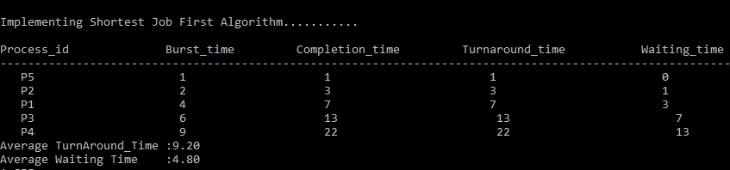
Test Case :
Assumed Test Case
Have you made minimum 5 revisions of solution on GitHub? Yes
GitHub Link:

Slide 8
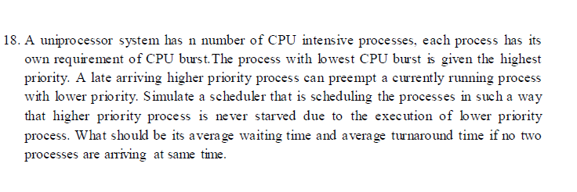
Question 2:
Description :
An operating system uses Shortest Remaining Time First(SRT) process scheduling algo.Consider the arrival times and execution times for the following processes:
These are completion times of the processes:
1.The process P1 finished at 17.
2.The process P2 finished at 5.
3.The process P3 finished at 26.
4.The process P4 finished at 10.

Slide 9
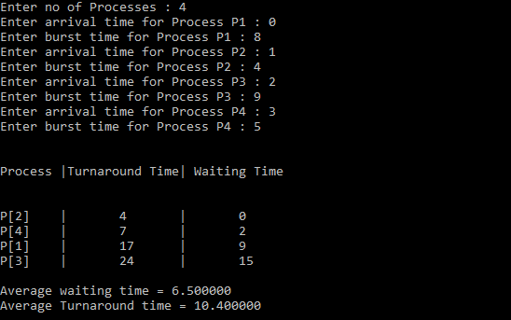
Now we add the concepts of varying arrival times and preemption to the analysis
Process Arrival Time Burst Time
P1 0 8
P2 1 4
P3 2 9
P4 3 5
Gantt Chart :
Average waiting time =
[(10-1)+(1-1)+(17-2)+(5-3)]/4 = 26/4 = 6.5 msec
P1 | P2 | P4 | P1 | P3
0 1 5 10 17 26

Slide 10
Code Snippet :
#include<stdio.h>
int main()
{
int arrival_T[10],burst_T[10],rt[10],endTime,i,smallest;
int remain=0,n,j,avgwait=0,avgturnaround=0;
printf("Enter no of Processes : ");
scanf("%d",&n);
for(i=0;i<n;i++)
{
printf("Enter arrival time for Process P%d : ",i+1);
scanf("%d",&arrival_T[i]);
printf("Enter burst time for Process P%d : ",i+1);
scanf("%d",&burst_T[i]);
rt[i]=burst_T[i];
}
printf("\n\nProcess\t|Turnaround Time| Waiting Time\n\n");
rt[9]=9999;
for(j=0;remain!=n;j++)
{
smallest=9;
for(i=0;i<n;i++)
{
if(arrival_T[i]<=j && rt[i]<rt[smallest] && rt[i]>0)
{
smallest=i;
}
}

Slide 11
Code Snippet :
rt[smallest]--;
if(rt[smallest]==0)
{
remain++;
endTime=j+1;
printf("\nP[%d]\t|\t%d\t|\t%d",smallest+1,endTime-arrival_T[smallest],endTime-burst_T[smallest]-arrival_T[smallest]);
avgwait+=endTime-burst_T[smallest]-arrival_T[smallest];
avgturnaround+=endTime-arrival_T[smallest];
}
}
printf("\n\nAverage waiting time = %f\n",avgwait*1.0/n);
printf("Average Turnaround time = %f",avgturnaround*1.0/5);
return 0;
}

Slide 12
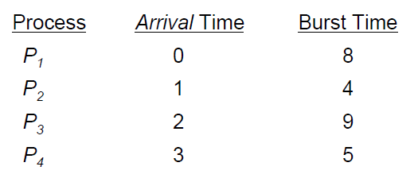
Test Case :
This is the given default test case for reference.
Have you made minimum 5 revisions of solution on GitHub? Yes
GitHub Link:

