Slide 1

AGENTIC MANDI TESTERS
AI Powered API
Documentation and Testing Portal
Turning raw API definitions into documentation, sample requests, test cases, and actionable error guidance.
TEAM
Raghav Satija (Roll No. 311)
Jnanesha V (Roll No. 383)
Thanush M (Roll No. 315)
AI Powered API Documentation and Testing Portal
1

Slide 2



THE PROBLEM
Problem Statement & Real-World Impact
Build a working solution for an AI-Powered API Documentation and Testing Portal that takes relevant input data, processes it through a clear workflow, and produces an actionable output for real users or decision-makers. The solution should not stop at code execution — it should help a user understand what action to take next.
Docs go stale or never get written
Edge-case tests are repetitive
Raw errors don't say what to fix
Teams skip writing developer docs under deadline pressure, leaving new endpoints undocumented.
Manually enumerating auth/validation/not-found cases for every route is tedious and error-prone.
A bare '422 Unprocessable Entity' tells a developer nothing actionable about the next step.
Real-world impact: faster onboarding for new developers, fewer support tickets caused by unclear errors, and a CI-ready test suite generated in minutes instead of days.
AI Powered API Documentation and Testing Portal
2

Slide 3
STARTER DATA
Dataset & Reference Material
data/endpoints.json — 100 realistic endpoint records across 20 resources
20 RESOURCES COVERED
Field | Meaning
method | HTTP verb: GET, POST, PUT, DELETE
path | Route, incl. path params e.g. /orders/{order_id}
description | Short summary of intent
request_body | Expected input fields & types
response_body | Returned fields & types
auth_required | Boolean — needs Authorization header
error_codes | List of possible HTTP error statuses
users · products · orders · payments · invoices · categories · reviews · carts · addresses · notifications · auth · wishlists · coupons · shipments · suppliers · warehouses · tickets · messages · subscriptions · reports
100
20
5
Endpoint records
Resources
CRUD ops / resource
Plus an error_code_reference table (400–500) shared across all endpoints, and support for uploading real OpenAPI/Swagger specs or FastAPI/Flask source files instead of the starter set.
AI Powered API Documentation and Testing Portal
3

Slide 4






ARCHITECTURE
System Workflow
User
Streamlit UI
FastAPI Backend
Parser
AI Engine
Actionable Output
uploads / pastes routes
input + results display
session + routing
OpenAPI / .py / text → schema
docs · tests · error explain
docs, tests, fixes
PROCESSING PATH
LIVE TESTING PATH
Upload OpenAPI / .py / paste text
Parser normalizes to a common schema
AI Engine generates docs + tests per endpoint
Results rendered in Streamlit, ready to copy into code/CI
User enters a real base URL + headers/body
Backend calls the live API via httpx
On failure, AI explains cause + fix in plain English
User knows exactly what to change next
AI Powered API Documentation and Testing Portal
4

Slide 5

THE AI LAYER
AI / Agent Innovation — Where & Why
1. Documentation Generator
2. Test-Case Generator
3. Error Explainer
Reads the sparse schema (method, path, body) and writes human prose: purpose, plain-English field explanations, sample request/response, usage notes & gotchas.
Infers which edge cases a schema implies — missing auth, invalid payload, not-found id — and emits runnable pytest snippets, not just descriptions.
Given a real failed response (status + body), explains the likely cause, plain-English meaning, and a concrete suggested fix — the actionable output.
Why this matters: any OpenAI-compatible LLM endpoint (OpenAI or NVIDIA NIM) plugs in unchanged. Every AI feature also has a deterministic template fallback, so the portal runs end-to-end with zero API key — reliable for demos with no internet, and a clear illustration that the AI adds reasoning on top of a working system, not a dependency it can't function without.
AI Powered API Documentation and Testing Portal
5

Slide 6
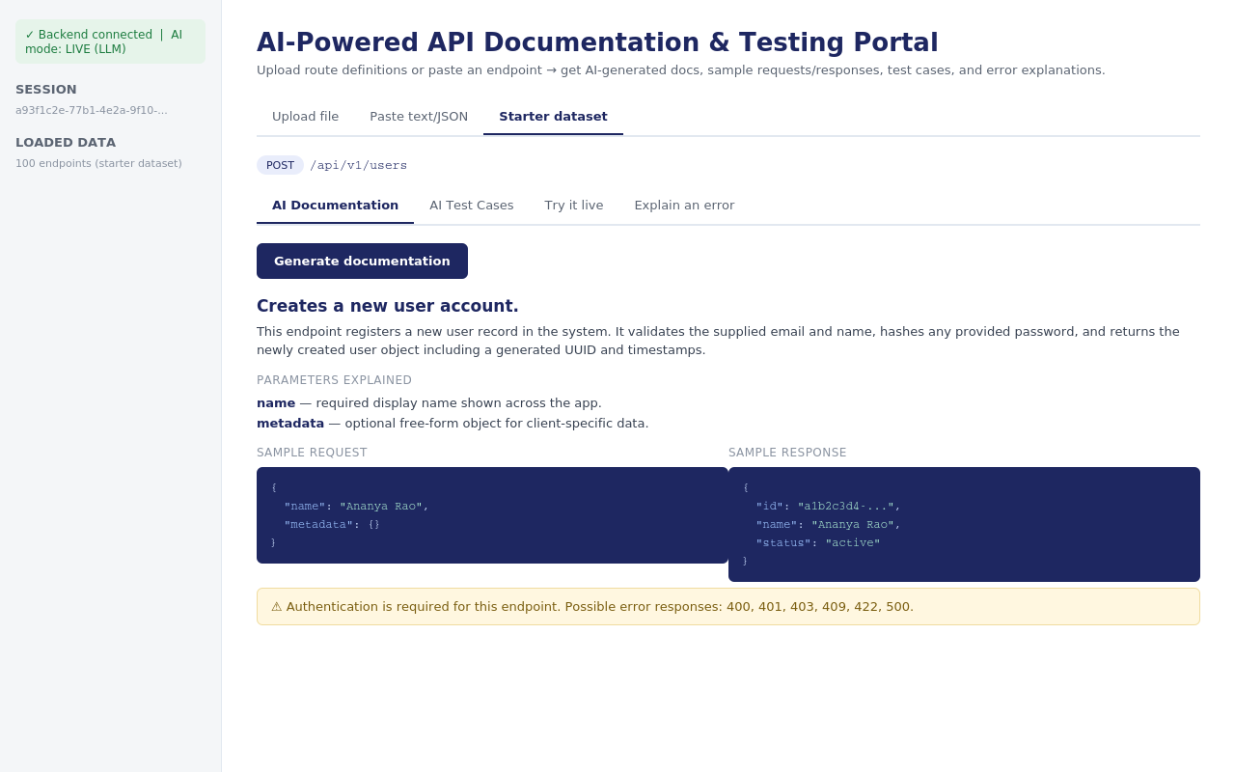
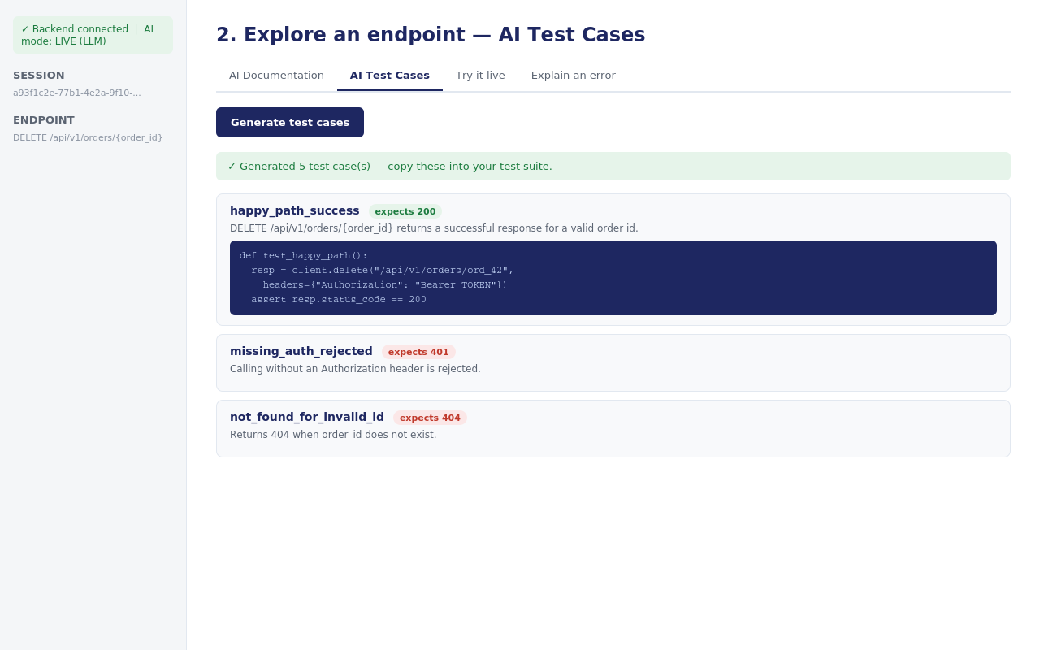
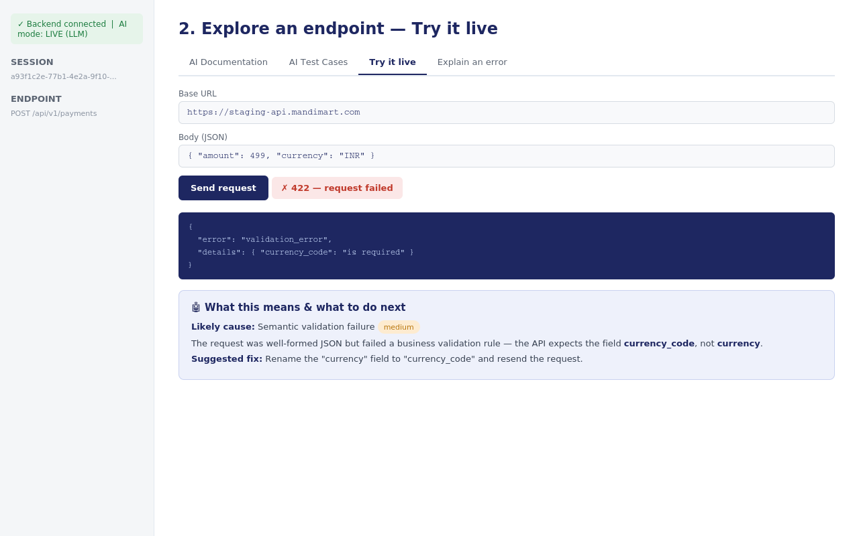
WORKING PROTOTYPE
Demo Screenshots
AI-generated documentation
AI-generated test cases
Live call + AI error explanation
All three screens share one Streamlit session: load endpoints once, then switch tabs per endpoint to generate docs, tests, run a live call, or decode any error.
1
Load endpoints
2
Pick one
3
Generate / Test / Try it
4
Act on the result
AI Powered API Documentation and Testing Portal
6

Slide 7
SAMPLE OUTPUT
Results — From One Endpoint Definition
INPUT
PORTAL-WIDE RESULTS
POST /api/v1/payments
100
endpoints documented from the starter dataset in one batch-ready run
{
"method": "POST",
"path": "/api/v1/payments",
"request_body": {"amount": "number", "currency_code": "string"},
"auth_required": true,
"error_codes": [400,401,403,409,422,500]
}
~5
test cases generated per endpoint, covering auth, validation & not-found
OUTPUT (AI-GENERATED)
3
input formats supported: OpenAPI/Swagger, FastAPI/Flask source, freeform text
Plain-English doc: “Creates a payment for the supplied amount and currency.”
5 test cases: happy path, missing auth, invalid payload, not-found, duplicate
Runnable pytest snippet per test case
Error fix: “rename 'currency' to 'currency_code'” on a live 422
0
API keys required to run the full demo — template fallback covers every feature
AI Powered API Documentation and Testing Portal
7

Slide 8


HONEST SCOPE
Limitations & Responsible Use
Known Limitations
Responsible Use Practices
In-memory session storage
No secrets are stored
Loaded endpoints reset when the backend restarts — fine for a demo, not for production multi-user use.
Auth tokens entered in 'Try it live' are used only for that single request, never persisted.
Heuristic Python parser
Live calls are user-initiated only
Regex-based FastAPI/Flask route extraction won't catch every code style or dynamic route registration.
The portal never calls a real API unless the user explicitly enters a base URL and clicks send.
AI can be wrong
Always review before production
Generated docs, tests and fixes are a strong starting draft, not a substitute for human review before shipping.
Generated test cases and docs should be reviewed by a developer before merging into CI or shipping to users.
AI Powered API Documentation and Testing Portal
8

Slide 9



ROADMAP
Future Improvements
Persistent storage
Auto-run generated tests
Multi-user collaboration
Move from in-memory sessions to a real database so teams can share and revisit projects.
Execute the generated pytest suite directly against a staging API and show pass/fail inline.
Accounts, shared workspaces, and comment threads on individual endpoints.
CI/CD integration
Agentic regression watch
Versioned doc history
Export generated tests straight into a GitHub Actions workflow on every PR.
An agent that periodically re-tests live endpoints and flags breaking changes automatically.
Track how an endpoint's docs/behavior changed release over release.
AI Powered API Documentation and Testing Portal
9

Slide 10

CONCLUSION
From Raw Endpoints to Action — In One Portal
The portal takes whatever API definition a developer already has — OpenAPI, source code, or a quick paste — and turns it into documentation, runnable tests, and concrete error fixes. The AI layer doesn't just generate text; it closes the loop by telling the user exactly what to do next, which is what makes the output actionable rather than just generated.
AGENTIC MANDI TESTERS
Raghav Satija
Roll No. 311
Jnanesha V
Roll No. 383
Thanush M
Roll No. 315
Working end-to-end prototype
Clear AI/agent justification
Runs with or without an API key
Real, testable starter dataset
Thank you.
AI Powered API Documentation and Testing Portal
10

