Slide 1

Venezuela → Stamford, CT
10 yrs Graphic Designer
Family’s “tech person”
Hobbies: Games, Music, Movies
Creative + Always Learning

Slide 2


🇻🇪 Venezuela → Stamford, CT
10 yrs Graphic Designer
Family’s “tech person”
Hobbies: Games, Music, Movies
Creative + Always Learning
Notes:
Hi everyone, my name is Javier Napoles. //
I was born and raised in Venezuela and for the past 5 years I’ve been living here in Stamford. //
I’ve spent about 10 years working as a graphic designer, mostly focusing on design and video editing. But in my family, I was always the “tech guy” — the one curious about how things work and how to keep information safe.//
Outside of work, I’m into video games, music and movies. I would say I’m creative, I love learning new things, and I’m working on being more organized and disciplined.

Slide 3

Goals & Aspirations
Immediate Goal
Master SOC Analyst skills: SIEM tools, monitoring systems, incident triage, and threat intelligence integration
Soft Skills Development
Enhance communication abilities and adaptability in high-pressure security environments
Long-Term Vision
Advance from Network Security to Penetration Testing — building both defensive and offensive cybersecurity expertise
Building a complete security mindset through continuous skill development
Notes:
In the short term, my main goal is to dive into cybersecurity and build up my SOC Analyst skills.// That means learning to use SIEM tools, analyze alerts, triage incidents, and apply threat intelligence.
I’ve also learned it’s not just about technical skills. Communication and teamwork are just as important if you want to be effective in this field.
Looking ahead, I want to move into Network Security and eventually Pentesting. That way, I will understand both sides, How to defend networks and how to test their weaknesses.

Slide 4
Why Cybersecurity?
Constant Evolution
The field demands continuous learning and adaptation to new threats and technologies
Daily Variety
Each day brings unique challenges and scenarios — no two security incidents are identical
Perfect Skill Match
My natural curiosity and adaptability directly translate to effective security analysis
Notes:
I chose cybersecurity because it’s a field where you never stop learning. //
Every day brings something new—different problems, different threats, and the chance to find creative solutions. //
What excites me the most is that curiosity and adaptability really matter here and those are traits I’ve always connected with.

Slide 5
Current Project: Divide & Defend
SOC Lab with Micro-Segmentation
Alert Analysis
SIEM Deployment
Identifying and categorizing security alerts across segmented network zones
Configuring and optimizing security information and event management tools
Incident Triage
Threat Intelligence
Determining severity and appropriate response paths for security events
Applying current threat data to enhance detection and prevention measures
Notes:
Right now, I’m working on a project I named Divide & Defend: A SOC Lab Project. It simulates the responsibilities of a SOC Analyst.
My role is to analyze alerts, use SIEM tools, triage incidents, and apply threat intelligence.
The biggest challenge has been learning so much in such a short time, but this has pushed me to adapt quickly and stay focused.
What I enjoy most is applying theory to real-world practice.

Slide 6
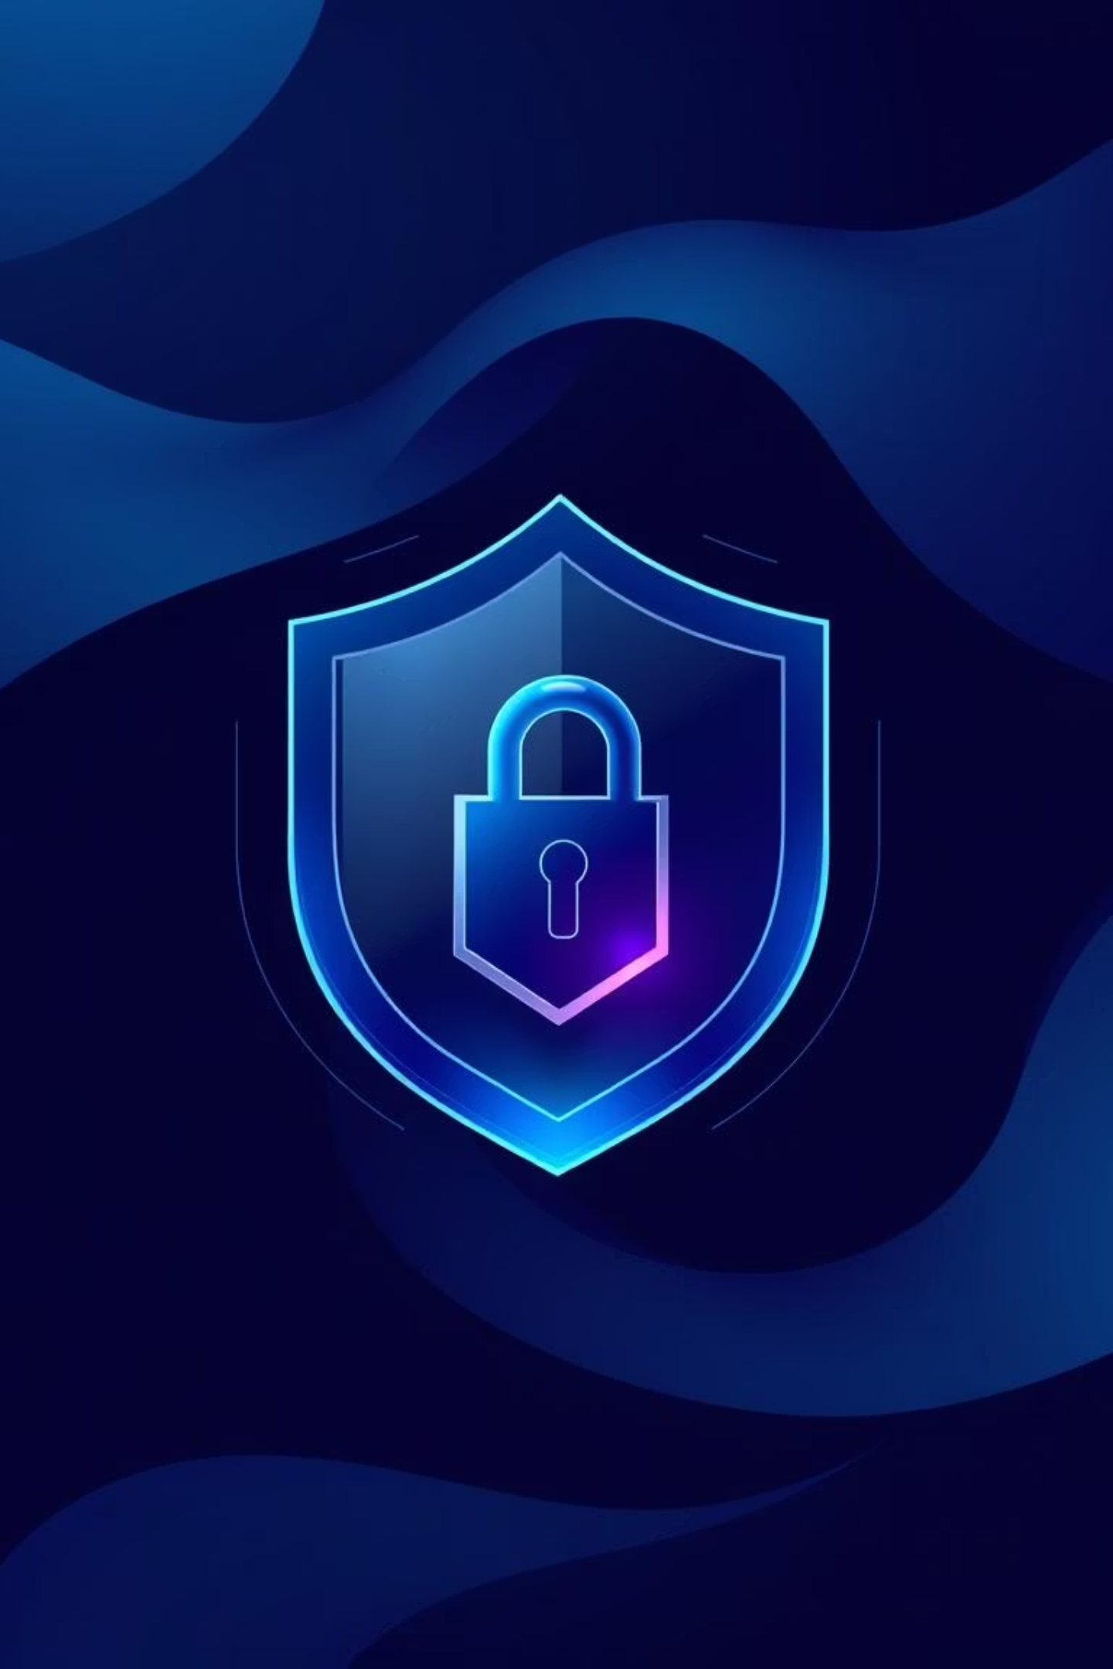
Conclusion
• Grow as cybersecurity professional
• Creativity + Problem-Solving
• Better life through learning
• Keep improving every day
Notes:
To wrap up//
my goal is to keep growing as a cybersecurity professional, combining creativity with problem-solving.
For me, this career path isn’t just about protecting digital environments, it’s also about building a better future for myself, while continuing to learn and improve every day.

Slide 7

Thank You
Javier Napoles | jnapfx@gmail.com

