Slide 1

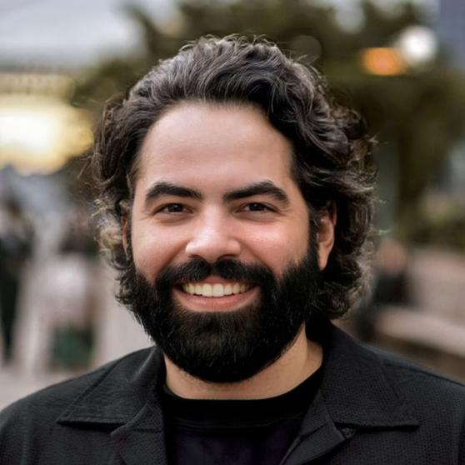

My Journey Into Cybersecurity
Javier Napoles
A creative professional's path from graphic design to securing digital landscapes, blending creativity with technical defense skills.

Slide 2



Who I Am
Core Identity
Background
Born and raised in Venezuela, now based in Stamford, Connecticut
Growth
Creativity
Curiosity
Always curious about technology & protecting information — a natural progression from creating content to securing it.
Professional Experience
10 years in graphic design & video editing, developing creative solutions and visual storytelling
Personal Interests
Passionate about video games, music, and films — creative outlets that inspire my technical approach

Slide 3

Goals & Aspirations
Immediate Goal
Master SOC Analyst skills: SIEM tools, monitoring systems, incident triage, and threat intelligence integration
Soft Skills Development
Enhance communication abilities and adaptability in high-pressure security environments
Long-Term Vision
Advance from Network Security to Penetration Testing — building both defensive and offensive cybersecurity expertise
Building a complete security mindset through continuous skill development

Slide 4

Why Cybersecurity?
Constant Evolution
The field demands continuous learning and adaptation to new threats and technologies
Daily Variety
Each day brings unique challenges and scenarios — no two security incidents are identical
Perfect Skill Match
My natural curiosity and adaptability directly translate to effective security analysis
The cybersecurity landscape is like a complex puzzle that constantly rearranges itself — ideal for someone who thrives on creative problem-solving.

Slide 5
Current Project: Divide & Defend
SOC Lab with Micro-Segmentation
Alert Analysis
SIEM Deployment
Identifying and categorizing security alerts across segmented network zones
Configuring and optimizing security information and event management tools
Incident Triage
Threat Intelligence
Determining severity and appropriate response paths for security events
Applying current threat data to enhance detection and prevention measures
Primary Challenge:

Slide 6

The Creative Defender
Creative Perspective
Technical Discipline
Bringing a designer's eye to security visualization and threat pattern recognition
Applying methodical analysis and procedural rigor to security operations
Problem Solving
Leveraging both analytical and creative thinking to solve complex security challenges
My unique journey from creative professional to cybersecurity specialist equips me with a distinctive approach to digital protection.

Slide 7

Thank You
Javier Napoles | jnapfx@gmail.com
Dedicated to mastering SOC analysis and threat response
Committed to learning and evolving in the security field
Driven by a passion to safeguard digital environments

