Slide 1
Introduction to the Database System
Lec 1

Slide 2
Database Architecture
A database-management system (DBMS) is a collection of interrelated data and a set of programs to access those data.
The collection of data, usually referred to as the database, contains information relevant to an enterprise.
The primary goal of a DBMS is to provide a way to store and retrieve database information that is both convenient and efficient.
Database systems are designed to manage large bodies of information. Management of data involves both defining structures for storage of information and providing mechanisms for the manipulation of information.
Notes:
In addition, the
database system must ensure the safety of the information stored, despite system
crashes or attempts at unauthorized access. If data are to be shared among several
users, the system must avoid possible anomalous results.

Slide 3
Database-System Applications
Enterprise Information
Banking and Finance
Universities
Airlines
Telecommunication

Slide 4
Purpose of Database Systems
Database systems arose in response to early methods of computerized management of commercial data.
In 1960s, before DBMSs, system programmers use file-processing system and wrote programs that manipulates files.
Keeping organizational information in a file-processing system has a number of major disadvantages:
Data redundancy and inconsistency
Difficulty in accessing data
Data isolation
Integrity problems
Atomicity problems
Concurrent-access anomalies
Security problems
So what is now the purpose of DBMS?
Notes:
---A database system is a collection of interrelated data and a set of programs that
allow users to access and modify these data.
---A major purpose of a database
system is to provide users with an abstract view of the data. That is, the system
hides certain details of how the data are stored and maintained.

Slide 5
View of Data
Data Abstraction
For the system to be usable, it must retrieve data efficiently.
The need for efficiency has led designers to use complex data structures to represent data in the database.
Developers hide the complexity from users through several levels of abstraction
Physical level
Logical level.
View level

Slide 6
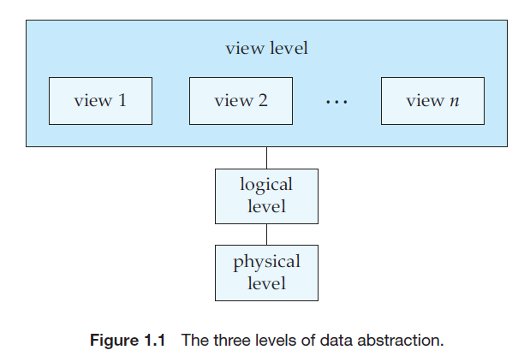
View of Data cont.
describes only part of the entire
database
Describes what data are
stored in the database, and what relationships exist among those data.
describes how the data are actually
stored.
Notes:
Example: Let’s say we are storing customer information in a customer table.
At physical level these records can be described as blocks of storage (bytes, gigabytes, terabytes etc.) in memory. These details are often hidden from the programmers.
At the logical level these records can be described as fields and attributes along with their data types, their relationship among each other can be logically implemented. The programmers generally work at this level because they are aware of such things about database systems.
At view level, user just interact with system with the help of GUI and enter the details at the screen, they are not aware of how the data is stored and what data is stored; such details are hidden from them.

Slide 7
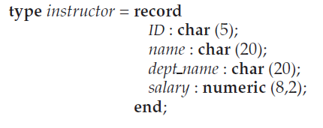
View of Data cont.
This code defines a new record type called instructor with four fields. Each field
has a name and a type associated with it.
Notes:
--- A university organization may have several such record types, including
* department, with fields dept name, building, and budget
• course, with fields course id, title, dept name, and credits
• student, with fields ID, name, dept name, and tot cred
--At the physical level, an instructor, department, or student record can be described
as a block of consecutive storage locations. The compiler hides this level
of detail from programmers. Similarly, the database system hides many of the
lowest-level storage details from database programmers. Database administrators,
on the other hand, may be aware of certain details of the physical organization
of the data.
---At the logical level, each such record is described by a type definition, as
in the previous code segment, and the interrelationship of these record types is
defined as well. Programmers using a programming language work at this level
of abstraction. Similarly, database administrators usually work at this level of
abstraction.
---at the view level, computer users see a set of application programs
that hide details of the data types. At the view level, several views of the database
are defined, and a database user sees some or all of these views. In addition
to hiding details of the logical level of the database, the views also provide a
security mechanism to prevent users from accessing certain parts of the database.
For example, clerks in the university registrar office can see only that part of the
database that has information about students; they cannot access information
about salaries of instructors

Slide 8
Database Languages
A database system provides a data-definition language to specify the database schema and a data-manipulation language to express database queries and updates.
In practice, the data-definition and data-manipulation languages are not two separate languages; instead they simply form parts of a single database language, such as the widely used SQL language.

Slide 9
Database Languages cont.
Data-Manipulation Language
is a language that enables users to access or manipulate data as organized by the appropriate data model.
Retrieval of information stored in the database
Insertion of new information into the database
Deletion of information from the database
Modification of information stored in the database
2 types:
Procedural DMLs
Declarative DMLs (nonprocedural)
query
Notes:
---Procedural DMLs require a user to specify what data are needed and how to
get those data.
---Declarative DMLs (also referred to as nonprocedural DMLs) require a user to
specify what data are needed without specifying how to get those data.
---A query is a statement requesting the retrieval of information. The portion of
a DML that involves information retrieval is called a query language. Although
technically incorrect, it is common practice to use the terms query language and
data-manipulation language synonymously

Slide 10
Database Languages cont.
Data-Definition Language
We specify a database schema by a set of definitions expressed by a special language called a data-definition language (DDL). The DDL is also used to specify additional properties of the data.
We specify the storage structure and access methods used by the database system by a set of statements in a special type of DDL called a data storage and definition language.
define the implementation details of the database schemas, which are usually hidden from the users.
The data values stored in the database must satisfy certain consistency constraints.
Notes:
---For example, suppose the university requires that the account balance
of a department must never be negative. The DDL provides facilities to specify
such constraints. The database system checks these constraints every time the
database is updated. In general, a constraint can be an arbitrary predicate pertaining
to the database

Slide 11
Database Languages cont.
Database systems implement integrity constraints that can be tested with minimal overhead:
Domain Constraints
User inputs should match the attribute type of a certain table
Referential Integrity
The reference record used from another table should exists
Assertions
any condition that the database must always satisfy
Authorization
read
Insert
Update
delete

Slide 12
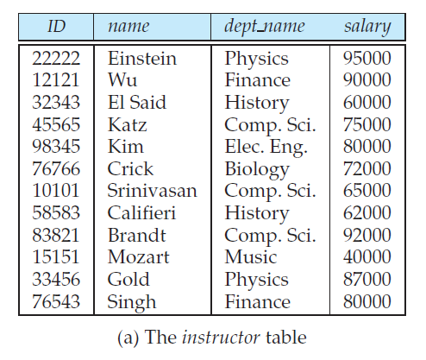
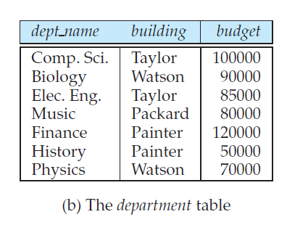
Relational Database
A sample relational database.
A relational database is based on the relational model and uses a collection of tables to represent both data and the relationships among those data. It also includes a DML and DDL.
Tables
Each table has multiple columns and each column has a unique name.

Slide 13
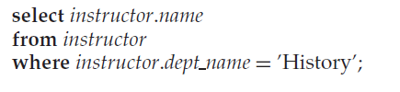
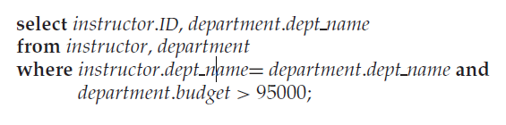
Relational Database cont.
Data-Manipulation Language
The SQL query language is nonprocedural. A query takes as input several tables (possibly only one) and always returns a single table.
Notes:
--- If the above query were run on the tables in Figure 1.2, the system would find
that there are two departments with budget of greater than $95,000—Computer
Science and Finance; there are five instructors in these departments. Thus, the
result will consist of a table with two columns (ID, dept name) and five rows:
(12121, Finance), (45565, Computer Science), (10101, Computer Science), (83821,
Computer Science), and (76543, Finance).

Slide 14
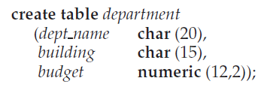
Relational Database cont.
Data-Definition Language
SQL provides a rich DDL that allows one to define tables, integrity constraints, assertions, etc.
Notes:
--- Execution of the above DDL statement creates the department table with three
columns: dept name, building, and budget, each of which has a specific data type
associated with it.We discuss data types in more detail in Chapter 3. In addition,
the DDL statement updates the data dictionary, which contains metadata (see
Section 1.4.2). The schema of a table is an example of metadata

Slide 15
Database Design
The schema developed at this conceptual-design phase provides a detailed overview of the enterprise
Database systems are designed to manage large bodies of information
Database design mainly involves the design of the database schema
database designer needs to interact extensively with domain experts and users to carry out this task
the designer chooses a data model, and by applying the concepts of the chosen data model, translates these requirements into a conceptual schema of the database.

Slide 16
Database Design cont.
A fully developed conceptual schema indicates the functional requirements of the enterprise.
In a specification of functional requirements, users describe the kinds of operations (or transactions) that will be performed on the data.
Example operations include modifying or updating data, searching for and retrieving specific data, and deleting data. At this stage of conceptual design, the designer can review the schema to ensure it meets functional requirements.

Slide 17
Database Design cont.
Two final design phases
logical-design phase
The designer maps the high-level conceptual schema onto the implementation data model of the database system that will be used.
physical-design phase
The designer uses the resulting system-specific database schema from the logical-design phase, in which the physical features of the database are specified
Include the form of file organization and the internal storage structures;

Slide 18
Database Design cont.
DB Design for a University Organization
The university is organized into departments. Each department is identified by a unique name (dept name), is located in a particular building, and has a budget.
Each department has a list of courses it offers. Each course has associated with it a course id, title, dept name, and credits, and may also have associated prerequisites.
Instructors are identified by their unique ID. Each instructor has name, associated department (dept name), and salary.
Students are identified by their unique ID. Each student has a name, an associated major department (dept name), and tot cred (total credit hours the student earned thus far).
The university maintains a list of classrooms, specifying the name of the building, room number, and room capacity
The university maintains a list of all classes (sections) taught. Each section is identified by a course id, sec id, year, and semester, and has associated with it a semester, year, building, room number, and time slot id (the time slot when the class meets).
The department has a list of teaching assignments specifying, for each instructor, the sections the instructor is teaching.
The university has a list of all student course registrations, specifying, for each student, the courses and the associated sections that the student has taken (registered for).
Notes:
---A real university database would be much more complex than the preceding
design. However we use this simplified model to help you understand conceptual
ideas without getting lost in details of a complex design

Slide 19
Next meeting… Database Architecture

Slide 20
Database Architecture
Provides a single picture of the various components of a database systems and the connections among them.
The architecture of a database system is greatly influenced by the underlying computer system on which the database system runs.
Database systems can be centralized, or client-server, where one server machine executes work on behalf of multiple client machines.

Slide 21
Introduction to the Database System
Lec 2

Slide 22
Database Architecture
Provides a single picture of the various components of a database systems and the connections among them.
The architecture of a database system is greatly influenced by the underlying computer system on which the database system runs.
Database systems can be centralized, or client-server, where one server machine executes work on behalf of multiple client machines.

Slide 23
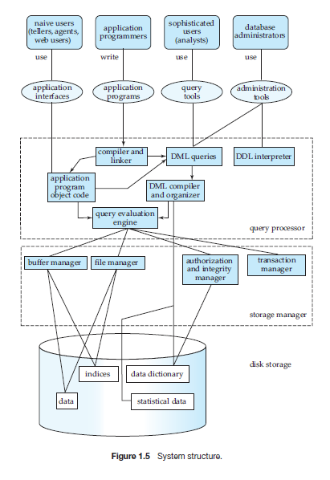
Database Architecture

Slide 24
Database Architecture cont.
Centralized Architecture
the mainframe computers are used for processing all system functions including User application Programs and User Interface Programs as well as DBMS functionalities.
Client/Server Architecture
assumes an underlying framework that consists of many PCs as well as a smaller number of mainframe machines, connected via LANs and other types of computer networks.
Notes:
---This is because in earlier days, most users accessed such systems via Computer Terminals, which can’t Process and they have only display capability. Therefore the Processing used to takeplace in these Computer Systems and the display information is sent to display terminals and these terminals are connected to mainframe computers via various kinds of Networks.
---A client in this framework is typically a user machine that provides user interface capabilities and local processing. When a client requires access to additional functionality, such as database access which does not exist at that machine, it connects to a server that provides the needed functionality.
A Server is a system which contains both Hardware and Software which provides services to client Machines like file access, printing and database access.

Slide 25
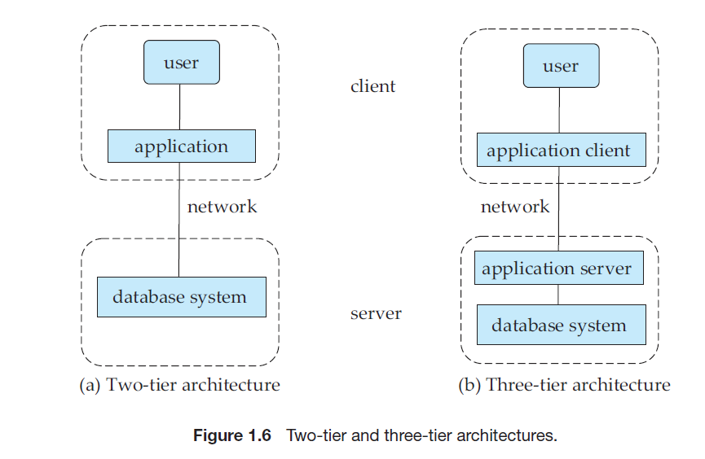
Database Architecture cont.
the client machine acts as merely a
front end and does not contain any direct database calls. Instead, the client end
communicates with an application server, usually through a forms interface.
the application resides at the client machine, where it invokes database system functionality at the server machine through query language statements.
Notes:
1)Two Tier Client/Server Architecture for DBMS:
Here Two-tier means that our Architecture has two layers, which are client layer and Datalayer. In Client layer we have several Client machines which can have the access to the database server. The API present on the client machine will establish the connection between the machine and the Database server through JDBC somthing else.This is because Clients and Database Server may be at different different locations.Once this connection gets established,the Interface present on the client machine contains an Application Program on the back-side which contains a query. This query will be processed by the Database server and in turn the queried information will be sent to the client machine.
For example if we query the database to retrieve some information, the query will be Processed by Database server and that information will be sent to the client by Database server itself!!!
2) Three-Tier client/server Architecture for DBMS:
Here there is an additional layer which acts as an intermediate between Client layer and Datalayer called Business logic layer. Business logic layer is the layer where the Application Programs are processed. Here the Application Programs are processed in the Application server itself, which makes it different from Two-tier Architecture where queries are processed in the database server.
Simply the Client machines will contact Application Server which in turn processes our Application Programs and fetches the Required Data from Database and then sends this Information back to the client machine in the suitable format only.

Slide 26
When not to use DBMS?
In spite of the advantages of using a DBMS, there are a few situations in which a DBMS may involve unnecessary overhead costs that would not be incurred in traditional file processing. The overhead costs of using a DBMS are due to the following:
High initial investment in hardware, software, and training
The generality that a DBMS provides for defining and processing data
Overhead for providing security, concurrency control, recovery, and integrity functions

Slide 27
Reading Assignment..
History of DBMS

