Slide 1
Java Inheritance
CSC 104 – OBJECT-ORIENTED PROGRAMMING
College of Computing & Info. Sciences

Slide 2
Objectives:
learn about Java Inheritance,
Identify what are the types of inheritance
learn how inheritance works

Slide 3
Outline
Inheritance
Types of Inheritance
Why multiple inheritance is not possible in Java in case of class?

Slide 4
Inheritance in Java
Inheritance in Java is a mechanism in which one object acquires all the properties and behaviors of a parent object.
Inheritance represents the IS-A relationship which is also known as a parent-child relationship.
Why use inheritance in java
For Method Overriding .
For Code Reusability.
Notes:
Inheritance in Java is a mechanism in which one object acquires all the properties and behaviors of a parent object. It is an important part of OOPs (Object Oriented programming system).
The idea behind inheritance in Java is that you can create new classes that are built upon existing classes. When you inherit from an existing class, you can reuse methods and fields of the parent class. Moreover, you can add new methods and fields in your current class also.
Inheritance represents the IS-A relationship which is also known as a parent-child relationship.
Why use inheritance in java
For Method Overriding (so runtime polymorphism can be achieved).
For Code Reusability.

Slide 5
Inheritance in Java
Terms used in Inheritance
Class: A class is a group of objects which have common properties
Sub Class/Child Class: Subclass is a class which inherits the other class. It is also called a derived class, extended class, or child class.
Super Class/Parent Class: Superclass is the class from where a subclass inherits the features. It is also called a base class or a parent class.
Reusability: a mechanism which facilitates you to reuse the fields and methods of the existing class when you create a new class.
Notes:
Terms used in Inheritance
Class: A class is a group of objects which have common properties. It is a template or blueprint from which objects are created.
Sub Class/Child Class: Subclass is a class which inherits the other class. It is also called a derived class, extended class, or child class.
Super Class/Parent Class: Superclass is the class from where a subclass inherits the features. It is also called a base class or a parent class.
Reusability: As the name specifies, reusability is a mechanism which facilitates you to reuse the fields and methods of the existing class when you create a new class. You can use the same fields and methods already defined in the previous class.

Slide 6
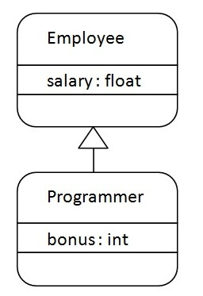
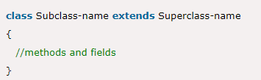
Inheritance in Java
The syntax of Java Inheritance
The extends keyword indicates that you are making a new class that derives from an existing class.
The meaning of "extends" is to increase the functionality
Notes:
The extends keyword indicates that you are making a new class that derives from an existing class. The meaning of "extends" is to increase the functionality.
In the terminology of Java, a class which is inherited is called a parent or superclass, and the new class is called child or subclass.
As displayed in the above figure, Programmer is the subclass and Employee is the superclass. The relationship between the two classes is Programmer IS-A Employee. It means that Programmer is a type of Employee.

Slide 7
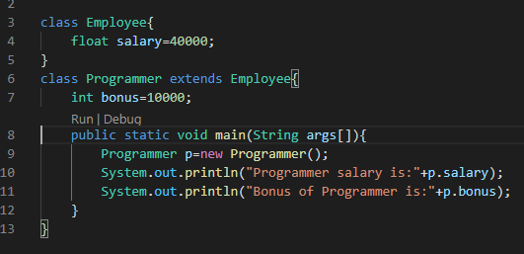
Inheritance in Java
Notes:
In the example, Programmer object can access the field of own class as well as of Employee class i.e. code reusability.

Slide 8
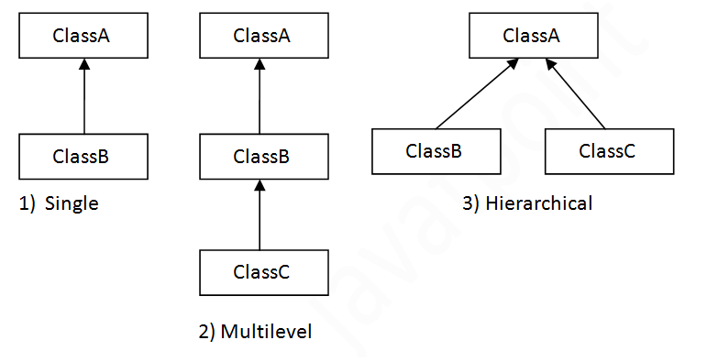
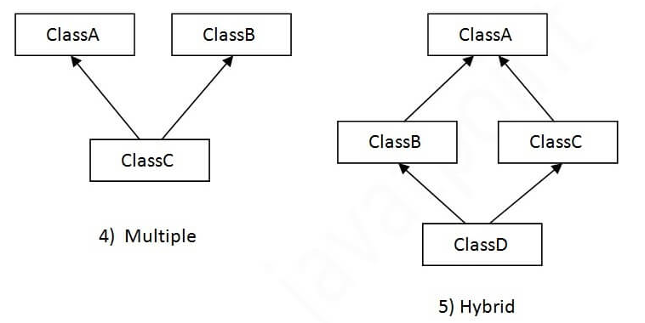
Types of inheritance in java
Notes:
On the basis of class, there can be three types of inheritance in java: single, multilevel and hierarchical.
In java programming, multiple and hybrid inheritance is supported through interface only. We will learn about interfaces later.

Slide 9
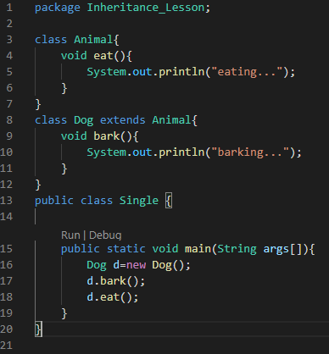
Types of inheritance in java
Single Inheritance
In the example given, Dog class inherits the Animal class, so there is the single inheritance.
Notes:
Single Inheritance Example
When a class inherits another class, it is known as a single inheritance. In the example given below, Dog class inherits the Animal class, so there is the single inheritance.

Slide 10
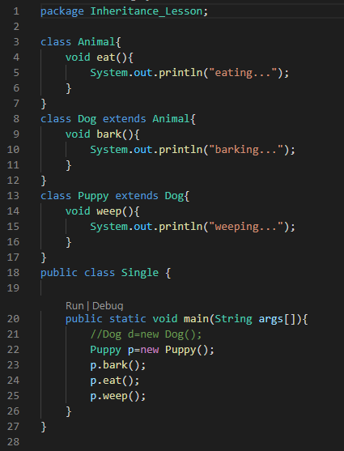
Types of inheritance in java
Multilevel Inheritance
As you can see in the example given below, Puppy class inherits the Dog class which again inherits the Animal class, so there is a multilevel inheritance.
Notes:
When there is a chain of inheritance, it is known as multilevel inheritance. As you can see in the example given below, Puppy class inherits the Dog class which again inherits the Animal class, so there is a multilevel inheritance.

Slide 11
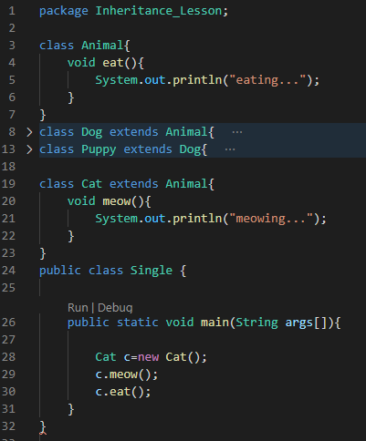
Types of inheritance in java
Hierarchical Inheritance
When two or more classes inherits a single class, it is known as hierarchical inheritance.
In the example given, Dog and Cat classes inherits the Animal class, so there is hierarchical inheritance.
Notes:
When two or more classes inherits a single class, it is known as hierarchical inheritance. In the example given below, Dog and Cat classes inherits the Animal class, so there is hierarchical inheritance.

Slide 12
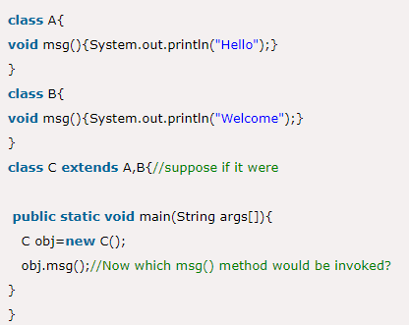
Types of inheritance in java
Why multiple inheritance is not supported in java?
To reduce the complexity and simplify the language.
Java renders compile-time error if you inherit 2 classes.
multiple and hybrid inheritance is supported through interface only.
Notes:
To reduce the complexity and simplify the language, multiple inheritance is not supported in java.
Consider a scenario where A, B, and C are three classes. The C class inherits A and B classes. If A and B classes have the same method and you call it from child class object, there will be ambiguity to call the method of A or B class.
Since compile-time errors are better than runtime errors, Java renders compile-time error if you inherit 2 classes. So whether you have same method or different, there will be compile time error.
In java programming, multiple and hybrid inheritance is supported through interface only. We will learn about interfaces later.

Slide 13
Java Aggregation

Slide 14
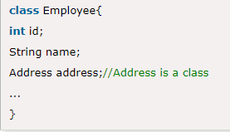
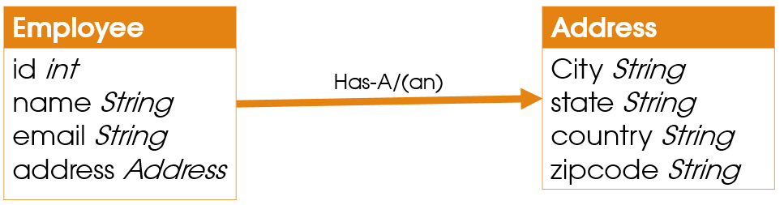
Java Aggregation
Aggregation represents HAS-A relationship.
Ex.
Employee object contains many information such as id, name, email, etc. It contains one more object named address, which contains its own information such as city, state, country, zip code etc. as given in the code.
Notes:
If a class have an entity reference, it is known as Aggregation. Aggregation represents HAS-A relationship.
Consider a situation, Employee object contains many information such as id, name, email_Id etc. It contains one more object named address, which contains its own information such as city, state, country, zipcode etc. as given below.
In such case, Employee has an entity reference address, so relationship is Employee HAS-A address.

Slide 15
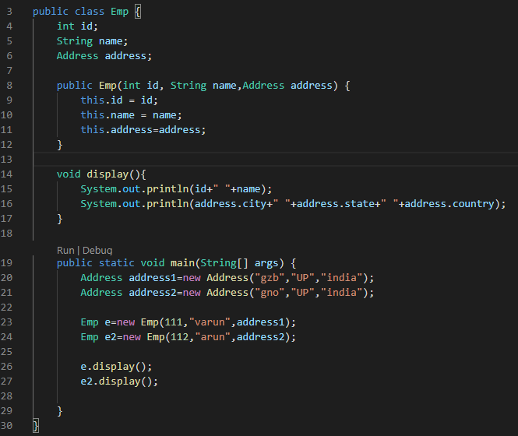
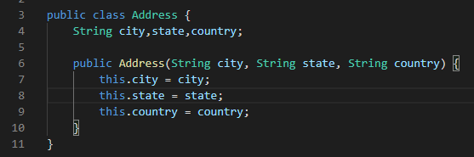
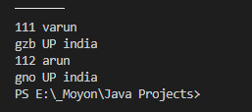
Java Aggregation
Understanding meaningful example of Aggregation
Emp.java
Address.java
Output
Notes:
In this example, Employee has an object of Address, address object contains its own informations such as city, state, country etc. In such case relationship is Employee HAS-A address.

Slide 16
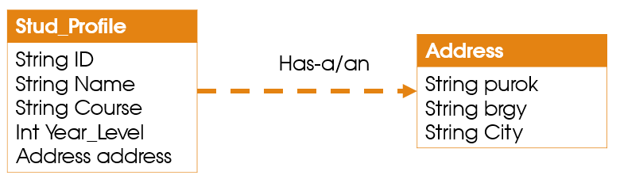
Assignment 3
Sample Output
Continuation to assignment #2.
Implement the student profiling by applying the concept of Java inheritance. In this case, Address should be inherited to all the student objects.
Please refer to the sample output below.
Student1:
ID: 071-00222,
Name: James Smith,
Course/Year: BSIT-2,
Address: P3, Ampayon, Butuan City
Student2:
ID: 182-01234,
Name: Christian Brown,
Course/Year: BSIS-3,
Address: P5, Mabini, Cabadbaran City
Student3:
ID: 172-01455,
Name: Christian Green,
Course/Year: BSIS-1,
Address: P12, Brgy 172, Caloocan City

Slide 17
References
https://www.programiz.com/java-programming/class-objects
https://www.tutorialspoint.com/java/java_object_classes.htm
https://www.w3schools.com/java/java_oop.asp
https://beginnersbook.com/2013/04/oops-concepts/#1
https://www.javatpoint.com/java-oops-concepts

