Slide 1

LANCASHIRE TEACHING HOSPITALS NHS FOUNDATION TRUST · RESULTS REPORT-OUT
Which trials pharmacy can complete within 60 days, and what limits that number
THE FINDING
On-time performance is set by the usable time remaining when the study reaches pharmacy — not by the number of set-ups opened each month.
Optimisation identifies the best portfolio within the time available. Simulation tests whether that promise survives the variation in set-up durations. Sensitivity analysis identifies which operational changes genuinely move the outcome.
A planning model built on LTHTR's own records, across 25 monthly decision points, 2024 to 2026 · MSc dissertation with R&I and Pharmacy Clinical Trials, September 2026
01
Notes:
Give the audience the answer in the first ninety seconds; everything after this slide is evidence for it. Optimisation finds the best plan inside the time available, simulation says what can be promised, sensitivity analysis says what actually moves the outcome. This is the final meeting of the project: the deck ends in a rule the service can run, and asks for nothing.

Slide 2
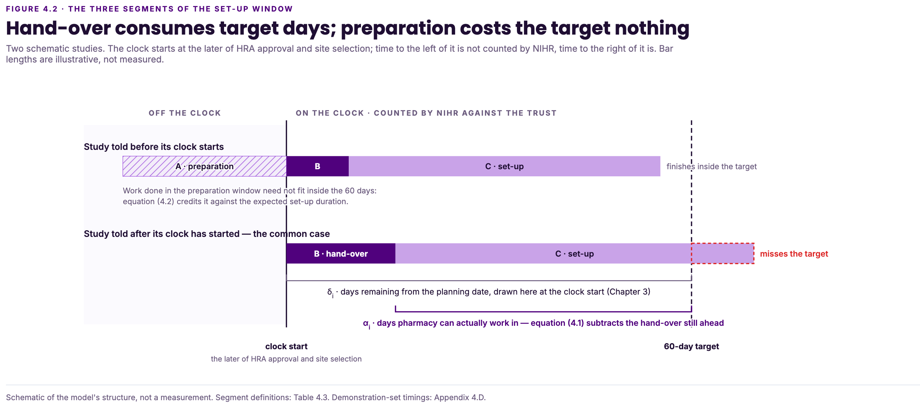
ACT 1 · THE PROBLEM
02
The clock opens before pharmacy is notified, and that gap consumes the target
60
79
0
days in the target window, from the later of HRA approval and site selection
days is the median pharmacy work interval — longer than the whole target before any hand-over is counted
case studies finished inside the target from a standing start
The four trials that met the target had all entered the pharmacy queue before the clock opened. The window did not stretch; the work began earlier.
The binding constraint is the usable time remaining when the study reaches pharmacy — and that is decided before any capacity decision is made.
Figure 4.2 — where the 60 days are spent
Notes:
This is the operational problem, before any model. The window opens on the later of HRA approval and site selection, which is often well before pharmacy is told. The median pharmacy work interval alone is longer than the whole target. No case study finished inside the target from a standing start — the four that met it had all entered the queue before the clock opened.

Slide 4
ACT 1 · THE PROBLEM
02
The clock opens before pharmacy is notified, and that gap consumes the target
60
79
0
days in the target window, from the later of HRA approval and site selection
days is the median pharmacy work interval — longer than the whole target before any hand-over is counted
case studies finished inside the target from a standing start
The four trials that met the target had all entered the pharmacy queue before the clock opened. The window did not stretch; the work began earlier.
The binding constraint is the usable time remaining when the study reaches pharmacy — and that is decided before any capacity decision is made.
Figure 4.2 — where the 60 days are spent
Notes:
This is the operational problem, before any model. The window opens on the later of HRA approval and site selection, which is often well before pharmacy is told. The median pharmacy work interval alone is longer than the whole target. No case study finished inside the target from a standing start — the four that met it had all entered the queue before the clock opened.

Slide 5
ACT 2 · HOW IT WAS TESTED
03
Three sources from the trust, and what each can and cannot supply
SOURCE | WHAT IT SUPPLIES | ROLE AND LIMITATION
CTIMP 150-day tracker | Problem scale and arrival pattern | 104 trials, of which 23 carry a measurable pharmacy duration
Prioritisation Tool, version 1.6 | Measure 4b, operational burden for pharmacy and aseptics, re-scored jointly by both teams. It is the pharmacy burden rank used throughout | Its value score is not used, so no trial is selected or excluded on perceived value
The August 2026 case-study return | Every per-study planning parameter: the dates, the pathway, the burden rank | 20 completed CTIMPs, 19 usable for the planning replay
WHAT THE EVIDENCE RESTS ON, SAID ONCE
No system captures the pharmacy set-up start automatically. Both teams reconstructed each date from their own records for the return, which is why the dissertation treats them as retrospective estimates. Hands-on approval time is recorded nowhere at all, so it is carried as a sensitivity parameter rather than a measured value.
The set-up duration floors are demonstrated-achievable standards rather than averages or forecasts. Results computed on them describe an optimistic operating condition, not an expected one. The measurement stage of the roadmap is how the trust closes both limitations.
Notes:
State the evidence base once, here. Twenty case studies, nineteen usable. An approval time recorded nowhere. Duration floors taken from the fastest performance each pathway has achieved. Say the reconstruction point plainly: it credits the work both teams did, and it is why the measurement stage of the roadmap exists. The dissertation calls these retrospective estimates rather than recorded events, and the deck must not describe them more confidently than the submitted text does.

Slide 6
ACT 2 · HOW IT WAS TESTED
04
Optimisation finds the best plan, simulation tests whether it holds, sensitivity analysis finds what matters
Monthly trust queue
→
Optimisation
→
Best on-time portfolio
→
Simulation
→
Reliable commitment
Optimisation
Simulation
Sensitivity analysis
“If we must decide now, which waiting trials should we commit to, so as to complete the most inside 60 days?” Where plans tie, it prefers the one leaving the least weighted lateness across the queue, so deferring a trial carries an explicit cost.
“If set-up duration varies as it has historically, how often will the selected plan actually deliver what it promised?” Each committed plan was replayed 10,000 times.
“Which operational changes genuinely change the outcome?” Six settings were swept across their tested ranges at all 25 decision points.
The model decides which trials to commit. It does not decide the order in which the work is done, and it does not rank a study's worth. All eligible trials are treated as equally worthwhile.
Notes:
Three methods, three different jobs. Optimisation: if we must decide now, which trials should we commit to. Simulation: how often will that plan actually deliver. Sensitivity: which operational changes genuinely change the outcome. Say what the model does not do, so nobody hears it as a ranking of scientific worth.

Slide 7
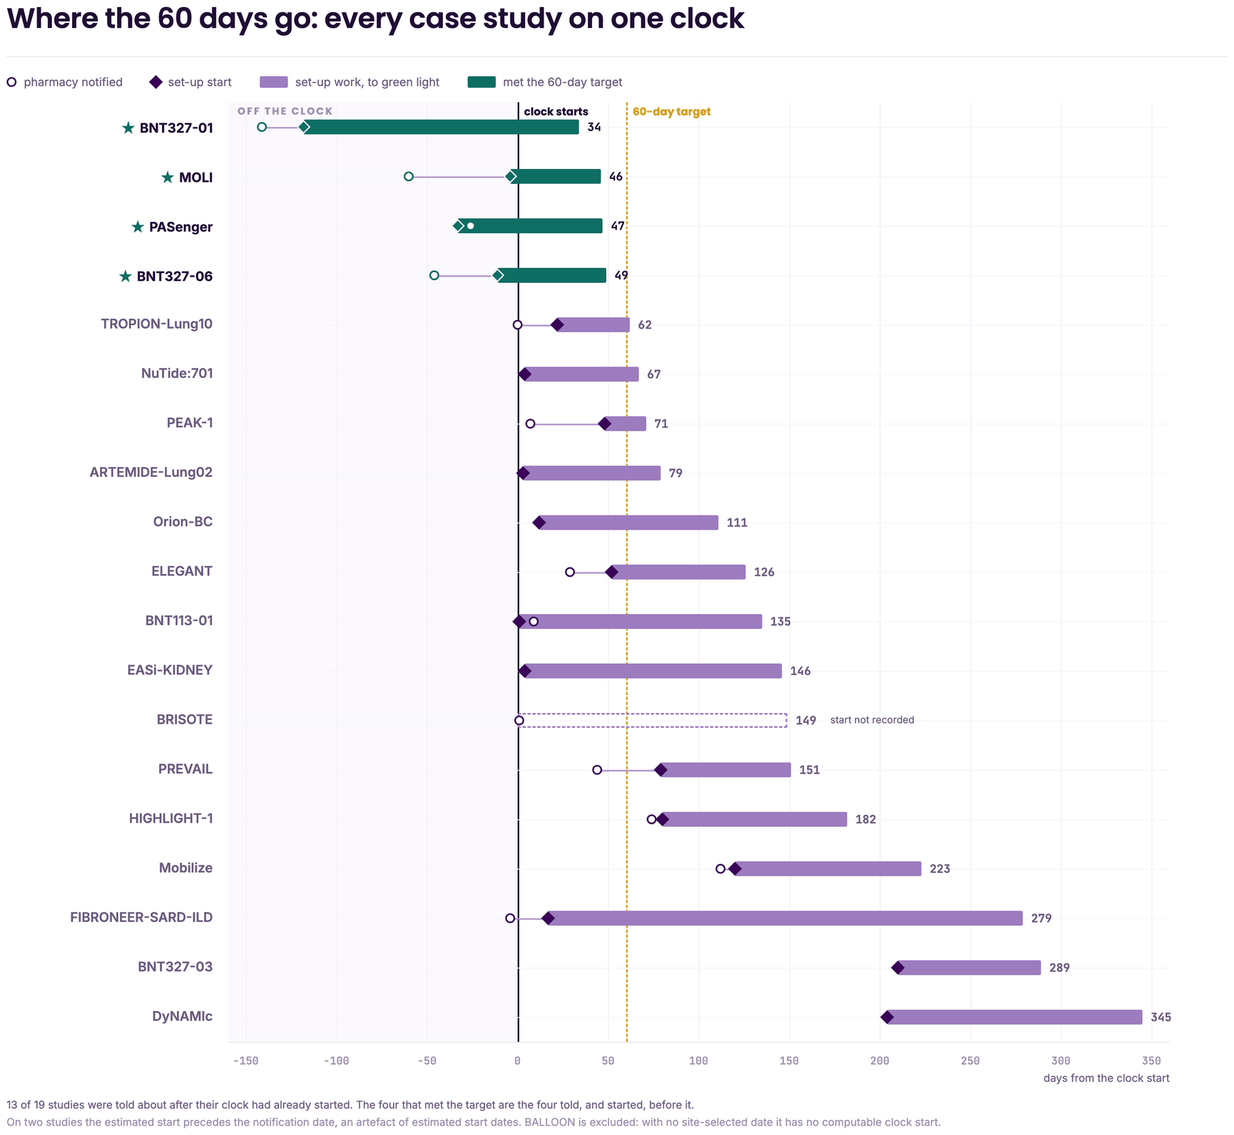
ACT 2 · HOW IT WAS TESTED
05
If nothing changes: four trials were ever feasible, and all four entered the queue before the clock opened
9 of 25
4
The model identifies those four in advance rather than in hindsight: they are exactly the four that met the target in reality. It does not uncover any additional trial the service could have brought in on time.
monthly decision points already admit one on-time trial, with no change at all
distinct trials in total — a trial that still fits is re-committed and counted again
TRIAL | DAYS ENTERED BEFORE CLOCK START | WORK INTERVAL (DAYS) | CLOCK INTERVAL (DAYS)
MOLI | 4 | 50 | 46
BNT327-06 | 11 | 60 | 49
PASenger | 33 | 80 | 47
BNT327-01 | 118 | 152 | 34
Two of the four met the target despite requiring more than 60 days of work, because their set-up began before the window opened. Where the plan falls short it does so by relatively little: four trials missed by 20 days or less and, under the plan, fall 10 to 29 days short of their available windows. No selection rule recovers those days.
The four-trial figure is an upper bound across the whole period under the recorded timing conditions. It is not a count per cycle, and not a throughput estimate.
Notes:
Two counts of nine exist in the analysis and are easily confused. This slide uses the lever baseline: 9 of the 25 monthly queues already admit one on-time trial with no change at all. The other nine is against the arrival-order comparator, where the model produced at least one on-time completion at 9 decision points against 6 for the comparator, at commitment limits of one and two. Both nines cover only four distinct trials. Careful in the room: four is an upper bound observed across 25 decision points, on the fastest durations each pathway has achieved. Saying we can do four a year would misstate it.

Slide 8
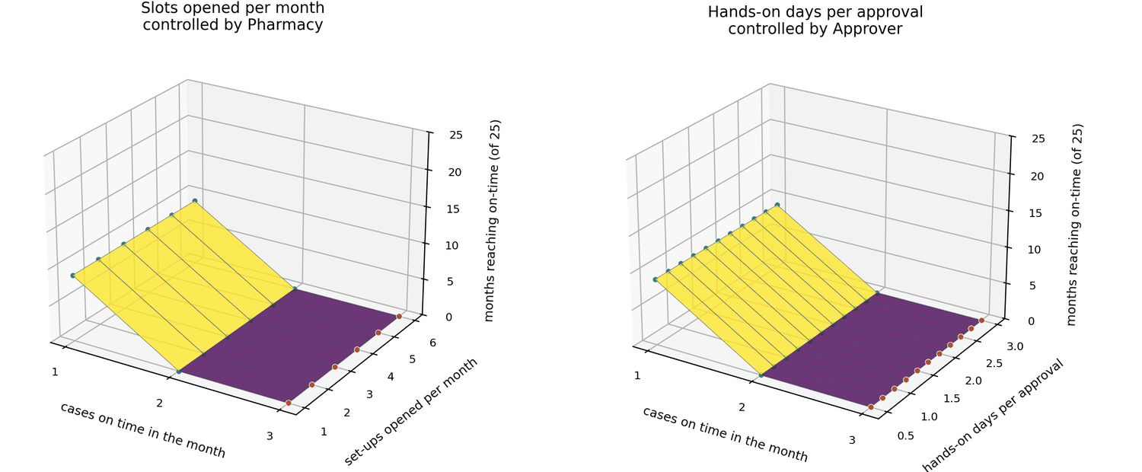
ACT 3 · WHAT CHANGES THE OUTCOME
06
More slots and better selection reduce lateness, but they do not create time
LEVER | RAISES THE CEILING? | WHAT IT CHANGES | MANAGEMENT IMPLICATION
Preparation before the clock opens | Yes | Creates usable time | The primary intervention
Pharmacy queue, notification to start | Partly | Rescues borderline moderate cases | Prioritise after notification
Hand-over gap, clock to notification | Limited | Reduces lateness most, by 498 days | Improve jointly, but do not rely on it alone
Set-ups opened per month | No | Reduces lateness only | Do not justify this as an on-time intervention
Optimised selection | Limited | Helps only under very tight capacity | Decision support, not the root-cause solution
Hands-on days per approval | Uncertain | Can become binding if slow | Measure it before operationalising the planner
Figure G.2 — flat across the whole range
The approval signature isn't binding under the assumed workload, and we don't measure that input anywhere. At 1.5 hands-on days, the expected wait reaches 48.5 days with six commitments; at three days, 97 days with only three. Which is why recording it sits on the roadmap.
9 → 17
+5
0 of 25
months with at least one on-time trial, of 25, when a 30-day preparation lead is given
further decision points gain an on-time completion when the pharmacy queue is shortened
decision points gain an on-time completion from opening more set-ups
Notes:
The scorecard is the whole sensitivity analysis on one slide. Five of the six settings move months onto the target or reduce lateness; only one raises the ceiling. Opening more set-ups changed the on-time count at none of the 25 decision points — give that number plainly. Closing the hand-over gap produces the largest single-date reduction in weighted lateness, 498 days, but adds on-time completions at only two further decision points, because it mainly affects trials already beyond rescue.

Slide 10
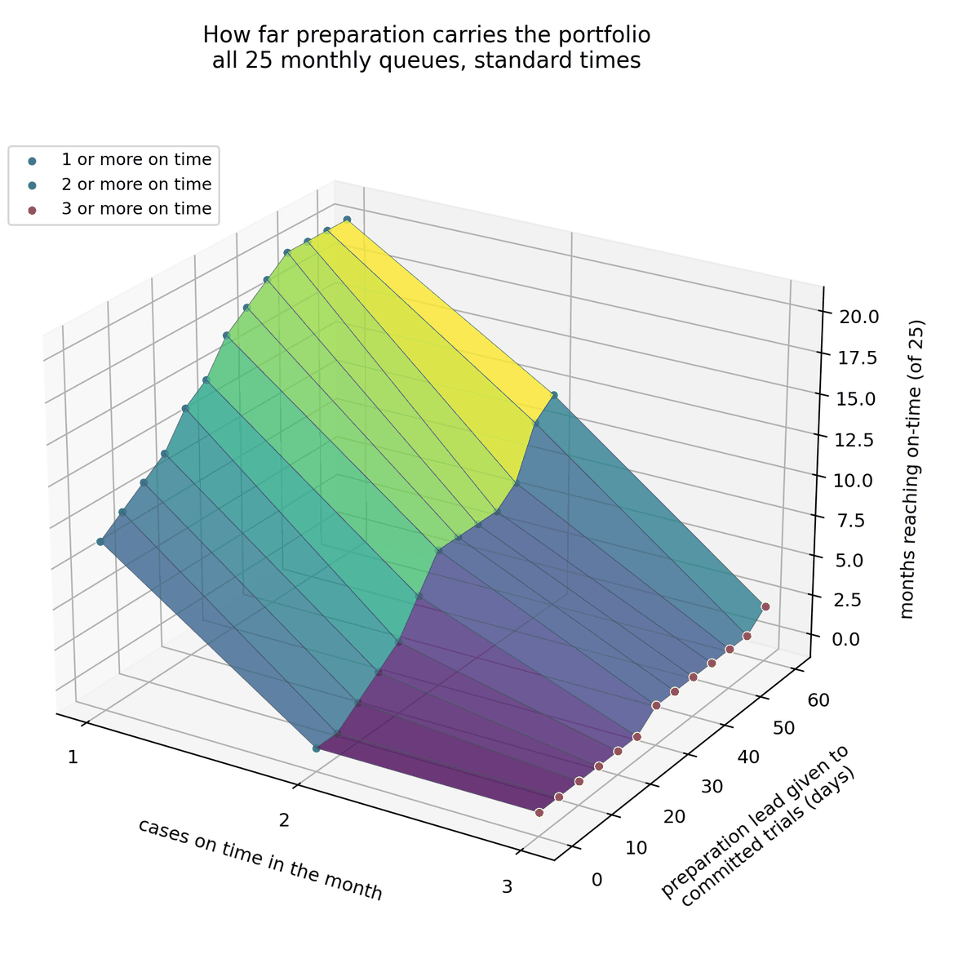
ACT 3 · WHAT CHANGES THE OUTCOME
07
Preparation is the only tested lever that creates time rather than redistributing it
11
17
20
months of 25 reach one on-time trial at a 10-day lead
at a 30-day lead — against a baseline of 9
at a 60-day lead
—
Two on-time trials are harder: no month reaches two below 10 days of lead, seven reach it at 30 days and twelve at 60. Three occur in one month at 30 days and two at 60.
—
Every other setting redistributes days inside the window. Preparation adds days before it opens, which is why it is the only one that moves the ceiling.
—
The first rescue is cheap; each further one costs more lead than the last.
Caveat. The base model does not charge pre-window preparation against the commitment limit, so it may overstate the benefit. Tested under reduced capacity, preparation still increases the number of months with at least one on-time completion, although the three-trial result disappears with two setups.
The honest limit. What a queue can reach is set by its own composition. Across the whole range tested, the February 2025 queue never passes two. That ceiling belongs to the queue rather than to any lever.
Notes:
Preparation adds days before the window opens; everything else moves days around inside it. Keep both caveats audible: the base model does not charge pre-window preparation against the commitment limit, and a queue's own composition sets a ceiling no lever passes. These figures give the lead to every committed trial, which no service can sustain — the targeted version follows on slides 9 and 10.

Slide 11
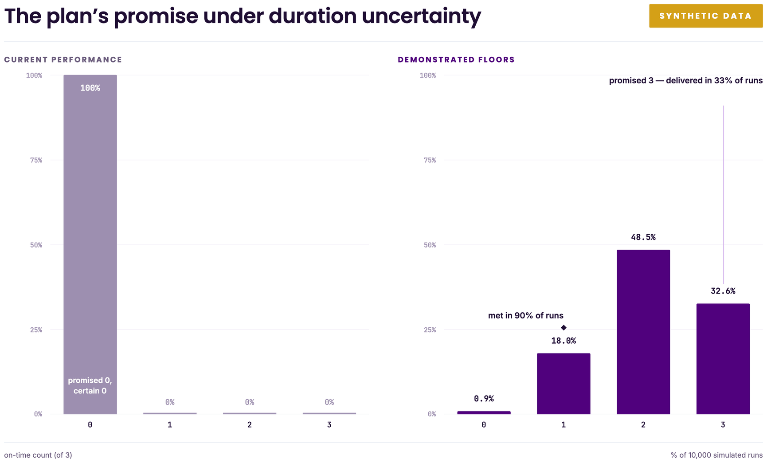
ACT 3 · WHAT CHANGES THE OUTCOME
08
Three on-time trials is a feasible maximum, not a reliable service commitment
Each committed plan was replayed 10,000 times against the observed spread of set-up durations. On the synthetic standing queue, the plan that promises three delivers:
Three on time
32.6%
Two on time
48.5%
One on time
18.0%
Committing to 3 studies simultaneously, the test indicates that at least a 90% chance of delivering at least 1 study on time
Agree a confidence threshold, and commit to the count the service can hold at it — not to the maximum the deterministic model reports.
Figure 5.3 — the plan's promise under duration uncertainty
—
Where a margin is smaller than the observed spread of durations, the result is a tie-break rather than a finding. A one-day lateness label carries no information.
—
Every figure here understates total uncertainty, because the approval wait is held at its expected value throughout.
Notes:
This is what simulation is for, in one sentence: it stops the service over-promising. A possible maximum is not a reliable promise. Agree a confidence level and commit to the count that holds at it.

Slide 12
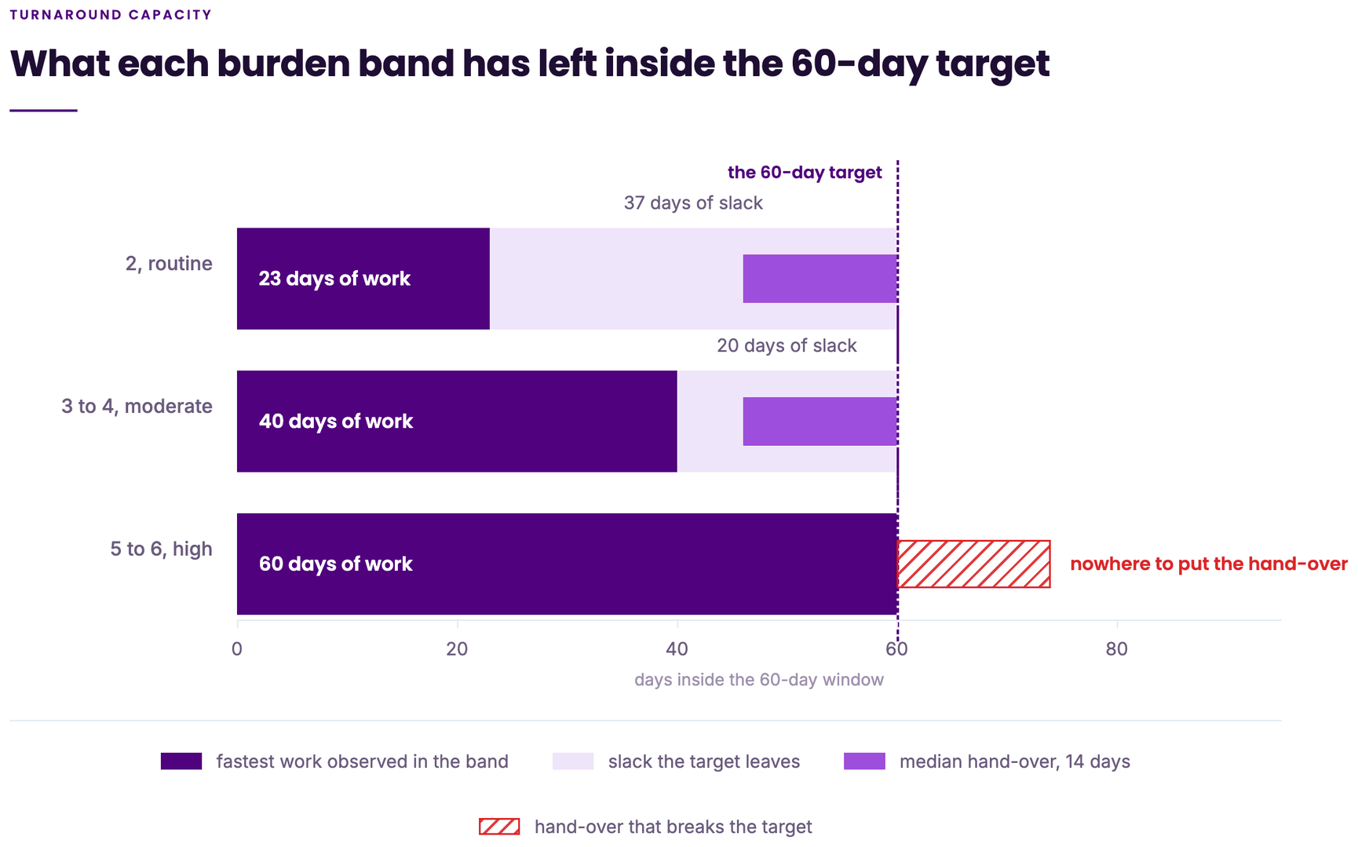
ACT 4 · WHAT TO DO
09
Preparation does not have to be given to every trial, and it should not be
The slack each band carries inside the 60-day window, from the fastest set-up each has achieved:
BAND | FASTEST OBSERVED | SLACK IN THE WINDOW | ACTION
Low, rank 2 | 23 days | 37 days | Normal path — needs neither intervention
Moderate, ranks 3 to 4 | 40 days | 20 days | Front of the pharmacy queue after notification
High, ranks 5 to 6 | 60 days | none | Preparation lead before the clock opens
A high-burden study cannot be rescued by any choice made after the clock starts. Against a median 14-day hand-over it arrives with no room, so preparation is not an optimisation for these studies — it is the only route by which they can be on time. A moderate study is on time if the hand-over is quick and lost if it is not; that is the band where the pharmacy queue does the work. A low-burden study carries 37 days and needs neither.
LEAD BEFORE THE CLOCK OPENS | FINISHES ON TIME
None | 50 per cent
28 days | 75 per cent
63 days | 90 per cent
Say it as a floor, not an average. What the data supports is not that high-burden studies take longer on average, but that none has ever been set up here in under 60 days. The identifier is available at notification: all six high-burden studies in the case set are aseptic, so the aseptic requirement catches every one of them, plus five others. It is a risk screen, not a value ranking, and it does not decide which studies are committed.
Twenty-eight days is the working standard. Sixty-three is a second window on top of the first, and is worth it only for a study that must land.
Notes:
Phrase the high-burden claim as a floor, never as an average. What the data supports is not that high-burden studies take longer on average, but that none has ever been set up here in under 60 days. The band is a risk screen, not a value ranking, and it does not decide which studies are committed.

Slide 14
ACT 4 · WHAT TO DO
10
Score the field the trust already owns, and the rule runs itself
TARGETING IS WHAT MAKES IT AFFORDABLE
Measure 4b of the Prioritisation Tool is the pharmacy burden score. It reads 0 on every study scored to date — its lowest-burden option.
APPROACH | MONTHS ON TIME, OF 25 | Preparation (days)
No lead, today | 9 | 0
Targeted, 35-day lead on high-burden studies only | 14 | 735
Spread, 21-day lead across the queue | 14 | 1,407
Targeted, 60-day lead on high-burden studies only | 16 | 1,260
Zero on every study is not a finding about the portfolio. The scoring group has no pharmacy member, so when pharmacy is involved, nobody in the room can judge the burden. The measure is uncollected rather than flat. That is why the study used a burden rank returned separately by pharmacy, and it is the one change that would let the trust run the triage rule itself.
TWO CHANGES, NEITHER NEEDING NEW DATA COLLECTION
Put a pharmacy clinical trials voice in the scoring group, for measure 4b only. It is the single measure drawing on pharmacy clinical trials, technical services, quality assurance, clinical and supply, and ePMA together, so nobody else in the room can score it. It costs a standing invitation to one meeting.
The same 14 months, for a little over half the R&I effort. Across the whole range, targeting costs about 147 R&I days for each additional month that delivers, against 234 to 365 days when the lead is spread.
Say the limit plainly. Spreading the lead is the only way to reach three on-time trials in a month; targeting reaches two. Targeting is the affordable policy, not the maximum one. It is recommended because it is the version the service can actually run.
Adopt the rubric on the leave-behind, which maps what a study asks of pharmacy onto a rank, and the rank onto the preparation it needs. Once 4b is scored at the point the tool is used, the rule runs automatically — the tool already fires before set-up begins, which is exactly when the lead has to be granted.
On the ranks. The burden ranks were given after the outcomes were known. They classify what these twenty studies demanded rather than predict what a new one will, so the rubric is a risk screen to revise as pharmacy scores real studies against it.
Notes:
Deliver the 4b finding as a fact about the scoring group's membership, not about anyone's diligence: the measure asks a question only pharmacy can answer, and pharmacy is not in the room when it is asked. Targeting is the affordable policy, not the maximum one — spreading the lead is the only way to reach three in a month, and targeting reaches two.

Slide 15
ACT 4 · WHAT TO DO
11
Start targeted preparation now, make the score operational next, then measure the process
NOW · 0 TO 3 MONTHS
NEXT · 3 TO 6 MONTHS
THEN · 6 TO 12 MONTHS
Create time for studies with no slack
Make the rule run without an analyst
Replace estimates with records
Give high-burden and aseptic-flagged studies a 28-day preparation lead before the clock opens. The only tested lever that raises the ceiling, and for these studies the only route to on time at all.
Add a pharmacy clinical trials representative to the 4b scoring group. It costs a standing invitation to one meeting.
Record four timestamps at the time: pharmacy notified, set-up started, approval-ready, green light issued. Durations become records rather than reconstructions.
Score studies before set-up begins, using the rubric, rather than classifying them retrospectively.
Move moderate-burden studies to the front of the pharmacy queue after notification. That segment never exceeds 23 days and sits inside pharmacy's own control.
Re-estimate durations, validate the rubric prospectively, and re-run the simulation on observed data. The approval-ready timestamp is the one input measured nowhere: the assumption holds below 1.5 hands-on days and breaks sharply above it.
Link the score to the action rule: high burden takes the lead, moderate takes queue priority, low takes the normal path. The tool already fires before set-up begins, which is when the lead has to be granted.
Commit to a count the service can hold, at a stated confidence. It changes what is promised, not what is done.
Build the planner only once data quality is sufficient — before that it would compute on reconstructed dates.
NOT RECOMMENDED — AND NOT A FOURTH STAGE
Staffing is held constant throughout the analysis, so every gain above comes from the establishment the establishment already has. What it is worth in money the study cannot say, because commercial income per trial and the cost of a set-up day are not in the data. The table converts directly once the trust puts those two figures against it.
× Opening more set-ups per month to chase the target. It changed the on-time count at none of the 25 decision points.
× Changing the selection rule on its own. From three set-ups upwards it selects the same trials as arrival order.
× Closing the hand-over gap entirely. It runs to 210 days and is not wholly inside anyone's control.
× Building the planner first. It belongs after the measurement stage, not before it.
Notes:
Sequencing matters. Do not let the measurement stage read as a precondition, or the service will wait for data and start nothing. The not-recommended list is deliberately set apart so nobody reads it as a fourth stage.

Slide 16
ACT 4 · WHAT TO DO
12
Four sentences to take away
01
The problem is not how many studies pharmacy opens each month. It is the usable time remaining when the study reaches pharmacy.
02
Optimisation tells us the best possible portfolio within that time. Simulation tells us what the service can responsibly promise.
03
More capacity and better selection reduce lateness, but only earlier preparation raises the on-time ceiling.
04
Start with targeted preparation for high-burden studies, operationalise the burden score, then measure the timestamps that make the rule precise.
These results describe demonstrated-achievable conditions, not average expected performance, on twenty case studies with reconstructed set-up dates. The next phase is to replace those estimates with recorded operational timestamps. The one-page rule follows as a leave-behind.
Do not add slots to chase on-time performance. Create earlier preparation for the studies that arrive with no slack, then measure the process properly.
Notes:
Close on the four sentences and stop. The A4 sheet is the leave-behind; hand it over rather than presenting it line by line. This is the last meeting of the project and the deck asks for nothing.

Slide 17
THE GUIDELINE — LEAVE-BEHIND, A4
A4
PHARMACY CLINICAL TRIALS SET-UP · LTHTR
The rule, small enough to put on the wall
Step 1. At notification, ask three questions
Step 2. Score measure 4b using this rubric
Step 3. Act on the band
All three are answerable from what R&I already holds.
RANK | WHAT THE STUDY ASKS OF PHARMACY | BAND
2 | Dispensary-led, low-complexity IMP, no aseptic work, no new prescribing build | Low
3 to 4 | Either aseptic preparation or an electronic prescribing build, but not both; standard supply arrangements | Moderate
5 to 6 | Aseptic preparation with a prescribing build, non-standard supply, or a technical services or quality assurance requirement the unit has not run before | High
High, 5 to 6
Begin pharmacy preparation as soon as the study is known, targeting 28 days before the clock opens. Do not wait for the hand-over meeting.
1 Does the study need aseptic preparation?
2 What is the later of HRA approval and site selection? That day is when the 60-day clock opens.
No slack inside the window. Without a lead the study is on time half the time; with 28 days, three times in four.
3 Has pharmacy been told before that day?
Moderate, 3 to 4
Step 4. When committing the month, state a count the service can hold
Normal path, but move it to the front of the pharmacy queue after notification.
A plan promising three on-time completions delivers three in about a third of runs and two in about half. Commit to the count that holds at the confidence the service has agreed, not to the maximum the plan reports.
Twenty days of slack against a median 14-day hand-over. The queue is what decides it.
Low, 2
Note for the room: this rubric is the study's ranks 2 to 6 written as descriptions. The ranks were given after the outcomes were known, so they classify what these twenty studies demanded rather than predict what a new one will. Use it as a risk screen and revise the wording as pharmacy scores real studies against it.
Normal path.
Thirty-seven days of slack. Neither intervention changes the outcome.
Step 5. Review it at the meeting that already happens
The screen needs the study name, the two approval dates, the pathway and the band. It supports judgement and does not replace governance.
Notes:
This is the leave-behind. Print it as a single A4 sheet and hand it over rather than presenting it line by line.

Slide 18
END OF THE MAIN DECK
B0
Back-up slides
Seven items held in reserve: the model parameters and duration floors, the full lever table, the approval surface, the statistical tests, what a rescue costs, the robustness sweep and burden weights, and the planner interface.
Notes:
End of the main deck. The following seven slides are back-up, shown only if asked.

Slide 19
BACK-UP · B1
B1
The model parameters, and the pathway duration floors
INPUT | VALUE USED | WHERE IT COMES FROM
Target window | 60 days from the later of HRA approval and site selection | The national 150-day definition
Time available | Due date less the later of today and the date pharmacy can begin | Calculated per trial; delay still ahead is subtracted, delay already served is not
Set-up duration floors | 30 days prescription-only, 50 routine, 60 both, 72 aseptic-only, with a 63-day overlay where a trial is both high burden and on the Both pathway | The demonstrated work floors, audited in Appendix F
Preparation lead | Tested at 0, 7, 14, 21, 35 and 60 days; zero in the base case | Tested as a range, not assumed
Approval wait | Rises with the number of trials committed at once | A single-server queue formula. The only input in the results that is not measured
Set-ups per cycle | Tested at 1 to 6, against a stated limit of two | The service-level agreement
The three hand-over medians, and why they differ. The CTIMP tracker gives a median 8-day hand-over across 104 trials. The case-study return gives a median of 35 days before pharmacy began, on the 14 of 19 usable studies where the hand-over was positive, running as high as 210. The triage rule uses the median 14 days between the clock starting and pharmacy receiving the study. Each is valid for its own source and definition; only the 14-day figure is used in the rule.
Notes:
The full parameter set behind the model. The floors are demonstrated-achievable standards, not averages or forecasts. The three hand-over medians come from different sources and definitions, which is why only the 14-day figure is used in the triage rule.

Slide 20
BACK-UP · B2
B2
Table G.2 in full: each setting's tested range and what it moves
SETTING | TESTED RANGE | MONTHS ON TIME, OF 25 | BEST COUNT | LARGEST SINGLE-DATE REDUCTION IN WEIGHTED LATENESS
Preparation lead on committed trials | 0, 7, 14, 21, 35 and 60 days | 20 | 3 | The only setting that raises the on-time ceiling
Pharmacy queue, notification to start | Never exceeds 23 days in the records | 14 | 2 | About one-seventh of the hand-over gap's reduction, but adds on-time completions at five further decision points
Hand-over gap, clock to notification | Swept to 120 days; recorded gaps run to 210 | 11 | 2 | 498 days, the largest of any setting, but only two further on-time decision points
Target window | 55 to 70 days | 11 | 2 | Held by national policy, not by the trust
Set-ups opened per month | 1 to 6, against a stated limit of two | 9 | 1 | Lowers weighted lateness at every on-time count, changes the on-time count at none
Hands-on days per approval | 0.5 to 3 days | 9 | 1 | Flat across the range at the assumed workload; measured nowhere
The baseline is nine months. On-time completion is a threshold measure while lateness accumulates, which is why the two outcome columns rank the settings differently.
Notes:
Ranges as tested. The hand-over gap was swept to 120 days in the figure, although recorded gaps run to 210.

Slide 21
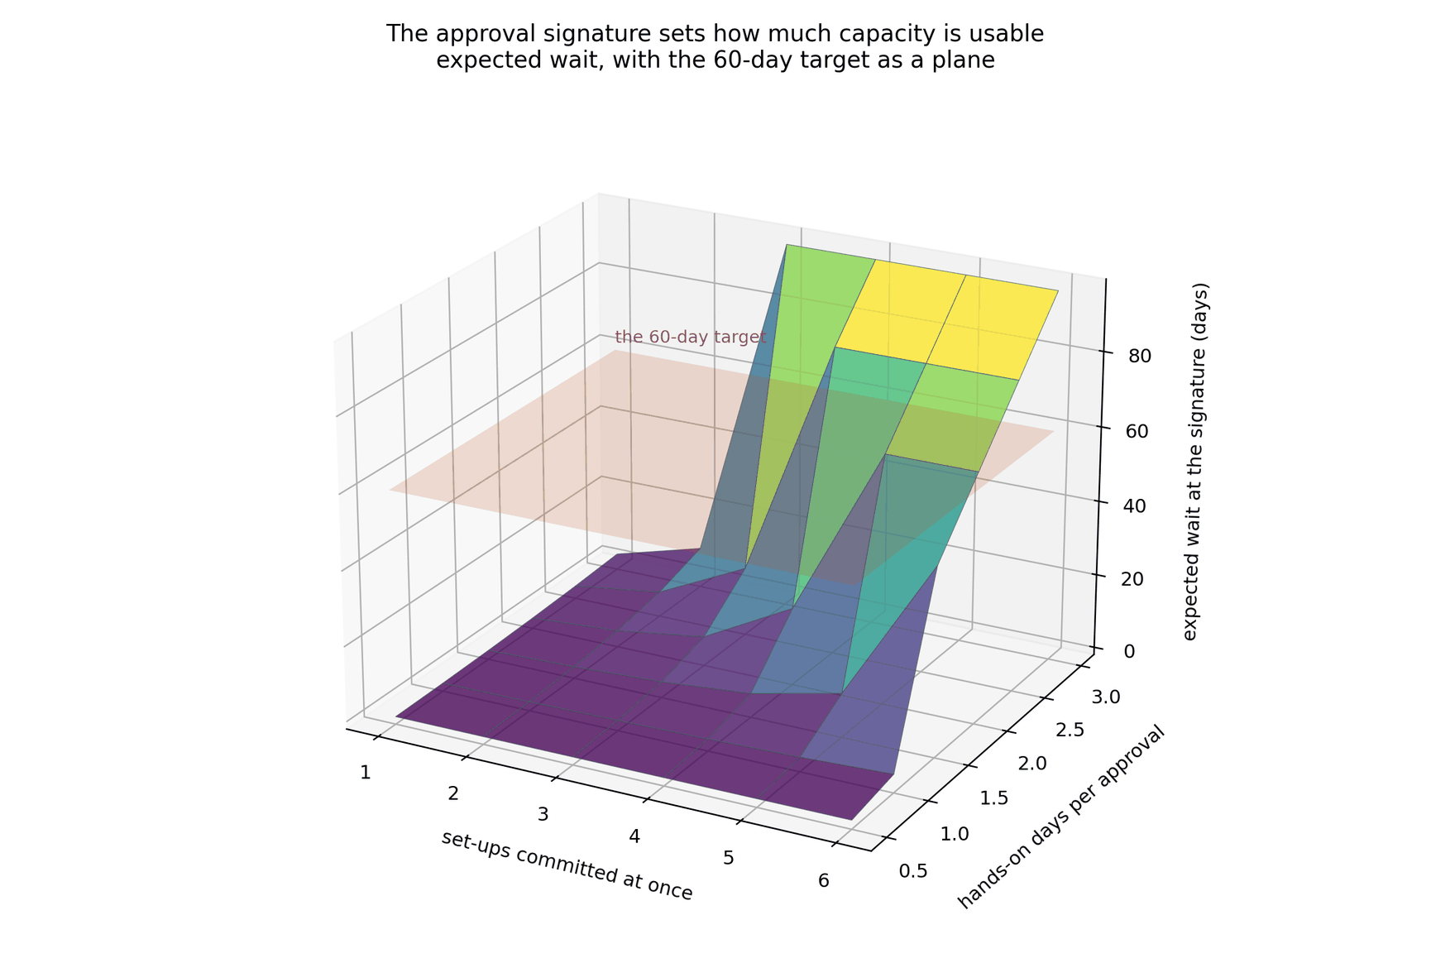
BACK-UP · B3
B3
What if the signature takes longer than a day
—
Below 1.5 hands-on days all six set-ups are worth opening.
—
At two days about four are worth opening.
—
At three days only two are worth opening.
—
This is where the approval assumption breaks, which is why it sits in back-up, and why the approval-ready timestamp is in the measurement stage of the roadmap.
Figure G.3 — the approval surface
Notes:
Use this only if asked what happens if the signature takes longer than a day.

Slide 22
BACK-UP · B4
B4
The statistical tests, and what each does and does not establish
p = 0.557
p = 0.067
p = 0.71
Kruskal–Wallis, across the three burden bands
Fisher's exact, on the six high-burden trials
Work intervals, early against late starters
The bands showed no detectable difference in median duration, although groups this small would not reveal a moderate one. What separates them is the fastest each has achieved, which is what sets the slack.
The two that began before the clock started met the target; all four that began afterwards missed it. The pattern fits the proposed mechanism but does not establish it.
Work intervals did not differ significantly. Earlier preparation moves work outside the window rather than shortening it. Given the small case base, this does not establish that earlier preparation has no operational effect.
Two further observations from the case set. No recorded trial characteristic predicted an early start, so the early starts were not the product of a rule the service could repeat. The model also starts the right trials sooner: three of the four are among the six it starts earliest, by 34, 22 and 17 days, and of the twelve trials the service began before the model would, eleven missed the target anyway.
Notes:
The tests are held here rather than in the main deck. Each pattern fits the proposed mechanism without establishing it, and the case base is too small to rule out a moderate effect.

Slide 23
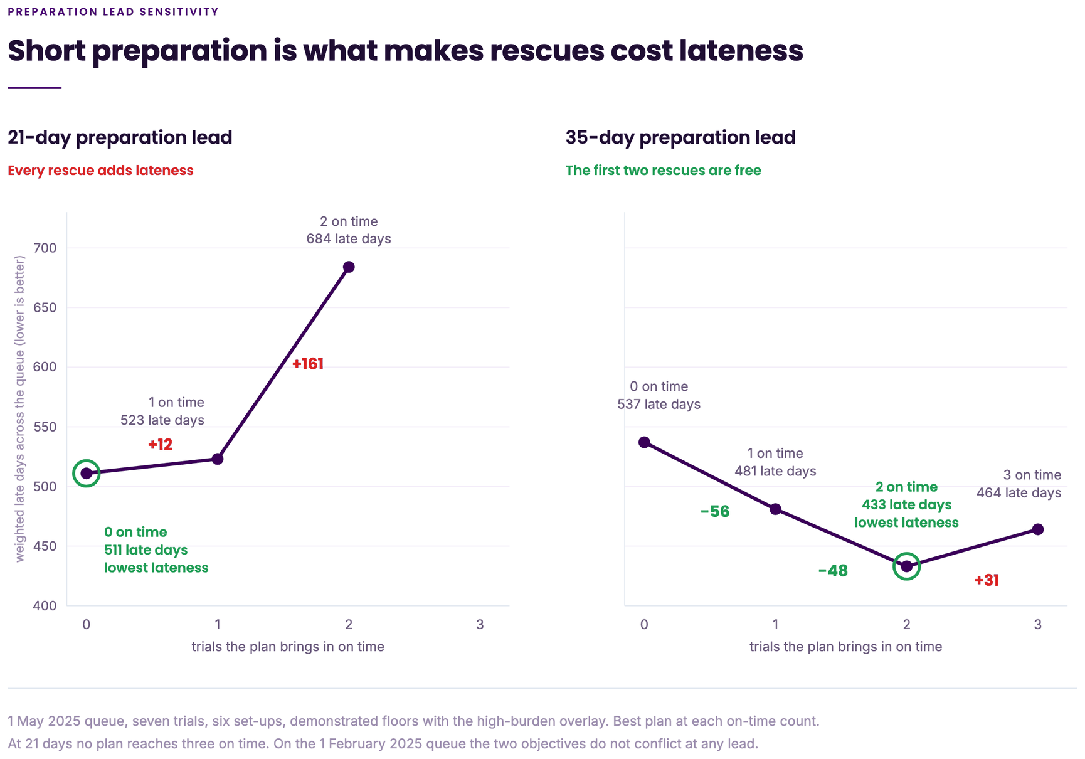
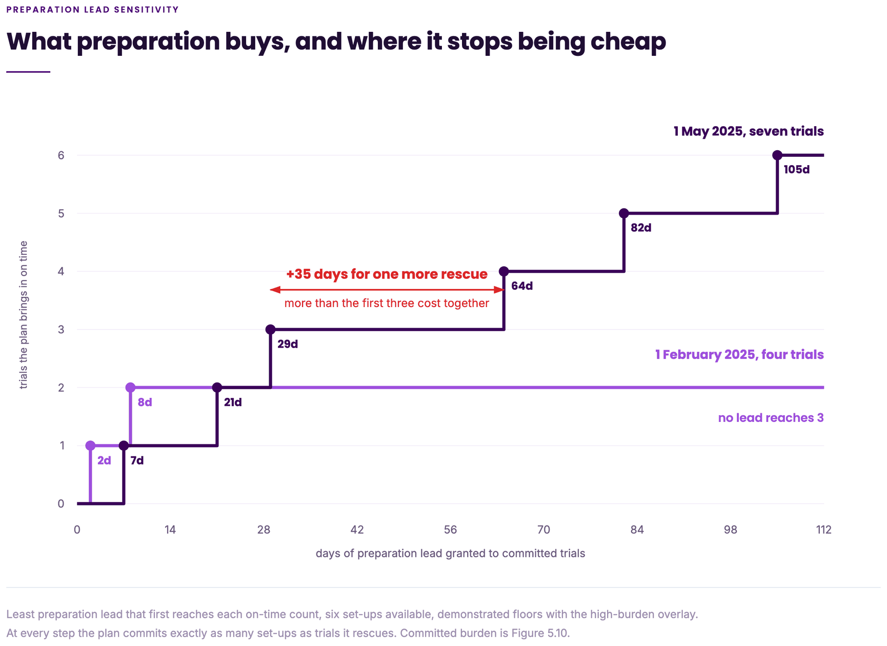
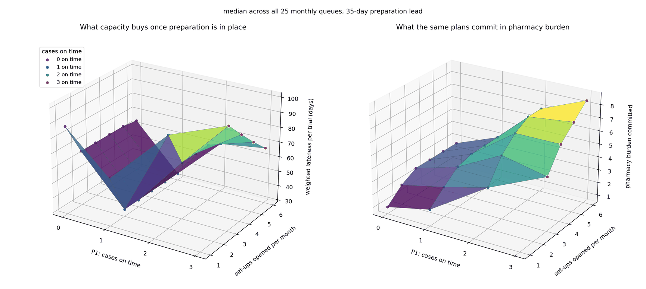
BACK-UP · B5
B5
What a rescue costs, what preparation buys, and what capacity buys
Figure 5.7 — what a rescue costs at two leads
Figure 5.8 — what preparation buys
Figure 5.9 — what capacity buys
—
On the largest queue, 1 May 2025, a 21-day lead makes each rescue cost additional lateness. A 35-day lead brings two trial(s in on time at the lowest weighted lateness of any plan. On the 1 February 2025 queue the two goals never conflict at any lead. A governance rule that ranks lateness first therefore gives up nothing when preparation is adequate and two rescues when it is not.
—
Figure 5.8 reports the least preparation that first reaches each on-time count. The first rescue is cheap; each further one costs more lead than the last. Across the whole range tested the February queue never passes two, and that ceiling belongs to the queue rather than to any lever.
—
Holding the lead at 35 days, weighted lateness falls with every slot opened at each on-time count, while the pharmacy burden the plan commits rises with both. That is the capacity decision stated properly: it buys a shorter queue, not a higher on-time count.
Notes:
The frontier rotation and the preparation steps. A governance rule that ranks lateness first gives up nothing when preparation is adequate, and two rescues when it is not, so it is the wrong rule to fix in advance.

Slide 24
BACK-UP · B6
B6
The robustness sweep, and the burden weights
9,000 GENERATED PORTFOLIOS
ROUTINE-TRIAL-EQUIVALENT WEIGHTS
—
At current performance the model never beats the arrival-order rule for on-time completions.
1.00
1.74
2.61
—
At the demonstrated floors it wins in 36 per cent of cases, each win costing 24.3 weighted days of lateness elsewhere.
Low burden
Moderate burden
High burden
—
It helps most when trials arrive early and the aseptic share is low.
Used only to compare the burden composition of two portfolios. They are not staff-time ratios.
Notes:
At current performance the model never beats arrival order for on-time completions. The weights are not staff-time ratios.

Slide 25
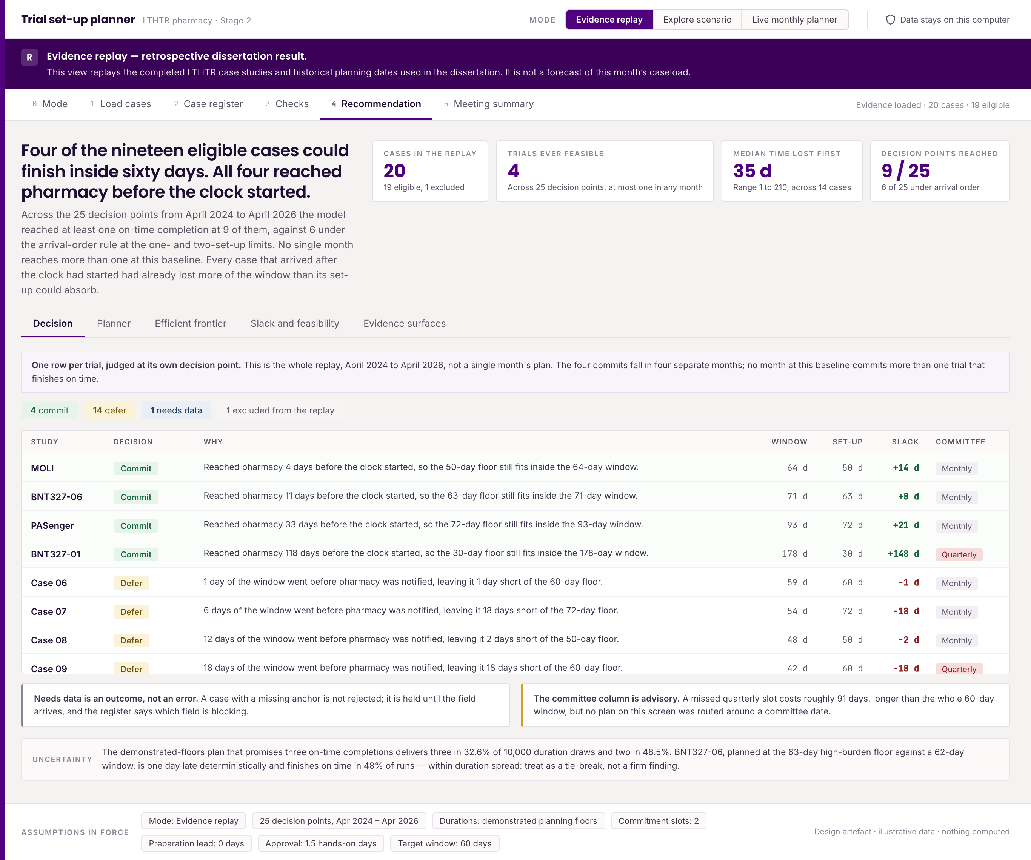
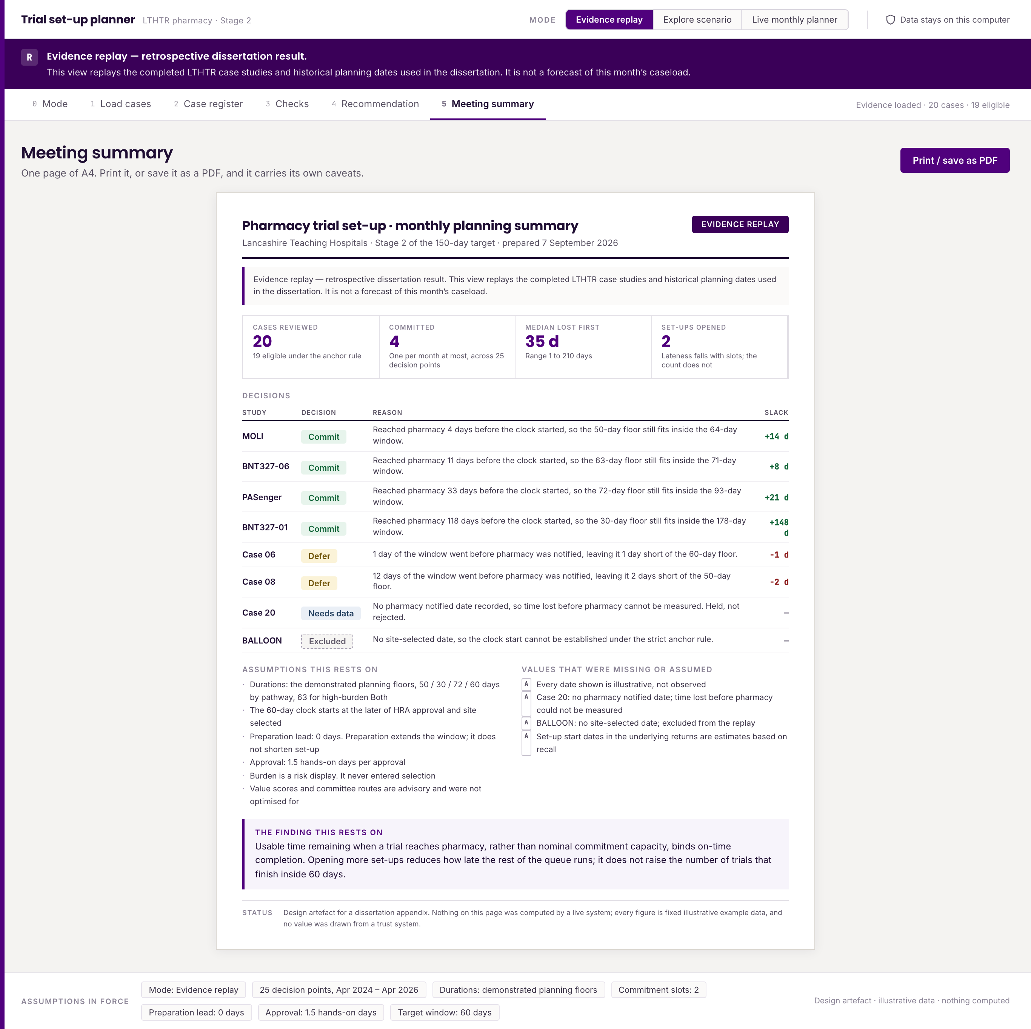
BACK-UP · B7
B7
The planner interface, with the caveat that it computes nothing and has not been used by anyone
Figure I.5 — the recommendation screen
Figure I.10 — the meeting summary screen
Notes:
It computes nothing and has not been used by anyone. It belongs after the measurement stage.

