Slide 1
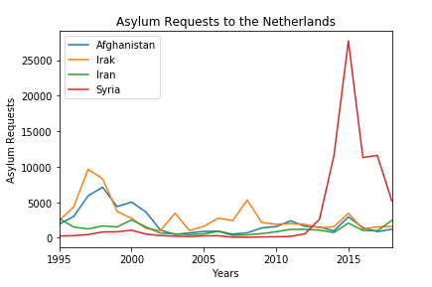
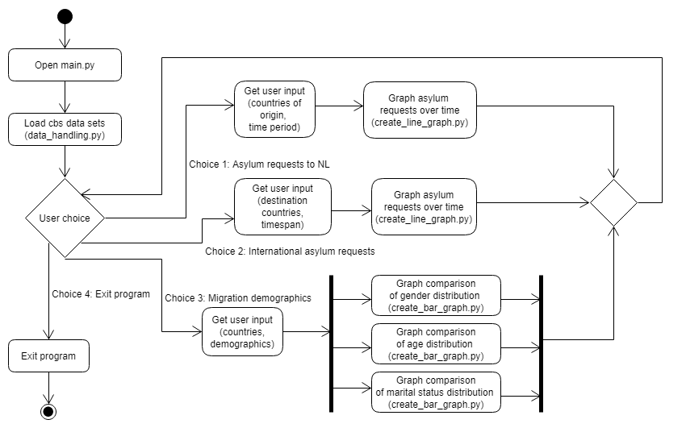
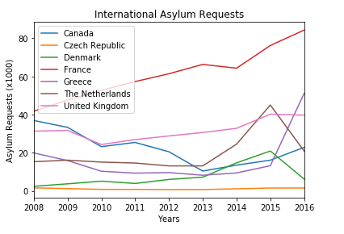
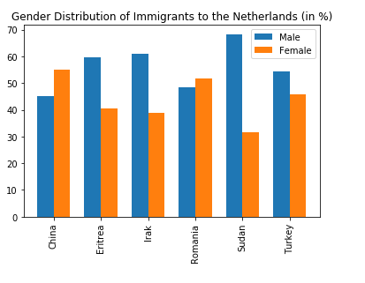
Faculty of Science
Department of Information and Computing Sciences
Migration Flows and Demographics
Karel Zwetsloot, Johanna von Winning
Liberal Artists
Research Questions
How have the asylum requests to the Netherlands, for different countries of origin, changed over time?
How have the asylum requests to different countries of destination changed over time?
How is the migrating population distributed in terms of age, gender, and marital status?
Data
Asylum requests to the Netherlands per year, separated by country of origin. Data available from 1975 to 2018.
Total asylum requests per year, separated by country of destination. Data available from 2008 to 2016.
Demographics of immigrating population to the Netherlands since 1995. Data is available about gender, age, marital status, and country of origin.
Results
Implementation
Overall structure
Modules defined
data_handling.py
create_line_graph.py
create_bar_graph.py
Libraries used
pandas
matplotlib
Future Research
Investigate relationship between historical and/or global events and migration trends.
Investigate the acceptance rate of asylum requests over time.
Investigate the population of migrants in EU countries relative to the total population.
References
Data obtained from: CBS Open data StatLine
https://opendata.cbs.nl/statline/portal.html?_la=nl&_catalog=CBS

