Slide 1


Multimodal Information Processing and Analysis
P3 Large – scale cross – modal speech emotion recognition
Alevizopoulou Sofia 2022201704002
Avgeros Giannis 2022201704003
Tsiatsios George 2022201704024
MSC Data Science Athens 2019

Slide 2
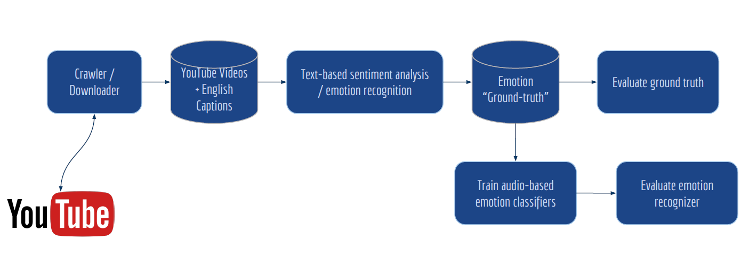
Introduction
Crawled videos that contain English dialogs from YouTube
3 sentiments classifiers used to recognize negative, neutral and positive sentiments
most confident of these decisions will be used to train an audio-based emotion recognizer
Use the train model to classify other testing videos
Evaluate the model by defining the ground truth
100 samples of negative, neutral and positive were evaluated by listening them and put a sentiment tag
Train dataset
125 random interviews from YouTube
Test dataset
10 random interviews from YouTube
Each video has a unique Id

Slide 3
Sentiment classification for negative, neutral and positive sentiments
Captions data Preprocessing
exclude the segments that has no actual text and contain only tags
excluded segments whose duration is less than 2 secs
excluded segments with less than 4 words
Sentiment classifier
3 sentiment classifiers
VADER
Textblob
en.pattern
Excluded segments at which the above sentiment classifiers had different results
Final score of sentiment→ the average outcome of the 3 classifiers for each segment
Reject positives and negatives segments whose polarity is less than 0.25 (absolute value)
The outcome of each video will be saved at a pickle file and will be used from the audio classifier

Slide 4
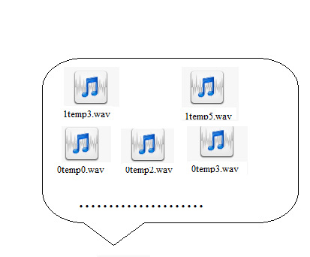
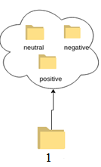
Audio-based emotion recognizer
Each wav from the train dataset splitted in the segments that are referred at sentiment analysis
A folder per VideoID will be created
Functions from pyAudioAnalysis are used
dirsWavFeatureExtraction of pyaudioanalysis for audio sentiment classification
Features set are normalized to 0-mean and 1-std, to avoid any outliers
Perform Cross Validation
select the best C parameter for the SVM classifier based on the best fold
Split per VideoId and no per segment for the cross validation
Negative, Positive and Neutral classes become balanced using SMOTE from imblearn library
The final model is saved at a pickle to be used for test dataset

Slide 5
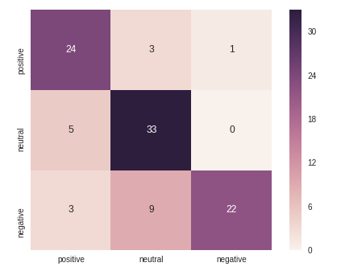
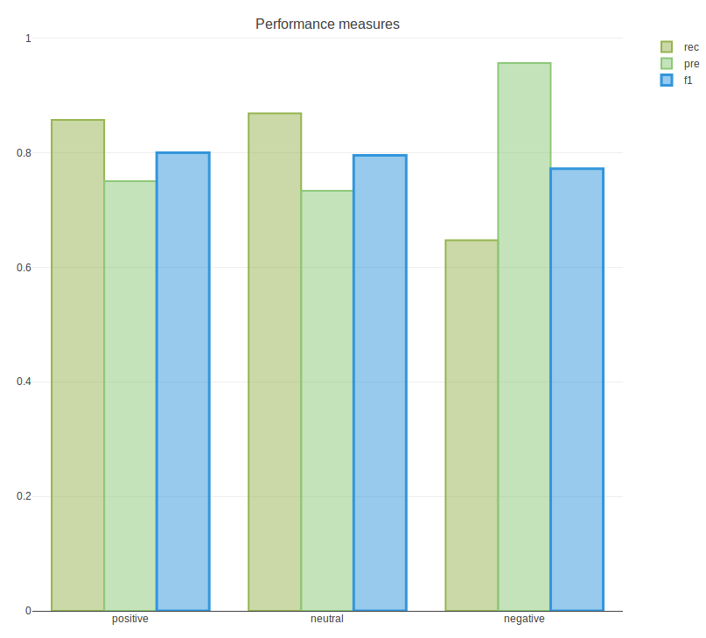
Audio-based model performance [1/5]
Evaluate the ground-truth (sentiment analysis) of train dataset
Listen 100 segments from the train dataset to declare its polarity and compare then with the results of the sentiment classifiers
3 different polarities declared and at the final state the majority sentiment is used as ground truth
On x-axis are presented the sentiment analysis form the
sentiment classifiers and on y-axis the results which are
declared by us, listening the segments
80% of segments are well classified with sentiment analysis
F1_score: 0.7890368491509899
Precision: 0.8132850241545894
Recall: 0.7908742444346161

Slide 6
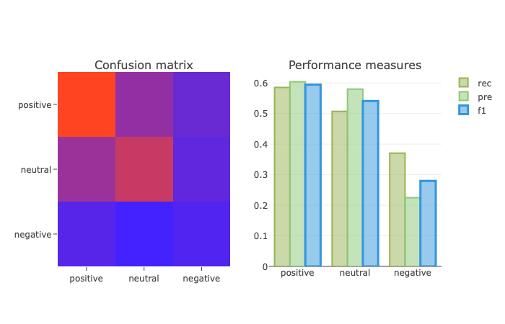
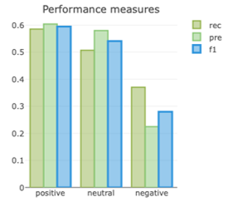
Audio-based model performance [3/5]
Performance of the audio-based emotion recognizer on train dataset
On the x-axis are presented the predictions
and on y-axis the results from sentiment analysis.
60% of the positive,55% of neutral
30% of negative segments are predicted well.
F1_score:0.4833333333333333

Slide 7
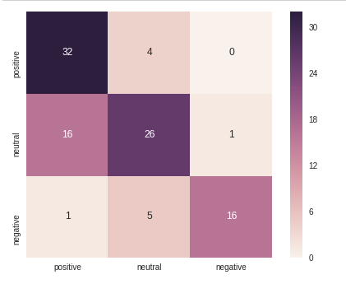
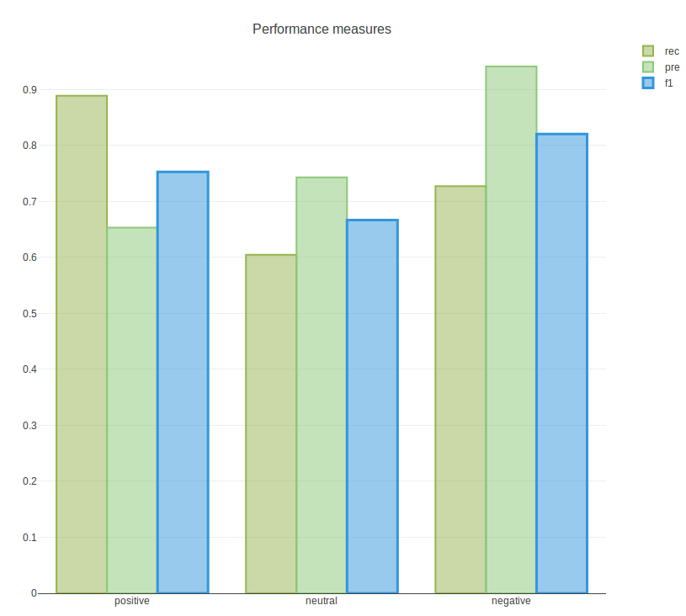
Audio-based model performance [4/5]
Evaluate the sentiment analysis on test dataset
Listen 100 segments from the test dataset to declare its polarity and compare then with the results of the sentiment classifiers
3 different polarities declared and at the final state the majority sentiment to used as ground truth
On x-axis are presented the sentiment analysis
form the sentiment classifiers and on y-axis the
results which are declared by us, listening the segments
75% positive, 65% neutral and 80% of negative segments are well classified with sentiment analysis
F1_score 0.7467068878833585
Precision: 0.779031612645058
Recall: 0.740270926317438

Slide 8
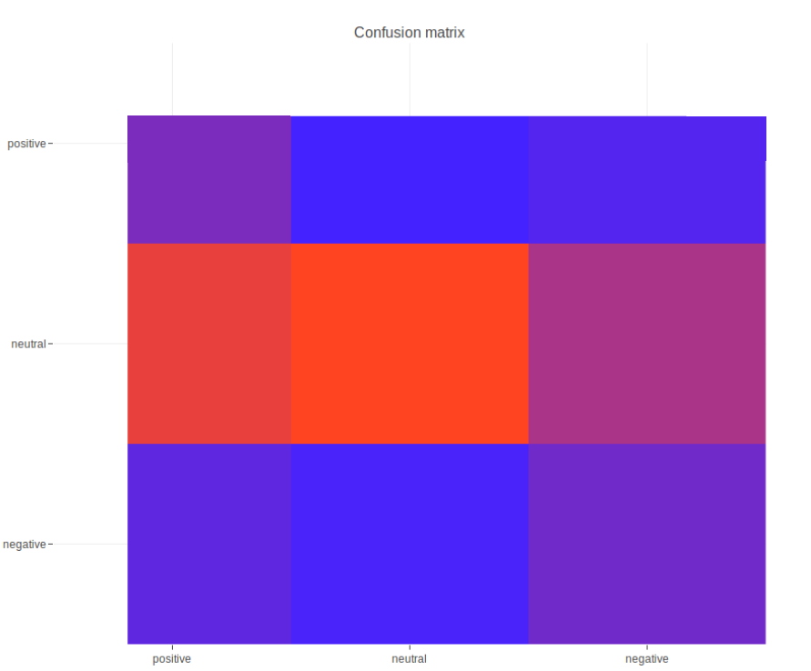
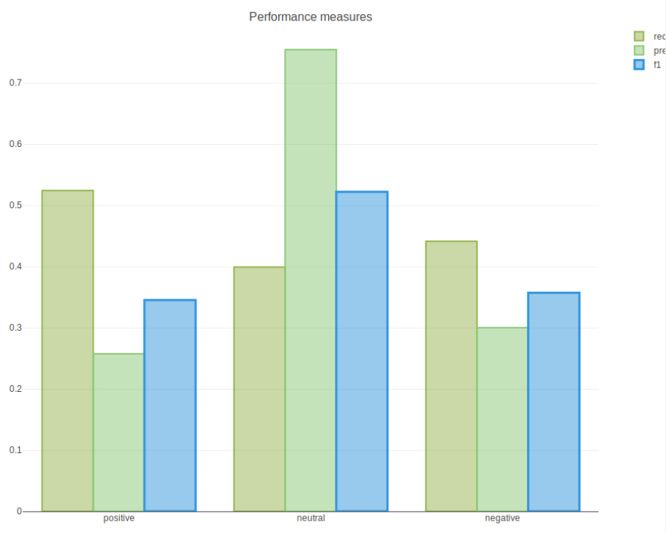
Audio-based model performance [5/5]
Performance of the audio-based emotion recognizer on test dataset
Ground truth → listen 100 segments from the test dataset, from all sentiments
37% of the positives, 50% of the neutral and 37% of negative segments are predicted well
F1_score:0.43121387283236995
On the x-axis are presented the predictions
and on y-axis the results from sentiment analysis.

Slide 9
Final Results
 | Train dataset | Test dataset
automatic text sentiment | About 80/% of segments are well classified with sentiment analysis Performance metrics of the model: F1_score: 0.7890368491509899 Precision: 0.8132850241545894 Recall: 0.7908742444346161 | About 75% positive, 65% neutral and 80% of negative segments are well classified with sentiment analysis. Performance metrics of the model: F1_score 0.7467068878833585 Precision: 0.779031612645058 Recall: 0.740270926317438
Audio-based classifier | About 60% of the positive, 55% of neutral and 30% of negative segments are predicted well. Performance metrics of the model: F1_score: 0.4833333333333333 | About 37% of the positives, 50% of the neutral and 37% of negative segments are predicted well. Performance metrics of the model: F1_score: 0.43121387283236995
https://github.com/salevizo/multimodal_audio.git

Slide 10

Thank you

