Slide 1
rnadnavar: From FASTQ to Labeled FILTER
How variant classifications are derived from raw inputs to final VCF FILTER
Notes:
EN
- This talk explains the labeling pipeline, not caller internals.
- The key goal is traceability: each final FILTER label can be traced to upstream evidence.
中文
- 本次汇报重点是标签如何生成，而不是各个 caller 的算法细节。
- 核心目标是可追溯：最终 FILTER 标签都能追溯到上游证据。

Slide 2
1) rnadnavar Workflow Introduction
status 0: DNA normal (COO8801DN)
status 1: DNA tumor (COO8801DT)
status 2: RNA tumor (COO8801RT)
Flow: FASTQ -> alignment -> calling -> consensus -> rescue -> final FILTER
Notes:
EN
- Status labels define modality and downstream routing.
- DNA and RNA are processed in parallel and converge in rescue.
中文
- status 标签决定样本所属模态及后续流程路由。
- DNA 与 RNA 并行处理，并在 rescue 阶段汇合。

Slide 3
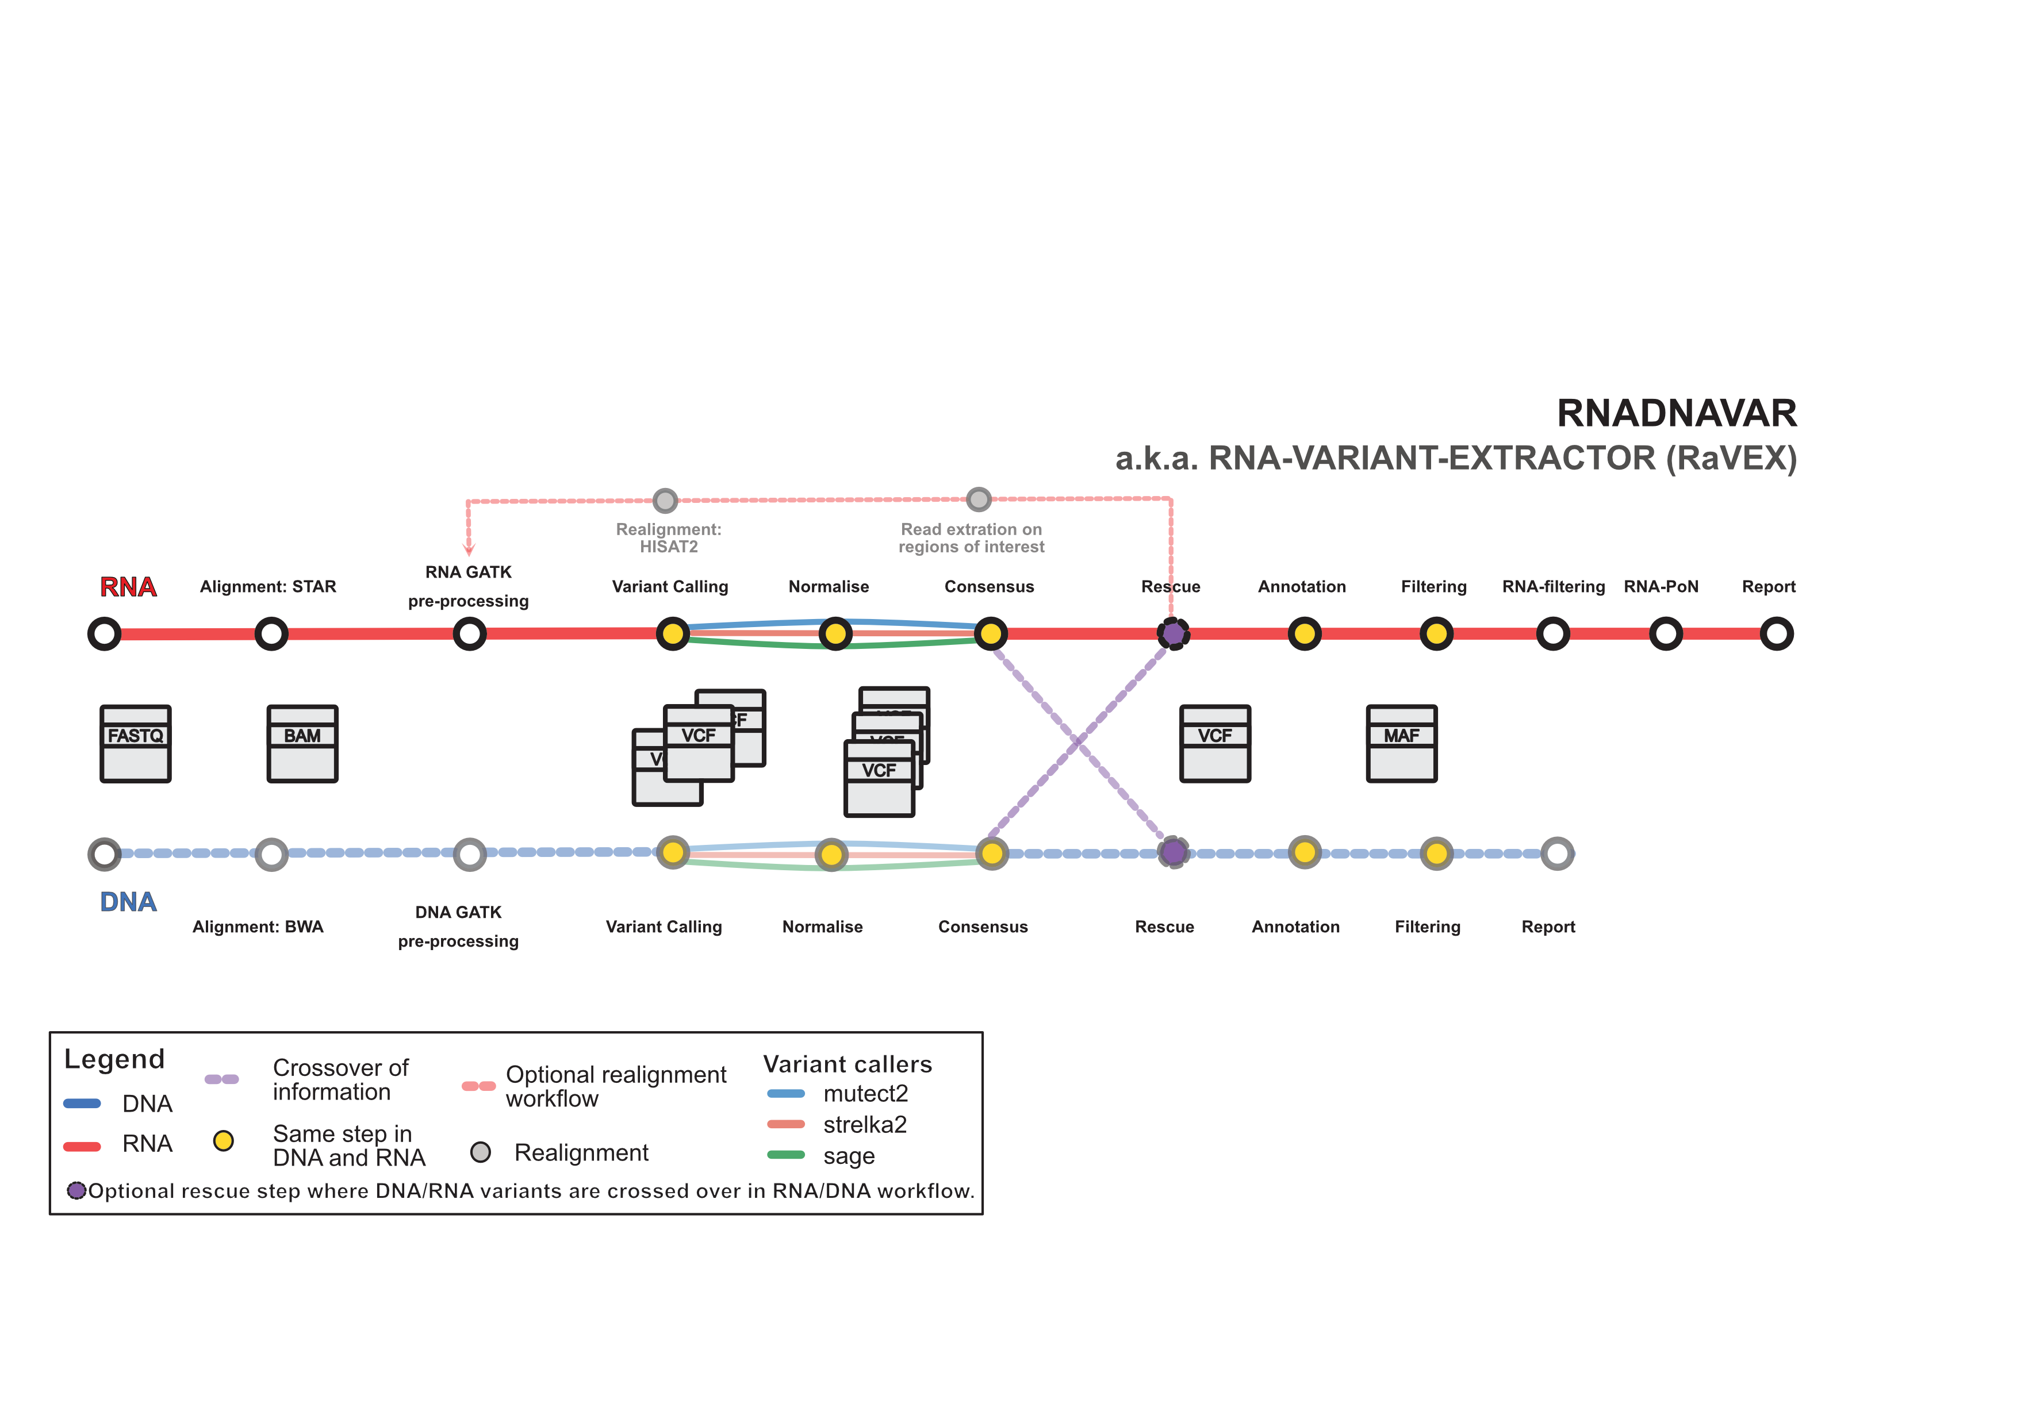
1) rnadnavar Workflow Introduction
DNA and RNA paths run in parallel, then cross over in rescue; optional RNA realignment enables second rescue.
Notes:
EN
- Use this figure to orient the audience from raw FASTQ to final VCF.
- Consensus happens within modality; rescue happens across modalities.
中文
- 此图用于展示从 FASTQ 到最终 VCF 的全流程。
- consensus 是模态内整合，rescue 是跨模态整合。

Slide 4
2) How Per-Caller Labels Are Produced
DeepSomatic FILTER -> Somatic/Germline/Reference/Artifact
Mutect2 FILTER -> Somatic/Germline/Reference/Artifact
Strelka FILTER + NT + normal depth -> biological class
These per-caller classes are the inputs to consensus labeling
Notes:
EN
- Each caller output is normalized to the same biological label space.
- This standardization enables voting across heterogeneous callers.
中文
- 每个 caller 的输出都会先标准化到统一的生物学标签空间。
- 只有先标准化，后续 consensus 投票才可比较。

Slide 5
3) Within-Modality Consensus Logics
Group same variant by normalized key within one modality
Apply thresholds: SNV 2, indel 2 (this run)
Clear majority across callers -> consensus label
Top-class tie -> Artifact; below threshold -> NoConsensus
Notes:
EN
- Consensus converts multiple caller labels to one modality-level label.
- Tie means disagreement and is intentionally labeled Artifact.
中文
- consensus 将多个 caller 标签汇总为一个模态级标签。
- 并列代表不一致，因此标记为 Artifact。

Slide 6
4) Cross-Modality Rescue Logics
Combine DNA and RNA consensus labels for each variant
If labels agree -> keep label; if disagree -> support-aware decision
One-modality consensus can still label variant when supported
Optional second rescue uses realigned RNA consensus
Notes:
EN
- Rescue integrates modality-level evidence, not raw FASTQ directly.
- Support counts from individual callers control conflict handling.
中文
- rescue 结合的是模态级证据，而不是直接从 FASTQ 判定。
- 冲突处理由各模态支持数控制，是 support-aware 逻辑。

Slide 7
5) Final VCF FILTER Categories
Somatic: final label indicates likely somatic variant
Germline: final label indicates likely inherited variant
Reference: final label indicates non-variant/reference-like evidence
Presentation scope intentionally shows only these three categories
Notes:
EN
- For this audience, final interpretation is focused on three categories.
- Other internal classes exist but are not the focus of this deck.
中文
- 本次演示只聚焦最终解释最常用的三类 FILTER。
- 其他内部类别存在，但不作为本次重点。

Slide 8
6) Traceability: FASTQ to Final FILTER
Input status labels define modality routing
Per-caller mapping creates normalized biological labels
Consensus and rescue propagate and resolve labels
Final VCF FILTER stores the unified final classification
Notes:
EN
- This is the summary chain from raw data to final label.
- The message is consistency and traceability across stages.
中文
- 该页总结了从原始数据到最终标签的完整链路。
- 核心信息是各阶段标签定义一致且可追溯。

