Slide 1
rnadnavar: From FASTQ to Labeled FILTER
How variant classifications are derived from raw inputs to final VCF FILTER
Notes:
EN
- This talk explains the labeling pipeline, not caller internals.
- The key goal is traceability: each final FILTER label can be traced to upstream evidence.
中文
- 本次汇报重点是标签如何生成，而不是各个 caller 的算法细节。
- 核心目标是可追溯：最终 FILTER 标签都能追溯到上游证据。

Slide 2
1) rnadnavar Workflow Introduction
status 0: DNA normal (COO8801DN)
status 1: DNA tumor (COO8801DT)
status 2: RNA tumor (COO8801RT)
Flow: FASTQ -> alignment -> calling -> consensus -> rescue -> final FILTER
Notes:
EN
- Status labels define modality and downstream routing.
- DNA and RNA are processed in parallel and converge in rescue.
中文
- status 标签决定样本所属模态及后续流程路由。
- DNA 与 RNA 并行处理，并在 rescue 阶段汇合。

Slide 3
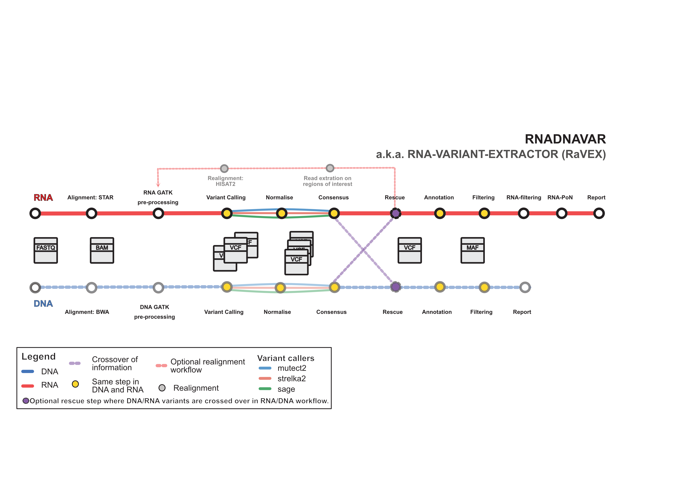
1) rnadnavar Workflow Introduction
DNA and RNA paths run in parallel, then cross over in rescue; optional RNA realignment enables second rescue.
Notes:
EN
- Use this figure to orient the audience from raw FASTQ to final VCF.
- Consensus happens within modality; rescue happens across modalities.
中文
- 此图用于展示从 FASTQ 到最终 VCF 的全流程。
- consensus 是模态内整合，rescue 是跨模态整合。

Slide 4
2) How Per-Caller Labels Are Produced
DeepSomatic FILTER -> Somatic/Germline/Reference/Artifact
Mutect2 FILTER -> Somatic/Germline/Reference/Artifact
Strelka FILTER + NT + normal depth -> biological class
These per-caller classes are the inputs to consensus labeling
Notes:
EN
- Each caller output is normalized to the same biological label space.
- This standardization enables voting across heterogeneous callers.
中文
- 每个 caller 的输出都会先标准化到统一的生物学标签空间。
- 只有先标准化，后续 consensus 投票才可比较。

Slide 5
3) Within-Modality Consensus Logics
Group same variant by normalized key within one modality
Apply thresholds: SNV 2, indel 2 (this run)
Clear majority across callers -> consensus label
Top-class tie -> Artifact; below threshold -> NoConsensus
Notes:
EN
- Consensus converts multiple caller labels to one modality-level label.
- Tie means disagreement and is intentionally labeled Artifact.
中文
- consensus 将多个 caller 标签汇总为一个模态级标签。
- 并列代表不一致，因此标记为 Artifact。

Slide 6
4) Cross-Modality Rescue Logics
Combine DNA and RNA consensus labels for each variant
If labels agree -> keep label; if disagree -> support-aware decision
One-modality consensus can still label variant when supported
Optional second rescue uses realigned RNA consensus
Notes:
EN
- Rescue integrates modality-level evidence, not raw FASTQ directly.
- Support counts from individual callers control conflict handling.
中文
- rescue 结合的是模态级证据，而不是直接从 FASTQ 判定。
- 冲突处理由各模态支持数控制，是 support-aware 逻辑。

Slide 7
5) Final VCF FILTER Categories
Somatic: final label indicates likely somatic variant
Germline: final label indicates likely inherited variant
Reference: final label indicates non-variant/reference-like evidence
Presentation scope intentionally shows only these three categories
Notes:
EN
- For this audience, final interpretation is focused on three categories.
- Other internal classes exist but are not the focus of this deck.
中文
- 本次演示只聚焦最终解释最常用的三类 FILTER。
- 其他内部类别存在，但不作为本次重点。

Slide 8
6) Traceability: FASTQ to Final FILTER
Input status labels define modality routing
Per-caller mapping creates normalized biological labels
Consensus and rescue propagate and resolve labels
Final VCF FILTER stores the unified final classification
Notes:
EN
- This is the summary chain from raw data to final label.
- The message is consistency and traceability across stages.
中文
- 该页总结了从原始数据到最终标签的完整链路。
- 核心信息是各阶段标签定义一致且可追溯。

Slide 9
rnadnavar: From FASTQ to Labeled FILTER
Optimized Variant Classification Workflow
End-to-End Tracking and Rescue Integration
Notes:
欢迎了解 rnadnavar 分析流程。
本简报将带您鸟瞰从原始测序数据（FASTQ）到最终变异标记（Labeled VCF FILTER）的全过程。
我们将把原始的详细步骤精简为核心的三大环节：变异检测原理、组学内部共识（Consensus）与跨组学拯救（Rescue），为您提供清晰的全景视图。

Slide 10
End-to-End Workflow Architecture
1. Input FASTQ
(Status 0, 1, 2)
2. Alignment & Preprocessing
(DNA/RNA Parallel Tracks)
3. Variant Calling
(DeepSomatic, Mutect2, Strelka)
4. Within-Modality Consensus
(Voting & Filtering)
5. Cross-Modality Rescue
(DNA & RNA Integration)
6. Final VCF Labeled FILTER
(Somatic, Germline, Reference)
Notes:
如图所示，这是整个数据处理的完整流程图。
1. 数据流分为并行处理的 DNA 和 RNA 两条主线。
2. 数据经过高质量的比对（Alignment）后，交由多种检测器（如 DeepSomatic）进行变异检测（Variant Calling）。
3. 接着，基于投票机制生成单组学共识（Modality Consensus）。
4. 最后，在 Rescue 阶段进行跨组学相互印证和融合，输出最终的高可信 VCF 过滤标签。

Slide 11
Variant Calling & Consensus Logic
Per-Caller Classification Mapping:
DeepSomatic & Mutect2 map direct filters to Somatic/Germline/Artifact.
Strelka uses normal tier (NT) and read depths to derive biological class.
Within-Modality Consensus (Voting):
Variants are grouped by normalized keys separately in DNA/RNA tracks.
Strict thresholds applied (e.g., SNV ≥ 2, Indel ≥ 2 valid caller support).
A clear majority establishes the label; ties default to 'Artifact'.
Notes:
本页详细说明了单组学内部的数据处理逻辑。
首先，各检测软件（如 DeepSomatic, Mutect2 和 Strelka）根据其独有的算法生成基础的突变分类标签。
接着，系统会对这些标签进行汇总，即“共识（Consensus）”阶段：系统基于同类归一化后的变异进行多数投票。
只有满足最低支持软件数量（例如至少2个软件支持）的突变才会获得有效共识标签。若各软件意见平局或不明确，为了严谨起见，通常会被保守标记为 Artifact（假阳性/伪影）。

Slide 12
Cross-Modality Rescue & Final Categories
Cross-Modality Integration (Rescue):
Combines DNA and RNA consensus labels on a per-variant basis.
Agreeing labels validate the variant strongly.
Conflicting labels undergo a support-aware resolution algorithm.
Optional second rescue phase uses newly realigned RNA data.
Final VCF FILTER Categories Delivered:
Somatic: High-confidence acquired tumor mutations.
Germline: Highly likely inherited variants.
Reference: Insufficient variant evidence or reference-like state.
Notes:
跨组学拯救（Rescue）是流程的最高决断阶段。
在此阶段，系统比对 DNA 与 RNA 的共识结果。如果双方一致，突变可信度极高；如果不一致，算法会基于多维度证据支持度进行高级决策（可结合可选的 RNA 二次比对进行补充拯救）。
最终，变异结果会被清晰、精准地分类输出在 VCF 文件的 FILTER 列中：
1. Somatic (体细胞突变)
2. Germline (生殖细胞突变)
3. Reference (参考集/非突变)
极大降低了人工复核的复杂度。

