Slide 1


Computer Vision
2024/2025
Valerio Massimo Carioti
Efficient Anomaly Detection in Industrial Images using Transformers with Dynamic Tanh

Slide 2
The Challenge:
Developing an Efficient Anomaly Detection System
1
2
3
4
5
Anomaly detection is required to guarantee high quality products
Vision Transformers are computationally demanding
Dynamic Tanh offers an easy way to increase efficiency
6
7
8
9
10
11
12
13

Slide 3
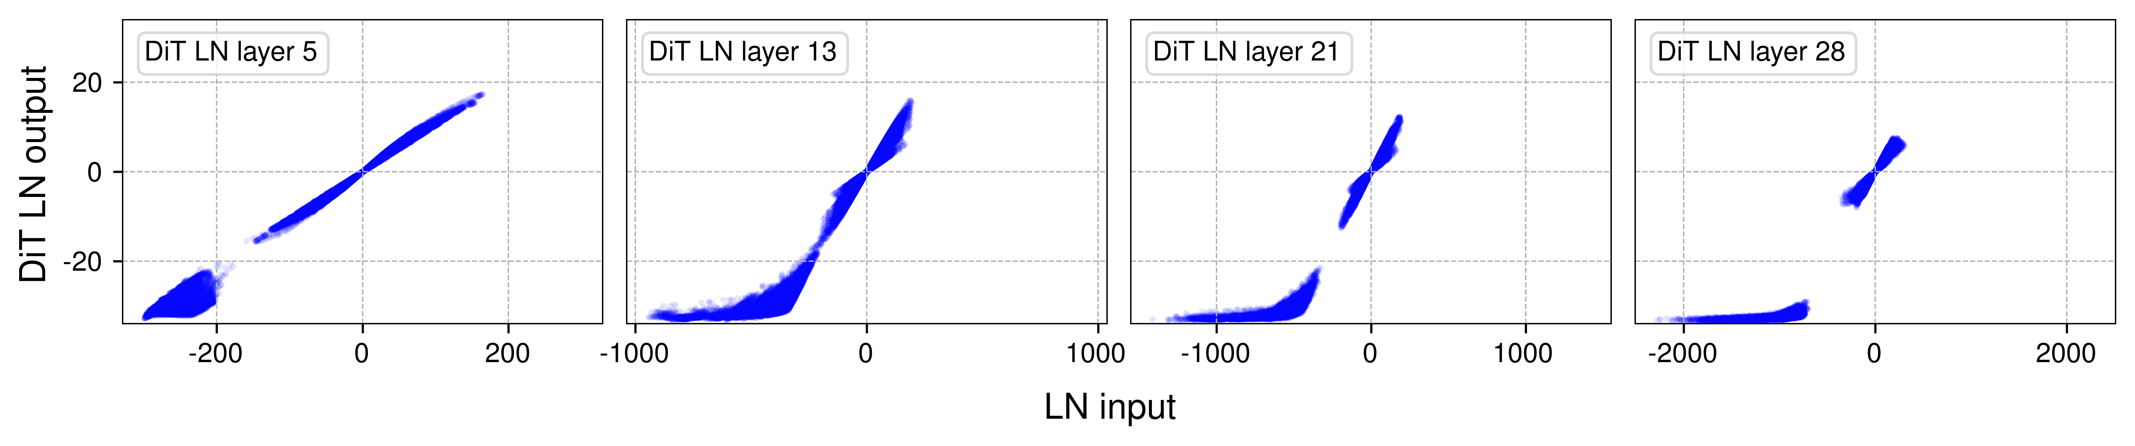
1
Tested Methods
2
1 – Better implementation of a model
Use of VT-ADL¹
Full re-implementation to have more hyperparameters available
​2 - Use of Dynamic Tanh​²
This layer offers a faster alternative to layer normalization in transformers
3
4
5
6
7
8
9
10
11
12
13
[1] Mishra P., Verk R., Fornasier D., Piciarelli C., Foresti G. L., VT-ADL: A Vision Transformer Network for Image Anomaly Detection and Localization (2021)
[2] Zhu J., Chen X., He K., LeCun Y., Liu Z., Transformers without Normalization (2025)

Slide 4

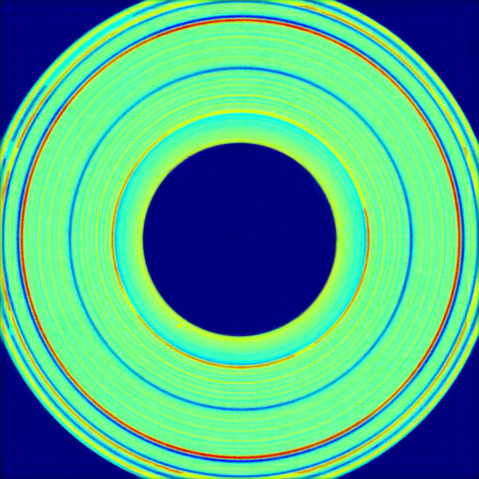
The Model
1
2
VT-ADL
3
4
Structure:
ViT encoder
Add of noise
Routing algorithm
Decoder recontruction
Mixture Density Network
Upscaling + smoothing
5
6
7
8
9
10
Loss:​
Composed by:
MDN loss
SSIM loss
Reconstruction loss (MAE)
11
12
13

Slide 5
VT-ADL re-implementation
1
2
3
Available efficiency-related hyperparameters:
4
Original Implementation:
Routing iterations
Number of gaussians
Encoder depth
Encoder feed forward dimension
Our Implementation:
Image size
Patch size
Latent channels
Encoder heads
Encoder depth
Encoder feed forward dimension
Capsules per patch
Capsule size
Routing iterations
Number of gaussians
Use of dynamic tanh
Matrix multiplication precision
5
6
7
8
9
10
11
12
13

Slide 6
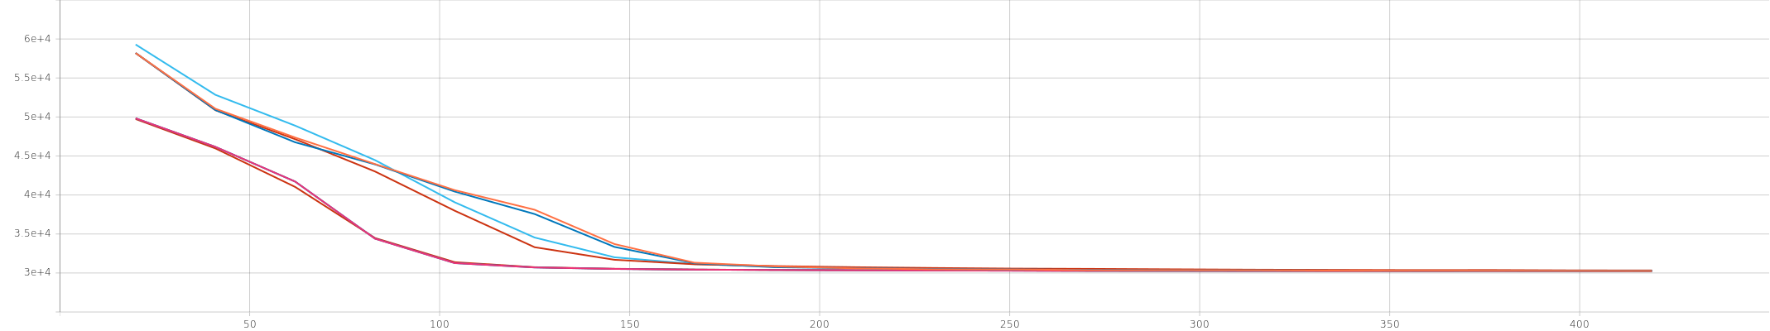
Exploring Hyperparameters
1
2
3
Changed one hyperparameter at the time
Trained for 20 epochs
Kept the new value if the cumulative loss was less than or almost equal to the previous one
4
5
6
7
8
9
10
11
12
Loss evolution on MVTech with different hyperparameters
13

Slide 7
VT-ADL re-implementation
1
2
3
4
What achieved:
5
6
Changed Parameter | Original Value | New MVTech Value | New BTAD Value
Encoder Heads | 8 | 8 | 2
Encoder depth | 6 | 2 | 2
Encoder feed forward dimension | 1024 | 512 | 1024
Capsules per patch | 64 | 32 | 64
Capsule dimension | 8 | 8 | 2
Routing iterations | 3 | 1 | 1
Number of gaussians | 150 | 50 | 50
Precision | Full | bf16-mixed | bf16-mixed
7
8
9
10
11
12
13

Slide 8
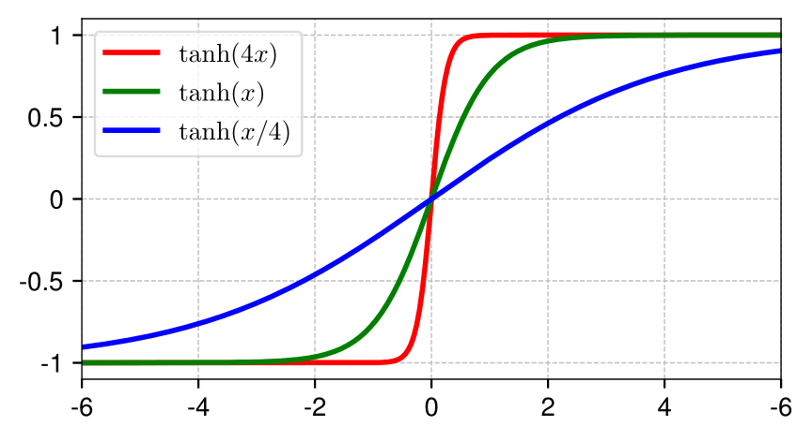
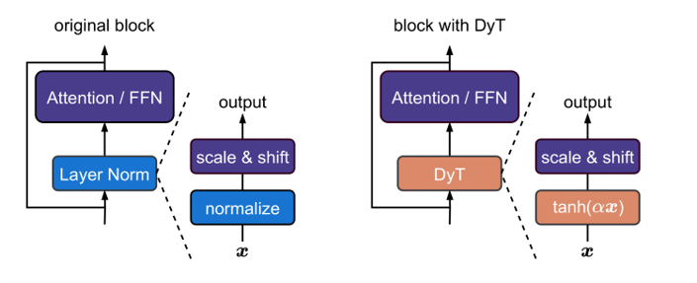
Use of Dynamic Tanh
1
2
3
Replaces the LayerNorm in the transformer encoder
Initialized with alpha = 0.5
4
5
6
7
8
9
10
11
12
13

Slide 9
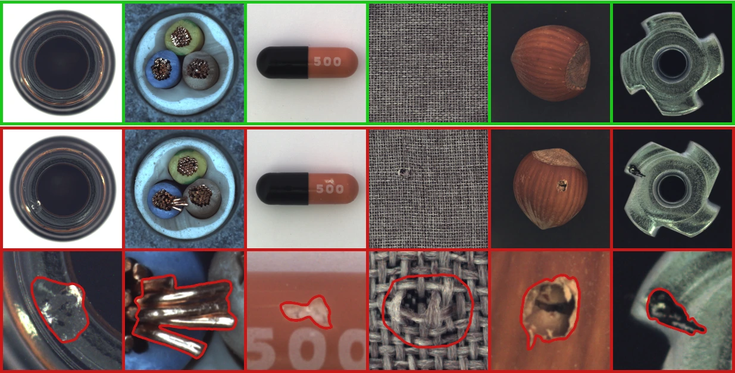
The Datasets
1
2
2 datasets have been used:
MVTech³: a benchmark dataset focused on industrial inspection
BTAD: an industrial anomaly dataset with real data from the beanTech company
3
4
5
6
7
8
9
10
11
12
13
[3] Bergmann P., Fauser M., Sattlegger D., Steger C., MVTec AD — A Comprehensive Real-World Dataset for Unsupervised Anomaly Detection (2021)

Slide 10
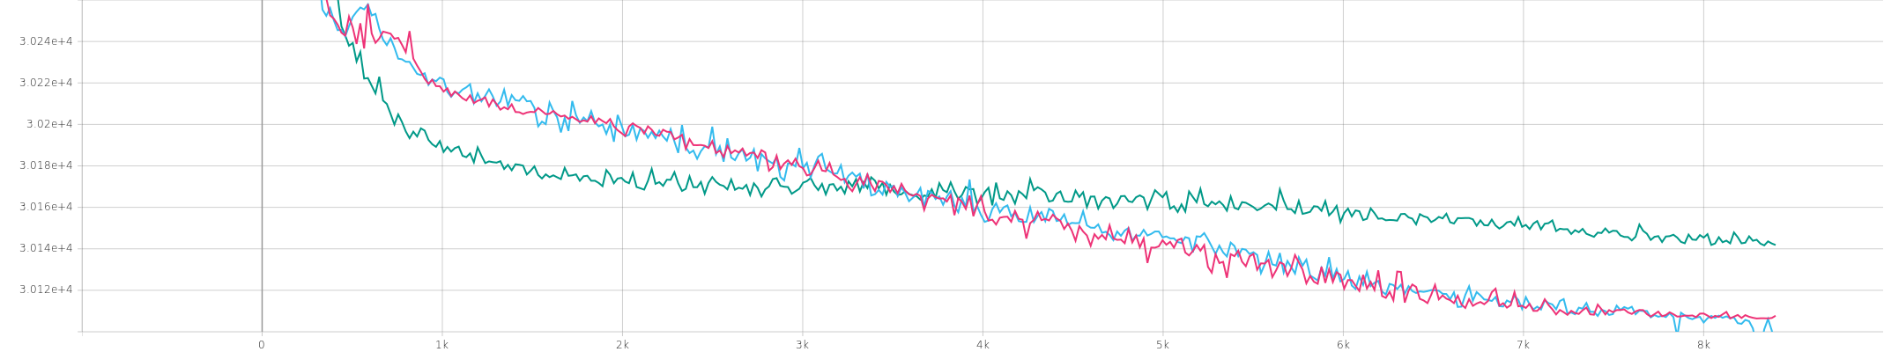
6
Results
1
2
3
MVTech
4
 | Original | Light – Layer Norm | Light - DyTanh
Pro-Score | 0.3603 | 0.4472 | 0.4394
Training time (min.) | 16.98 | 11.70 | 11.70
Inference time | 23.74 | 23.00 | 23.05
GFLOPS | 91.73 | 81.64 | 81.64
GMACS | 128.93 | 126.24 | 126.24
# Parameters (M) | 12.75 | 7.49 | 7.48
5
6
7
8
9
10
11
12
13
l Original l Light – Layer Norm l Light - DyTanh

Slide 11
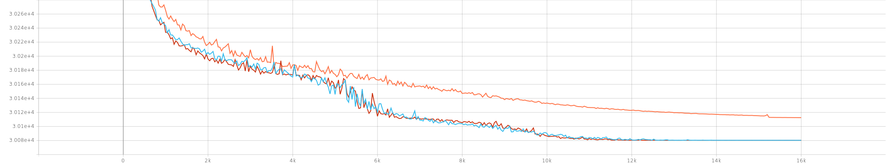
6
Results
1
2
3
BTAD
4
 | Original | Light – Layer Norm | Light - DyTanh
Pro-Score | 0.7007 | 0.6039 | 0.4369
Training time (min.) | 31.24 | 20.76 | 20.92
Inference time | 23.76 | 23.00 | 23.06
GFLOPS | 91.73 | 82.73 | 82.73
GMACS | 128.93 | 126.78 | 126.77
# Parameters (M) | 12.75 | 8.54 | 8.53
5
6
7
8
9
10
11
12
13
l Original l Light – Layer Norm l Light - DyTanh

Slide 12
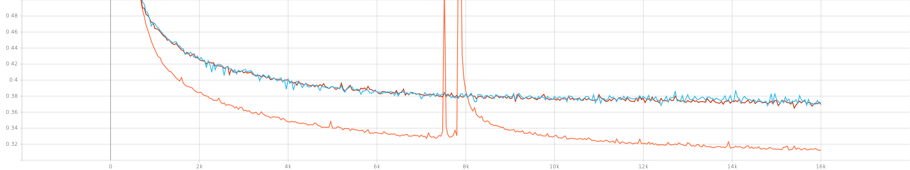
What Happened?
1
2
3
The comulative loss is not everything:
The original implementation has higher loss
But lower SSIM loss!
4
5
6
7
8
9
10
11
12
13
l Original l Light – Layer Norm l Light - DyTanh

Slide 13
Conclusions
1
2
3
4
5
6
Hyperparameter tuning for efficiency matters
Dynamic Tanh didn't show notable results
Maybe in future (optimized) implementations
7
8
9
10
11
12
13

Slide 14
1
References
2
3
4
Mishra P., Verk R., Fornasier D., Piciarelli C., Foresti G. L., VT-ADL: A Vision Transformer Network for Image Anomaly Detection and Localization (2021)
Zhu, J., Chen, X., He, K., LeCun, Y., & Liu, Z., Transformers without Normalization (2025)
Liu J., Xie G., Wang J., Li S., Wang C., Zheng F., Jin Y., Deep Industrial Image Anomaly Detection: A Survey (2024)
Bergmann P., Fauser M., Sattlegger D., Steger C., MVTec AD — A Comprehensive Real-World Dataset for Unsupervised Anomaly Detection (2021)
Sabour S., Frosst N., Hinton G. E., Dynamic Routing Between Capsules (2017)
5
6
7
8
9
10
11
12
13

Slide 15
Computer Vision
2024/2025
Valerio Massimo Carioti
Thanks for your time

