Slide 1

Neural Networks
06/02/2026
Valerio Massimo Carioti
Hybrid Models for Hyperspectral Image Classification

Slide 2
Project Aim
1
Labeled hyperspectral images are hardly available
Precise classification requires both local features and global context
Use of a small hybrid CNN-Transformer architecture
Data expansion techniques can help
2
3
4
5
6
7

Slide 3
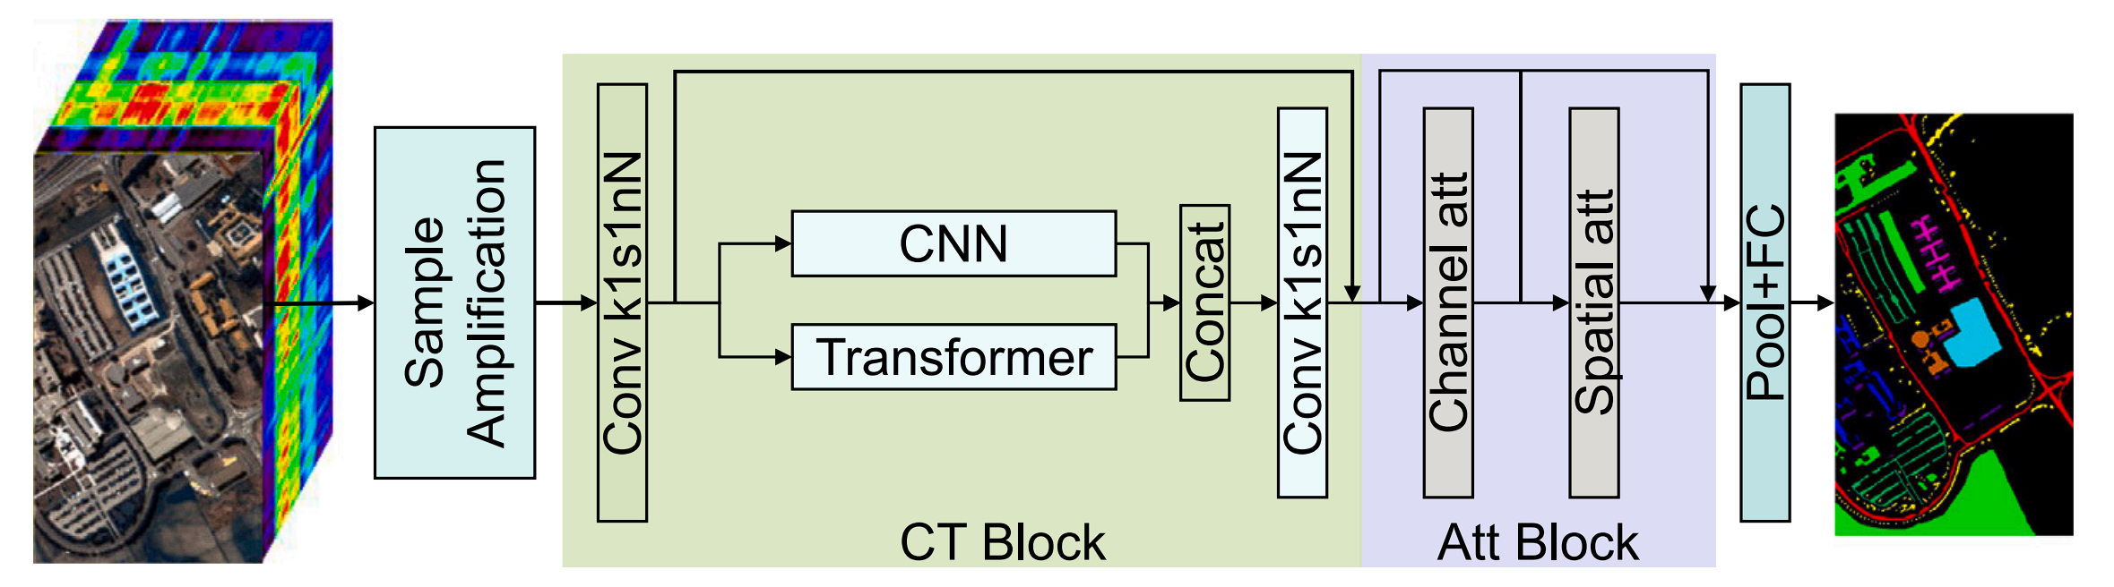
CTA-net*
1 – Data Expansion
Traditional data augmentation techniques has to be adapted to hyperspectral images
​2 - CNN-Transformer
2 branches:
Multi-resolution CNN for local features
Transformer for global context
1
2
3 – Channel-Spatial Attention
Two lightweight attention modules that capture relations between channels and between positional features
3
4
5
6
7
*CNN-Transformer and Channel-Spatial Attention based network for hyperspectral image classification with few samples, Fu et al., 2025

Slide 4
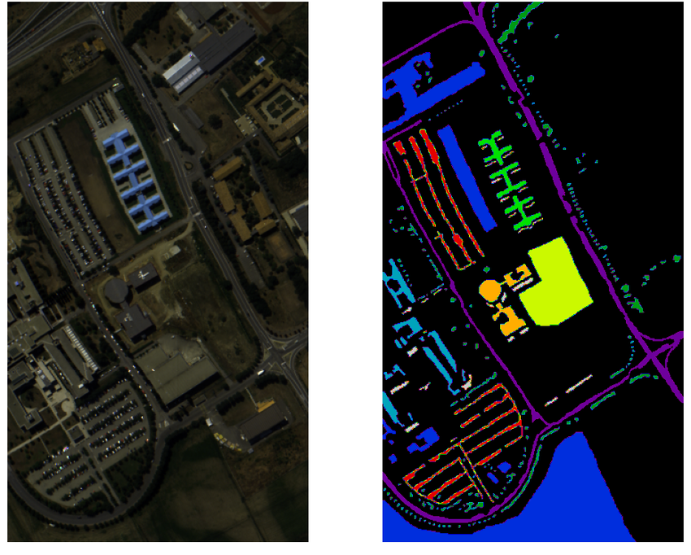
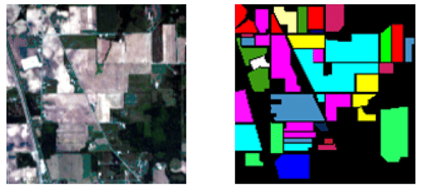
Dataset
Pavia University:
Urban setting
103 useful bands
Resolution of 1.3m
42776 labeled pixels
9 classes
Indian Pines:
Agricultural setting
200 useful bands
Resolution of 20m
10249 labeled pixels
16 classes
1
2
3
4
5
To test the pipeline when very few data are available, only 10 samples of each class were used for training and 5 for validation.
Each channel has been normalized independently based on the training set.
10 runs with different training and validation sets
6
7
Learning Hyperspectral Feature Extraction and Classification with ResNeXt Network, Nyasaka et al., 2020

Slide 5
Data Expansion
The central pixel carries more information than in RGB images: traditional techniques must be adapted
1
2
3 offline techniques:
Random rotation
Noise addition, excluding the central pixels
Linear summation between elements of the same class
3
4
Increase variance in training samples:
Online data augmentation
Randomized noise variance
Mixup instead of linear summation
5
6
7

Slide 6
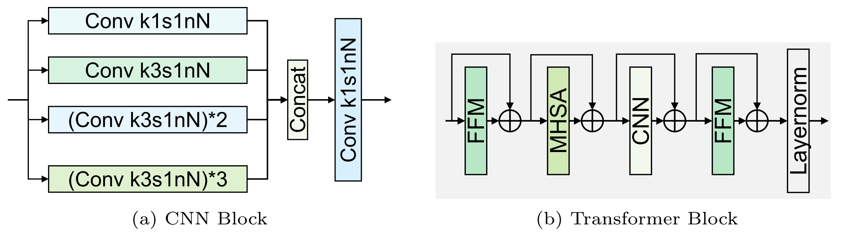
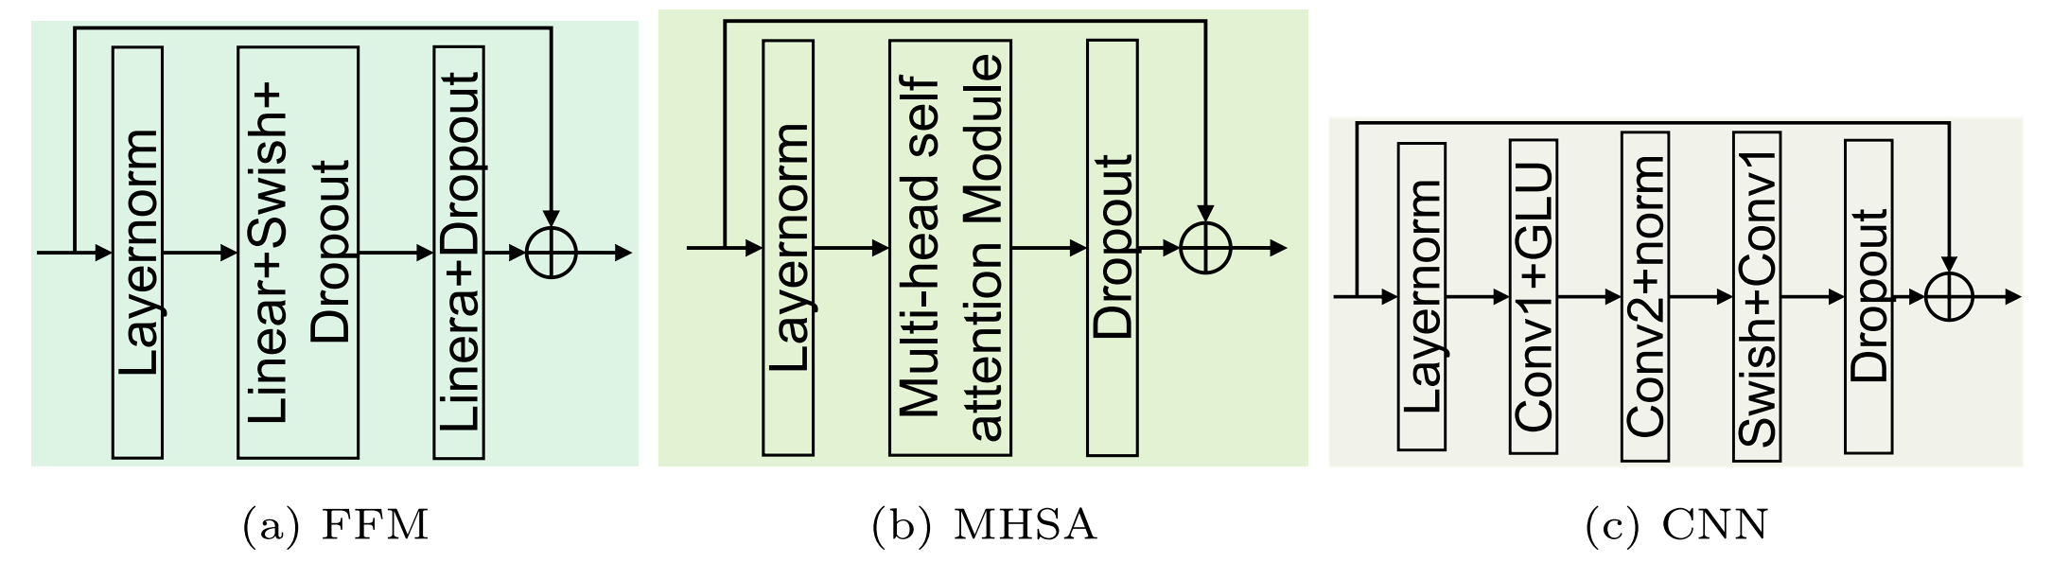
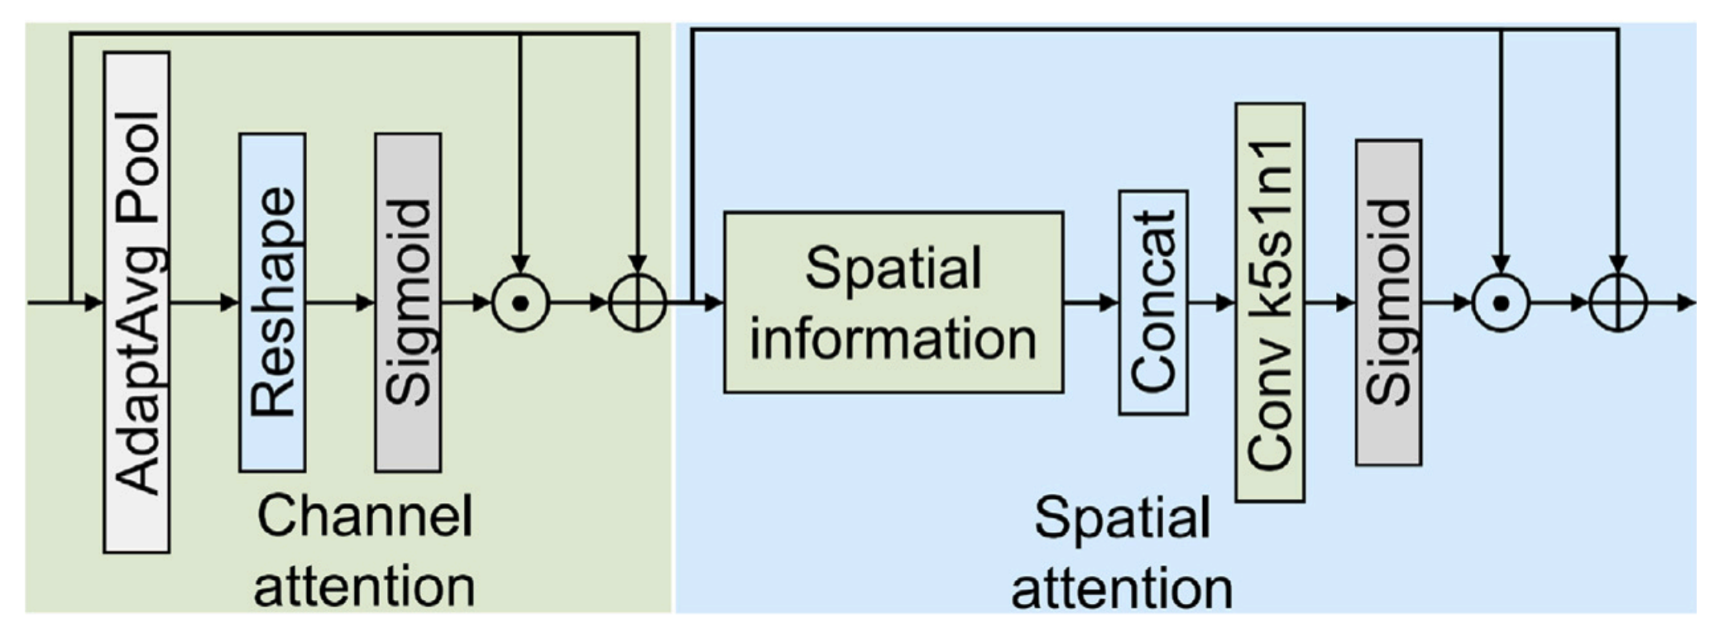
The Model
Multi-resolution CNN:
4 branches with different receptive fields
Final 1x1 convolution to merge the outputs
1
2
3
Transformer:
Combines feed forward, convolutional and multi-head self-attention layers
Use of relative positional encoding
4
5
6
7
Channel-Spatial Attention:
Weighted sum of the input features channel-wise and pixel-wise
Positional features: min, max, average and standard deviation

Slide 7
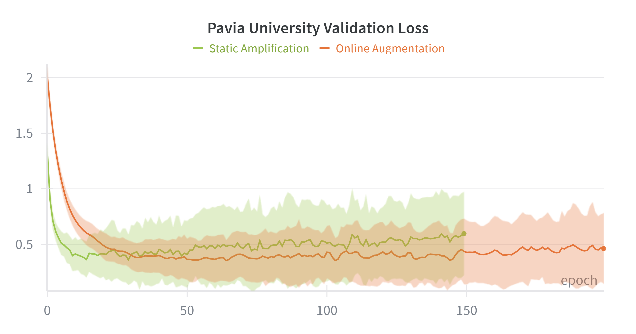
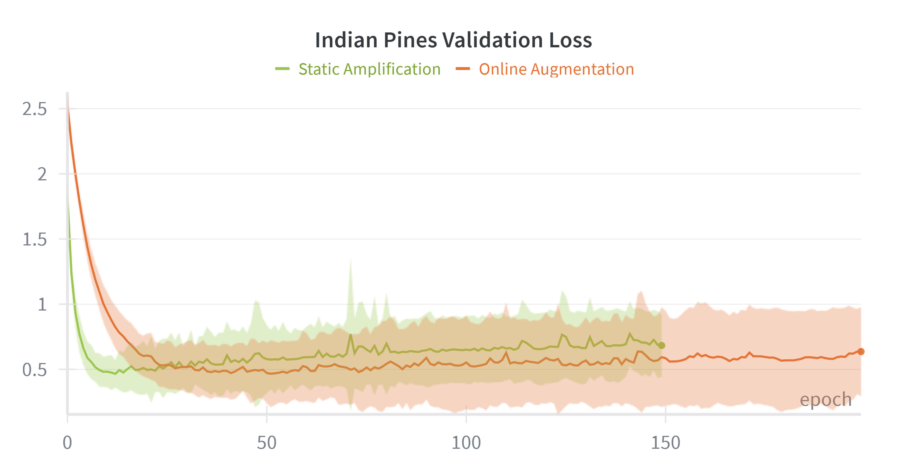
Results
Pavia University
1
metric | Static Amplification | Online Data Augmentation | Δ%
Overall Accuracy | 86.98 ± 4.94 | 86.57 ± 4.65 | -0.47%
Average Accuracy | 90.72 ± 2.55 | 90.81 ± 2.35 | +0.10%
Kappa | 83.33 ± 5.94 | 82.81 ± 5.66 | -0.63%
2
3
4
5
Indian Pines
6
7
metric | Static Amplification | Online Data Augmentation | Δ%
Overall Accuracy | 76.43 ± 1.71 | 77.84 ± 2.30 | +1.85%
Average Accuracy | 86.83 ± 1.06 | 87.45 ± 1.24 | +0.71%
Kappa | 73.51 ± 1.86 | 75.08 ± 2.51 | +2.14

Slide 8
Conclusions
1
A ligthweight network can obtain good results even with very few training samples
Online data augmentation is helpful when classes are similar to each other
Future work:
Optimize hyperparameters and data augmentation pipeline
Adapt the model to work with fewer training samples
2
3
4
5
6
7

Slide 9
Neural Networks
06/02/2026
Valerio Massimo Carioti
Thanks for your time

