Slide 1
CITS5503 AWS API Gateway
Dr Zhi Zhang

Slide 2
Overview
API gateway
My research on cloud security
Final exam
Practice questions

Slide 3
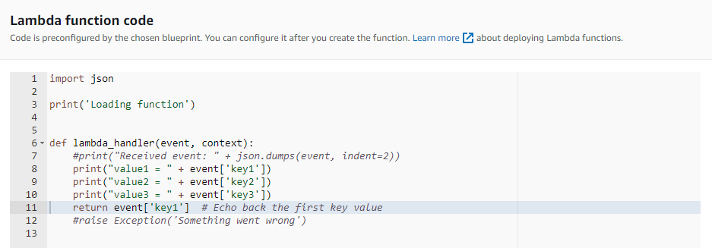
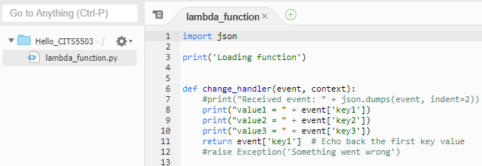

Slide 4
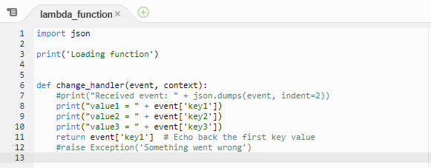
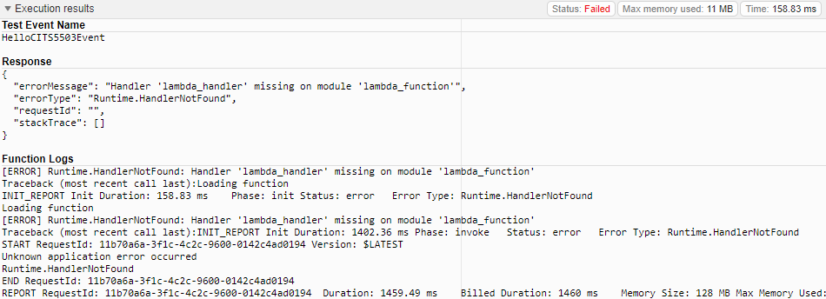

Slide 5
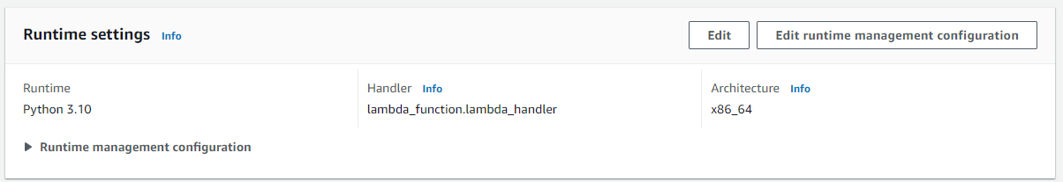
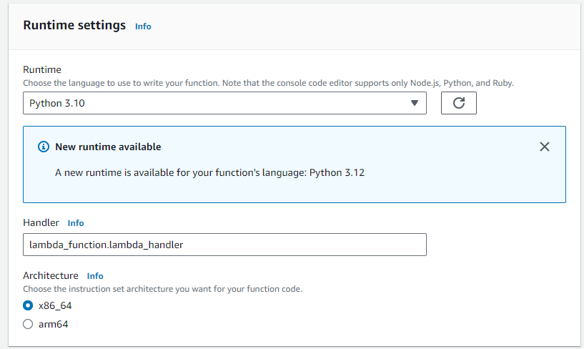
lambda_function.change_handler

Slide 6
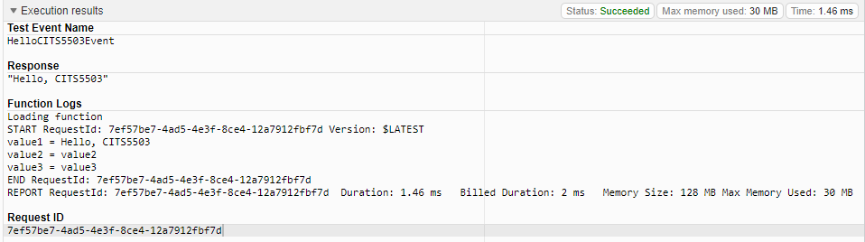

Slide 7
What is API Gateway?
It is a service for creating, publishing, and maintaining APIs at any scale.
What is API?

Slide 8
What is API Gateway?
It is a service for creating, publishing, and maintaining APIs at any scale.
What is API?
An application programming interface defines the rules for a client or an application to communicate with a target application.
e.g., a timesheet application exposes an API that requests for a student’s ID and a range of UWA semesters as inputs.

Slide 9
What is API Gateway?
It is a service for creating, publishing, and maintaining APIs at any scale.
What is API?
An application programming interface defines the rules for a client or an application to communicate with a target application.
Web API: API used for communication on the web
Examples: REST/RESTful API, WebSocket API

Slide 10
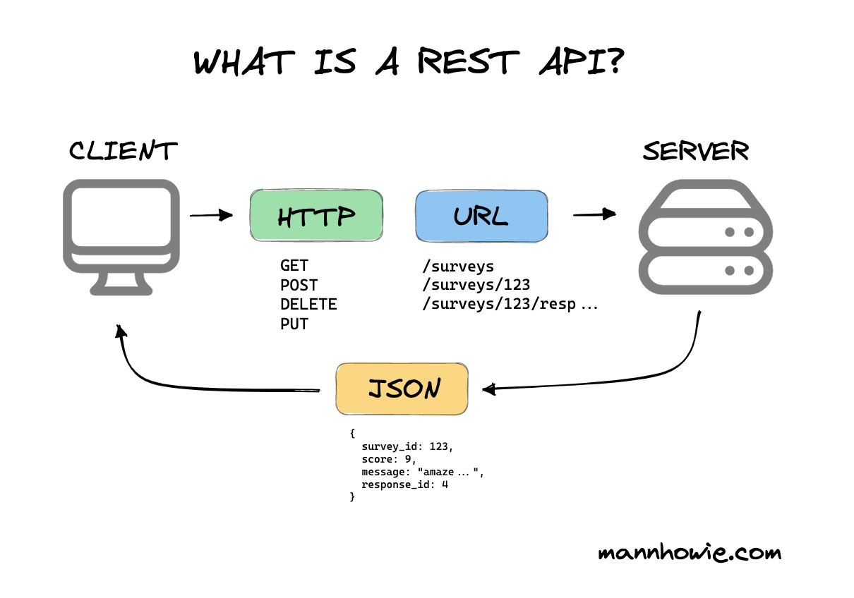
What is REST/RESTful API?
Representational State Transfer (REST) API is a software architecture that manages http(s)-based communications over the web.
HTTP verb
URL endpoint
message
https://mannhowie.com/rest-api

Slide 11
HTTP verbs
GET: make a read only request to view a resource from the server
POST: create a new resource specified in the request
DELETE: destroy a specified resource on the server
PUT: update the resource based on the request or create a new one if not exist
PATCH: update the resource if it exists

Slide 12
URL endpoints
A URL endpoint represents any given resource one HTTP verb can access
e.g., example.com/surveys, example.com/surveys/123/responses

Slide 13
Common HTTP status codes
Status code | Meaning
200 OK | A successful request.
401 Unauthorized | Server requires authentication.
403 Forbidden | Client authenticated but does not have permissions to view certain resources.
404 Not Found | Page not found because no search results or may be out of stock.
500 Internal Server Error | Server side error.
503 Server Unavailable | Server side error.

Slide 14
REST API: employs a request/response model where a client sends a request to a web service and the service responds back synchronously.

Slide 15
REST API: employs a request/response model where a client sends a request to a web service and the service responds back synchronously.
WebSocket API: employs a bidirectional model: clients can send messages to a web service, and the service can also independently send messages to clients.

Slide 16
REST API: employs a request/response model where a client sends a request to a web service and the service responds back synchronously.
WebSocket API: employs a bidirectional model: clients can send messages to a web service, and the service can also independently send messages to clients.
WebSocket: a bidirectional, full-duplex network protocol that is also used in the web scenarios.
Two main differences between HTTP(S) and WebSocket
HTTP(S) request starts with http(s)://, WebSocket request starts with ws(s)://
While HTTP(S) is a stateless protocol, WebSocket is stateful.

Slide 17
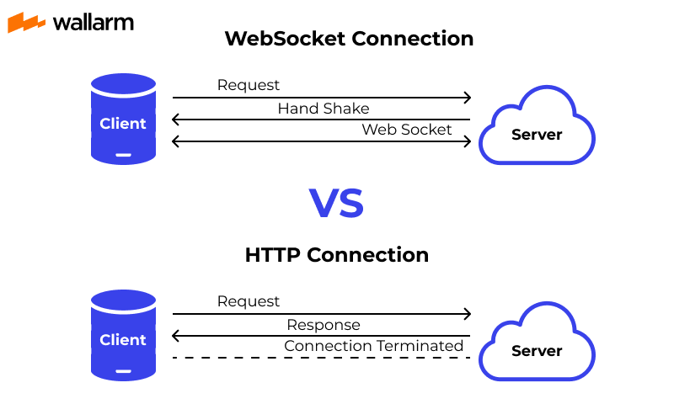
https://www.wallarm.com/what/a-simple-explanation-of-what-a-websocket-is

Slide 18
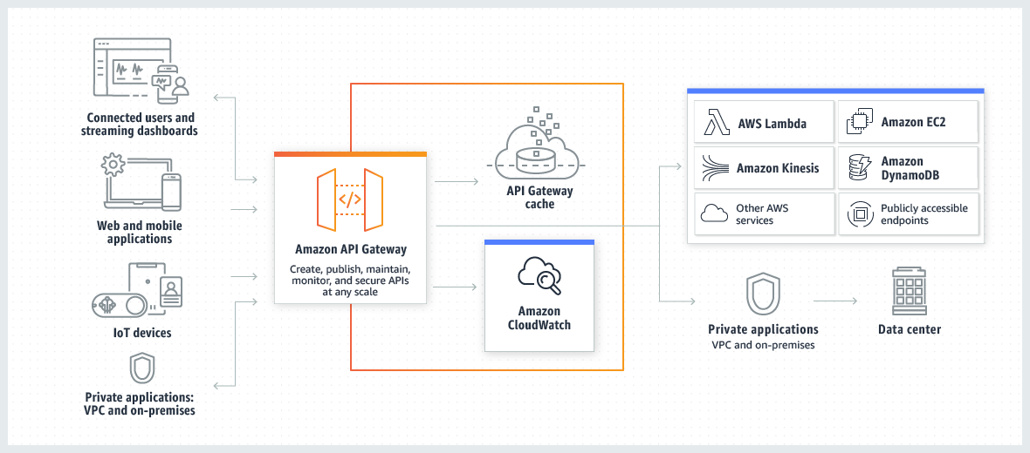
How AWS API Gateway works

Slide 19
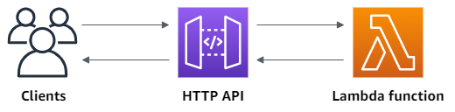
An example: HTTP API Gateway

Slide 20
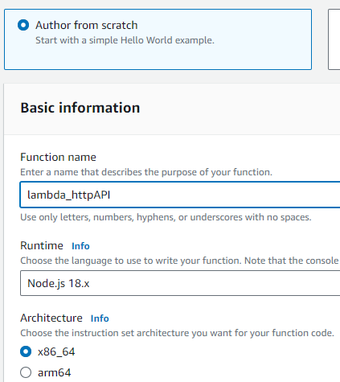
Step1: create a Lambda function

Slide 21
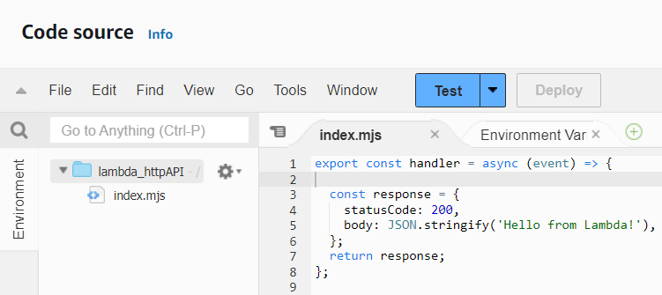
Step1: create a Lambda function

Slide 22
Step1: create a Lambda function
When the handler lambda function is invoked, it returns a status code of 200 and a JSON message of Hello from Lambda.

Slide 23
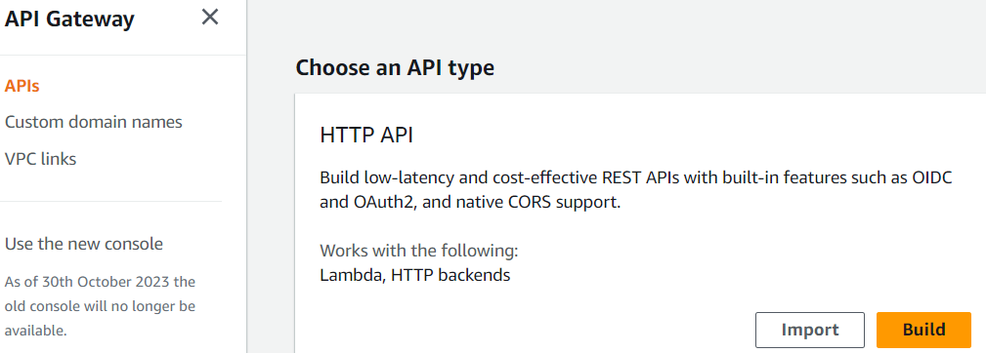
Step2: create an HTTP API

Slide 24
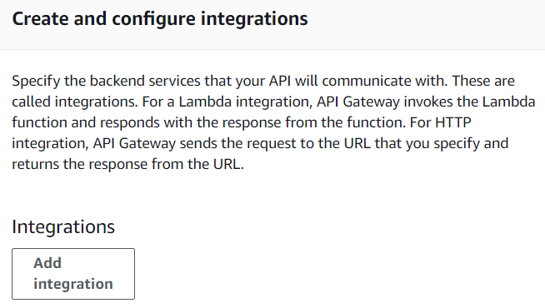
Step2.1: create and configure integrations

Slide 25
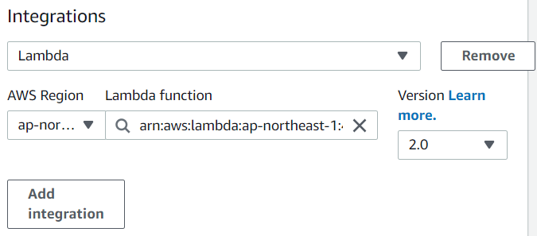
Step2.1: create and configure integrations

Slide 26
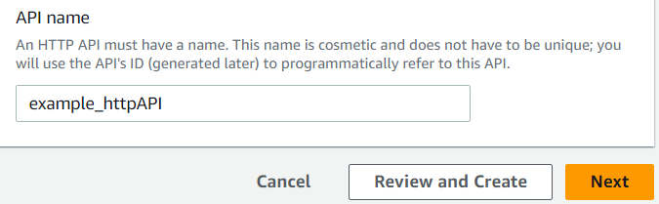
Step2.2: create the API name

Slide 27
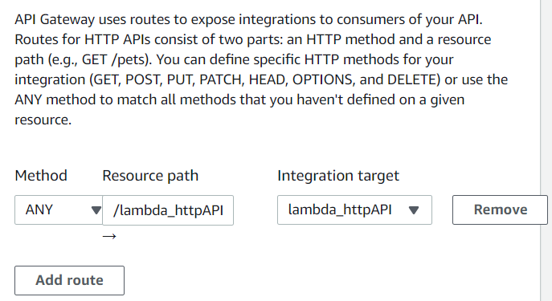
Step2.3: create routes

Slide 28
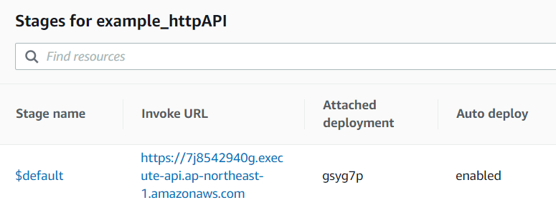
Step3: test the HTTP API
Full URL:
https://7j8542940g.execute-api.ap-northeast-1.amazonaws.com/lambda_httpAPI

Slide 29
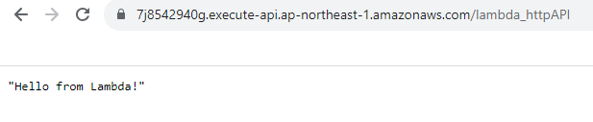
Step3: test the HTTP API

Slide 30
API gateway
My research on cloud security
Final exam
Practice questions

Slide 31
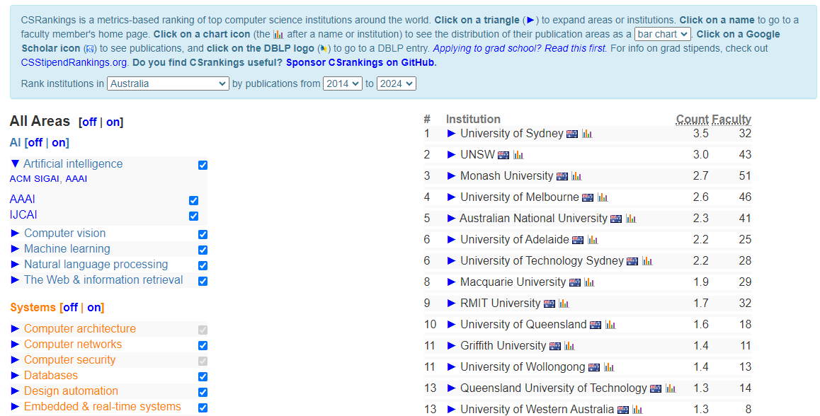
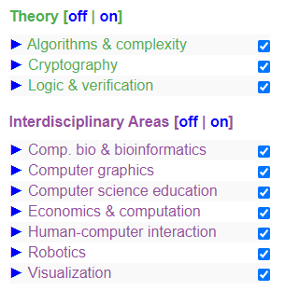
csrankings.org:

Slide 32
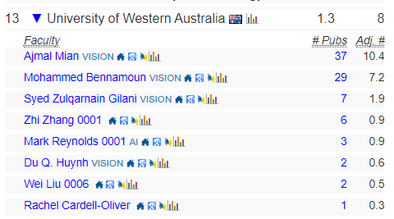
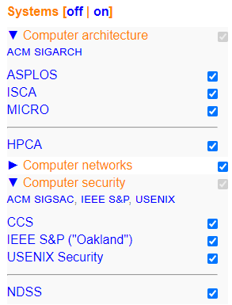
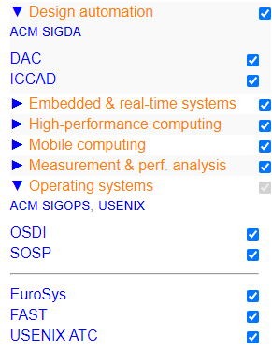
‪Zhi Zhang‬ - ‪Google Scholar‬

Slide 33
Research on cloud security
Introduction to important terms in public cloud security
A Cross-VM attack

Slide 34
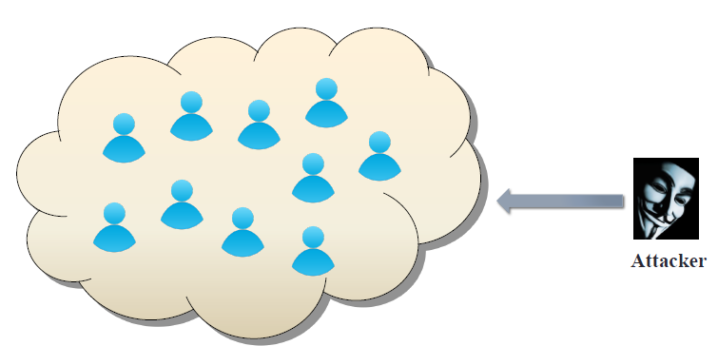
Public cloud becomes tempting target
Valuable targets:
banking, medical information, DNN models

Slide 35
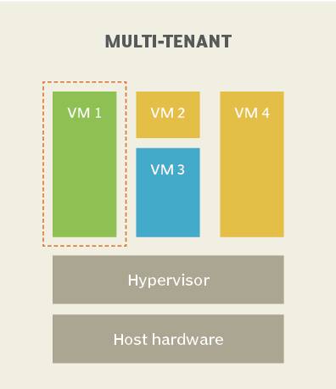
Key Terms
Multi-tenancy:
IaaS clouds multiplex virtual machines (VMs) of disjoint customers upon the same physical machines.
Co-residency:
A malicious VM is co-resident with a target VM upon the same physical machine.
https://www.techtarget.com/whatis/definition/multi-tenancy

Slide 36
Key Terms
Multi-tenancy:
Co-residency:
Placement:

Slide 37
Key Terms
Multi-tenancy:
Co-residency:
Placement:
Cross-VM attack :
The adversary from the malicious VM breaks data confidentiality or integrity against the target VM, so-called cross-VM attack.
e.g., side-channel, hardware fault
Side-channel attacks: the adversary attempts to infer a secret from a victim by gathering information about security-critical operations performed by the victim.
e.g., power consumption based side channel
Hardware-fault attacks: the adversary disrupts the normal operations of the computer hardware, compromising the integrity of the victim or the whole system.
e.g., rowhammer

Slide 38
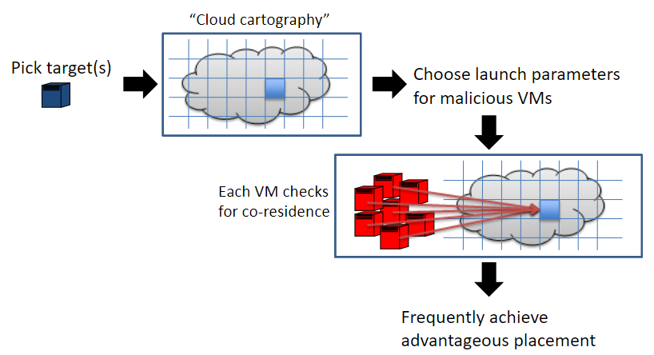
Achieve placement
2
1
Ristenpart et al. [CCS’09]

Slide 39
Achieve placement
2
1
3
4
5
Ristenpart et al. [CCS’09]

Slide 40
Power consumption-based deep-learning model stealing
Cross-VM attack

Slide 41
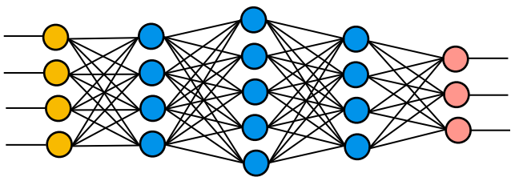

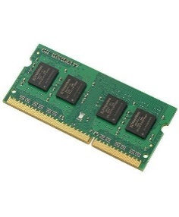
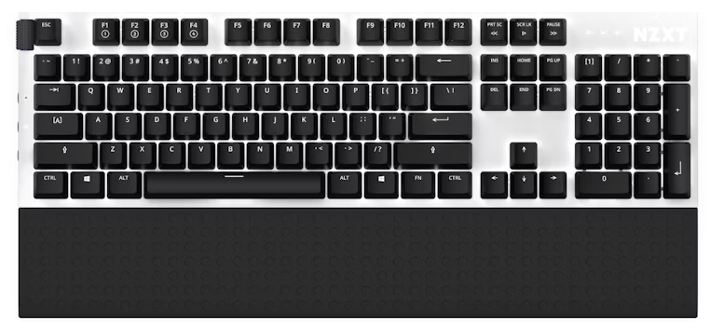
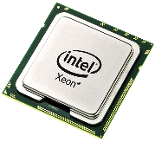
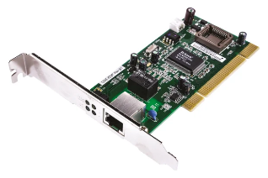
Power consumption-based deep-learning model stealing
Malicious VM
Victim VM
VMM/hypervisor
Intel RAPL framework
SW
HW
CPU and DRAM power consumption are available to VMs via Intel RAPL (Running Average Power Limit) framework.

Slide 42
DNN key terms
Training: feed-forward and back-propagation
For given input data, it goes through from the input layer to the output layer (feed-forward). The resultant output is compared against ground truth via a loss function. To minimize the loss, the weights of the network are updated accordingly (back-propagation).
Inference: a well-trained model is used to infer real-world unseen data

Slide 43
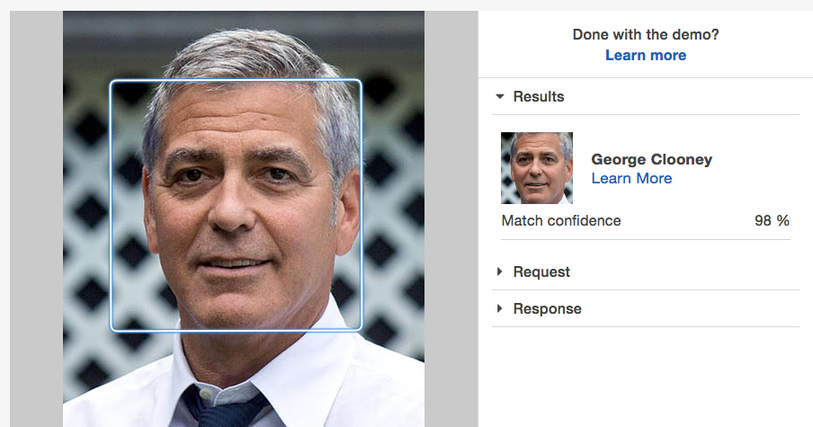
A well-trained DNN model

Slide 44
DNN key terms
DNN architecture: the whole set of processing layers.
layers: the number of layers and the type of each layer, e.g., convolutional layer, pooling layer, and fully-connected layer.
layer-wise hyperparameters, e.g., the neuron number for a fully-connected layer.

Slide 45
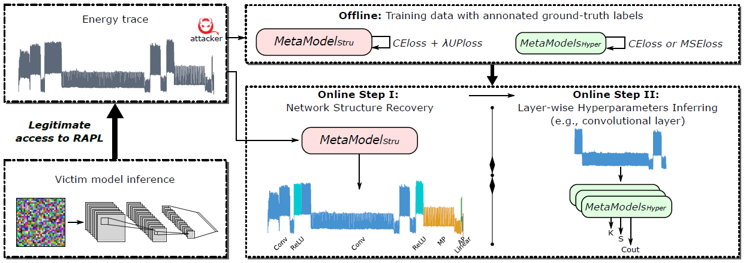
The flow of model architecture stealing
Zhang et al. (S&P’24)

Slide 46
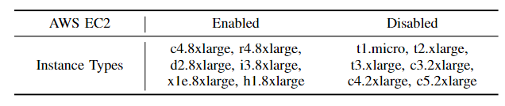
Our key observation
some (not all) EC2 instances have provided access to RAPL

Slide 47
Malicious Container
Victim Container
Docker engine
Host OS
SW
Intel RAPL framework
HW
A proof-of-concept (PoC) attack (https://github.com/LearningMaker/DeepTheft)
has been demonstrated in a recent docker environment, i.e., version 20.10.1
Zhang et al. (S&P’24)

Slide 48
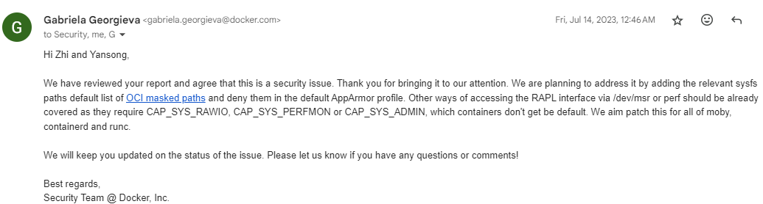
Docker container

Slide 49
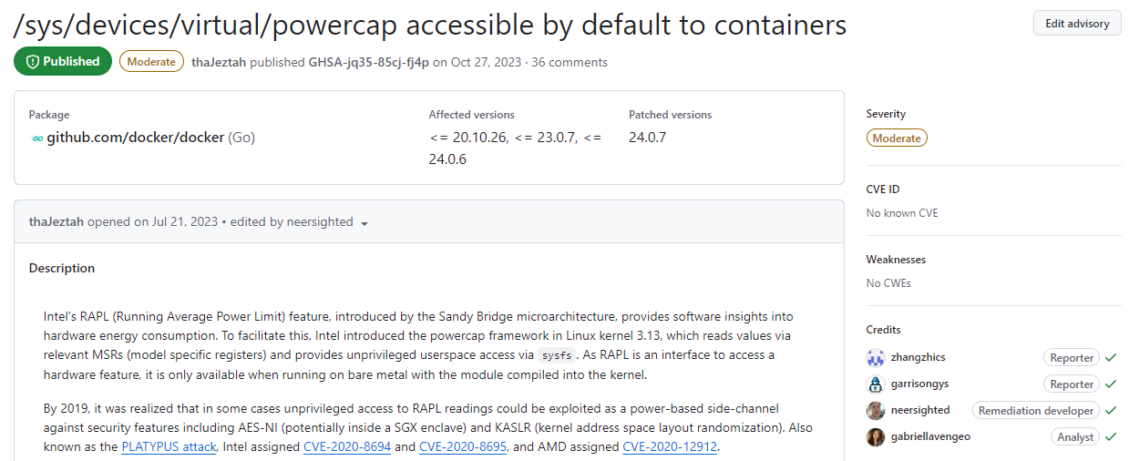
Docker container
https://github.com/moby/moby/security/advisories/GHSA-jq35-85cj-fj4p#event-104999

Slide 50
API gateway
My research on cloud security
Final exam
Practice questions

Slide 51
Exam Format
The exam is F2F and has a time limit of 2 hours
The exam is marked out of 100 points and is worth 50% of the overall unit mark.
The exam is open book: any printed or written materials are allowed (no page limit).
UWA approved calculators with stickers are NOT needed.
e.g., 2^5 - 2 or 32 -2 or 30.

Slide 52
Exam Instructions
You will be provided with an answer booklet
You should clearly state which questions of the final exam you are answering.
Please do NOT use a pencil or a red pen.
Please use readable handwriting. What cannot be read cannot be marked.

Slide 53
Exam Topics
6 themed questions in total and each themed question describes a scenario, based on which, some sub-questions are asked.
The format of sub questions is similar to that of part C in the mid-sem test, i.e., short answer questions.
Each themed question will assess one of the following topics from certain lecture notes and labs (excluding optional steps):
Networking (Week 7)
IAM (Week 5)
Miscellaneous
(Week 5 + Week 7 + Lab 5)
AI (Week 8 + Labs 8&9)
DevOps (Week 10 + Lab 7)
Miscellaneous
(Week 7 + Week 9 + Lab 6)

Slide 54
To prepare for the exam
Carefully review relevant lectures and labs (excluding optional steps).
Practice questions from last year.

Slide 55
Q1: A network can be defined as a group of computers and other devices connected for data exchange.
Part 1. Suppose the public IPv4 address has a CIDR notation of 212.114.20.0/24, this specifies the subnet where the IPv4 address resides. How many IPv4 addresses does this subnet have? Justify your answer.
Part 2. If the Internet service provider divides the original /24 subnet using /27, how many small subnets will be created? For each created subnet, how many IPv4 addresses does it have? Justify your answer.
Part 3. When a user message is being sent from a host machine, it goes forward through layers in the 5-layer TCP/IP model. Which layers in the model will add their header/trailer into the message?
Notes:
55

Slide 56
Q1: A network can be defined as a group of computers and other devices connected for data exchange.
Part 1. Suppose the public IPv4 address has a CIDR notation of 212.114.20.0/24, this specifies the subnet where the IPv4 address resides. How many IPv4 addresses does this subnet have? Justify your answer.
Answer:
the notation "/24" indicates a subnet mask of 24 bits, leaving 32-24 = 8 bits for the host portion of the IP address. Total IPv4 Addresses in a /24 subnet: 2^8 = 256 addresses.
Notes:
56

Slide 57
Q1: A network can be defined as a group of computers and other devices connected for data exchange.
Part 2. If the Internet service provider divides the original /24 subnet using /27, how many small subnets will be further created? For each created subnet, how many IPv4 addresses does it have? Justify your answer.
Answer:
when dividing a /24 subnet into /27 subnets, the ISP is using an additional 3 bits to create small subnets (27 - 24 = 3). The number of subnets created: 2^(27 - 24) = 2^3 = 8 subnets.
Within each of the small /27 subnets, 5 (32 - 27) bits are available for host addresses. Total IPv4 Addresses per /27 Subnet: 2^5 = 32.
Notes:
57

Slide 58
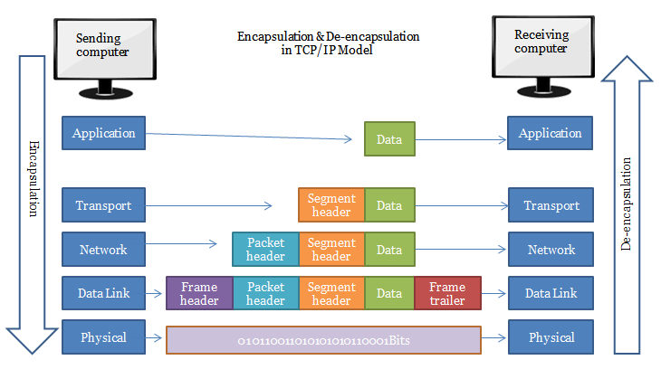
Q1: A network can be defined as a group of computers and other devices connected for data exchange.
Part 3. When a user message is being sent from a host machine, it goes forward through layers in the 5-layer TCP/IP model. Which layers in the model will add their header/trailer into the message?
Answer: Transport Layer, Network Layer, Data Link Layer
Notes:
58

Slide 59
Q2: Security and IAM
Bob is a system engineer at an internet company. One of his main jobs is to maintain their e-commerce applications that are hosted by AWS cloud. Thus, he is responsible for managing AWS resources including the AWS accounts in his company.
Part 1. His boss doesn't have much knowledge about cloud computing and is concerned about the security of AWS. Help Bob list and describe 3 critical security measures implemented by AWS.
Part 2: Bob needs to attach an identity-based policy to Alice. Explain the role of Action and Condition in a policy.
Part 3. To better manage AWS user accounts, Bob has implemented an identity-based policy for a group of certain developers within his company. The policy is called DeveloperGroup_Policy. Then, Bob adds Alice into the group. To set the maximum permissions that DeveloperGroup_Policy can grant, Bob attaches a permissions-boundary policy to Alice. The policy is called PermissionsBoundary_Policy. What are the effective permissions that Alice can perform? Justify your answer.
Notes:
59

Slide 60
Q2: Security and IAM
Bob is a system engineer at an internet company. One of his main jobs is to maintain their e-commerce applications that are hosted by AWS cloud. Thus, he is responsible for managing AWS resources including the AWS accounts in his company.
Part 1. His boss doesn't have much knowledge about cloud computing and is concerned about the security of AWS. Help Bob list and describe 3 critical security measures implemented by AWS.
Answer:
Data Encryption: AWS uses various encryption algorithms such as AES and RSA to encrypt data, ensuring the confidentiality of data during transmission and storage.
Instance/Container Isolation. AWS allows virtual machines or containers to run in their isolated and secure environments, mitigating mutual interference among them and reducing security risks from attacks by unauthorized users.
Authorization: AWS uses policies to determine what actions or resources authenticated users are allowed to access or perform, preventing damage due to the unauthorized actions of legitimate users.
Notes:
60

Slide 61
Q2: Security and IAM
Bob is a system engineer at an internet company. One of his main jobs is to maintain their e-commerce applications that are hosted by AWS cloud. Thus, he is responsible for managing AWS resources including the AWS accounts in his company.
Part 2: Bob needs to attach an identity-based policy to Alice. Explain the role of Action and Condition in a policy.
Answer:
Action: defines a set of resource operations a user/application is allowed (or denied) to perform.
Condition: is a set of criteria or rules that are specified to further refine or control the access permissions granted.
Notes:
61

Slide 62
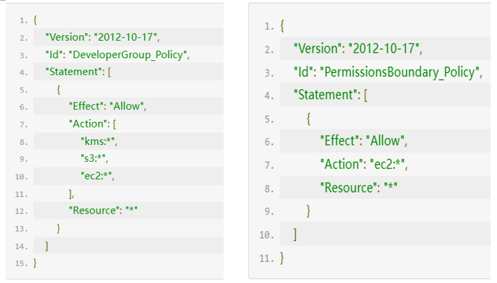
Q2: Security and IAM
Part 3. To better manage AWS user accounts, Bob has implemented an identity-based policy for a group of certain developers within his company. The policy is called DeveloperGroup_Policy. Then, Bob adds Alice into the group. To set the maximum permissions that DeveloperGroup_Policy can grant, Bob attaches a permissions-boundary policy to Alice. The policy is called PermissionsBoundary_Policy. What are the effective permissions that Alice can perform? Justify your answer.
Notes:
62

Slide 63
Q2: Security and IAM
Alice is only allowed to perform any action to EC2.
According to the DeveloperGroup _Policy, Alice can perform any actions to kms, s3 and ec2. However, Alice is attached with a permissions boundary that restricts her to any ec2-related actions. Considering that effective permissions are determined by the intersection of Identity-based policy and permissions boundary, Alice is limited to performing actions to ec2 only.
Notes:
63

Slide 64
Question 3 Fine-turning
Part 1. Hyperparameters are important in (re)training a model. To fine-tune a pre-trained model, you should retrieve its default hyperparameters and then update them based on your specific task and dataset. List 2 hyperparameters and explain their role in fine-tuning the pre-trained model.
Answer:
Learning Rate: it determines the step size at which the model's parameters (e.g., weights and biases) are updated during training.
Optimizer: it updates the model's parameters (e.g., weights and biases) during training.
Training Epochs: it represents the number of times the entire training dataset is passed forward and backward through the model during training. One epoch corresponds to one complete iteration through the entire dataset.
Batch size: it defines the number of samples processed in a single iteration (or batch) during training.
Notes:
64

Slide 65
Question 3 Fine-turning
Part 2. List 2 AWS resources that are beneficial to the pre-trained model fine-tuning and explain why.
Answer:
Amazon SageMaker, because it can provide a machine-learning environment for setting up, training, and deploying models in the cloud.
Amazon S3, because it can store dataset for fine-tuning.
Amazon EC2, because it can supply compute resources for fine-tuning the model.
Amazon CloudWatch, because it can provide metrics in real-time that help track fine-tuning progress, identify issues, and optimize model fine-tuning.
Notes:
65

Slide 66
Question 3 Fine-turning
Part 3. Given a csv file as your dataset, how will you divide it so as to fine-tune the pretrained model and evaluate its performance? Justify your answers.
Answer:
The dataset should be divided into three parts: training, validation and test datasets.
A training dataset is used to retrain the model.
A validation dataset is needed to fine-tune the hyperparameters and assess the model performance during retraining
A test dataset is required to evaluate the final retrained model to gauge its real-world performance.
Notes:
66

Slide 67
Question 4 IAM, Django and DynamoDB
Tom is a web developer and tasked with setting up a Django-based web application for music sharing. To host the application, Tom rents an EC2 instance. For the first month, the performance of the website works perfectly. However, as the website becomes increasingly popular, the website response is getting slower and sometimes it even crashes.
Part 1. Which aspect of the CIA triad has been compromised with regard to the crash? Justify your answer.
Notes:
67

Slide 68
Question 4 IAM, Django and DynamoDB
Tom is a web developer and tasked with setting up a Django-based web application for music sharing. To host the application, Tom rents an EC2 instance. For the first month, the performance of the website works properly. However, as the website becomes increasingly popular, the website response is getting slower and sometimes it even crashes.
Part 1. Which aspect of the CIA triad has been compromised with regard to the crash? Justify your answer.
Answer:
Availability
because the website is inaccessible to users
Notes:
68

Slide 69
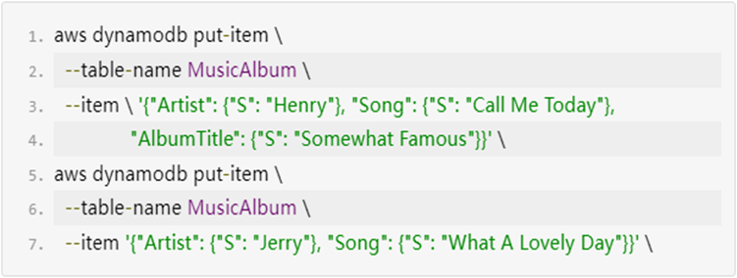
Question 4 IAM, Django and DynamoDB
Part 2. Tom decides to move the website’s user data from Postgres to DynamoDB. He has created a DynamoDB table named "MusicAlbum" with two attributes ("Artist" and "Song") where "Artist" is set as the partition key and "Song" is set as the sort key. He further populates the table via the following code snippet.
Question: If Tom performs a scan against the populated table, draw a table that shows the scanning result.
Notes:
69

Slide 70
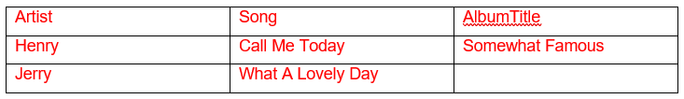
Question 4 Django and DynamoDB
Part 2.
Question: If Tom performs a scan against the populated table, draw a table that shows the scanning result.
Notes:
70

Slide 71
Good Luck!

