Slide 1
Week 2 Amazon Web Services Introduction
Dr Zhi Zhang

Slide 2
Overview
Introduction to virtualization
Introduction to AWS
Lab report submission, marking guidelines and AWS resources

Slide 3

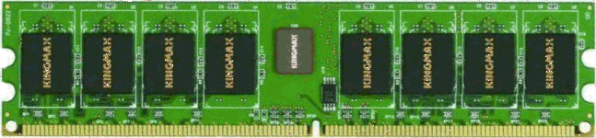





Virtualization: the core technique of cloud computing
Bob
Charlie
Alice
Physical machine
Daniel
Suppose Alice has a machine with 16 CPUs and 64 GB of memory. There are three customers:
Bob wants a machine with 8 CPUs and 32 GB of memory
Charlie wants a machine with 8 CPUs and 32 GB of memory
Daniel wants a machine with 4 CPUs and 8 GB of memory
What should Alice do?

Slide 4


Virtualization: the core technique of cloud computing
Bob
Virtual machine monitor
Charlie
Alice
Physical machine
Virtual machines
Daniel
Alice installs a virtual machine monitor (VMM) and provides each customer with a guest OS/virtual machine (VM) and the requested resources
Bob is assigned with 8 vCPUs and 32 GB of guest physical memory
Charlie is assigned with 8 vCPUs and 32 GB of guest physical memory
Daniel is assigned with 4 vCPUs and 8 GB of guest physical memory
Obviously, more resources are provided by virtualization.

Slide 5
VM isolation
Bob
Virtual machine monitor
Charlie
Alice
Physical machine
Virtual machines
Daniel
One VM cannot access data of another VM

Slide 6
VM live migration
Bob
Virtual machine monitor
Alice
Charlie
Virtual machines
Daniel
Physical machines
What if the machine needs to be shut down for maintenance?
Alice can migrate the running VMs to different physical machines without interrupting any customers.

Slide 7
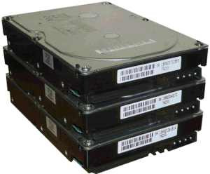
How is virtualization implemented?
VM 1
VM 2
VM | Mem_Idx in VM | Mem_Idx in VMM
1 | 0-99 | 0-99
1 | 300-399 | 100-199
2 | 0-99 | 300-399
2 | 200-299 | 500-599
2 | 600-699 | 400-499
App
App
App
OS 1
OS 2
VMM
Translation table
Physical machine
VMM ("Hypervisor") has translation tables that map guest memory to physical memory
Example: VM 1 accesses memory cell #0; VMM maps this to memory cell #0. VM 2 accesses memory cell #0; VMM maps this to memory cell #300.

Slide 8
How is virtualization implemented?
VM 1
VM 2
VM | Mem_Idx in VM | Mem_Idx in VMM
1 | 0-99 | 0-99
1 | 300-399 | 100-199
2 | 0-99 | 300-399
2 | 200-299 | 500-599
2 | 600-699 | 400-499
App
App
App
OS 1
OS 2
VMM
Translation table
Physical machine
VMM ("Hypervisor") has translation tables that map guest memory to physical memory.
VMs also time-share CPUs
(a time-multiplexed manner)
What if Alice serves more VMs?
Time-multiplex does not work for memory. Why?

Slide 9
The benefits of virtualization
Flexible to cloud providers
Secure to VM users
Convenient to VM users
But there might be performance impacts
Load changes in one VM may affect the performance of another VM on the same physical machine
e.g., Bob is allowed to increase his vCPUs from 8 to 16.

Slide 10
Amazon: the pioneer
Jul 2002: Amazon Web Services launched
Mar 2006: Amazon S3 (Simple Storage Service) launched
Proposed the ‘pay-per-use’ business model
Aug 2006: Amazon EC2 (Elastic Compute Cloud) launched
Nov 2009: Microsoft Azure Beta launched
Microsoft’s online services are gradually transitioning to Azure
Dec 2013: Google Compute Engine launched

Slide 11
What services does a cloud provide?
Three common types of cloud services:
Software as a service (SaaS)
SaaS delivers functional software on a subscription basis.

Slide 12

Software as a Service (SaaS)
SaaS provider
Application
Middleware
Hardware
Cloud provides an entire application
Email, Drive, Doc, Slides,...
Example: Google Workspace

Slide 13
What services does a cloud provide?
Three common types of cloud services:
Software as a service (SaaS)
SaaS delivers functional software on a subscription basis.
Platform as a service (PaaS)
PaaS provides pre-configured environments for users to develop their application.

Slide 14
Platform as a Service (PaaS)
PaaS provider
Application
Middleware
Hardware
Cloud provides middleware
Common Language Runtime environment
Example: Heroku

Slide 15
What services does a cloud provide?
Three common types of cloud services:
Software as a service (SaaS)
SaaS delivers fully functional software on a subscription basis.
Platform as a service (PaaS)
PaaS provides pre-configured environments for users to develop their application.
Infrastructure as a service (IaaS)
IaaS offers basic computing resources.

Slide 16
Infrastructure as a Service (IaaS)
IaaS provider
Application
Middleware
Hardware
Cloud provides hardware resources
Virtual CPUs, Virtual Memory, Virtual Disk,...
Examples: AWS Elastic Compute Cloud (EC2)

Slide 17
What services does a cloud provide?
Three common types of cloud services:
Software as a service (SaaS)
SaaS delivers fully functional software on a subscription basis.
Platform as a service (PaaS)
PaaS provides pre-configured environments for users to develop their application.
Infrastructure as a service (IaaS)
IaaS offers basic computing resources.

Slide 18
What services does a cloud provide?
Three common types of cloud services:
Software as a service (SaaS)
Platform as a service (PaaS)
Infrastructure as a service (IaaS)
Other XaaS (anything as a service) types have been defined, but are less common
Desktop as a service (DaaS)
Network as a service (NaaS)
...

Slide 19

Public/Community/Private clouds
Company A
Company B
Public
Community
Private
Targeting different customers:
Public cloud: open to general public.
Example: AWS, Microsoft Azure, Google Compute Engine
Community cloud: shared by multiple organizations with common interests and requirements.
Example: Healthcare Sectors
Private cloud: exclusively used by a single organization.
Example: Google’s internal datacenter

Slide 20
Practice Questions
[7 marks] Q1: What is XaaS cloud computing? Describe three different services of XaaS cloud computing can provide and a specific example of each service.

Slide 21
Practice Questions
[7 marks] Q1: What is XaaS cloud computing? Describe three different services of XaaS cloud computing can provide and a specific example of each service.
[1 mark] Cloud computing offers a range of services, referred to as "XaaS," which stands for "Anything as a Service."
[2 marks] Infrastructure as a Service that provides basic virtualized computing resources. An example is AWS EC2.
[2 marks] Platform as a Service that provides pre-configured environments for developers to build, deploy, and manage applications. An examples is Google App Engine or Heroku.
[2 marks] Software as a Service that delivers functional software. An example is Microsoft 365 office or Google workplace.

Slide 22
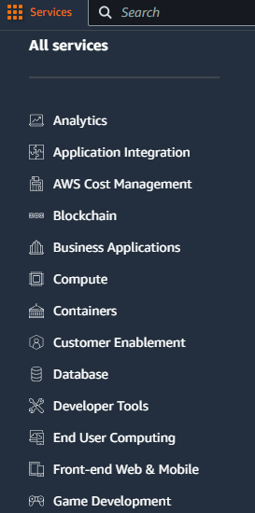
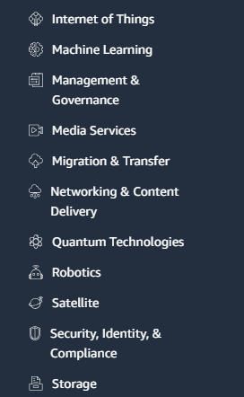
AWS: the leading cloud providing a wide range of services

Slide 23
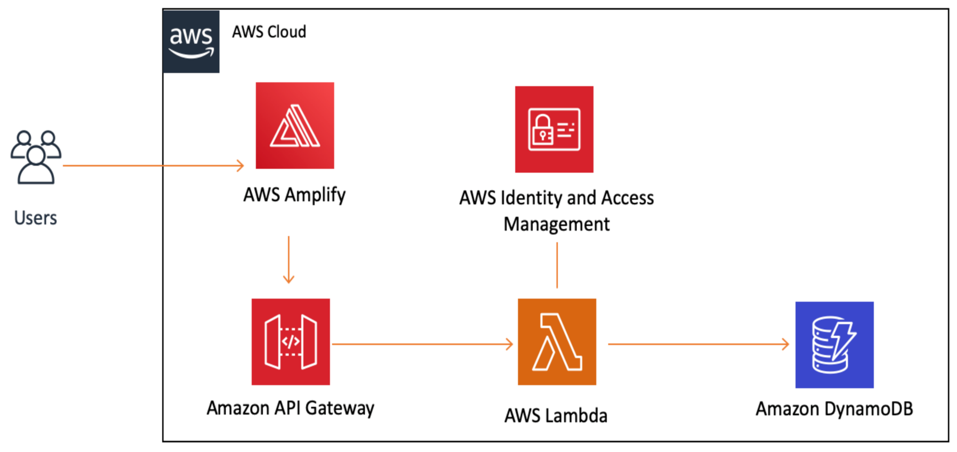
AWS: the leading cloud providing a wide range of services
The services satisfy different needs of customers.
e.g., build a web application

Slide 24
What is an application architecture?
It is the structural design and organization of a software application.
Main types of application architectures
Monolithic architecture: combines the frontend, backend, and database into a single application.
e.g., wordpress: a content management system (CMS)

Slide 25
What is an application architecture?
It is the structural design and organization of a software application.
Main types of application architectures
Monolithic architecture: combines the frontend, backend, and database functionalities into a single application.
e.g., wordpress: a content management system (CMS)
Client/Server architecture: an application is split into two main components: the client, which handles the user requests, and the server, which handles the processing of requests and data storage.
e.g., FileZilla + FTP server

Slide 26
What is an application architecture?
It is the structural design and organization of a software application.
Main types of application architectures
Monolithic architecture: combines the frontend, backend, and database functionalities into a single application.
e.g., wordpress: a content management system (CMS)
Client/Server architecture: an application is split into two main components: the client, which handles the user requests, and the server, which handles the processing of requests and data storage.
e.g., FileZilla + FTP server
Three-tier architecture: a presentation tier (frontend), application logic tier (backend), and a database tier (backend).
e.g., Amazon.com (early version)

Slide 27
What is an application architecture?
It is the structural design and organization of a software application.
Main types of application architectures
Monolithic architecture: combines the frontend, backend, and database functionalities into a single application.
e.g., wordpress: a content management system (CMS)
Client/Server architecture: an application is split into two main components: the client, which handles the user requests, and the server, which handles the processing of requests and data storage.
e.g., FileZilla + FTP server
Three-tier architecture: a presentation tier (frontend), application logic tier (backend), and a database tier (backend).
e.g., Amazon.com (early version)
Cloud-based serverless architecture: known as Function-as-a-Service, where the cloud provider provisions, maintains and scales applications.
e.g., AWS Lambda

Slide 28
Deploying an application onto AWS
Elastic Compute Cloud (EC2): an EC2 instance is a virtual machine that runs a Windows or Linux OS. It is essentially running on Virtual Machine Monitor (VMM).
Elastic Container Service (ECS): a customized environment provided by an EC2 instance.

Slide 29
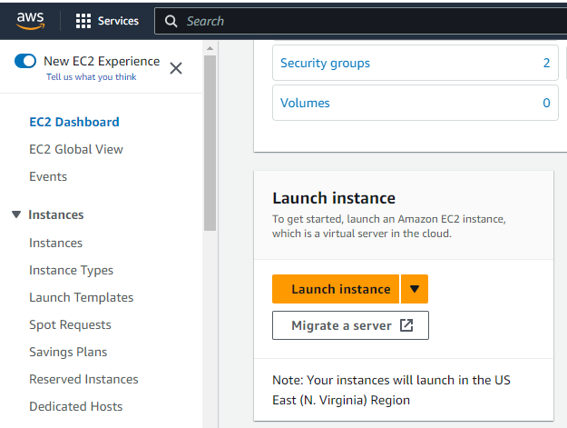
AWS EC2
Steps of creating, configuring and launching an EC2 instance :
Sign in to the AWS Management Console:
https://aws.amazon.com/ or https://489389878001.signin.aws.amazon.com/console
Navigate to EC2 Dashboard and Click “Launch instance”

Slide 30
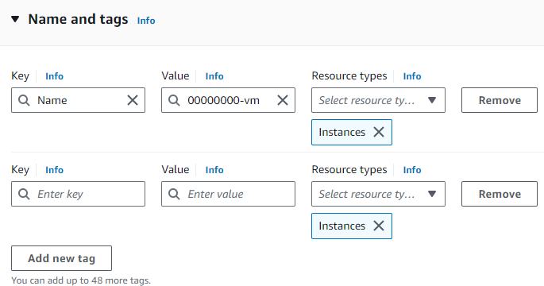
AWS EC2
Steps of creating, configuring and launching an EC2 instance :
“Name and tags”: In this step, we add a tag for the instance.

Slide 31
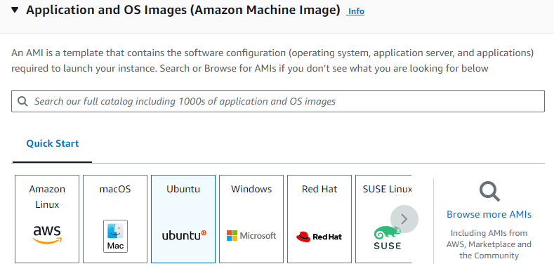
AWS EC2
Steps of creating, configuring and launching an EC2 instance :
“Application and OS Images (Amazon Machine Image)”: In this step, we select an AMI that suits our requirements.

Slide 32
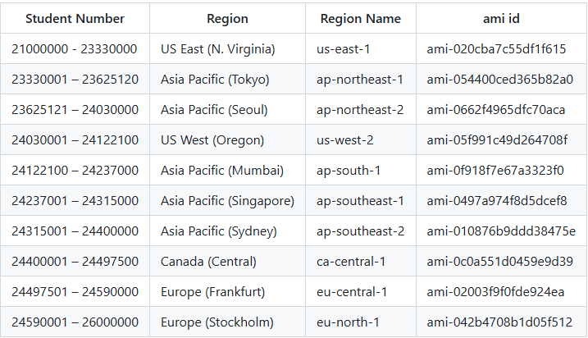
AWS EC2

Slide 33
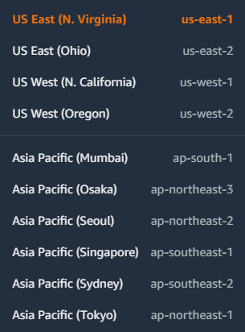
Geographical location of an instance
AWS region:
Geographical locations of AWS data centers around the world, known as “Regions”, identified by names such as “us-west-2” (US West-Oregon).

Slide 34
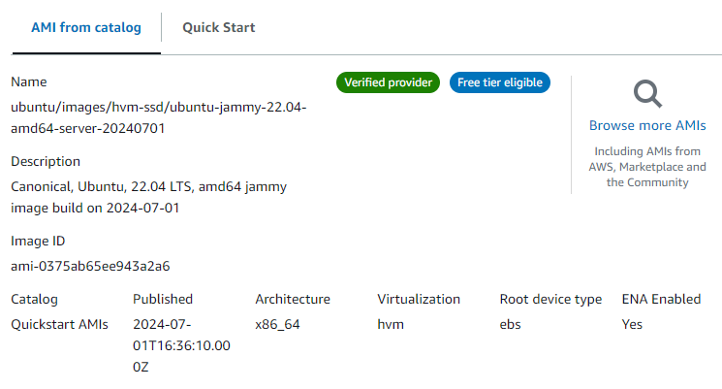
AWS EC2

Slide 35
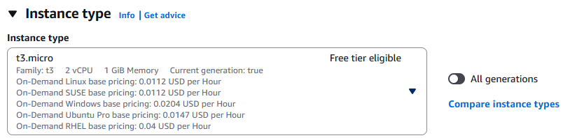
AWS EC2
Steps of creating, configuring and launching an EC2 instance :
“Instance type”: In this step, we select an appropriate instance type.

Slide 36
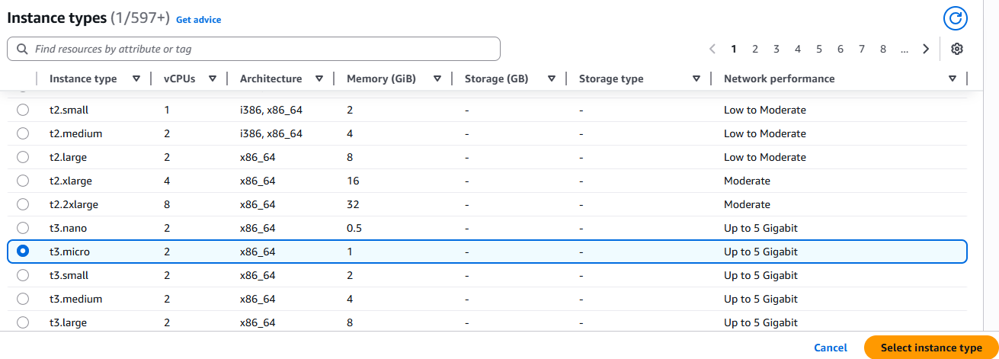
AWS EC2
Steps of creating, configuring and launching an EC2 instance :
“Instance type”
What does Architecture mean?

Slide 37
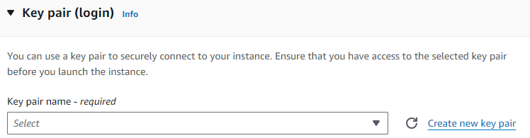
AWS EC2
Steps of creating, configuring and launching an EC2 instance :
“Key pair (login)”: In this step, we can select/create a key pair (SSH key) for secure access to our first instance.

Slide 38
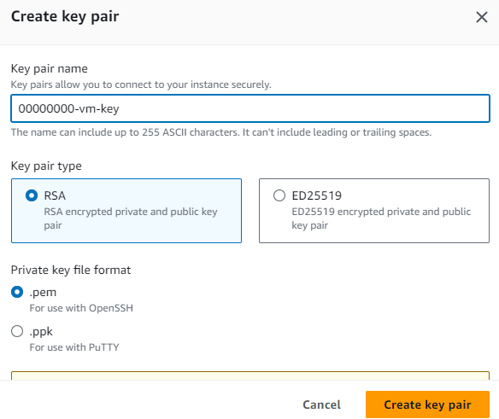
AWS EC2
Steps of creating, configuring and launching an EC2 instance :
“Key pair (login)”:

Slide 39
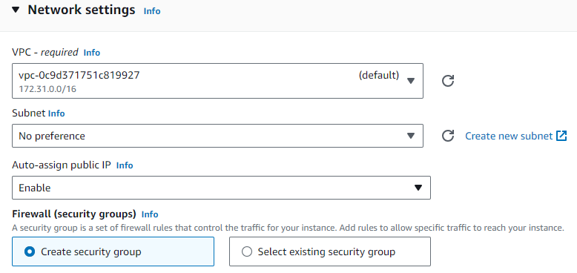
AWS EC2
Steps of creating, configuring and launching an EC2 instance :
“Network settings”

Slide 40
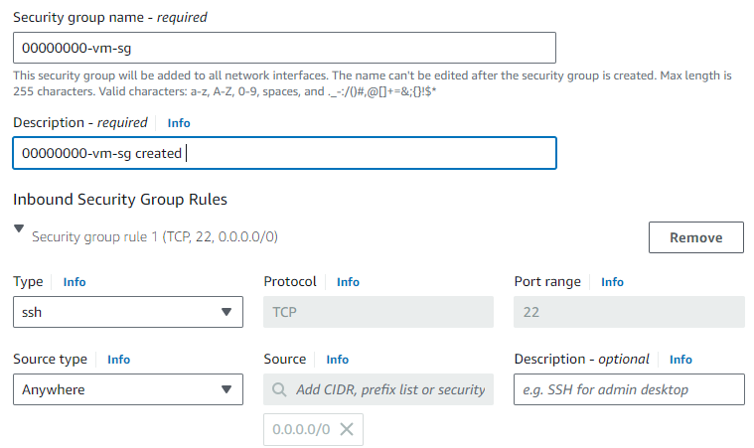
AWS EC2
Steps of creating, configuring and launching an EC2 instance :
“Network settings”
Create security group: a security group is a set of firewall rules that control the network traffic for our instance.

Slide 41
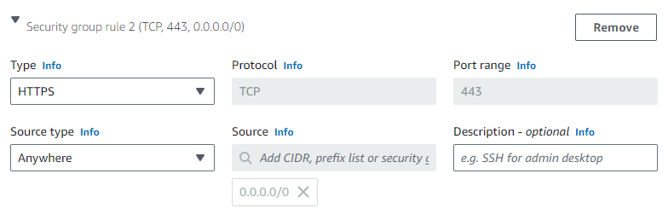
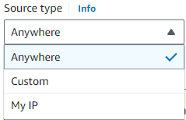
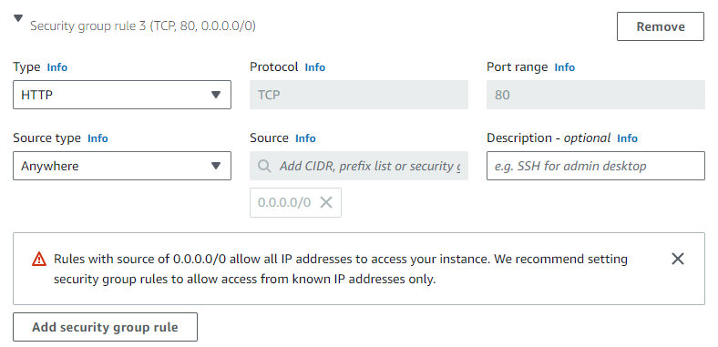
AWS EC2
Steps of creating, configuring and launching an EC2 instance :
“Network settings”
Create security group

Slide 42
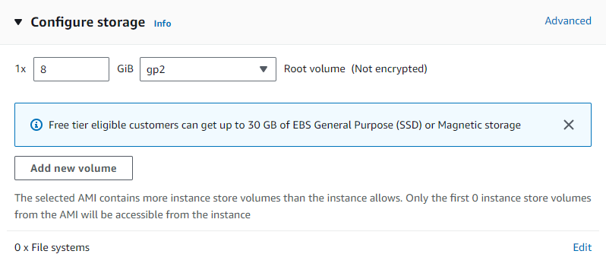
AWS EC2
Steps of creating, configuring and launching an EC2 instance :
“Configure storage”: In this step, we specify storage volume for our instance. By default, one EBS volume is attached to the instance.

Slide 43
AWS EC2
Steps of creating, configuring and launching an EC2 instance :
“Configure storage”
What is EBS?
EBS is a 'virtual disk’ and allocated in volumes. A volume ranges from 1GB to 1TB.
We pay for what we use with EBS.
EBS is attached to any instance in the same Availability Zone.

Slide 44
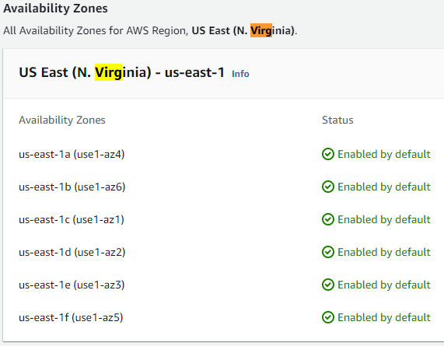
AWS EC2
Availability zone:
A region is further divided into multiple availability zones, which are identified by additional letters.
Availability zones represent data centers in different physical locations within a region.
Each availability zone within a region is networked with low-latency connections.

Slide 45
AWS EC2
Steps of creating, configuring and launching an EC2 instance :
“Configure storage”
EBS features
Persistent Storage: EBS volumes persist independently from EC2 instances.
High availability: EBS replicates volumes data across multiple physical servers within the same availability zone.
Snapshots: EBS allows users to create point-in-time snapshots of their volumes.
Elastic volumes : EBS allows users to dynamically adapt their volumes when the needs of their applications change.

Slide 46
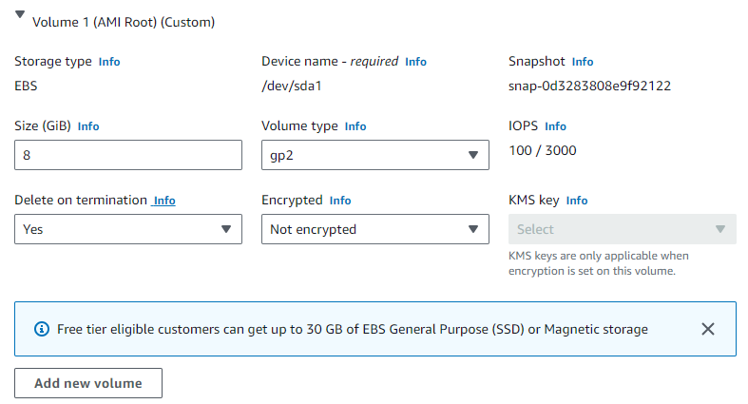
AWS EC2
Steps of creating, configuring and launching an EC2 instance :
“Configure storage”
EBS setting

Slide 47
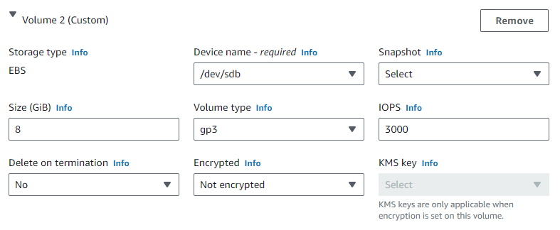
AWS EC2
Steps of creating, configuring and launching an EC2 instance :
“Configure storage”
EBS setting

Slide 48
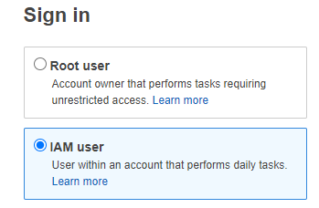
AWS EC2
Steps of creating, configuring and launching an EC2 instance :
“Advanced details”
Identity and Access Management (IAM) : AWS service that allows us to manage users, groups, and permissions to securely control access to AWS resources.
What is the principle of least privilege?

Slide 49
AWS EC2
Steps of creating, configuring and launching an EC2 instance :
“Advanced details”
Identity and Access Management (IAM) : It is a service that allows us to manage users, groups, and permissions to securely control access to AWS resources, e.g., root user and IAM user (according to the principle of least privilege).
What is the principle of least privilege?
A user only has those privileges which are essentially vital to perform their intended operations.

Slide 50
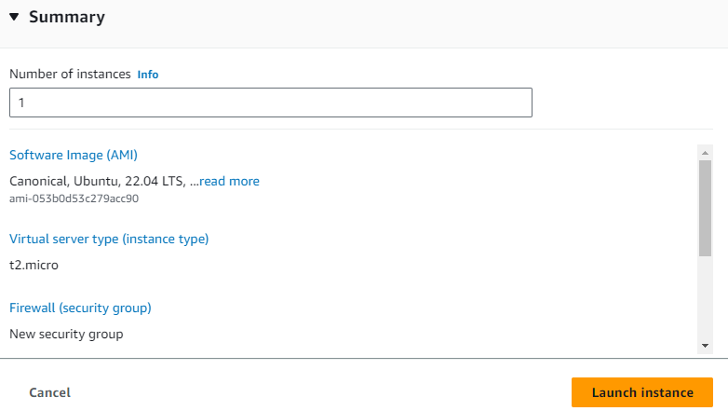
AWS EC2
Steps of creating, configuring and launching an EC2 instance :
“Review and Launch”

Slide 51
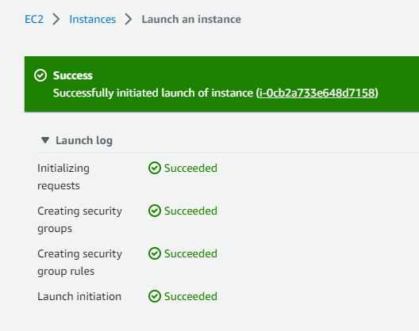
AWS EC2
Steps of creating, configuring and launching an EC2 instance :
“Review and Launch”

Slide 52
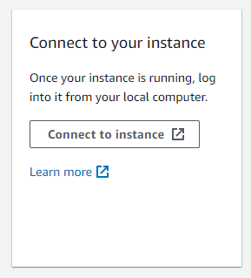
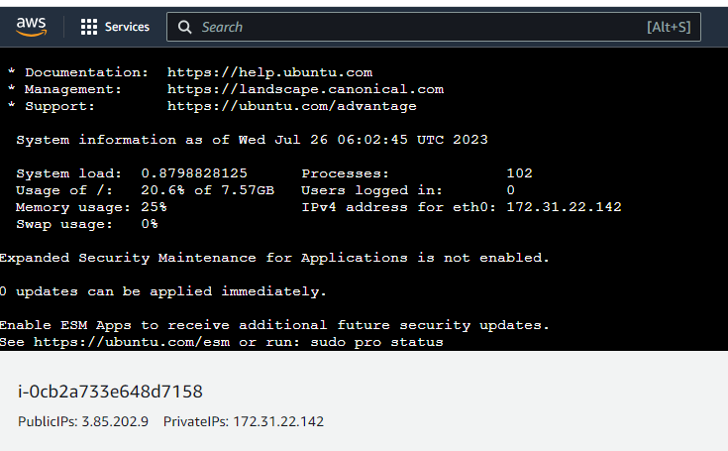
AWS EC2
Connecting to an EC2 instance :

Slide 53
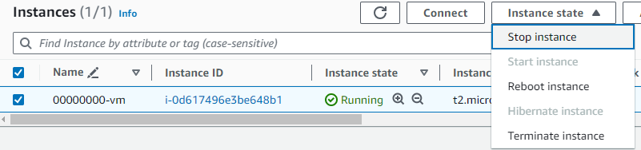
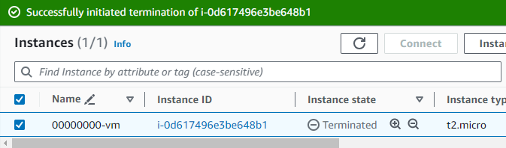
AWS EC2
Terminating an EC2 instance :

Slide 54
Practice Questions
[7 marks] Q2: Describe the main steps which you would take on AWS and the decisions that would need to be made to create, configure and launch an EC2 Instance.
[1 mark] Sign in to the AWS management console
[1 mark] Navigate to EC2 Dashboard and click “Launch instance”
[1 mark] Select/Create names and tags
[1 mark] Select AMI and Instance type
[1 mark] Select/Create Key pair for login
[1 mark] Configure network settings and storage
[1 mark] Review and launch

Slide 55
Practice Questions
[7 marks] Q3: Describe EBS and what features it offers.
[1 mark] A brief introduction to EBS.
[2 marks] One feature and its brief description.
[2 marks] One feature and its brief description.
[2 marks] One feature and its brief description.

Slide 56
Lab report submission, marking guidelines and AWS resources:
https://docs.google.com/document/d/1-mhkO6kiAdkRIGsDc7srHTd4K4fytzosLUvx17Mgh70/edit?usp=sharing
https://github.com/zhangzhics/CITS5503_Sem2/tree/master/Labs

