Slide 1
Week 9 Web Application Architecture and Design Pattern
Dr Zhi Zhang

Slide 2
Overview
Web Application Architecture
Web Application Design Pattern
Django Framework

Slide 3
What is a web application architecture
A web application architecture is a layout that displays the interactions between different software components, such as frontend, and backend.

Slide 4
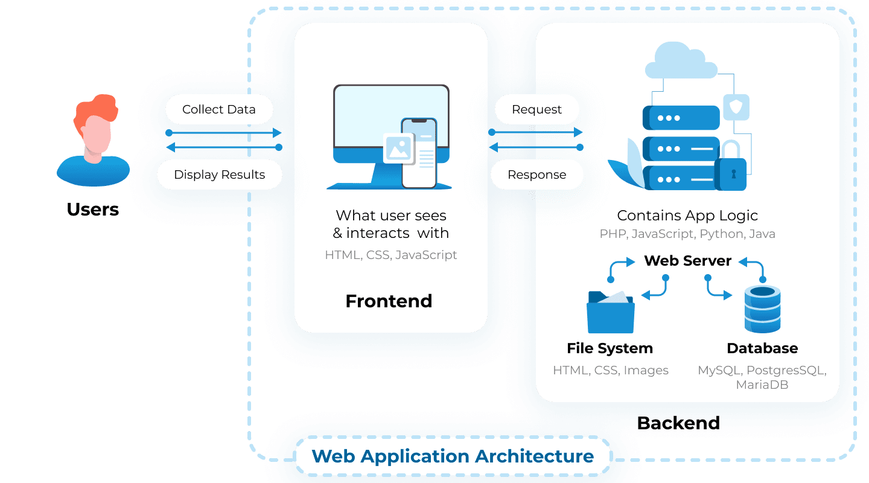
What is a web application architecture
A web application architecture is a layout that displays the interactions between different software components, such as frontend, and backend.
https://litslink.com/blog/web-application-architecture#types-of-web-application-architecture

Slide 5
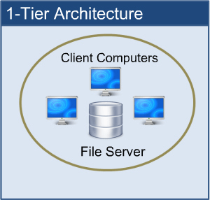
1-Tier web application architecture
1-Tier Architecture: all the software components are available on the same machine.
https://www.perfmatrix.com/software-architecture-and-its-types/

Slide 6
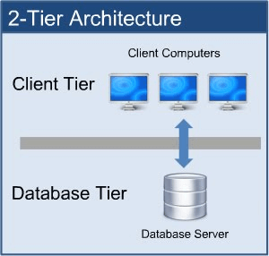
2-Tier web application architecture
2-Tier Architecture: The client sends the request to the server and the server processes the request and sends the response back to the client.
https://www.perfmatrix.com/software-architecture-and-its-types/

Slide 7
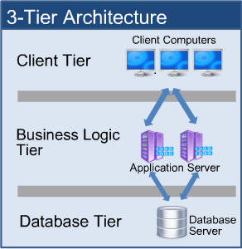
3-Tier web application architecture
Client Tier/Presentation Layer: displays the user interface and manages user interaction.
Business Logic Tier/Application server: has all the business logic that dictates how data is handled, and routed between the Client and Database Tiers.
Database Tier/Database server: stores data and handles data queries and updates.
https://www.perfmatrix.com/software-architecture-and-its-types/

Slide 8
Complex web application architecture
Presentation Layer.
Application Layer.
Database Layer.
More layers of services: serve specific tasks or provide additional functionality to the web application.

Slide 9
Complex web application architecture
More layers of services:
Examples: Caching service, and datawarehouse.

Slide 10
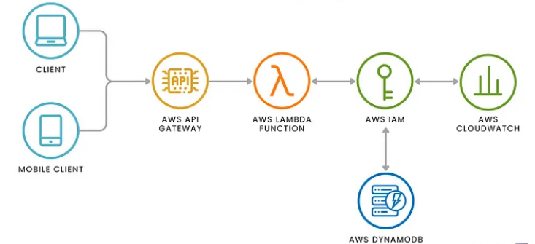
Serverless architecture
Example: AWS
https://www.skiplevel.co/blog/cloud-and-serverless-computing-101

Slide 11
Web application architecture
It is the skeleton: outlining how different software components are organized, and interact with each other.
Web application design pattern
It is the code-level reusable solution to implementing the components and their interaction such as how to organize the business logic, how to handle user requests, or how to separate different services.

Slide 12
A popular design pattern
Model—View—Controller (MVC):
Model: Maintains the application’s data. It interacts with the database to retrieve, update, and store data.
View: Provides templates for presenting the data to the user. It handles the layout and visual presentation of the data.
Controller: Acts as an intermediary between the Model and the View. It processes user inputs, makes calls to the Model to retrieve data, and then selects the appropriate View to display the data. The Controller manages the flow of data and controls the application logic.

Slide 13
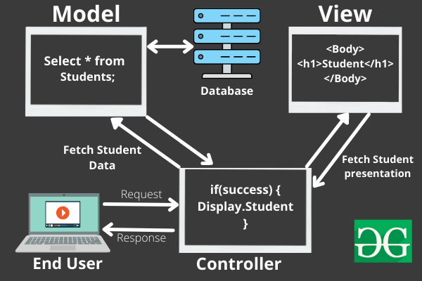
Model—View—Controller (MVC)
An example:
2
1
https://www.geeksforgeeks.org/mvc-framework-introduction/

Slide 14
Model—View—Controller (MVC)
An example:
3
2
4
1
https://www.geeksforgeeks.org/mvc-framework-introduction/

Slide 15
Model—View—Controller (MVC)
An example:
3
2
4
5
6
1
7
https://www.geeksforgeeks.org/mvc-framework-introduction/

Slide 16
MVC
Django is an open-source web application framework written in Python.
Django customizes the MVC design pattern.

Slide 17
Django customizes MVC as MVT (Model—View—Template)
M — — — ->For data interaction— — — — — ->M V — — — -> For data visualization— — — — — ->T C — — — -> For component interaction— — — —>V
Any real-world Django-based web application?
Instagram, Spotify, Youtube

Slide 18
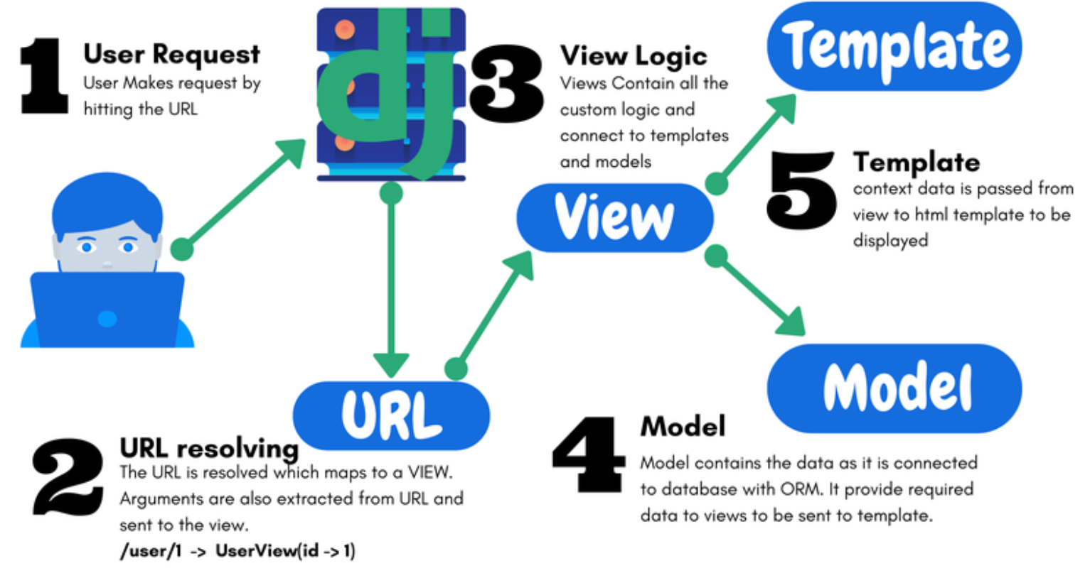
A Django-based web application:
URL resolving: maps an incoming request to an appropriate view function.
Extracts specific strings and/or digits in the URL and sends them to the VIEW function.

Slide 19
A Django-based web application:
View: uses the resolved arguments to interacts with templates and models as needed.

Slide 20
A Django-based web application:
Model: interacts with the database.

Slide 21
A Django-based web application:
Template: takes the data passed from the view logic for rendering the HTML template (or other XML templates)

Slide 22
urls.py: implements the component of URL resolving
1
2
3
4
5
6
from django.urls import path
from music import views
urlpatterns = [
path('', views.home, name='home'),
]

Slide 23
views.py: implements the View component
1
2
3
4
5
from django.shortcuts import render
# Create our views here.
def home(request):
return render(request, 'home.html')

Slide 24
1
2
3
4
5
6
7
8
9
10
<h1>Main Page:</h1>
<ul>
<li><a href="{% url 'home' %}">Home Page</a></li>
</ul>
<p>MVT means:</p>
<ul>
<li>Model</li>
<li>View</li>
<li>Template</li>
</ul>

Slide 25
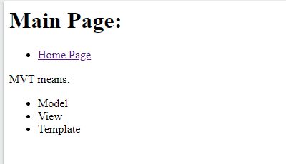

Slide 26
models.py: implements the Model component
1
2
3
4
5
6
from django.db import models
# Define your models here.
class Artist(models.Model):
name = models.CharField(max_length=100)
song = models.CharField(max_length=25)

Slide 27
Demo: set up a Django web app called music
Create a Django project and a music app
Setup the music app
Enable template rendering
Render templates with retrieved data

Slide 28
Step 1: create a virtual environment
mkdir ~/cits5503_django
cd cits5503_django
python3 -m venv cits5503venv
source cits5503venv/bin/activate
Question: /opt/wwc/ is not a good path for deploying a Django application. Why?

Slide 29
Step 1: create a virtual environment
mkdir ~/cits5503_django
cd cits5503_django
python3 -m venv cits5503venv
source cits5503venv/bin/activate
Question: /opt/wwc/ is not a good path for deploying a Django application:
While this path requires the root privilege, the application itself does not require it.

Slide 30
Step 1: create a virtual environment
mkdir ~/cits5503_django
cd cits5503_django
python3 -m venv cits5503venv
source cits5503venv/bin/activate
Question: Why do we need to setup a virtual environment in python?

Slide 31
Step 1: create a virtual environment
Question: Why do we need to setup a virtual environment in python?
Isolation: Virtual environments isolate Python packages and dependencies between different projects. This prevents conflicts where different projects require different versions of the same package.
Ease of Deployment: All the installed packages in a virtual environment can be copied onto another machine or virtual environment
pip freeze > requirements.txt
pip install -r requirements.txt

Slide 32
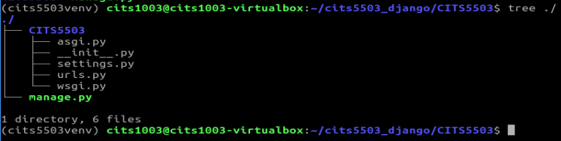
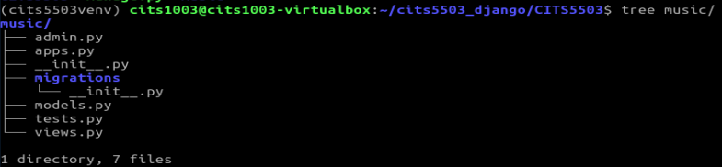
Step 2: create a Django project and app
pip install django
django-admin startproject CITS5503
cd CITS5503
python3 manage.py startapp music

Slide 33
Step 2: create a Django project and app
pip install django
django-admin startproject CITS5503
cd CITS5503
python3 manage.py startapp music
Question: What's the difference between the outputs of
django-admin startproject CITS5503
django-admin startproject CITS5503 .

Slide 34
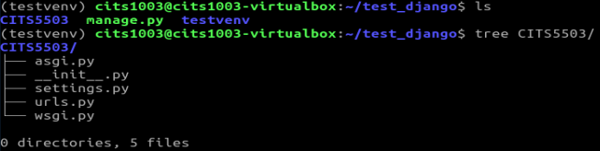
django-admin startproject CITS5503 (under cits5503_django)
django-admin startproject CITS5503 . (under test_django)

Slide 35
Step 2: create a Django project and app
pip install django
django-admin startproject CITS5503
cd CITS5503
python3 manage.py startapp music
Question: What's the difference between the outputs of
django-admin startproject CITS5503: Django creates a new directory named "CITS5503" , inside which another subdirectory named "CITS5503" is created: the python project files is placed inside the subdirectory.
django-admin startproject CITS5503 . : Django creates a new directory named "CITS5503" that contains the project files.

Slide 36
Step 3: start the Django application server
python manage.py check
python manage.py runserver
Question: Which default port is the Django application server is listening on?

Slide 37
Step 3: start the Django application server
python manage.py check
python manage.py runserver
Question: What if the default port is taken by another process in our system?

Slide 38
Step 3: start the Django application server
Question: What if the default port is taken by another process in our system?
python manage.py runserver 9000
#ngnix
proxy_pass http://127.0.0.1:8000;

Slide 39
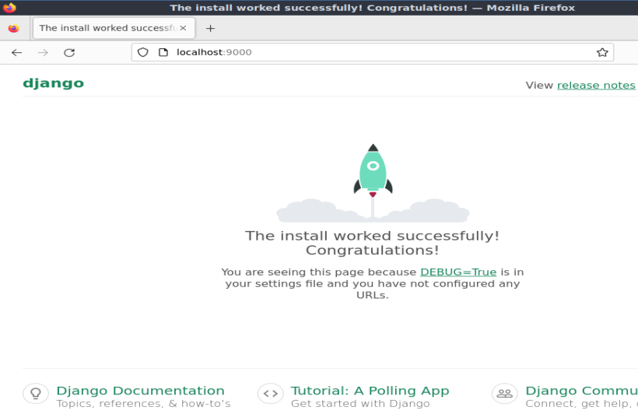
Step 4: Access the server
Open a browser and go to: http://localhost:9000

Slide 40
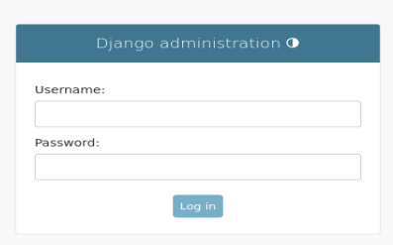
Step 4: Access the server
If we go to: http://localhost:9000/admin/

Slide 41
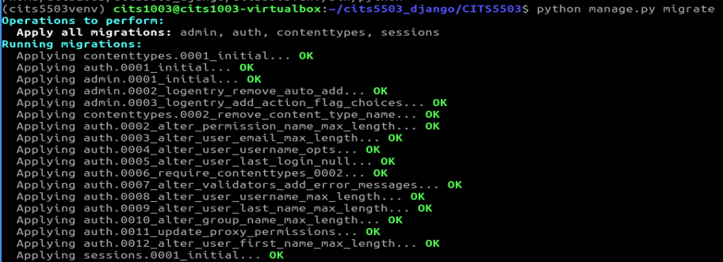
Step 5: create an admin
python manage.py migrate

Slide 42
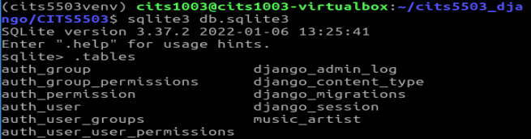
Step 5: create an admin
python manage.py migrate

Slide 43
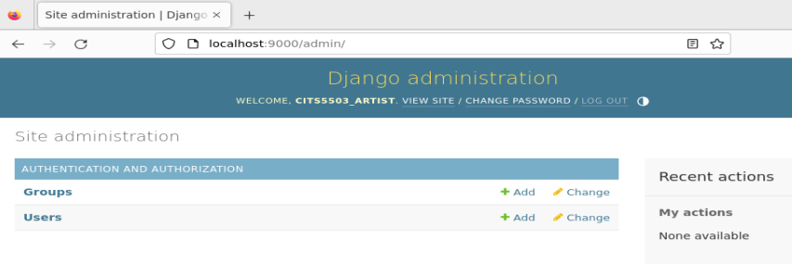
Step 5: create an admin
python manage.py createsuperuser
restart the server

Slide 44
Demo: set up a Django web app called music
Create a Django project and a music app
Setup the music app
Enable template rendering
Render templates with retrieved data

Slide 45
Step 1: register the app
# inside CITS5503/settings.py
INSTALLED_APPS = [
'django.contrib.admin’, #The admin site 'django.contrib.auth’, #Authentication 'django.contrib.contenttypes’, #A framework for content types 'django.contrib.sessions’, #A session framework 'django.contrib.messages’, #A messaging framework 'django.contrib.staticfiles’, #A framework for managing static files
#new app below: ‘music.apps.MusicConfig', ]

Slide 46
Step 2: update the url component in the project
# inside CITS5503/urls.py
from django.contrib import admin from django.urls import path from music import views # added
urlpatterns = [ path('', views.home, name='home'), # added path('admin/', admin.site.urls),
]

Slide 47
Step 3: update the view component in the app
# inside music/views.py
from django.shortcuts import render from django.http import HttpResponse #added
#added
def home(request): return HttpResponse('This is the home page.')

Slide 48
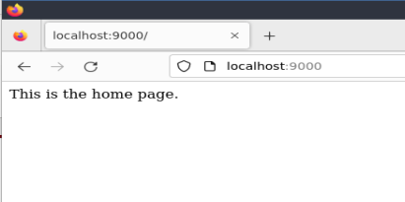
Step 4: access the app
restart the server and go to: http://localhost:9000

Slide 49
Demo: set up a Django web app called music
Create a Django project and a music app
Setup the music app
Enable template rendering
Render templates with retrieved data

Slide 50
Step 1: create html templates in the project and the app
Inside the current working directory of the project
mkdir templates mkdir music/templates mkdir music/templates/music
touch templates/home.html touch music/templates/music/main.html touch music/templates/music/artist.html

Slide 51
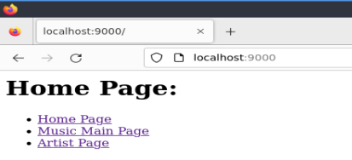
templates/home.html
<h1>Home Page:</h1> <ul> <li><a href="{% url 'home' %}">Home Page</a></li> <li><a href="{% url 'music:main' %}">Music Main Page</a></li> <li><a href="{% url 'music:artist' %}">Artist Page</a></li> </ul>

Slide 52
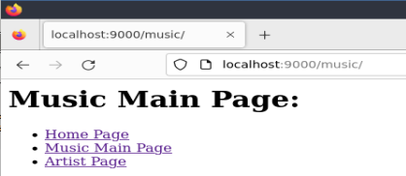
music/templates/music/main.html
<h1>Music Main Page:</h1> <ul> <li><a href="{% url 'home' %}">Home Page</a></li> <li><a href="{% url 'music:main' %}">Music Main Page</a></li> <li><a href="{% url 'music:artist' %}"> Artist Page </a></li> </ul>

Slide 53
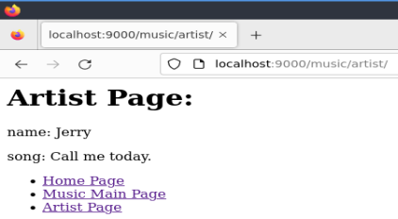
music/templates/music/artist.html
<h1>Artist Page:</h1> <p>name: Jerry</p>
<p>song: Call me today</p> <ul> <li><a href="{% url 'home' %}">Home Page</a></li> <li><a href="{% url 'music:main' %}">Music Main Page</a></li> <li><a href="{% url 'music:artist' %}"> Artist Page </a></li> </ul>

Slide 54
Step 2: update the url component in the project
# inside CITS5503/urls.py
from django.contrib import admin from django.urls import path from music import views
urlpatterns = [ path('', views.home, name='home'), path('admin/', admin.site.urls),
path('music/', include('music.urls')), # added
]

Slide 55
Step 3: create the url component in the app
touch music/urls.py
# inside music/urls.py
from django.urls import path from . import views app_name = 'music'
urlpatterns = [ path('', views.main, name='main'), path('artist/', views.artist, name='artist'), ]
Question: What kind of URL requests will be processed by the first URL pattern?

Slide 56
Step 3: create the url component in the app
touch music/urls.py
# inside music/urls.py
from django.urls import path from . import views app_name = 'music'
urlpatterns = [ path('', views.main, name='main'), path('artist/', views.artist, name='artist'), ]

Slide 57
Step 4: update the view component in the app
# inside music/views.py
from django.shortcuts import render
def home(request): return render(request, 'home.html’)
#added
def main(request): return render(request, 'music/main.html')
def artist(request): return render(request, 'music/artist.html')

Slide 58
Step 5: register the home template in the project
# inside CITS5503/settings.py
import os #added
TEMPLATES = [ {
(...)
'DIRS': [os.path.join(BASE_DIR, 'templates')], #added
(...)
} ]

Slide 59
Step 6: restart the server and access the app
Go to the home page
Go to the main page
Go to the artist page

Slide 60
Demo: set up a Django web app called music
Setup a Django project
Setup a web app called music
Enable template rendering
Render templates with retrieved data

Slide 61
Step 1: add a model in the app
# inside music/models.py
from django.db import models
class Artist(models.Model):
name = models.CharField(max_length=200)
song = models.CharField(max_length=200)
def __str__(self):
return self.name

Slide 62
Step 2: create the Artist table and register it into the admin interface
# inside music/admin.py
from django.contrib import admin from .models import Artist
admin.site.register(Artist)

Slide 63
Step 3: make changes and apply changes to the database
python manage.py makemigrations
python manage.py migrate

Slide 64
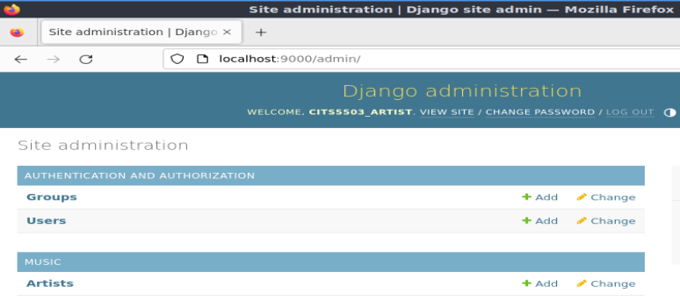
Step 4: restart the server and access the app
Go to the admin interface

Slide 65
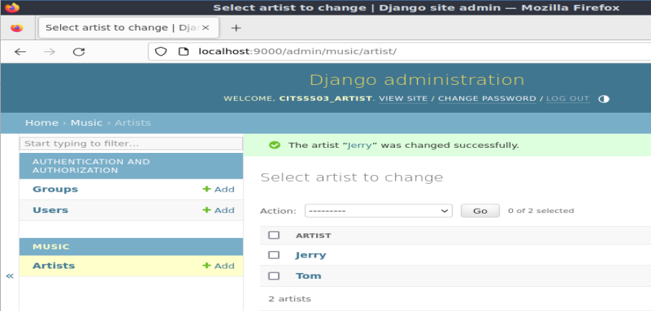
Step 5: populate the artist table
def __str__(self):
return self.name

Slide 66
Step 6: update the view component in the app
# inside music/views.py
from django.shortcuts import render
from .models import Artist
def home(request): return render(request, 'home.html')
def main(request): return render(request, 'music/main.html')
#updated
def artist(request): title = 'Artist Page Info'
artist_list = Artist.objects.all()
context = {'title': title, 'artist_list': artist_list}
return render(request, 'music/artist.html', context)

Slide 67
Step 7: update music/templates/music/artist.html
<h1>{{title}}</h1> <ul> <li><a href="{% url 'home' %}">Home Page</a></li> <li><a href="{% url 'music:main' %}">Music Main Page</a></li> </ul>
<ul>
{% for artist in artist_list %} <li> {{artist.name}}: {{artist.song}}</li>
{% endfor %} </ul>

Slide 68
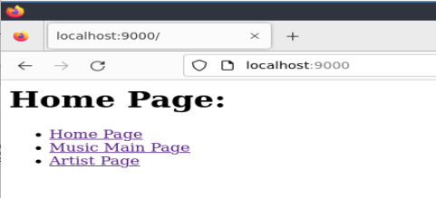
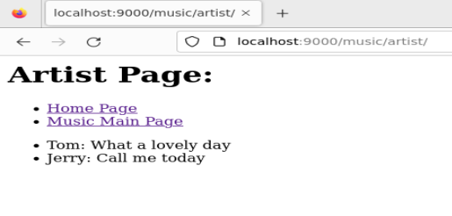
Step 8: restart the server and access the app

Slide 69
Question: What if 'title' in context is replaced by 'titlectx'?
def artist(request): title = 'Artist Page Info'
artist_list = Artist.objects.all()
context = {'title': title, 'artist_list': artist_list}
return render(request, 'music/artist.html', context)
def artist(request): title = 'Artist Page Info'
artist_list = Artist.objects.all()
context = {'titlectx': title, 'artist_list': artist_list}
return render(request, 'music/artist.html', context)

Slide 70
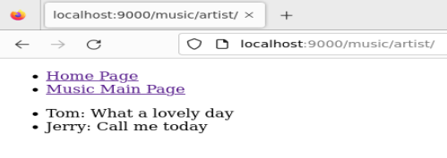
<h1>{{titlectx}}</h1> <ul> <li><a href="{% url 'home' %}">Home Page</a></li> <li><a href="{% url 'music:main' %}">Music Main Page</a></li> </ul>
<ul>
{% for artist in artist_list %} <li> {{artist.name}}: {{artist.song}}</li>
{% endfor %} </ul>
Otherwise

