Slide 1
Week 4 AWS S3 and DynamoDB
Dr Zhi Zhang

Slide 2
Overview
Amazon S3
Amazon DynamoDB
Mid-semester Test

Slide 3

Cloud storage
Cloud storage, provided by a third-party cloud provider allows customers to store and access data over the internet.
Examples: Dropbox, Google drive, iCloud, Amazon S3

Slide 4
Amazon S3 (Simple Storage Service)
It is a popular and widely used cloud storage service provided by AWS
It allows users to store and retrieve any amount of data at any time over the internet
Bucket
Object

Slide 5
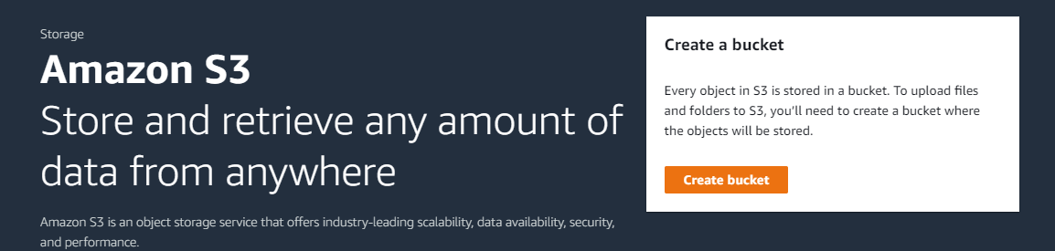
Create bucket

Slide 6
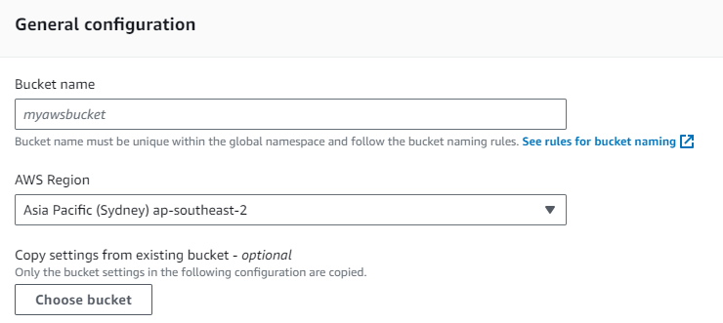
Create Bucket
Bucket name must be unique within the global namespace.
Bucket names must be unique across all AWS accounts in an AWS partition. A partition is a group of AWS Regions.
three partitions: AWS (Standard Regions), AWS-CN (China Regions), and AWS-US-Gov (US Gov Regions).
It must follow the bucket naming rules.

Slide 7
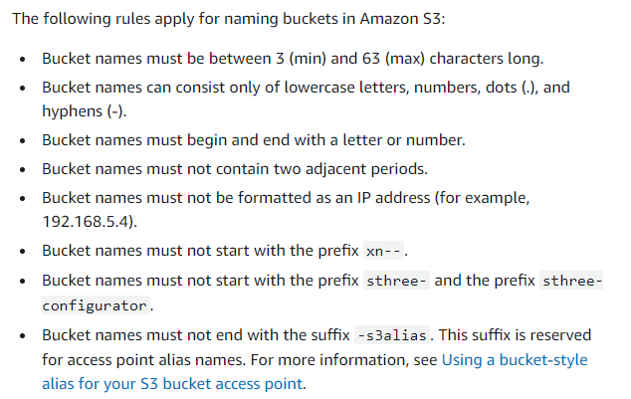
Rules for bucket naming

Slide 8
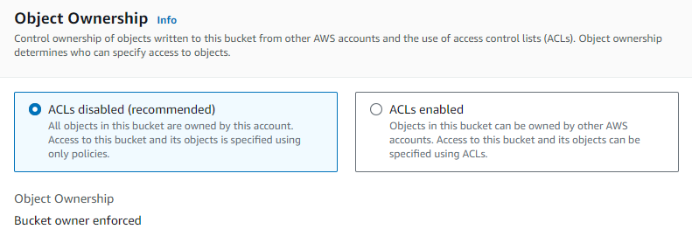
Object ownership
What is an object?

Slide 9
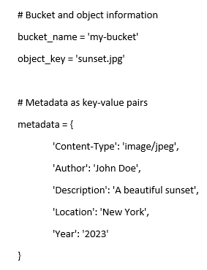
Object
It is an individual unit of data stored in a bucket
Can be a file of any type:
documents, images, videos, etc
It contains both data and metadata:
Data refers to file contents. Metadata include file attributes.
e.g., a file called sunset.jpg is uploaded into a bucket.

Slide 10
Object
How to identify an object? object key + version ID (if enabled)
Object key is a string specifying the object’s location and name, e.g., cits5503-123456-lecture/subdir/sunset.jpg
Version ID: denotes a specific version of an object, e.g., v1AbCdEfGhIjKlMnOpQrStUvWxYz1234567890
A combination of an object key and version ID uniquely identifies a specific version of an object in a bucket.

Slide 11
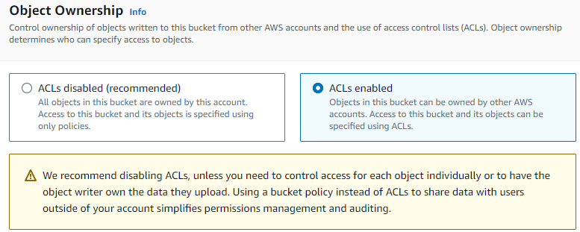
Object ownership
Bucket ACLs are old access-control mechanism for buckets.

Slide 12
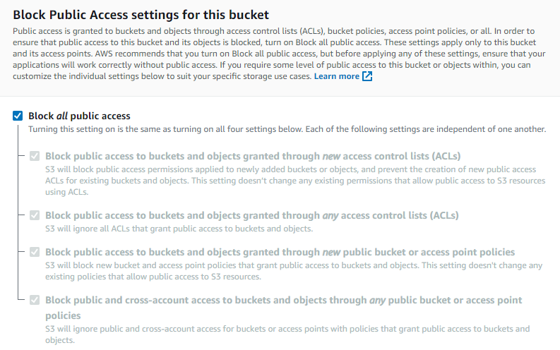
Block Public Access settings for this bucket

Slide 13
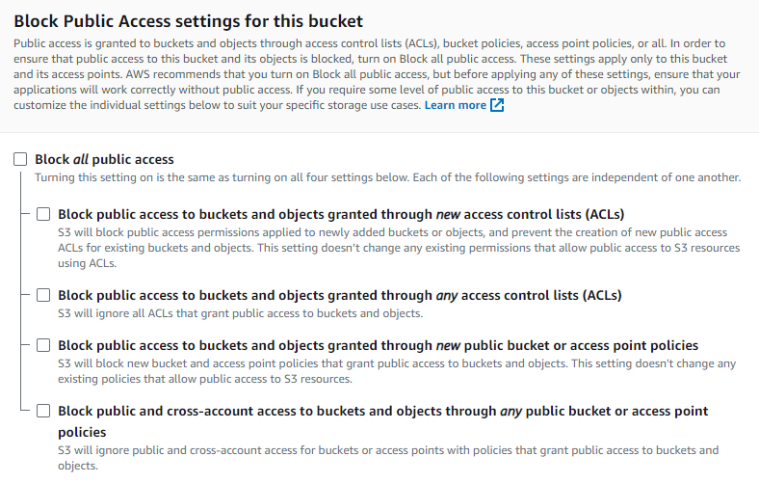
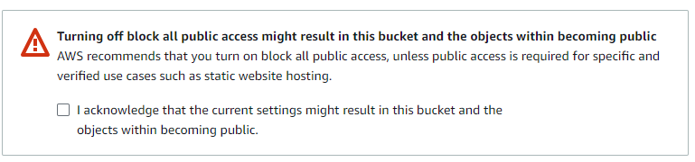
Block Public Access settings for this bucket

Slide 14
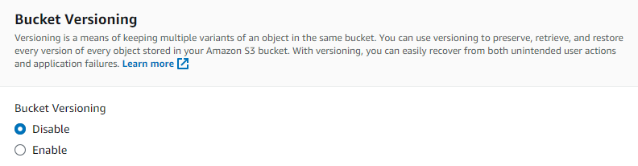
Bucket versioning

Slide 15
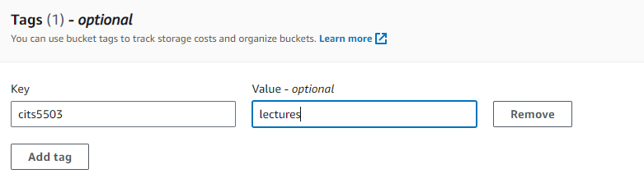

Tags
Tags are key-value pairs that provide customized label to track costs from buckets, e.g.,
If a bucket is tagged as cits5503/lectures, ‘cits5503’ is a key and ‘lectures’ is a value.
If another bucket is tagged as cits5503/labs, ‘cits5503’ is a key and ‘labs’ is a value.

Slide 16
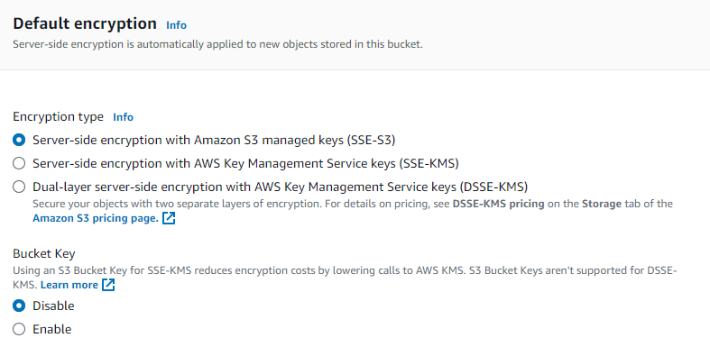
Default encryption

Slide 17
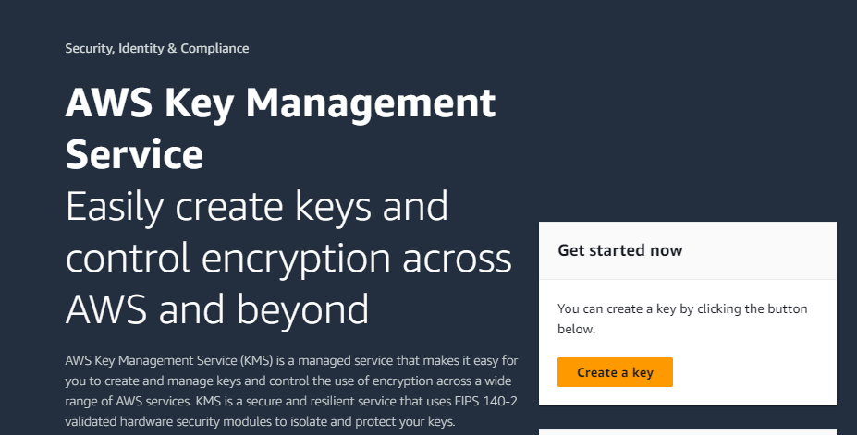
Default encryption
Server-side encryption with S3 managed keys (SSE-S3): S3 manages the encryption keys (AES-256 encryption) used to encrypt and decrypt objects.
Server-side encryption with AWS Key Management Service keys (SSE-KMS): It uses KMS to manage the encryption keys for each object stored in the bucket.

Slide 18
Default encryption
Server-side encryption with S3 managed keys (SSE-S3): S3 manages the encryption keys (AES-256 encryption) used to encrypt and decrypt objects.
Server-side encryption with AWS Key Management Service keys (SSE-KMS): It uses KMS to manage the encryption keys for each object stored in the bucket.
Dual-layer server-side encryption with AWS KMS (DSSE-KMS): It is a combination of SSE-S3 and SSE-KMS.

Slide 19
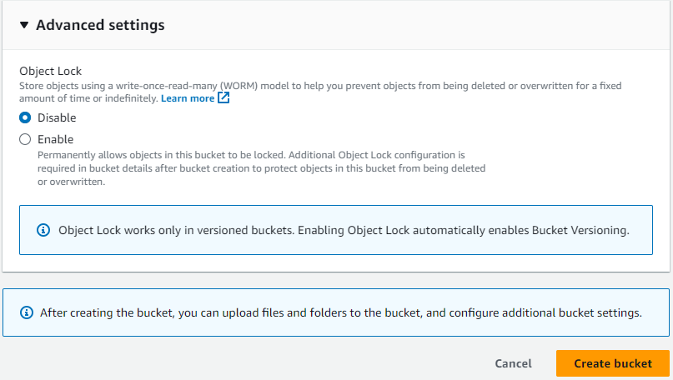
Object lock

Slide 20
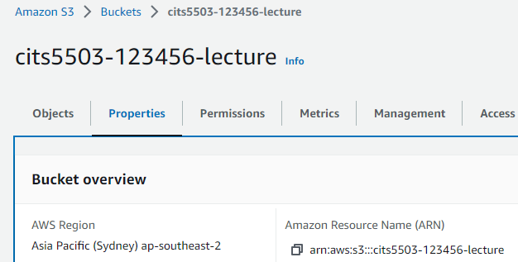
Configure a bucket
ARN: a unique ID for any AWS resources, such as S3 buckets, EC2 instances and IAM users.
ARN is needed when configuring a bucket policy

Slide 21
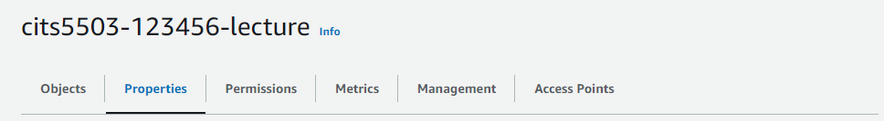
Configure a bucket
Properties
Bucket versioning
Tags
Default encryption
Object Lock
Server access logging
Provides records for the requests that are made to a bucket.

Slide 22
Configure a bucket
Permissions
Bucket policy
CORS (Cross-origin resource sharing) policy

Slide 23
Bucket policy
Secure access to buckets and their objects
For unauthenticated users, access is denied
For authenticated users, access is dependent on their permissions

Slide 24
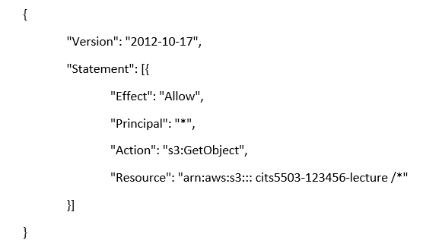
Bucket policy
Secure access to buckets and their objects
Version: indicates the language version of the policy language.
Statement: represents a permission rule.
Effect: what the effect will be when a user requests a specific action—this can be either ’Allow’ or ’Deny’.
Principal: refers to a set of users/applications that have allowed (or denied) access to the actions and resources below.
Action: defines a set of resource operations a principal is allowed (or denied) to perform.
Resource: specifies AWS resources for which a principal is allowed (or denied) to take actions. ARN identifies the bucket.

Slide 25
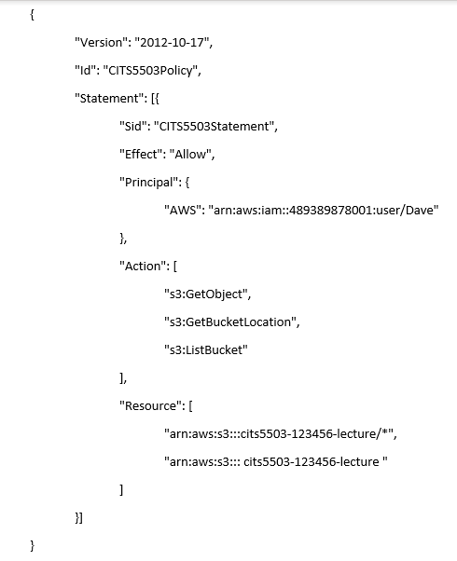
Bucket policy
Id: An optional identifier for the policy, denoting a unique name for the policy.
Sid: An optional identifier for the statement, denoting a unique name for the statement.
s3:GetObject: Allows users to read objects in the bucket.
s3:GetBucketLocation: Allow users to retrieve the bucket's region.
s3:ListBucket: Allows users to list the objects in the bucket.
What is the difference between the two ARNs in the Resource field?

Slide 26
Bucket policy
Id: An optional identifier for the policy, denoting a unique name for the policy.
Sid: An optional identifier for the statement, denoting a unique name for the statement.
s3:GetObject: Allows users to read objects in the bucket.
s3:GetBucketLocation: Allow users to retrieve the bucket's region.
s3:ListBucket: Allows users to list the objects in the bucket.
What is the difference between the two ARNs in the Resource field?
First ARN: refers to all the objects within the bucket.
Second ARN: refers to the bucket itself.

Slide 27
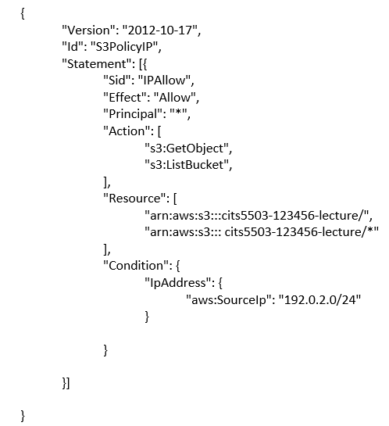
Bucket policy: practice
What does this code snippet do?
192.0.2.0 is an Internet Protocol Version 4 address.
An IPv4 (Internet Protocol version 4) address has 4 bytes (32 bits) separated by periods.

Slide 28
CIDR (Classless Inter-Domain Routing)
CIDR is a notation to represent IP addresses and their associated subnet masks.
In CIDR notation, an IPv4 address (e.g., 192.0.2.0/24) is followed by a slash ("/") and a number. This number represents the bit length of the network portion of the IP address.
Notes:
28

Slide 29
Bucket policy: practice
This policy allows two operations to the bucket named "cits5503-123456-lecture" and its contents from IP addresses within the "192.0.2.0/24" range. This range covers all IP addresses from 192.0.2.0 to 192.0.2.255, inclusive.
What does 192.0.2.0/16 mean?

Slide 30
Common S3 actions
s3:GetObject: Allow users to read objects from the bucket.
s3:PutObject: Allow users to upload new objects to the bucket.
s3:DeleteObject: Allow users to delete objects from the bucket.
s3:ListBucket: Allow users to list the objects in the bucket.
s3:GetBucketLocation: Allow users to retrieve the bucket’s AWS region.
A complete list of actions (https://docs.aws.amazon.com/AmazonS3/latest/API/API_Operations.html)

Slide 31
CORS (Cross-origin Resource Sharing )
CORS allows specific origins to access a bucket and specifies the allowed HTTP methods and HTTP headers for each origin.
HTTP method: defines the action to be performed against resources.
GET used to fetch resources, e.g., images, and user data.
DELETE is used to remove resources.
HTTP header: is a key-value pair that contains information about an HTTP request or response.
Request header
e.g., User-Agent: Mozilla/5.0 (Windows NT 10.0; Win64; x64).
Response header
e.g., Content-Type: application/json.

Slide 32
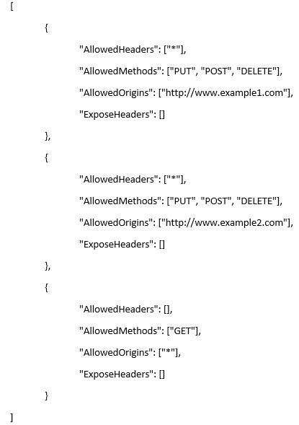
CORS (Cross-origin Resource Sharing )
CORS allows specific origins to access a bucket and specifies the allowed HTTP methods and HTTP headers for each origin.
An example:
Rule 1:
AllowedHeaders: All headers are allowed.
AllowedMethods: PUT, POST, and DELETE HTTP methods are allowed.
AllowedOrigins: HTTP requests originating from "http://www.example1.com" are allowed to access the bucket.
ExposeHeaders: No additional headers in the response are exposed to the origin.
Rule 2: The same as Rule 1 except the origin.
Rule 3:
AllowedHeaders: No headers are allowed.
AllowedMethods: Only the GET HTTP method is allowed.
AllowedOrigins: All origins are allowed.
ExposeHeaders: No additional headers in the response are exposed to the origin.

Slide 33
Practice Questions
[5 marks] Q1: When a bucket is created, AWS provides features that can be managed. List and describe 5 key features?

Slide 34
Practice Questions
[5 marks] Q1: When a bucket is created, AWS provides features that can be managed. List and describe 5 key features?
[1 mark] Bucket versioning: keeps multiple versions of an object in the same bucket.
[1 mark] Tags: are key-value pairs that provide customized label to track costs from buckets.
[1 mark] Default Encryption: All objects uploaded to the bucket will be automatically encrypted using one server-side encryption.
[1 mark] Object Lock: prevent objects in a bucket from being deleted or overwritten for a fixed amount of time or indefinitely.
[1 mark] Server access logging: provides records for the requests that are made to a bucket.

Slide 35
Practice Questions
[5 marks] Q2: Describe how S3 handles consistency of objects and how this approach affects the state of objects when they are read using a GET.

Slide 36
Practice Questions
[5 marks] Q2: Describe how S3 handles consistency of objects and how this approach affects the state of objects when they are read using a GET.
[4 marks] S3 delivers strong read-after-write and list (i.e., GET, PUT and LIST operations) consistency automatically. Specifically, what a user write is what they will read, and the results of a LIST will be an accurate reflection of what’s in the bucket.
[1 mark] When GET is used to read an object, the read request immediately receives the latest content of the object.

Slide 37
Amazon DynamoDB
A fast and flexible non-relational database service
relational database service: MySQL, PostgreSQL, etc.

Slide 38
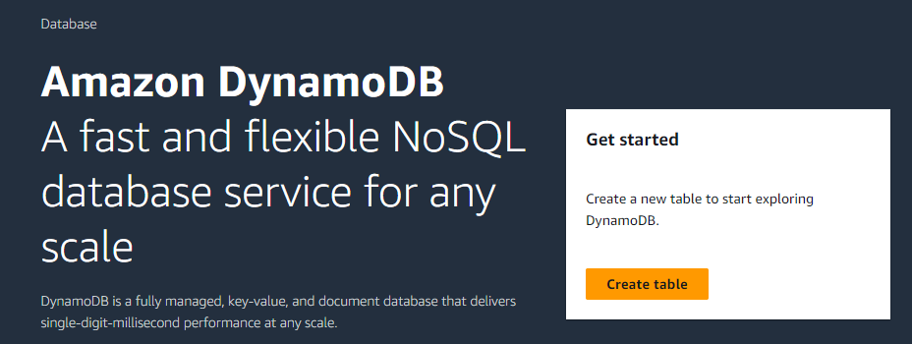
Amazon DynamoDB
A fast and flexible non-relational database service
relational database service: MySQL, PostgreSQL, etc.

Slide 39
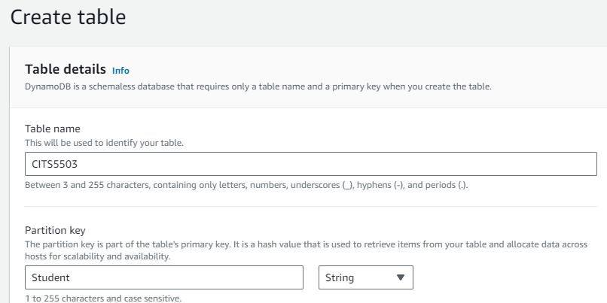
Amazon DynamoDB

Slide 40
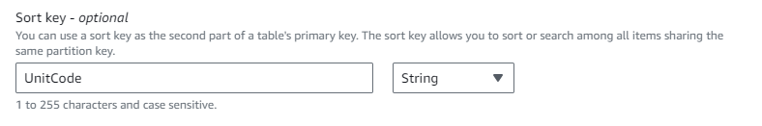
Amazon DynamoDB

Slide 41
Amazon DynamoDB
A composite primary key composed of partition key and sort key (table columns)
CITS5503
Student | UnitCode
partition key/hash key
sort key/range key

Slide 42
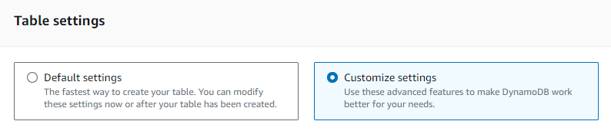
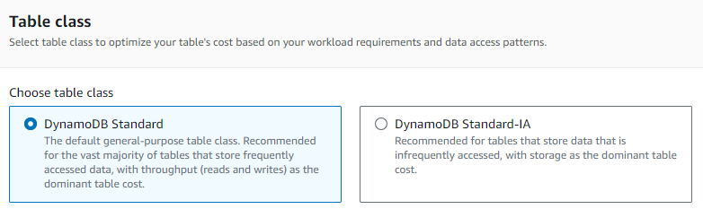
Core Components
Amazon DynamoDB

Slide 43
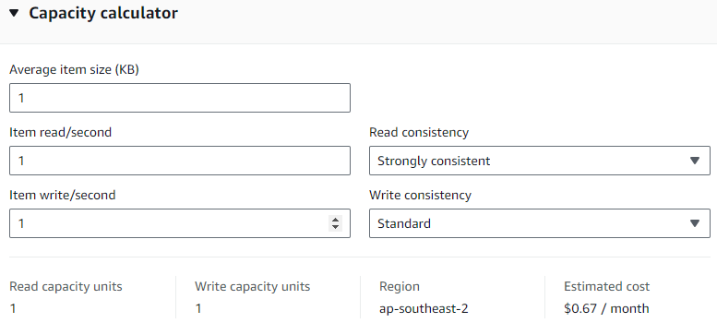
Core Components
Amazon DynamoDB
Throughput capacity
1 read/write capacity unit (RCU/WCU) = read/write 1 item of 1 KB in 1 second

Slide 44
Read/Write consistency
Read from DynamoDB can be:
Eventually Consistent
The response of a read may not reflect the result of a recent write operation
Strongly Consistent
The response of a read returns the most up-to-date data reflecting all updates from all previous write operations
Transactional
Group multiple read actions together and submit them in a single all-or-nothing operation
Write from DynamoDB can be:
Standard
Transactional
Group multiple write actions together and submit them in a single all-or-nothing operation

Slide 45
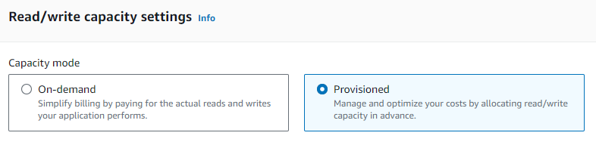
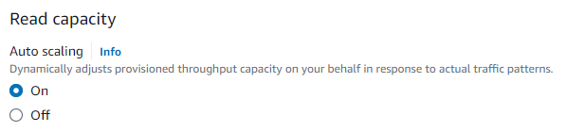
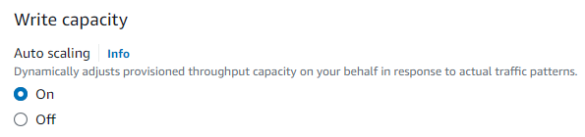
Core Components
Amazon DynamoDB

Slide 46
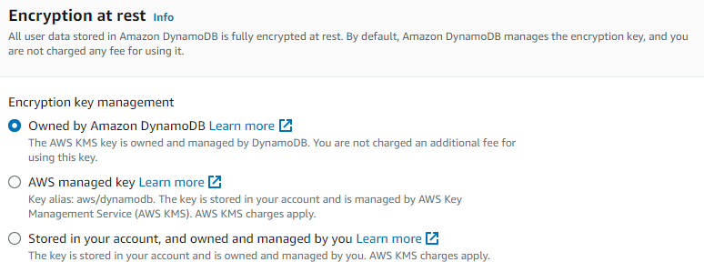
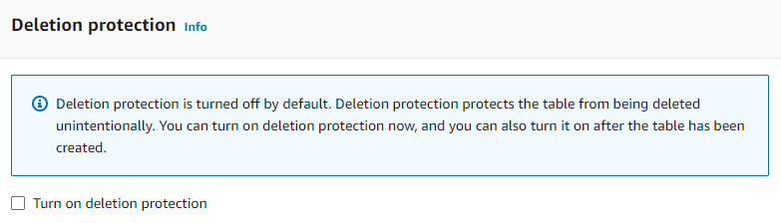
Core Components
Amazon DynamoDB

Slide 47
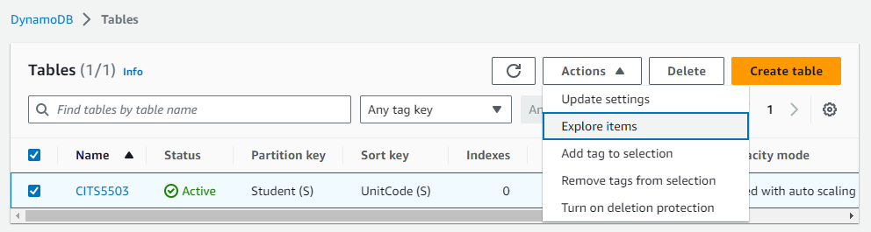
Core Components
Amazon DynamoDB

Slide 48
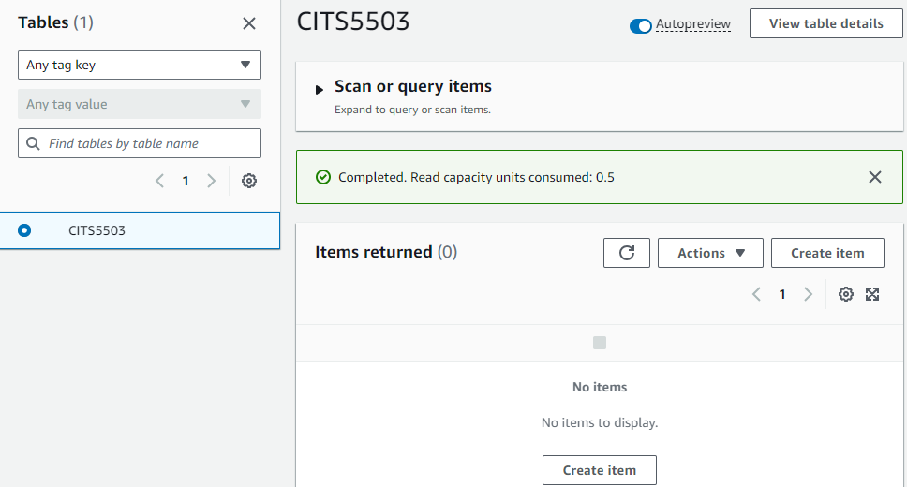
Core Components
Amazon DynamoDB

Slide 49
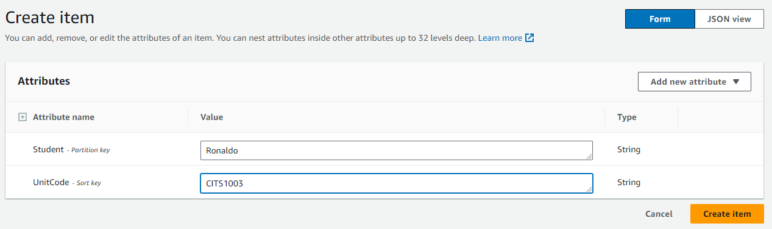
Core Components
Amazon DynamoDB

Slide 50
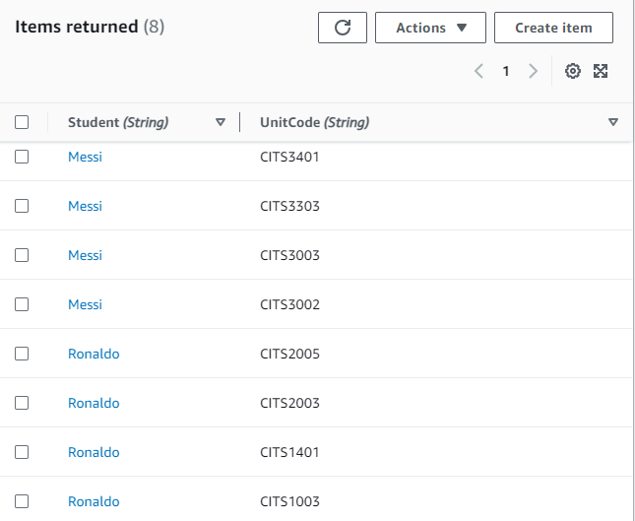
Core Components
Amazon DynamoDB

Slide 51
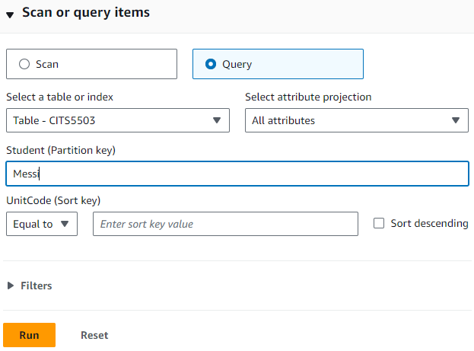
Core Components
Amazon DynamoDB

Slide 52
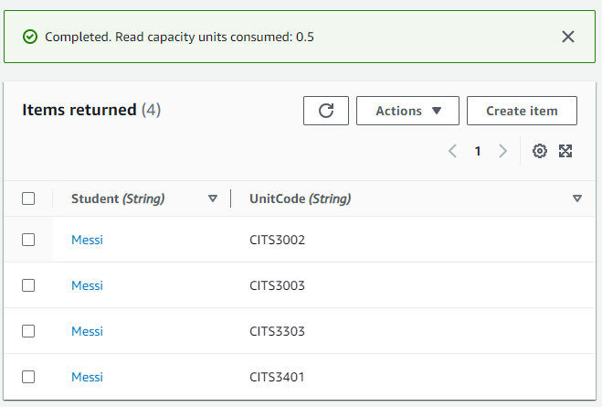
Core Components
Amazon DynamoDB

Slide 53
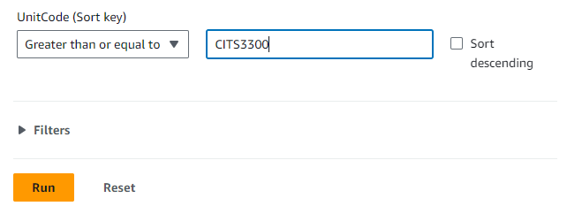
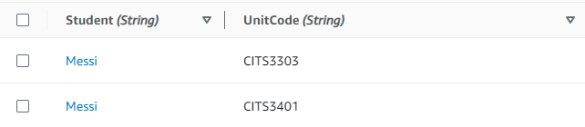
Core Components
Amazon DynamoDB

Slide 54
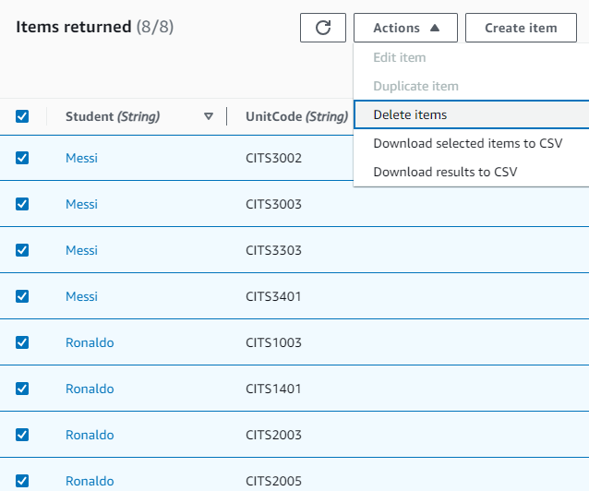
Core Components
Amazon DynamoDB

Slide 55
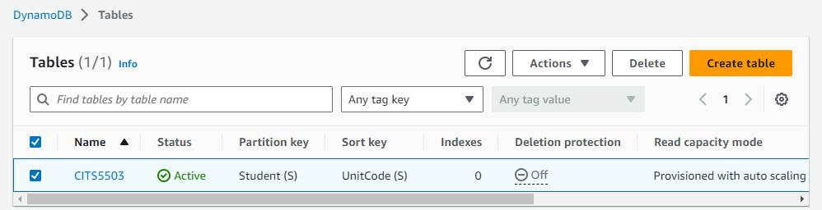
Core Components
Amazon DynamoDB

Slide 56
Practice Questions
Q3: You are asked to store data about music in a local DynamoDB table. Specifically, you need to record the artist name and their song names. Describe the AWSCLI commands you would use to create a table to store such information and write entries to that table.

Slide 57
Set up a local DynamoDB
From a terminal:
mkdir dynamodb; cd dynamodb
install jre if not done (sudo apt-get install default-jre)
wget https://s3-ap-northeast-1.amazonaws.com/dynamodb-local-tokyo/dynamodb_local_latest.tar.gz
tar -zxvf dynamodb_local_latest.tar.gz
java -Djava.library.path=./DynamoDBLocal_lib -jar DynamoDBLocal.jar –sharedDb

Slide 58
Create Table
1
2
3
4
5
6
7
8
aws dynamodb create-table --table-name MusicAlbum
--attribute-definitions \
AttributeName=Artist,AttributeType=S \
AttributeName=Song,AttributeType=S \
--key-schema AttributeName=Artist,KeyType=HASH \
AttributeName=Song,KeyType=RANGE \
--provisioned-throughput ReadCapacityUnits=1,WriteCapacityUnits=1 \
--endpoint-url=http://localhost:8000

Slide 59
Create Table
1
2
3
4
5
6
7
8
aws dynamodb create-table --table-name MusicAlbum
--attribute-definitions \
AttributeName=Artist,AttributeType=S \
AttributeName=Song,AttributeType=S \
--key-schema AttributeName=Artist,KeyType=HASH \
AttributeName=Song,KeyType=RANGE \
--provisioned-throughput ReadCapacityUnits=1,WriteCapacityUnits=1 \
--endpoint-url=http://localhost:8000
Creates a table named "MusicAlbum" with two attributes ("Artist" and "Song"),
Sets up "Artist" as the partition key and "Song" as the sort key,
Assigns provisioned throughput capacity of 1 read capacity unit and 1 write capacity unit,
Connects to a DynamoDB instance running locally on http://localhost:8000.

Slide 60
Create Items
1
2
3
4
5
6
7
8
9
10
aws dynamodb put-item \
--table-name MusicAlbum \
--item \ '{"Artist": {"S": “Tom"}, "Song": {"S": "Call Me Today"}}’\
--return-consumed-capacity TOTAL --endpoint-url=http://localhost:8000
aws dynamodb put-item \
--table-name MusicAlbum \
--item '{"Artist": {"S": “Jerry"}, "Song": {"S": "Happy Day"}}’ \
--return-consumed-capacity TOTAL --endpoint-url=http://localhost:8000

Slide 61
Create Items
1
2
3
4
5
6
7
8
9
10
aws dynamodb put-item \
--table-name MusicAlbum \
--item \ '{"Artist": {"S": “Tom"}, "Song": {"S": "Call Me Today"}}’\
--return-consumed-capacity TOTAL --endpoint-url=http://localhost:8000
aws dynamodb put-item \
--table-name MusicAlbum \
--item '{"Artist": {"S": “Jerry"}, "Song": {"S": "Happy Day"}}’ \
--return-consumed-capacity TOTAL --endpoint-url=http://localhost:8000
Insert two items with values of the attributes,
Request information about the consumed capacity for the operations,
Specify a local DynamoDB for the connection.
What if we want to add one more attribute to this table, e.g., AlbumTitle?

Slide 62
Create Entries
1
2
3
4
5
6
7
8
9
10
11
12
aws dynamodb put-item \
--table-name MusicAlbum \
--item \ '{"Artist": {"S": “Tom"}, "Song": {"S": "Call Me Today"},
"AlbumTitle": {"S": "Somewhat Famous"}}’ \
--return-consumed-capacity TOTAL --endpoint-url=http://localhost:8000
aws dynamodb put-item \
--table-name MusicAlbum \
--item '{"Artist": {"S": “Jerry"}, "Song": {"S": "Happy Day"}, \
"AlbumTitle": {"S": "Songs About Life"} }’ \
--return-consumed-capacity TOTAL --endpoint-url=http://localhost:8000

Slide 63
MusicAlbum Table
Artist | Song | AlbumTitle
Tom | Call Me Today | Somewhat Famous
Jerry | Happy Day | Songs About Life

Slide 64
Query
1
2
3
4
5
aws dynamodb query \
--table-name MusicAlbum \
--key-condition-expression "Artist = :artist" \
--expression-attribute-values '{":artist":{"S":"Tom"}}’ \
--endpoint-url=http://localhost:8000
‘artist’ works as a placeholder and can be changed by other word.

Slide 65
Query
1
2
3
4
5
aws dynamodb query \
--table-name MusicAlbum \
--key-condition-expression "Artist = :artist" \
--expression-attribute-values '{":artist":{"S":"Tom"}}’ \
--endpoint-url=http://localhost:8000
Queries the "MusicAlbum" table for items where the "Artist" is "Tom".
Table output:
Artist | Song | AlbumTitle
Tom | Call Me Today | Somewhat Famous

Slide 66
Scan
1
2
3
aws dynamodb scan \
--table-name MusicAlbum \
--endpoint-url=http://localhost:8000
Table output:
Artist | Song | AlbumTitle
Tom | Call Me Today | Somewhat Famous
Jerry | Happy Day | Songs About Life

Slide 67
Create Entries
1
2
3
4
5
6
7
8
9
10
11
aws dynamodb put-item \
--table-name MusicAlbum \
--item \ '{"Artist": {"S": "Tom"}, "Song": {"S": "Call Me Today"},
"AlbumTitle": {"S": "Somewhat Famous"}}' \
--return-consumed-capacity TOTAL --endpoint-url=http://localhost:8000
aws dynamodb put-item \
--table-name MusicAlbum \
--item '{"Artist": {"S": "Jerry"}, "Song": {"S": "Happy Day"}}' \
--return-consumed-capacity TOTAL --endpoint-url=http://localhost:8000
What will the table be like if we create the first item with 3 attributes and the second item with 2 attributes?

Slide 68
Create Entries
1
2
3
4
5
6
7
8
9
10
11
aws dynamodb put-item \
--table-name MusicAlbum \
--item \ '{"Artist": {"S": "Tom"}, "Song": {"S": "Call Me Today"},
"AlbumTitle": {"S": "Somewhat Famous"}}' \
--return-consumed-capacity TOTAL --endpoint-url=http://localhost:8000
aws dynamodb put-item \
--table-name MusicAlbum \
--item '{"Artist": {"S": "Jerry"}, "Song": {"S": "Happy Day"}}' \
--return-consumed-capacity TOTAL --endpoint-url=http://localhost:8000
Artist | Song | AlbumTitle
Tom | Call Me Today | Somewhat Famous
Jerry | Happy Day

Slide 69
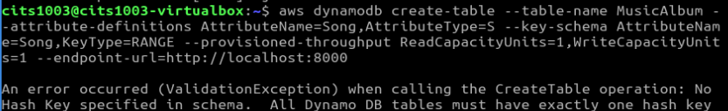
What if the hash key is NOT provided?

Slide 70
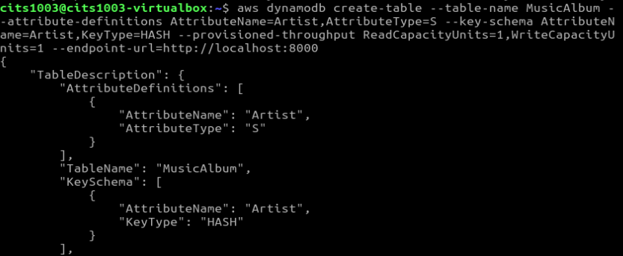
What if the range key is NOT provided?

Slide 71
A dynamodb table
Artist | Song
Jerry | Happy Day
What will the table be like if we create an item by adding a value of “Tom” to the “Artist” key?

Slide 72
A dynamodb table
Artist | Song
Jerry | Happy Day
Tom
What will the table be like if we create an item by adding a value of “Poker Face” to the “Song” key?

Slide 73
Data Types
Attributes can be:
Scalar: represent exactly one value
Number, String, Binary, Boolean, null
Set: an array of the same scalar type
["Black", "Green" ,"Red"]
[42.2, -19, 7.5, 3.14]
Document

Slide 74
Document Types
List: a collection of values, enclosed in square brackets: [ ... ]
FavoriteThings: ["Cookies", "Coffee", 3.14159]
Map: a hierarchical structure of attributes within a single attribute, enclosed in curly brackets: {...}
{
Day: "Monday",
UnreadEmails: 42,
ItemsOnMyDesk: [
"Coffee Cup",
"Telephone",
{
Pens: { Quantity : 3},
Pencils: { Quantity : 2}
}
]
}

Slide 75
Mid-sem test
The exam has a time limit of 60 mins
The exam is at 5:30pm-6:30pm on 26/08/25
arrive at 5:15pm with your ID such as student card, driver license, etc.
No lecture on 26/08/24 and lab sessions are still open in week 5 and week 6.
The exam venues (will be updated next week).
The exam is close-book: NO notes are allowed.
The exam is F2F for all students.
Your name and student ID must be written on the cover page of the question booklet.
Please do NOT use a pencil or a red pen.
Please use readable handwriting. What cannot be read cannot be marked.

Slide 76
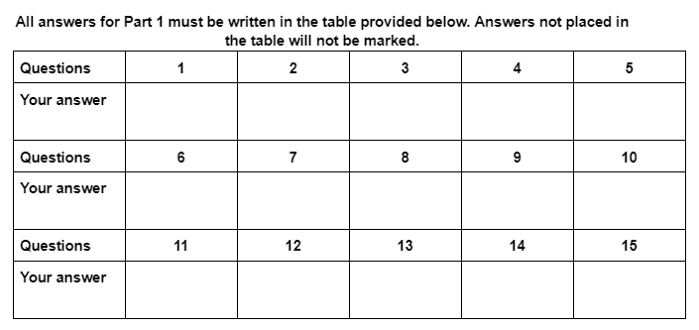
Mid-sem test
Part 1: Multi-choice questions (15 marks)
15 questions
Each question has only one correct answer and is worth 1 mark

Slide 77
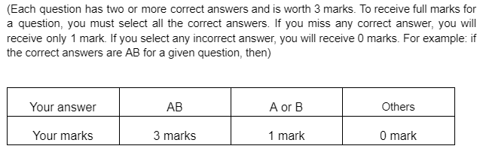
Mid-sem test
Part 1: Multi-choice questions (15 marks)
Part 2: Multi-answer questions (15 marks)
5 questions

Slide 78
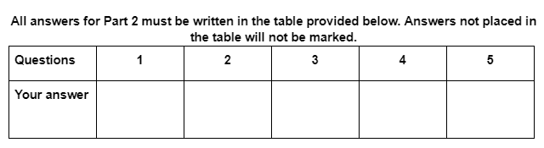
Mid-sem test
Part 1: Multi-choice questions (15 marks)
Part 2: Multi-answer questions (15 marks)
5 questions

Slide 79
Mid-sem test
Part 1: Multi-choice questions (15 marks)
All answers to Part 1 must be written in the provided table.
Part 2: Multi-answer questions (15 marks)
All answers to Part 2 must be written in the provided table.
Part 3: Short answer questions including reading code (30 marks)
5 themed questions
All answers to Part 3 must be written on the provided blank pages.

Slide 80
Mid-sem test
Part 1: Multi-choice questions (15 marks)
All answers to Part 1 must be written in the provided table.
Part 2: Multi-answer questions (15 marks)
All answers to Part 2 must be written in the provided table.
Part 3: Short answer questions including reading code (30 marks)
5 themed questions
All answers to Part 3 must be written on the provided blank pages.
Exam Content:
Lectures of Weeks 1-5 and Labs 1-3.

Slide 81
Mid-sem test
Part 1: Multi-choice questions (15 marks)
Part 2: Multi-answer questions (15 marks)
Part 3: Short answer questions including reading code (30 marks).
Exam Content:
Lectures of Weeks 1-5 and Labs 1-3.
For practice (will be provided next week)

