Slide 1
Week 5 AWS Identity Access Management
Dr Zhi Zhang

Slide 2
Mid-sem test (5:30pm-6:30pm on 26/08/25)
Student Number | Venues
21000000 - 23870000 | ENCM: [ G06] Harold and Margaret Clough Engineering Lecture Theatre 1
23870001 - 24142000 | ENCM: [ G04] Harold and Margaret Clough Engineering Lecture Theatre 2
24142001 - 24386400 | WTLTS:[ G106] Tattersall Lecture Theatre
24386401 - 24560000 | ARTS:[ 159] Austin Lecture Hall
24560001 - 25100000 | ARTS:[ 160] Arts Lecture Room 8
Students with UAAP | CSSE:[ 207] Seminar Room
If a student is 30 minutes late to the test, they are not allowed to sit for it

Slide 3
Mid-sem test
Part 1: Multi-choice questions (15 marks)
15 questions
Part 2: Multi-answer questions (15 marks)
5 questions
Part 3: Short answer questions including reading code (30 marks)
5 themed questions
Practice

Slide 4
Part 1
How does virtualization contribute to the benefits of cloud computing?
A. Virtualization eliminates the need for internet connectivity.
B. Virtualization increases hardware resource costs.
C. Virtualization enables efficient utilization of physical hardware by creating multiple virtual instances on a single server.
D. Virtualization limits the scalability of cloud services.

Slide 5
Part 1
How does virtualization contribute to the benefits of cloud computing?
A. Virtualization eliminates the need for internet connectivity.
B. Virtualization increases hardware resource costs.
C. Virtualization enables efficient utilization of physical hardware by creating multiple virtual instances on a single server.
D. Virtualization limits the scalability of cloud services.
Answer: C
What is EC2 used for in AWS?
A. Managing DNS records for domains.
B. Storing and managing relational databases.
C. Scaling compute capacity and launching virtual servers in the cloud.
D. Sending and receiving emails.

Slide 6
Part 1
How does virtualization contribute to the benefits of cloud computing?
A. Virtualization eliminates the need for internet connectivity.
B. Virtualization increases hardware resource costs.
C. Virtualization enables efficient utilization of physical hardware by creating multiple virtual instances on a single server.
D. Virtualization limits the scalability of cloud services.
Answer: C
What is EC2 used for in AWS?
A. Managing DNS records for domains.
B. Storing and managing relational databases.
C. Scaling compute capacity and launching virtual servers in the cloud.
D. Sending and receiving emails.
Answer: C

Slide 7
Part 1
Which of the following is NOT correct about cloud computing?
A. On-demand self service
B. Broad network access
C. Resource pooling
D. Slow elasticity

Slide 8
Part 1
Which of the following is NOT correct about cloud computing?
A. On-demand self service
B. Broad network access
C. Resource pooling
D. Slow elasticity
Answer: D
Which of the following best describes ARN?
A. a unique ID for AWS S3 buckets
B. a unique ID for AWS EC2 instances
C. a unique ID for AWS IAM users
D. a unique ID for any AWS resources

Slide 9
Part 1
Which of the following is NOT correct about cloud computing?
A. On-demand self service
B. Broad network access
C. Resource pooling
D. Slow elasticity
Answer: D
Which of the following best describes ARN?
A. a unique ID for AWS S3 buckets
B. a unique ID for AWS EC2 instances
C. a unique ID for AWS IAM users
D. a unique ID for any AWS resources
Answer: D

Slide 10
Part 1
Which of the following is the main feature of EBS?
A. A cloud-based email service for sending and receiving messages.
B. A service for launching and managing virtual servers in the cloud.
C. A block storage service that provides persistent storage.
D. A service that manages domain names and translates them to IP addresses.

Slide 11
Part 1
Which of the following is the main feature of EBS?
A. A cloud-based email service for sending and receiving messages.
B. A service for launching and managing virtual servers in the cloud.
C. A block storage service that provides persistent storage.
D. A service that manages domain names and translates them to IP addresses.
Answer: C
Part 2
Which of the following statements are correct in cloud computing? (Select all that apply)
A. Cloud providers allow users to pay as they go.
B. Data centers are usually distributed globally.
C. Cloud computing is built upon data centers.
D. Cooling may not be needed for data centers.

Slide 12
Part 1
Which of the following is the main feature of EBS?
A. A cloud-based email service for sending and receiving messages.
B. A service for launching and managing virtual servers in the cloud.
C. A block storage service that provides persistent storage.
D. A service that manages domain names and translates them to IP addresses.
Answer: C
Part 2
Which of the following statements are correct in cloud computing? (Select all that apply)
A. Cloud providers allow users to pay as they go.
B. Data centers are usually distributed globally.
C. Cloud computing is built upon data centers.
D. Cooling may not be needed for data centers.
Answer: ABC

Slide 13
Part 2
Which of the following are the types of application architecture? (Select all that apply)
A. Monolithic architecture.
B. Client/Server architecture.
C. Three-tier architecture.
D. Cloud-based serverless architecture.

Slide 14
Part 2
Which of the following are the types of application architecture? (Select all that apply)
A. Monolithic architecture.
B. Client/Server architecture.
C. Three-tier architecture.
D. Cloud-based serverless architecture.
Answer: ABCD
Which of the following statements are correct? (Select all that apply)
A. Page tables translate virtual memory into physical memory in modern OS.
B. When translating a 32-bit linear address, two levels of page tables are needed.
C. Ring 0 is the least privileged and Ring 3 is the most privileged.
D. The number of processes is much smaller than the number of physical CPUs.

Slide 15
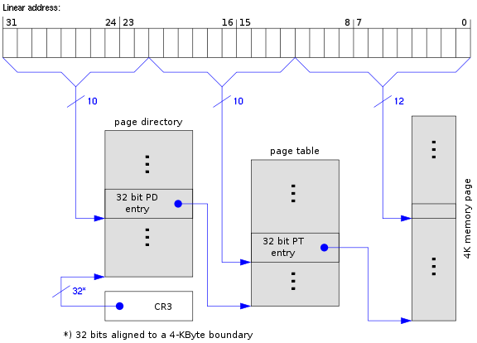
Page table:
A modern OS uses a set of page tables to map virtual memory within a process to their corresponding physical memory in main memory.
https://www.cs.virginia.edu/~bjc8c/class/cs6456-s20/slides/01-intro.pptx

Slide 16
Part 2
Which of the following are the types of application architecture? (Select all that apply)
A. Monolithic architecture.
B. Client/Server architecture.
C. Three-tier architecture.
D. Cloud-based serverless architecture.
Answer: ABCD
Which of the following statements are correct? (Select all that apply)
A. Page tables translate virtual memory into physical memory in modern OS.
B. When translating a 32-bit virtual address, two levels of page tables are needed.
C. Ring 0 is the least privileged and Ring 3 is the most privileged.
D. The number of processes is much smaller than the number of physical CPUs.
Answer: AB

Slide 17
Part 2
Which of the following statements are correct? (Select all that apply)
A. The number of processes is the same as that of physical CPUs.
B. Page tables translate virtual addresses into physical addresses in modern OS.
C. A virtual address and its corresponding physical address have the same page offset.
D. Both Intel VT-x and AMD SVM allow a guest OS to run directly on hardware without being trapped into the VMM.
Answer: BC
Which of the following statements are correct about IAM? (Select all that apply)
A. A principal must be authorized to access AWS resources after being authenticated.
B. An AWS root user account can create many IAM users and grant them access to AWS resources. The root user does not have to share their login credentials.
C. IAM policies define both permissions for an action and the method used to perform the action.
D. IAM allows fine-grained permissions, e.g., specifying actions that an IAM user or role can perform on specific AWS resources.
Answer: ABD

Slide 18
Part 3
1 import boto3
2 s3_resource = boto3.resource('s3’)
3 s3_resource.Object('bucket-mst', 'A2.txt').copy_from(CopySource ='bucket-mst/A1.txt’)
4 s3_resource.Object('bucket-mst', 'A1.txt').delete()
Read the python code snippet above. Explain Line 3 and Line4 and conclude what essential file operation has been performed.

Slide 19
Part 3
1 import boto3
2 s3_resource = boto3.resource('s3’)
3 s3_resource.Object('bucket-mst', 'A2.txt').copy_from(CopySource ='bucket-mst/A1.txt’)
4 s3_resource.Object('bucket-mst', 'A1.txt').delete()
Answer
Line 3 copies the object named 'A1.txt' from the 'bucket-mst' bucket to a new object named 'A2.txt' within the same bucket.
Line 4 deletes 'A1.txt' from the 'bucket-mst' bucket.
The operation is to rename the object from A1.txt to A2.txt.

Slide 20
Part 3
Read the following JSON code snippet and explain what it primarily does based on Effect, Principal, Action, Resource and Condition.
{
"Version": "2012-10-17",
"Statement": [
{
"Effect": “Allow",
"Principal": {
"AWS": "arn: aws: iam: :12345:user/dave"
},
"Action": "*",
"Resource": "*",
"Condition": {
"IpAddress": {
"aws: SourceIp": "192.168.110.110"
}
}
}
]
}

Slide 21
Part 3
Read the following JSON code snippet and explain what it primarily does based on Effect, Principal, Action, Resource and Condition.
{
"Version": "2012-10-17",
"Statement": [
{
"Effect": “Allow",
"Principal": {
"AWS": "arn: aws: iam: :12345:user/dave"
},
"Action": "*",
"Resource": "*",
"Condition": {
"IpAddress": {
"aws: SourceIp": "192.168.110.110"
}
}
}
]
}
Answer
This policy allows a specific IAM user (arn:aws:iam::12345:user/Alice) to do anything on any (AWS) resources from a specific IP address of 192.168.110.110.

Slide 22
Part 3
Read the code snippet below.
1
2
3
4
5
6
aws dynamodb create-table --table-name MusicAlbum
--attribute-definitions \
AttributeName=Artist,AttributeType=S \
--key-schema AttributeName=Artist,KeyType=HASH \
--provisioned-throughput ReadCapacityUnits=1,WriteCapacityUnits=1 \
--endpoint-url=http://localhost:8000

Slide 23
Part 3
Read the code snippet below and show its table output.
1
2
3
4
5
6
7
8
9
10
11
12
13
14
15
aws dynamodb put-item \
--table-name MusicAlbum \
--item '{"Artist": {"S": "Tom"}, "Song": {"S": "Call me today"}}'\
--return-consumed-capacity TOTAL --endpoint-url=http://localhost:8000
aws dynamodb put-item \
--table-name MusicAlbum \
--item '{"Artist": {"S": "Henry"}, "Song": {"S": "Flowers"}}' \
--return-consumed-capacity TOTAL --endpoint-url=http://localhost:8000
aws dynamodb put-item \
--table-name MusicAlbum \
--item '{"Artist": {"S": "Jerry"}, "Song": {"S": "Happy day"}}' \
--return-consumed-capacity TOTAL --endpoint-url=http://localhost:8000

Slide 24
Part 3
A DynamoDB table called MusicAlbum will be created
Artist | Song
Tom | Call me today
Henry | Flowers
Jerry | Happy day
Read the code snippet below and show its table output.
1
2
3
4
aws dynamodb query \
--table-name MusicAlbum \
--key-condition-expression "Artist = :A1 or Artist = :A2" \
--expression-attribute-values '{":A1":{"S":"Tom"}, ":A2":{"S":"Jerry"}}'

Slide 25
Part 3
1
2
3
4
aws dynamodb query \
--table-name MusicAlbum \
--key-condition-expression "Artist = :A1 or Artist = :A2" \
--expression-attribute-values '{":A1":{"S":"Tom"}, ":A2":{"S":"Jerry"}}'
Answer
Artist | Song
Tom | Call me today
Jerry | Happy day

Slide 26
Part 3
1
2
3
4
aws dynamodb put-item \
--table-name MusicAlbum \
--item '{"Artist": {"S": "Eason"}}'\
--return-consumed-capacity TOTAL --endpoint-url=http://localhost:8000
Read the code snippet above and show its table output.

Slide 27
Part 3
1
2
3
4
aws dynamodb put-item \
--table-name MusicAlbum \
--item '{"Artist": {"S": "Eason"}}'\
--return-consumed-capacity TOTAL --endpoint-url=http://localhost:8000
Read the code snippet above and show its table output.
Answer
Artist | Song
Tom | Call me today
Henry | Flowers
Jerry | Happy day
Eason

Slide 28
Further questions
1
2
3
4
5
6
7
8
aws dynamodb create-table --table-name MusicAlbum
--attribute-definitions \
AttributeName=Artist,AttributeType=S \
AttributeName=Song,AttributeType=S \
--key-schema AttributeName=Artist,KeyType=HASH \
AttributeName=Song,KeyType=RANGE \
--provisioned-throughput ReadCapacityUnits=1,WriteCapacityUnits=1 \
--endpoint-url=http://localhost:8000
What will the table be like if we put an item by adding a value of “Jason” to the “Artist” key?

Slide 29
Further questions
1
2
3
4
5
6
7
8
aws dynamodb create-table --table-name MusicAlbum
--attribute-definitions \
AttributeName=Artist,AttributeType=S \
AttributeName=Song,AttributeType=S \
--key-schema AttributeName=Artist,KeyType=HASH \
AttributeName=Song,KeyType=RANGE \
--provisioned-throughput ReadCapacityUnits=1,WriteCapacityUnits=1 \
--endpoint-url=http://localhost:8000
An error occurred (ValidationException) when calling the PutItem operation: One of the required keys was not given a value.

Slide 30
Further questions
1
2
3
4
aws dynamodb put-item \
--table-name MusicAlbum \
--item '{"Artist": {"S": "Tom"}, "Song": {"S": "Call me today"}}'\
--return-consumed-capacity TOTAL --endpoint-url=http://localhost:8000
1
2
3
4
5
aws dynamodb query \
--table-name MusicAlbum \
--key-condition-expression "Artist = :artist" \
--expression-attribute-values '{":artist":{"S":"Tom"}}' \
--endpoint-url=http://localhost:8000
Artist | Song
Tom | Call me today

Slide 31
Further questions
1
2
3
4
5
aws dynamodb query \
--table-name MusicAlbum \
--key-condition-expression "Song = :song" \
--expression-attribute-values ' {":song":{"S":"Call me today"}}' \
--endpoint-url=http://localhost:8000
If we use the query command above:
An error occurred (ValidationException) when calling the Query operation: Query condition missed key schema element

Slide 32
Overview
Cryptography
IAM (Identity Access Management)

Slide 33
Cybersecurity
It is about the protection of digital information from unauthorised access, harm or misuse.
This is done by preserving the CIA triad of the information, i.e., Confidentiality, Integrity and Availability.
Confidentiality: keeps sensitive information private and ensures that only authorized individuals or entities have access to it.
Integrity: maintains the accuracy, and reliability of information.
Availability: ensures that information such as services and data are accessible and operational for authorized users.

Slide 34
Cybersecurity
CIA can be extended to include such as Authentication, Authorization and Non-Repudiation.
Authentication: verifies the identity of a user, system, or entity trying to access a resource or system.
Authorization: determines what actions or resources an authenticated user or system is allowed to perform or access.
Non-Repudiation: prevents individuals or entities from denying their involvement in a particular digital transaction.

Slide 35



Cryptography
It is the practice and study of techniques for secure communication in the presence of adversaries or potential threats.
Insecure Channel
Alice
Bob
Attacker

Slide 36
Cryptography
It is the practice and study of techniques for secure communication in the presence of adversaries or potential threats.
It is mainly about the use of mathematical algorithms to transform plain, readable data (i.e., plaintext) into an unintelligible data (i.e., ciphertext) and vise versa

Slide 37
Cryptography
It is the practice and study of techniques for secure communication in the presence of adversaries or potential threats.
It is mainly about the use of mathematical algorithms to transform plain, readable data (i.e., plaintext) into an unintelligible data (i.e., ciphertext) and vise versa
Caesar cipher: an old-fashion substitution cipher where each letter in the plaintext is shifted a certain number of positions down the alphabet.
ROT3
plaintext : HELLO
ciphertext : KHOOR
H becomes K (H → I → J → K)
E becomes H (E → F → G → H)
L becomes O (L →M → N → O)
L becomes O (L → M → N → O)
O becomes R (O → P → Q → R)

Slide 38
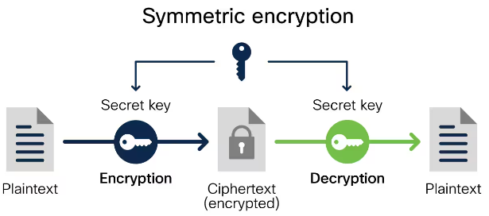
Cryptography today
Symmetric key cryptography: the same key is used for data transformation.
The transformation involve encryption and decryption.
Encryption: takes plaintext and converts it into ciphertext
Decryption: reverses the encryption process
Examples?

Slide 39
Cryptography today
Symmetric key cryptography: the same key is used for data transformation.
Examples: DES (insecure), 3DES (insecure), AES (AES-128, AES-192, AES-256).
Applications: data (file, network packets) encryption (AES-256 used by S3)
https://www.cisco.com/c/en/us/products/security/encryption-explained.html#~encryption-algorithms

Slide 40
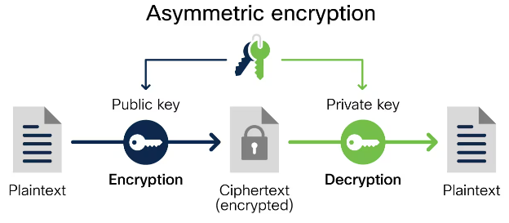
Cryptography today
Symmetric key cryptography: the same key is used for encryption and decryption of data.
Asymmetric key cryptography (public key cryptography): a pair of distinct keys is used for encryption and decryption.
Examples?
https://www.cisco.com/c/en/us/products/security/encryption-explained.html#~encryption-algorithms

Slide 41
Cryptography today
Symmetric key cryptography: the same key is used for encryption and decryption of data.
Asymmetric key cryptography (public key cryptography): a pair of distinct keys is used for encryption and decryption.
Examples: ECC, RSA
Application: remote authentication (SSH communication)
https://www.cisco.com/c/en/us/products/security/encryption-explained.html#~encryption-algorithms

Slide 42
Cryptography today
Symmetric key cryptography
Asymmetric key cryptography
Which aspect of the CIA triad do the cryptography techniques above protect?
Secure Channel
Alice
Bob
Attacker

Slide 43
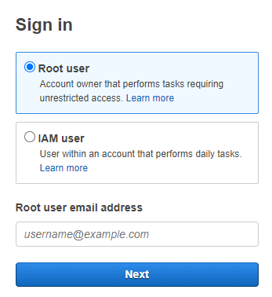
What is IAM (identity access management)?
It is a service that helps us securely control access to AWS resources.
It is used to control who is authenticated (signed in) and authorized (has permissions) to use AWS resources.
Root user: complete access to all AWS services and resources in the account

Slide 44
IAM identity
IAM user: an identity within a root user account that has specific permissions for a single person or application:
Each user has an ARN:
e.g., arn:aws:iam::489389878001:user/12345678@student.uwa.edu.au
IAM user group: an identity that specifies a set of IAM users:
Users within the same group are given the same set of permissions.
Users can belong to different groups.
Each group has an ARN, e.g., arn:aws:iam::489389878001:group/admins

Slide 45
IAM identity
IAM user: an identity within a root user account that has specific permissions for a single person or application.
IAM user group: an identity that specifies a set of IAM users.
IAM role: an identity that has specific permissions, similar to IAM user but not relevant to a specific person/application.
Any users/applications can assume a role to complete a specific task.
User case: an IAM role grants permissions to applications running on an EC2 instance
Each role has an ARN, e.g., arn:aws:iam:: 489389878001 :role/apps4ec2

Slide 46
IAM role
{
"Version": "2012-10-17",
"Statement": [
{
"Effect": "Allow",
"Action": [
"s3:GetObject",
"s3:PutObject"
],
"Resource": [
"arn:aws:s3:::my-app-bucket/*",
"arn:aws:s3:::my-app-bucket/*"
}
]
}

Slide 47
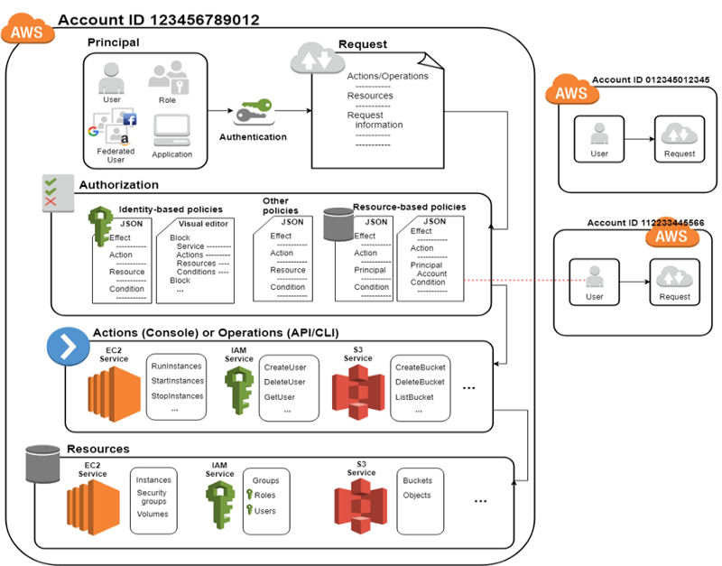
How IAM works
Step 1: Authenticate a principal.
Principal: a person or application that uses an IAM user, a root user, or an IAM role to sign in and make requests to AWS.

Slide 48

How IAM works
Step 1: Authenticate a principal.
Step 2: Authorize a principal.

Slide 49
How IAM works
Step 1: Authenticate a principal.
Step 2: Authorize a principal.
Step 3: Take actions/operations on AWS resources.

Slide 50
Main features of IAM
Shared access to AWS root user account
Grant other people permission to use resources in our root user account without having to share our password or access key.
Granular permissions
Grant varying permissions to different individuals for specific resources.
e.g., some IAM users have complete access to specified EC2 instances while some have read-only access to specific S3 buckets.

Slide 51
Policies and permissions
Access permissions (authorization) are managed by creating policies and attaching them to IAM identities (users, groups of users, or roles) or AWS resources.
Note: IAM policies only define permissions for an action regardless of the method that we use to perform the action
e.g., if a policy allows the GetUser action, then a user with that policy can get user information with all three methods.

Slide 52
Part 2
Which of the following statements are correct about IAM? (Select all that apply)
A. A principal must be authorized to access AWS resources after being authenticated.
B. An AWS root user account can create many IAM users and grant them access to AWS resources. The root user does not have to share their login credentials.
C. IAM policies define both permissions for an action and the method used to perform the action.
D. IAM allows fine-grained permissions, e.g., specifying actions that an IAM user or role can perform on specific AWS resources.
Answer: ABD

Slide 53
Policies and permissions
Access permissions (authorization) are managed by creating policies and attaching them to IAM identities (users, groups of users, or roles) or AWS resources.
Note: IAM policies only define permissions for an action regardless of the method that we use to perform the action
e.g., if a policy allows the GetUser action, then a user with that policy can get user information with all three methods.
Policy types (most frequently used):
Identity-based policy
permissions boundary

Slide 54
Identity-based policy
It controls what actions an identity can perform.
Managed policy: standalone identity-based policy that we can attach to multiple users, groups, and roles.
AWS managed policy: created and managed by AWS
Customer managed policy: created and managed by AWS users.
Inline policy

Slide 55
Identity-based policy
It controls what actions an identity can perform.
Managed policy: standalone identity-based policy that we can attach to multiple users, groups, and roles.
AWS managed policy: created and managed by AWS
Customer managed policy: created and managed by AWS users.
Inline policy: it maintains a strict one-to-one relationship between a policy and an identity/resource. If the identity/resource is deleted, the policy is deleted as well, e.g., resource-based policy.

Slide 56
AWS managed policy
full-access managed policy: defines permissions for administrators by granting full access to services, e.g., AdministratorAccess.
power-user managed policy: provides full access to services and resources, but disallows managing users and groups, i.e., a subset of full-access managed policy, e.g., PowerUserAccess.
partial-user managed policy: provides varying access to specific services, i.e., a subset of power-user managed policy, e.g., AWSCloudTrail_ReadOnlyAccess.

Slide 57
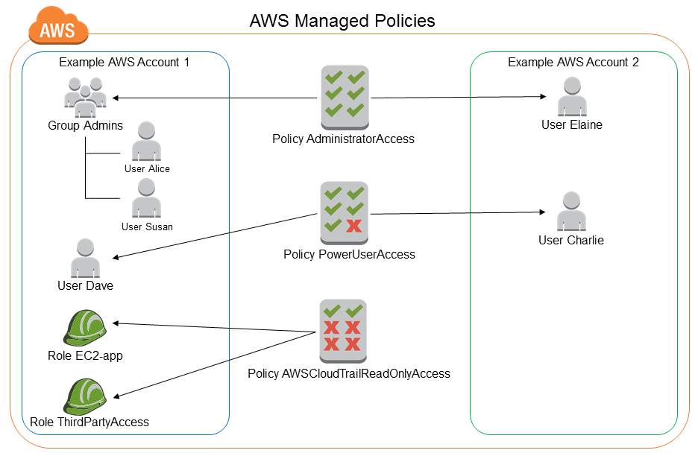
AWS managed policy
https://docs.aws.amazon.com/IAM/latest/UserGuide/access_policies_managed-vs-inline.html#aws-managed-policies

Slide 58
AdministratorAccess
Version: indicates the language version of the policy language.
Statement: represents a permission rule.
Effect: what the effect will be when a user requests the specific action—this can be either ’Allow’ or ’Deny’.
Action: defines a set of resource operations a user/application is allowed (or denied) to perform.
Resource: specifies AWS resources for which a user is allowed or denied to take actions. ARN is often used.
{
"Version": "2012-10-17",
"Statement": [
{
"Effect": "Allow",
"Action": "*",
"Resource": "*"
}
]
}

Slide 59
PowerUserAccess
{
"Version": "2012-10-17",
"Statement": [
{ "Effect": "Allow",
"NotAction": [
"iam:*",
"organizations:*",
"account:*"
],
"Resource": "*"
},
{ "Effect": "Allow",
"Action": [
"iam:ListRoles",
"organizations:DescribeOrganization",
"account:GetAccountInformation"
],
"Resource": "*"
}
]
}
Organizations: are a service that allows us to consolidate multiple AWS accounts into an organizational structure.

Slide 60
PowerUserAccess
{
"Version": "2012-10-17",
"Statement": [
{ "Effect": "Allow",
"NotAction": [
"iam:*",
"organizations:*",
"account:*"
],
"Resource": "*"
},
{ "Effect": "Allow",
"Action": [
"iam:ListRoles",
"organizations:DescribeOrganization",
"account:GetAccountInformation"
],
"Resource": "*"
}
]
}
This policy allows all actions on all resources except those related to IAM, Organizations, and Account management. However, it explicitly allows three actions of ListRoles, DescribeOrganization and GetAccountInformation, providing limited access to any resource.

Slide 61
What does this policy mean?
{
"Version": "2012-10-17",
"Statement": [
{ "Effect": "Allow",
"NotAction": [
"iam:*",
"organizations:*",
"account:*"
],
"Resource": "*"
},
{ "Effect": "Allow",
"Action": [
"iam:*",
"organizations:DescribeOrganization",
"account:GetAccountInformation"
],
"Resource": "*"
}
]
}

Slide 62
{
"Version": "2012-10-17",
"Statement": [
{ "Effect": “Deny",
"Action": [
"iam:*",
"organizations:*",
"account:*"
],
"Resource": "*"
},
{ "Effect": "Allow",
"Action": [
"iam:*",
“s3:*"
],
"Resource": "*"
}
]
}
Deny always wins. Otherwise, any Allow wins.

Slide 63
AWSCloudTrail_ReadOnlyAccess
{
"Version": "2012-10-17",
"Statement": [
{
"Effect": "Allow",
"Action": [
"cloudtrail:Get*",
"cloudtrail:Describe*",
"cloudtrail:List*",
],
"Resource": "*"
}
]
}
CloudTrail is a service that provides visibility into user activity and resource usage.
https://docs.aws.amazon.com/awscloudtrail/latest/APIReference/API_Operations.html

Slide 64
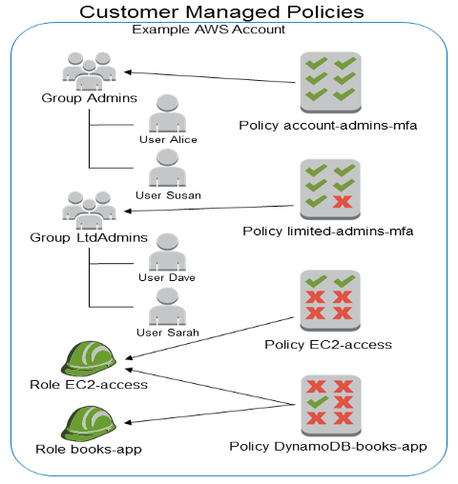
Customer managed policy
https://docs.aws.amazon.com/IAM/latest/UserGuide/access_policies_managed-vs-inline.html#aws-managed-policies

Slide 65
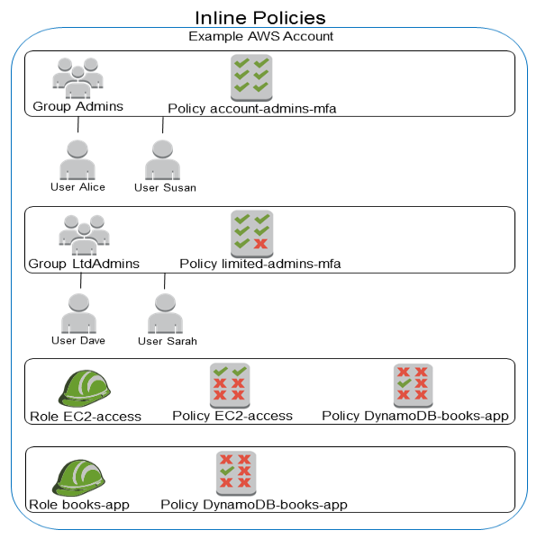
Managed policy
Inline policy
The DynamoDB-books-app policy is used by both roles. Is it shared?
https://docs.aws.amazon.com/IAM/latest/UserGuide/access_policies_managed-vs-inline.html#aws-managed-policies

Slide 66
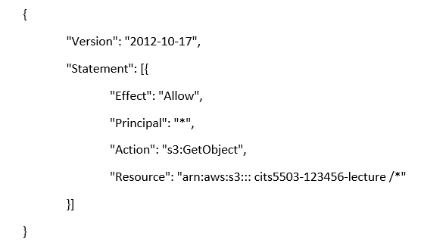
Resource-based policy
It specifies which principal has access to the resource and what actions they can perform on it, e.g., bucket policy.
Note: it is an inline policy.

Slide 67
Permissions boundary
It sets the maximum permissions that an identity-based policy can grant.
e.g., The permissions boundary is attached to an IAM user named Alice.
{
"Version": "2012-10-17",
"Statement": [
{
"Effect": "Allow",
"Action": [
"s3:*",
"ec2:*"
],
"Resource": "*"
}
]
}

Slide 68
Permissions boundary
identity-based policy
Permissions boundary
{
"Version": "2012-10-17",
"Statement": {
"Effect": "Allow",
"Action": "iam:CreateUser",
"Resource": "*"
}
}
{
"Version": "2012-10-17",
"Statement": [
{
"Effect": "Allow",
"Action": [
"s3:*",
"ec2:*"
],
"Resource": "*"
}
]
}
Both policies are attached to Alice.
Can Alice create a user?
Can Alice create S3 buckets and EC2 instances?

Slide 69
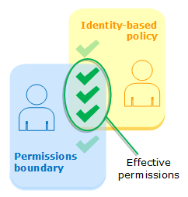
Permissions boundary
Both answers are NO.
Effective permissions are in the intersection of Identity-based policies and permissions boundaries.

Slide 70
Practice Questions
[6 marks] Q1: Name 3 of the keys in a Policy. Explain their role. An example of a key is “Version” that specifies the version of the policy syntax and is normally “Version”: “2012-10-17”

Slide 71
Practice Questions
[6 marks] Q1: Name 3 of the keys in a Policy. Explain their role. An example of a key is “Version” that specifies the version of the policy syntax and is normally “Version”: “2012-10-17”
[2 marks] Statement: represents a permission rule.
[2 marks] Effect: what the effect will be when a user requests the specific action—this can be either Allow or Deny.
[2 marks] Action: defines a set of resource operations a user/application is allowed (or denied) to perform.
[2 marks] Resource: specifies AWS resources for which a user is allowed or denied to take actions.

