Slide 1
CITS5503 Cloud Computing 2023 Introduction
Dr Zhi Zhang
Notes:
Welcome to cloud computing. Hope you had a relaxed holiday and get ready for this semester. Today I am gonna present the overview of this unit. My name is Zhi Zhang and I will be your unit coordinator. Prior to that, let me briefly introduce myself.

Slide 2

Prior to Joining UWA
Ph.D. at UNSW
Research Scientist in Cyber Security at CSIRO, Data61
Research Interests
Virtualization Security and Operating System Security
https://zhangzhics.github.io
Notes:
I joined UWA this year. Prior to that, I graduated from UNSW as a phd and worked for CSIRO’s data61 as a research scientist.
My research interests are virtualization security and OS security. If you want to pursue an honours degree and do a project about virtualization or cloud-based security in the future, welcome to email me. For more about me, welcome to visit my website. Alright, let’s move on.

Slide 3
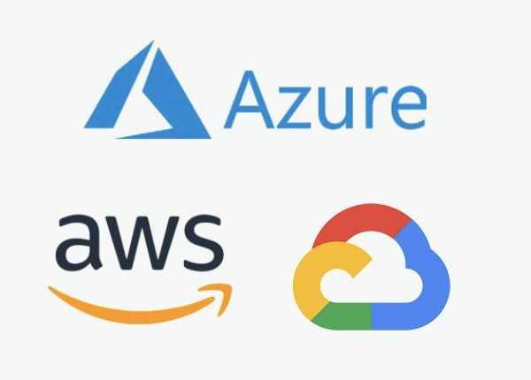
Three main cloud providers
Notes:
For this unit, we are talking about cloud computing. In real-world, we have three mainstream cloud providers. One is azure, from Microsoft, one is aws from amazon. The last one is google compute engine.

Slide 4
Three main virtual machine monitors (VMM)
?
?
?
Notes:
Alright, does anyone know virtual machine monitors that support these three public clouds? VMM can be interpreted as the underlying software infrastructure that manages the whole cloud.

Slide 5
Three main virtual machine monitors (VMM)
Hyper-V
Closed-source
Microsoft kernel module
Xen and KVM
KVM
Open-source
Build from scratch
Open-source
Linux kernel module
Notes:
Alright, for azure, its vmm is hyper-v. for aws, its vmm is xen and kvm. This means that some data centers in aws use xen. Some data centers use kvm. For google compute engine, its vmm is kvm. Both Xen and KVM are open-source VMM. KVM works as a Linux kernel module. Xen is different. It is built from scratch without Linux’s help. Hyper-v is closed-source and a Microsoft kernel module.

Slide 6
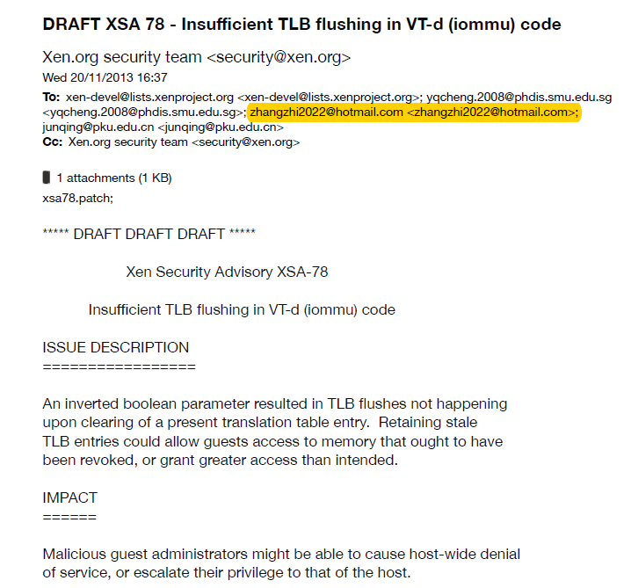
Notes:
So when I was doing a cloud security course like 10 years ago, I was motivated to read some source code of Xen and found a vulnerability and a couple of bugs. This is the email screenshot where we communicated with xen security’s team. we also submitted a patch to fix the vulnerability.

Slide 7
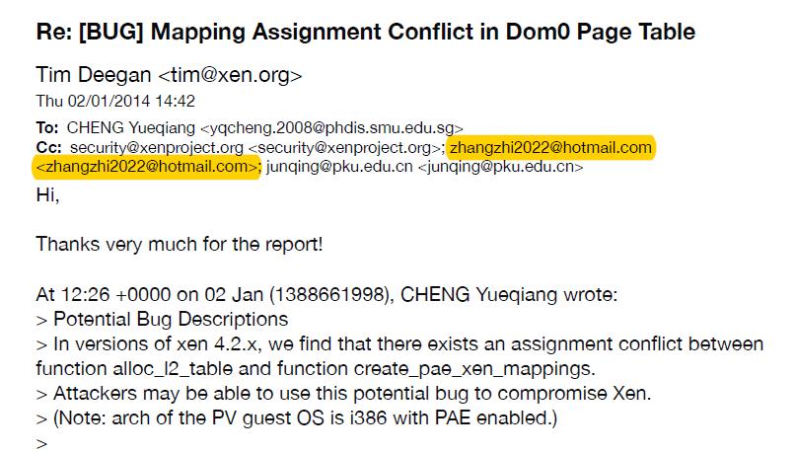
Notes:
This is the bug we reported in 2014. we also provided a solution to fix the bug.

Slide 8
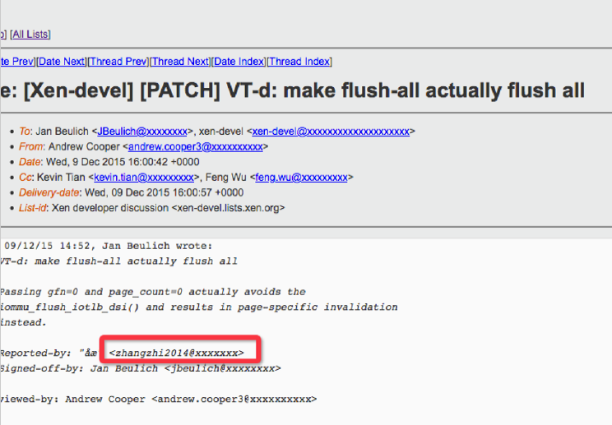
Notes:
This is the bug I found on my own in 2015. Since you already have some programming experience, if some of you are also interested in analysing open-source virtual machine monitor, I suggest you take a look at the source code of one VMM and you will get a better idea of how a cloud is implemented. I will talk more about the technical details of virtual machine monitor in week 3. Alright, let’s go back to our unit overview.

Slide 9
Pre-Requisites and Target Audience
There will be some coding in this unit and 12 points of programming-based units are required.
Most students enrolled in the unit are from MIT and should have some computer-science background.
Notes:
The Pre-Requisites and Target Audience of this unit. There will be some coding in this unit and we require 12 points of programming-based units. Most of you are from MIT and so should have some computer-science background. However, not all of you. So I will try to make everyone get familiar with the terms, concepts and practical aspects of cloud computing.

Slide 10
To Get Started
People
Emergency
Items of assessment
Topics
Ethics
Online resources
FAQs
What is Cloud Computing?
Learning outcomes
Notes:
To get started, I will introduce some basic items, including teaching staffs, emergency, items of assessments, etc.

Slide 11
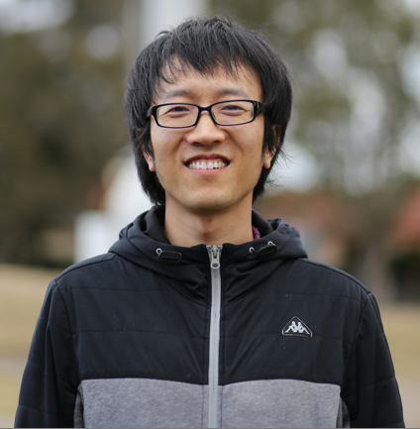

People
Zhi Zhang
Unit coordinator
Room G.10
zhi.zhang@uwa.edu.au
Hass
School operations team
Room: Main reception
schoolops-pmc@uwa.edu.au
Jichunyang Li
Lab facilitator
jichunyang.li@uwa.edu.au
Abdullah Alelyani
Lab facilitator
abdullah.alelyani@uwa.edu.au
Notes:
So these are the teaching staffs. I am in the top left corner. You can find me in G10, which is located in the ground floor of the computer science building. Of course you can always reach me by email, probably the easiest way.
Ok, jichunyang and Abdullah are our lab facilitators and you can reach them by email, MS teams or face2face when you attend labs in person. Both of our lab facilitators have served this unit last year and thus they are quite familiar with our labs. Hass is our staff in the admin team and you can find him in the reception area in the first floor of our computer science building.

Slide 12
Emergency
General emergency: call campus security at 6488 2222
In super emergency: call emergency at 000
For more details, please have a read through our emergency procedure for various potential incidents
http://www.safety.uwa.edu.au/incidents-injuries-emergency/procedures
For more student services:
https://www.uwa.edu.au/students/Support-services
UniAccess: https://www.uwa.edu.au/students/Support-services/Disability-and-accessibility (send me your Uniaccess letters ☺)
Notes:
Ok, we continue to cover the emergency part. So it is quite important for us to be aware of the emergency details. So for general emergency, we call campus security by 6488 2222. For super emergency, we should always call emergency 000. For more details about various scenarios, we can go to this website. For more student services, please visit this link. Particularly, for uniaccess support, we can visit this link. So if you have uniaccess letters, please send to me.

Slide 13
Assessments
Labs
Mid-sem Test
Final Exam
Notes:
We have 3 items of assessments for this semester. Labs, mid-semester test and final exam. We will introduce them one by one.

Slide 14
Lectures
For lectures, they will be recorded and uploaded into LMS.
Lectures are about different aspects of cloud computing with exam-style questions included.
Notes:
For lectures, they will be recorded and uploaded into LMS. So what is a lecture about? In a lecture, we will touch different aspects of cloud computing. During this time, I will also prepare some questions for interactive discussions. These questions are exam style questions. Okay, so that's what will be covered in the lectures. The lectures are expected to run for 60 to 90 minutes.

Slide 15
Labs start in week 2
Lab materials
Lab location
Lab computer
Lab assessment
Lab due dates
Lab help
Lab setup

Slide 16
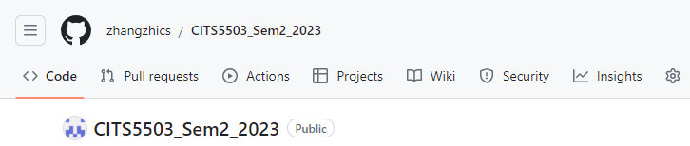
Lab materials
https://github.com/zhangzhics/CITS5503_Sem2_2023
Notes:
For lab materials, they are available at this github repo. When you are doing labs, please read through these pages carefully and they will give clear guidance on how you can complete the labs.
Okay, let’s go to this repo. As you can see, we have 9 labs in total. For each lab, we have instructions and guidance to help you complete the lab. Discussions and help are encouraged about labs but not copy and paste. This will be regarded as cheating. I will highlight it later.

Slide 17
Lab Location
Labs
Labs are in MATH computer lab (Net A and D) and South Civil Computer Room B
Check your timetable for your lab allocation
You can go to another scheduled lab IF there is a space (normally there is)
Notes:
For the location of labs, it is in the math computer lab and South Civil Computer Room.
Please check your timetable and attend the labs you are enrolled. You can also attend other scheduled labs. Based on past experience, normally, there are spaces per lab, and we're not going to, keep you outside if you are not in the lab you are allocated to.

Slide 18
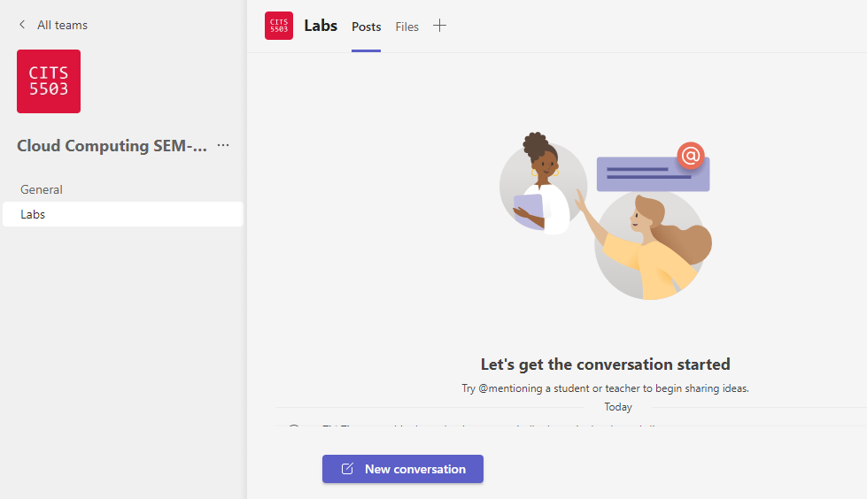
MS Teams
Notes:
So if you haven't downloaded MS teams, please do so as quickly as possible. You should be able to log in using your student account so don't use other Microsoft accounts. Use your UWA student account to log in. You should be able to see our unit. It has been added automatically.
I have also created a channel for lab discussions. So for all the discussions and help for the labs, please use this channel.

Slide 19
Lab Computer
The labs are related to docker, VirtualBox, Ubuntu OS, etc.
As docker is NOT available on UWA lab machines, it must be run on your laptops
If you do not have a laptop that is capable of running the labs, you can arrange to borrow one: https://uwacyber.gitbook.io/cits1003/cits1003-labs/introduction-to-labs
Else – invest in a decent laptop – it will make a big difference to your University life.
If none of these options are available to you, please come and chat with me.
Notes:
For labs, The labs are related to docker, VirtualBox, Ubuntu OS, etc. As docker is NOT available on UWA lab machines, it must be run on your laptops.
So if you do not have a laptop or computer that is capable of running the labs, you can arrange to borrow one. This URL provided here contains more details. Alternatively it's a good idea to invest in a decent laptop. It's going to make your study at university much easier. All right, if none of these options work, please come and talk with me, and we'll see what we can do about it.

Slide 20
Lab Assessment
Labs are worth 20% of the unit grade (i.e., 20 points in total).
9 labs in total: Each lab in labs 1-7 is worth of 2 points and each lab in labs 8-9 is worth of 3 points.
One lab for each study week Except Week 1,5 and 12.
Note: All AWS (Amazon Web Services) resources will be terminated at 11:59pm every Friday.
Notes:
labs are worth 20% of the unit grade, so we have 20 points in total. Since we have 9 labs, each lab in labs 1-7 is worth of 2 points and each lab in labs 8-9 is worth of 3 points.
Considering we use Amazon Web Services in this unit, so please remember to terminate your virtual-machine instances after completing your lab. I will talk more about this next week.

Slide 21
Lab Assessment
For every lab, prepare a lab report.
For each lab report,
You should follow all steps in the github (https://github.com/zhangzhics/CITS5503_Sem2_2023)
You should include screenshots showing the output for every command line instruction that you execute in the terminal and any other relevant screenshots that demonstrate you followed the steps.
You should include your own descriptions about the screenshots.
You should include scripts with comments that you create and the corresponding output you get when executed.

Slide 22
Lab Assessment
Every lab report is marked as follows:
A structured description (15%). This is to make sure a report’s readability good. We don’t provide any template. Instead, you are encouraged to use a markdown editor to organize your reports.
A clear step-by-step with detailed descriptions (85%). In each step, screenshots and their descriptions are needed. By doing so, our markers can follow the steps as described to get the answers.
Notes:
For each lab, it is marked based on two criteria. The first is a structured description worth of 15% of a lab’s points. This is to make sure a report’s readability good. We don’t provide any template. Instead, you are encouraged to use a markdown editor to present your reports.
The second is a clear step-by-step description, worth of 85%. In each step, screenshots and their descriptions are needed. By doing so, our markers can follow the steps as described to get the answers.

Slide 23
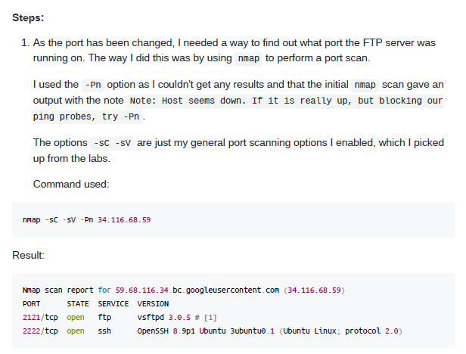
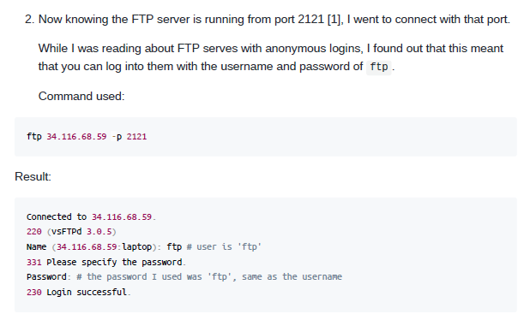
Lab Assessment
Every lab report is marked as follows:
A structured description (15%).
A clear step-by-step with detailed descriptions (85%).
Notes:
Here is an example I took from another different unit. This is done by a markdown editor. As you can see, this report has a clear structure. The commands are highlighted using special symbols, steps and the result for each step look quite clear.
Also for the screenshots, some descriptions or comments are needed so that we can follow your thought process.

Slide 24
Lab Due Dates
For labs 1-4, due date: 11:59pm 1 September (week 6)
Report name: studentid_firstname_labs1_4
For labs 5-9, due date: 11:59pm 18 October (week 12)
Report name: studentid_firstname_labs5_9
Again, no labs on Week 1,5 and 12.
Report submissions are via LMS (Similarity detection will be applied)
The submission must be a single PDF file - all other submissions will be IGNORED. Please note that you can submit multiple times before the due date and only the latest submission will be marked.
Late submission is allowed but penalty will be applied: a penalty of 5% of the marks allocated for labs1-4 or labs5-9 is deducted per day for the first 7 days after which the submission is not accepted. Each 24-hour block is recorded from the time the assignment is due.
Notes:
For different labs, we have different due dates. For labs1-4, its due date is 5pm 1 September. For labs 5-9, its due date is 5pm 20 October. For the report name, it should follow this format.
Again, no labs are scheduled on week 1, 5 and 12 so you have plenty of time to prepare your lab reports. All the lab reports are submitted via LMS. LMS provides Turnitin. So the similarity detection against the reports will be applied.

Slide 25
Lab Help
For labs, one facilitator hosts one lab session
Please attend scheduled lab sessions for help.
No lab help outside the scheduled lab time.
Notes:
For labs, one facilitator hosts one lab session. whoever put their hands up first will be served first. Please remember that outside the lab time, you should leave messages via MS teams or emails.

Slide 26
Lab Setup
Virtual Machine Manager: Virtualbox or VMware
Setup VM and install Ubuntu
Notes:
The first thing is to set up a virtual machine manager on your laptop. So if you have done the CITS1003 unit, you should already have a virtualbox on your computer. If you haven’t, you can get help in our lab session.
So basically virtual machine manager like virtual box or vmware. They are just applications running on your operating system. so it should be quite straightforward to use virtual box on your machine. After that, you can install ubuntu inside the virtualbox. If you have set-up issues, we try to help address them in the lab time.

Slide 27
Other Assessments
Mid-semester test is scheduled in Week 6.
Mid-semester test is worth 30% of assessment (more details later)
Final Exam: 50% of final assessment
Exam overview will be done in week 11 or 12.
Notes:
Ok that’s pretty much of lectures and labs. For other assessments. One is the mid-semester test. It is worth of 30% of your unit. It is going to be scheduled in week 6 during our live lecture. I will talk about this more later on.
The other one is the final exam. It takes 50% of the unit. I will present an exam overview in week 11 or 12.

Slide 28
Enquiries
Office hours
Maybe Friday 12 – 2pm (F2F and virtual ) -> this is just an arbitrary slot
Other times can be arranged too (send an email)
Lab Enquiries
Ask on Teams (but remember not to share answers)
Ping lab facilitators (you can contact any one of them)!
If all fails, email me
Notes:
For office hours, I am just throwing some available time slots and other time can be booked as well. Just send me an email.
For lab inquiries, when you do the labs and have questions, in general these are three recommended ways. So first, you can ask on teams, because people may have similar questions as you have. So it will be great to share it on teams. But do remember not to share answers that you have got because that's not going to help other people learn. If this way does not work in solving your problem, we can try to ping the facilitators. When it is outside the lab session, you can leave messages to the lab facilitators. If that does not work either, you can contact me via email.

Slide 29
Misconduct
Please do not cheat on any of the assessment items.
Don’t copy your friend’s code/answers/report.
Don’t share your code with your friends
Only share ideas
Consequences are dire!
Notes:
Please don’t cheat on any of the assessment items. don't copy your friends code or answers or report. Don't share your code with your friends. But you can share ideas or tips. The consequences of cheating are dire. I hope we don't have to get into detail for this.
Alright, now let’s introduce cloud computing.

Slide 30
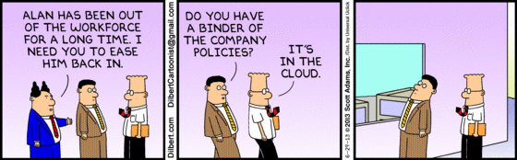
What is cloud computing?
http://www.dilbert.com/fast/2013-06-29/
Notes:
Obviously the cloud in the sky is not what we are talking about. So Is there any real-world cloud service you have in mind?

Slide 31
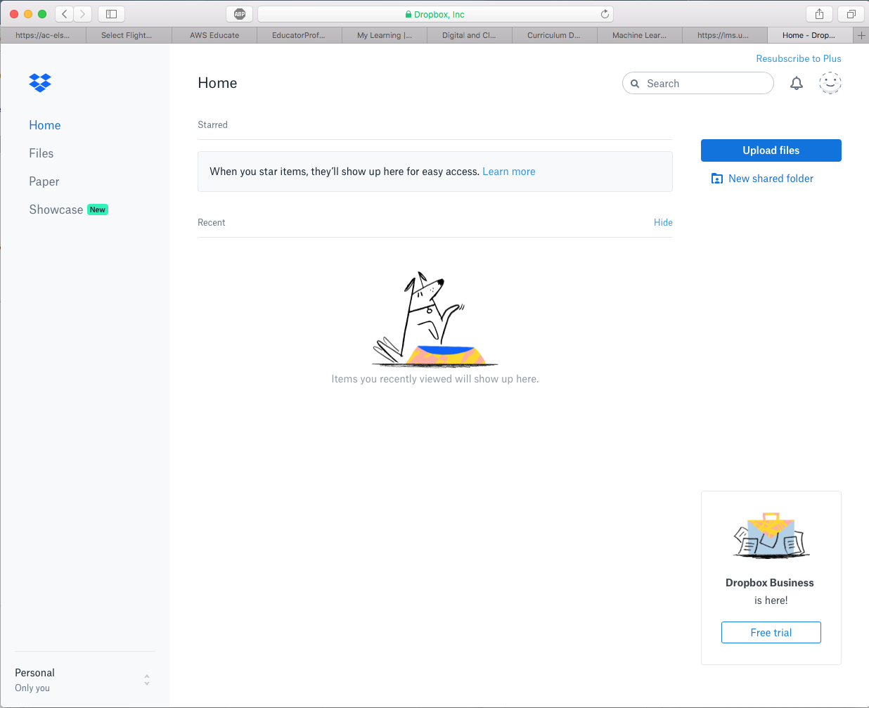
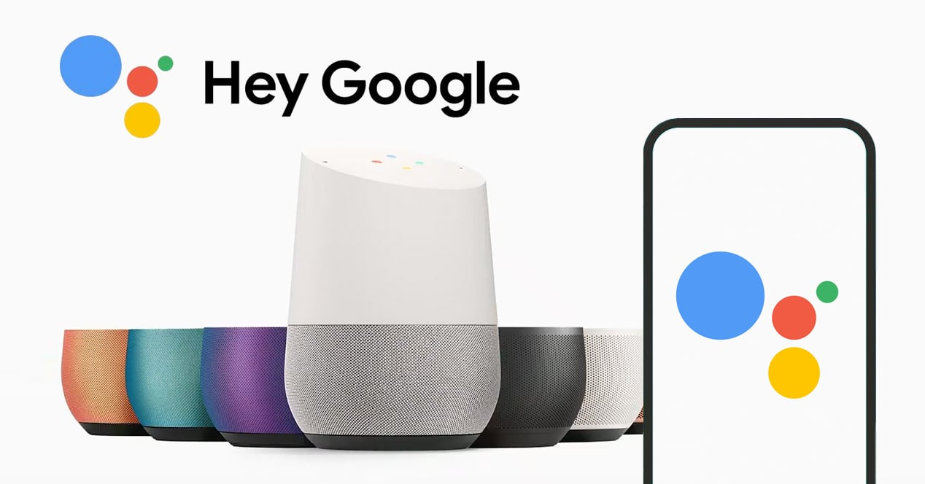

Cloud Services
Notes:
Dropbox is a file hosting service and all users’ files are stored in the cloud.
Some of you might use Google Assistant, this is primarily available on mobile and home automation devices. Actually all your voice data will be stored in google-based clouds.
Almost all the big tech companies have used cloud to store and process their user data. Does anyone know what alphabet is? Yes, it is the parent company of google.

Slide 32
Formal definition
According to NIST (USA’s National Institute of Standards and Technology):
Cloud computing is a model for enabling convenient, on-demand network access to a shared pool of configurable computing resources (e.g., processors, networks, storage) that can be rapidly provisioned and released with minimal management effort or service provider interaction.
Notes:
Alright, so here is the formal definition of cloud computing.
It has some essential characteristics.

Slide 33
Formal definition
According to NIST (USA’s National Institute of Standards and Technology):
Essential characteristics/benefits:
On-demand self service
Cloud providers allows us to provision computing resources, such as virtual machines, without interacting with them.
Broad network access
cloud services are accessible over a network in various ways.
Cloud computing is a model for enabling convenient, on-demand network access to a shared pool of configurable computing resources (e.g., processors, networks, storage) that can be rapidly provisioned and released with minimal management effort or service provider interaction.
Notes:
The first is on-demand self service, this means that: Cloud providers such as amazon, Microsoft or google allows us to independently provision computing resources, such as virtual machines, without requiring interaction with them.
The second is Broad network access: so cloud services are accessible over a network in various ways. We can access cloud resources using browsers, mobile apps, or other networked devices.

Slide 34
Formal definition
According to NIST (USA’s National Institute of Standards and Technology):
Essential characteristics/benefits:
On-demand self service
Broad network access
Resource pooling
Cloud providers consolidate and share computing resources among many users.
Rapid elasticity
Cloud providers enables the quick and automatic scaling of underlying hardware resources based on workload demands
Cloud computing is a model for enabling convenient, on-demand network access to a shared pool of configurable computing resources (e.g., processors, networks, storage) that can be rapidly provisioned and released with minimal management effort or service provider interaction.
Notes:
The third is Resource pooling: Cloud providers consolidate and share computing resources among many users. The underlying physical resources, such as processors, storage, and network bandwidth. They are dynamically assigned based on user demand.
The fourth one is Rapid elasticity: Cloud providers enables the quick and automatic scaling of underlying hardware resources based on workload demands. We can scale up or down our computing resources to match our needs.

Slide 35
Formal definition
According to NIST (USA’s National Institute of Standards and Technology):
Essential characteristics/benefits:
On-demand self service
Broad network access
Resource pooling
Rapid elasticity
Measured service
Cloud providers allow users to pay as they go
Cloud computing is a model for enabling convenient, on-demand network access to a shared pool of configurable computing resources (e.g., processors, networks, storage) that can be rapidly provisioned and released with minimal management effort or service provider interaction.
Notes:
The last one is Measured service: Cloud providers allow users to pay as they go. They are billed based on how long they are using the resources. In the following, I will explain how cloud computing is motivated.

Slide 36
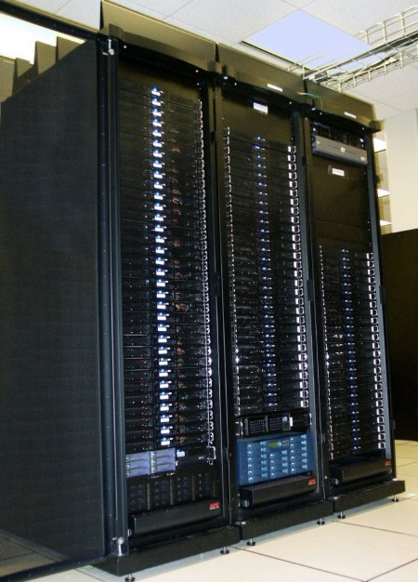
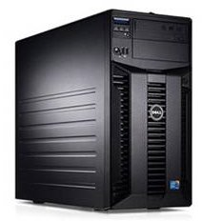
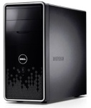
Motivating Cloud Computing
PC
Server
Cluster
What if one computer is not enough?
Buy a better (server-class) computer
What if the best server is not enough?
Buy many servers
Notes:
In this AI society, we have a large amount of data to process and manage. So what if one computer is not enough? Intuitively, we can buy a bigger server-class computer. But what if the best server is still not enough? We can buy many servers to form a cluster.

Slide 37
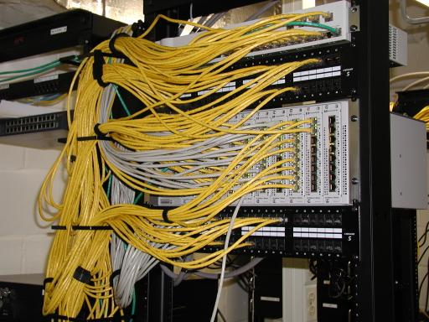
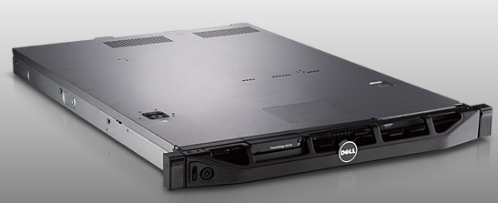
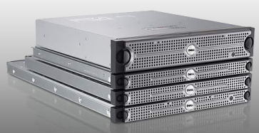
Cluster
Network switch (connects nodes with each other and with other racks)
Rack
Many nodes/blades (often identical)
Storage device(s)
Characteristics of a cluster:
Many similar machines with close interconnection
Special and standardized hardware (racks, blades, etc)
Notes:
So this is what a cluster looks like. This is called a rack. Inside a rack, we have storage devices to store our data. We have many nodes or blade servers. These blade servers are connected by network switch. Also, these racks are also connected by network switches.
So a cluster has many similar machines with close interconnection. They are actually special and standardized hardware.

Slide 38
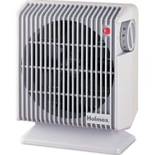
Power and cooling
Clusters need lots of power
Most of power is converted into heat
Large clusters need massive cooling
Notes:
Obviously, a cluster needs lots of power and most power is converted into heat when the cluster is working. So a large cluster needs massive cooling.

Slide 39
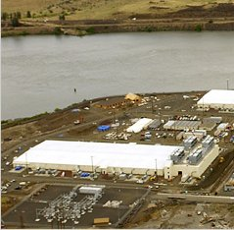
Scaling up
PC
Server
Cluster
Data center
What if a cluster is not enough?
Buy many clusters
Notes:
What if a cluster is not enough? We can buy many clusters and network them together, thus forming a data center

Slide 40
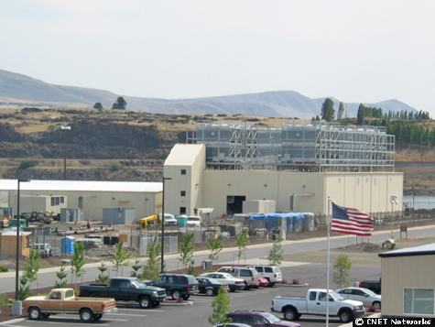
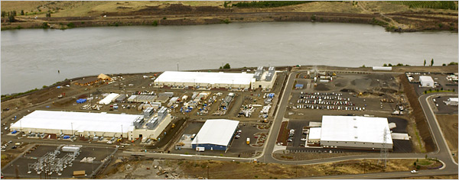
Data center
Cooling plant
Data centers (size of a football field)
Google data center in The Dalles, Oregon
Notes:
This is a floor plan for google datacenter in the state of Oregan.

Slide 41
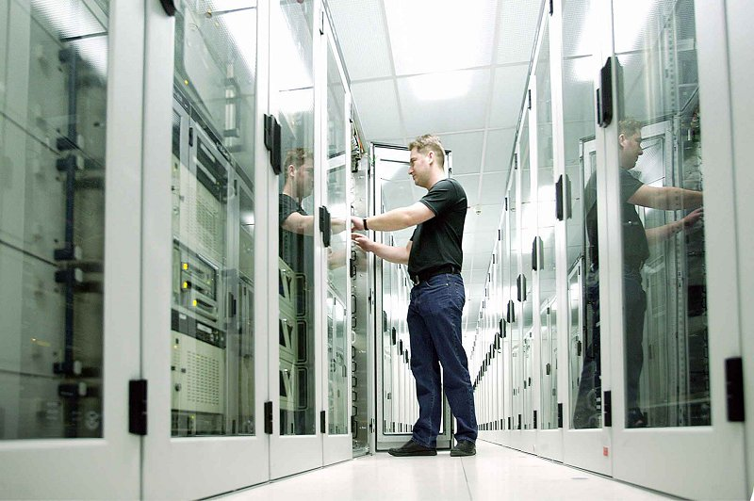
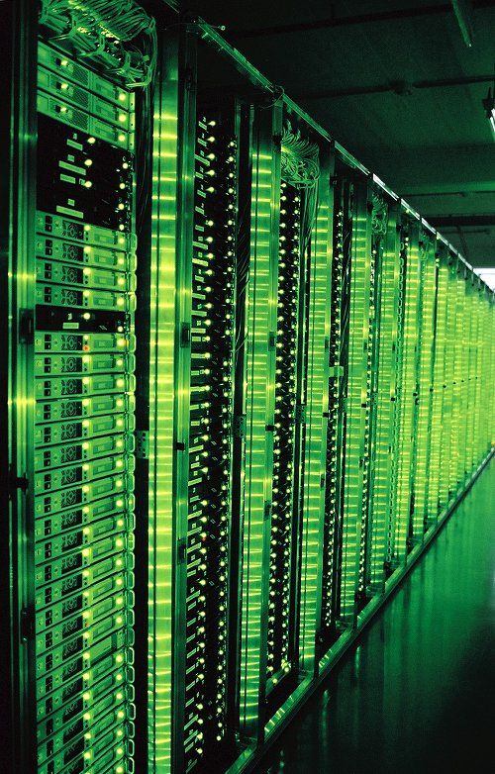
What's inside a data center?
Source: 1&1
Hundreds or thousands of racks
Notes:
So what’s inside a data center? It is essentially a much bigger cluster. So it has hundreds or thousands of racks

Slide 42
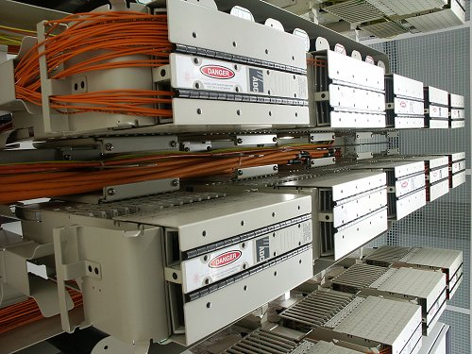
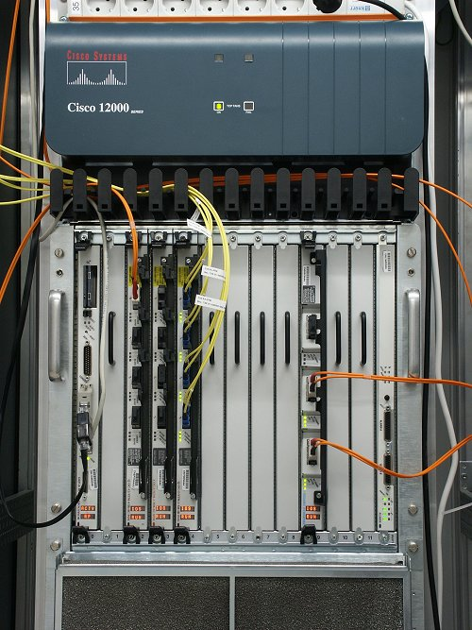
What's inside a data center?
Source: 1&1
Massive networking
Notes:
networking everywhere.

Slide 43
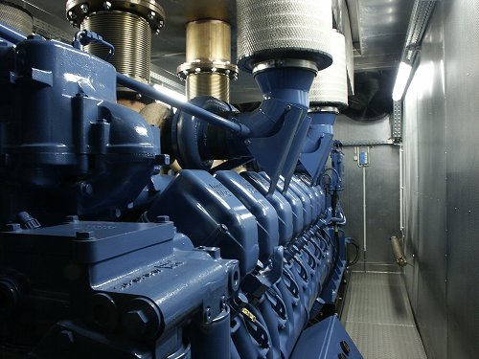
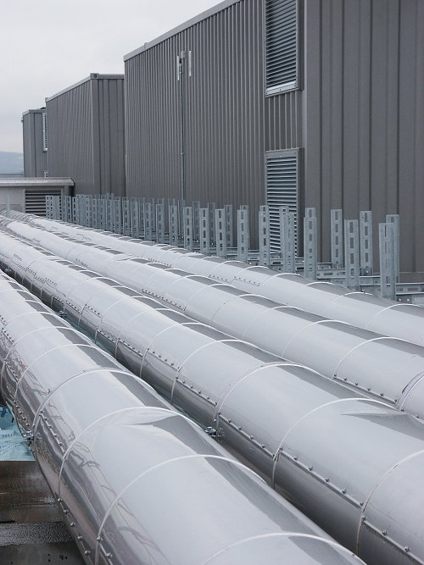
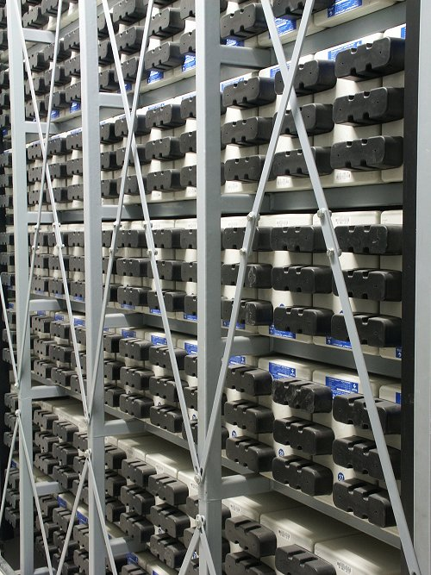
What's inside a data center?
Source: 1&1
Lots of power supplies
Notes:
Lots of power supplies

Slide 44
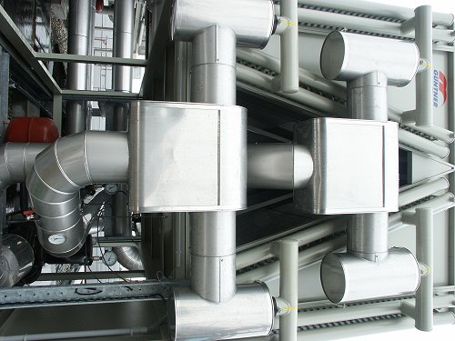
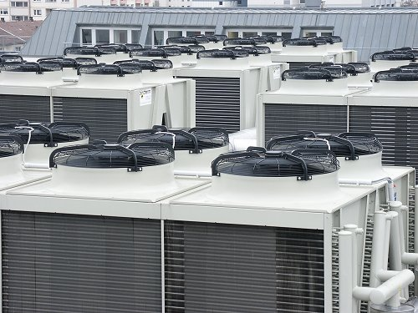
What's inside a data center?
Source: 1&1
Massive cooling

Slide 45
Scaling up
PC
Server
Cluster
Data center
Network of data centers
What if a data center is not big enough?
Build many data centers
Notes:
What if a data center is not big enough? We can build many data centers and network them together.

Slide 46
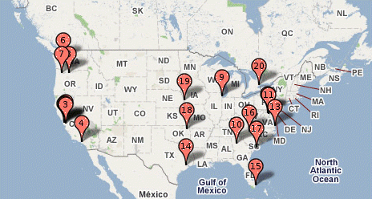
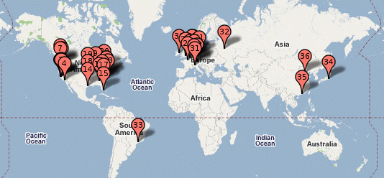
Global distribution
Google data centers
Data centers are globally distributed and networked
Why do we need to distribute the data centers globally?
Notes:
normally, we don’t put all our data centers in one place. Instead, these datacenters are distributed globally.
As you can see from this picture, google distributes its data centers across different continents. we can see it google many data centers in north America and Europe. When we zoom in the data centers here, it is this picture.
So my question is why do we need to distribute the data centers globally?

Slide 47
Global distribution
Google data center in The Dalles, Oregon
Data centers are often globally distributed and networked
Why do we need to distribute the data centers globally?
Reduced Latency
We can bring our cloud services closer to users.
Disaster Recovery
When a data center goes down, other data centers can replicate the data.
Regional Markets
We can deliver our cloud services that are optimized for specific regional markets.
…
Notes:
The first is Reduced Latency. We can bring our cloud services closer to users. This reduces the network latency, achieving better user experiences.
The second is disaster recovery. If a data center goes down due to natural disasters, or other unforeseen events, other data centers can replicate the data to enhance the disaster recovery.
The third is regional markets. we can deliver our services that are optimized for specific regional markets. Clearly, we have a lot more other reasons.

Slide 48

Data center has enabled cloud computing
Big tech companies use existing data centers to provide cloud computing
Benefits:
Economies of scale
Cheaper to run big data centers than many small ones
Statistical resource multiplexing
High utilization of hardware resources
No up-front commitment
No investment in data centers, enabling pay-as-you-go
Scalability
Thousands of servers available on demand
Add more within seconds
Notes:
So cloud computing brings lots of benefits.
For example, Economies of scale. It is cheaper to run big data centers than many small ones
We can multiplex our computing resources. We don’t have to invest in data centers, instead, we pay for the resources we use. Besides, the cloud computing can offer thousands of servers on demand and can offer more within seconds.

Slide 49
Other terms
Utility computing
Services being provided by a cloud
Focuses on the business model (pay-as-you-go), similar to classical utility companies
The Web
The Internet's information sharing model
Some web services run on clouds, but not all
The Internet
A network of networks.
Used by the web; connects (most) clouds to their customers
Notes:
so other terms that have come into effect is utility computing and this refers to the services being provided by a cloud and it focuses on the business model so this is why it's called utility computing
so the web has been redefined as a cloud, most of the time, it is drawn as a cloud. so anything that's on the web, anything that's on the Internet, is potentially a cloud service.

Slide 50
Cloud applications
Application hosting
Backup and Storage
Content delivery
E-commerce
High-performance computing
Media hosting
On-demand workforce
Search engines
Web hosting
…
Notes:
Here is a list of cloud applications.

Slide 51

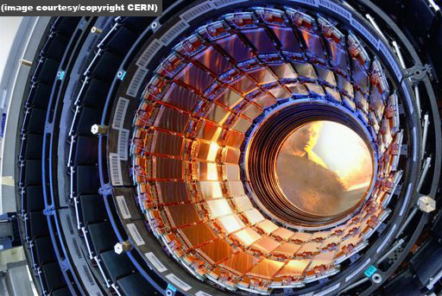

Some Examples
DreamWorks applies the Cerelink cloud to render animation movies
CERN leverages a "science cloud" to process experimental data
Virgin atlantic hosts their travel portal on Amazon AWS
Notes:
Here are some examples.

Slide 52
Practice Questions
Some questions in mid-semester test are picked from the link below:
github.com/zhangzhics/CITS5503_Sem2_2023/blob/master/assignments.md
Some practice questions are also picked from the link.
Answers to practice questions will be discussed in the live lecture.
Answers to other questions in the link need your own work.
Notes:
Some questions in mid-semester test are picked from the link below.
To easy the difficulty, I will also use some questions from the link for the practice purpose in our live lecture. So I will provide answers to these practice questions. But you have to work out the answers to other questions that have not been discussed. Chatgpt can assist you but please keep in mind that chatgpt is not always correct.

Slide 53
Practice Questions
[6 marks] Q1: The evolution of Cloud Computing has been compared to the evolution of electricity supply as a utility. Describe 3 specific problems that Cloud Computing solves as compared to businesses running their own data centers.

Slide 54
Practice Questions
[6 marks] Q1: The evolution of Cloud Computing has been compared to the evolution of electricity supply as a utility. Describe 3 specific problems that Cloud Computing solves as compared to businesses running their own data centers..
[2 marks] Operational expenses: Cloud computing enables businesses to apply a subscription policy without investing in building and maintaining their own data centers.
Notes:
So one mark is for the problem description and one mark is for the explanation.

Slide 55
Practice Questions
[6 marks] Q1: The evolution of Cloud Computing has been compared to the evolution of electricity supply as a utility. Describe 3 specific problems that Cloud Computing solves as compared to businesses running their own data centers..
[2 marks] Operational expenses: Cloud computing enables businesses to apply a subscription policy without investing in building and maintaining their own data centers.
[2 marks] Scalability: Cloud computing enables on-demand computing resources by providing virtualized execution environments.

Slide 56
Practice Questions
[6 marks] Q1: The evolution of Cloud Computing has been compared to the evolution of electricity supply as a utility. Describe 3 specific problems that Cloud Computing solves as compared to businesses running their own data centers..
[2 marks] Operational expenses: Cloud computing enables businesses to apply a subscription policy without investing in building and maintaining their own data centers.
[2 marks] Scalability: Cloud computing enables on-demand computing resources by providing virtualized computing resources.
[2 marks] Resource utilization: Cloud computing provides multi-tenant environments by allocating resources efficiently for different users, e.g., some tasks are computing intensive while some other are memory intensive.

Slide 57
Practice Questions
[6 marks] Q2: An established financial company is about to launch their new banking application. Give 3 reasons why the company should use their own data center rather than cloud computing.
Notes:
Obviously, clouds are good for many things... but not for everything. So any idea?

Slide 58
Practice Questions
[6 marks] Q2: An established financial company is about to launch their new banking application. Give 3 reasons why the company should use their own data center rather than cloud computing.
[2 marks] Data Security: Financial institutions must ensure CIA of user data security. By hosting their application in their own data center, the company can better protect their data security.

Slide 59
Practice Questions
[6 marks] Q2: An established financial company is about to launch their new banking application. Give 3 reasons why the company should use their own data center rather than cloud computing.
[2 marks] Data Security: Financial institutions must ensure CIA of user data security. By hosting their application in their own data center, the company can better protect their data security.
[2 marks] Data Sovereignty: For international financial institutions, data sovereignty is critical because user data will be stored and processed in compliance with local laws and regulations.

Slide 60
Practice Questions
[6 marks] Q2: An established financial company is about to launch their new banking application. Give 3 reasons why the company should use their own data center rather than cloud computing.
[2 marks] Data Security: Financial institutions must ensure CIA of user data security. By hosting their application in their own data center, the company can better protect their data security.
[2 marks] Data Sovereignty: For international financial institutions, data sovereignty is critical because user data will be stored and processed in compliance with local laws and regulations.
[2 marks] Optimized Performance: With their own data center, the company can have consistent performance for their application. Besides, they can fine-tune the infrastructure to optimize the application’s performance.
Notes:
Alright, these are just example answers and you can also present other solutions, as long as they sound reasonable, you will get full marks.

Slide 61
Learning Outcomes
Understandings
Understand cloud services, their motivation, design and implementation
Understand the basics of virtualization of hardware, networks and security
Understand cloud-based web architectures and their applications
Understand how to achieve scalability and security in a cloud
Hands-on skills
Use DevOps to deploy and manage the creation and update of software environments
Use cloud services to carry out specific use cases such as machine learning
Notes:
So what is the learning outcomes of this unit? For this unit, we will gain an understanding of various cloud services, the basics of virtualization, cloud-based web architectures and how to achieve scalability and security in a cloud-based architecture.
For hands-on skills,
We will learn how to use DevOps, apply cloud services to carry out specific use cases. So all these need you to have the background of python programming

Slide 62
Copyright notice
Commonwealth of Australia
Copyright Regulations 1969
WARNING
Materials in this unit have been reproduced and communicated to you by or on behalf of The University of Western Australia pursuant to Part VB of the Copyright Act1968 (the Act).
The material in this communication may be subject to copyright under the Act. Any further reproduction or communication of this material by you may be the subject of copyright protection under the Act.
Notes:
This is the last slide today. this copyright notice. Basically, it’s telling you not to copy the materials and sell for profits. But as you see, all of our materials are already freely available online anyway. So if you want to, for example, refer your friends to learn about cloud computing. You can always provide those materials for them by giving the link instead of giving the copies of the materials. Okay, I will stop here in the live lecture. See you again next week.

