Slide 1
CITS5503 Cloud Computing 2025 Introduction
Dr Zhi Zhang

Slide 2
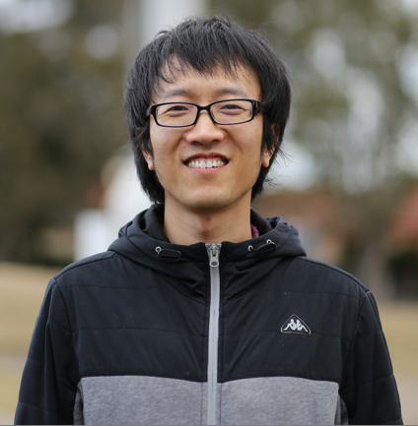
Lecturer
Office: G10@CSSE
https://zhangzhics.github.io‬
Email: zhi.zhang@uwa.edu.au
queries related to CITS5503: cits5503-pmc@uwa.edu.au

Slide 3
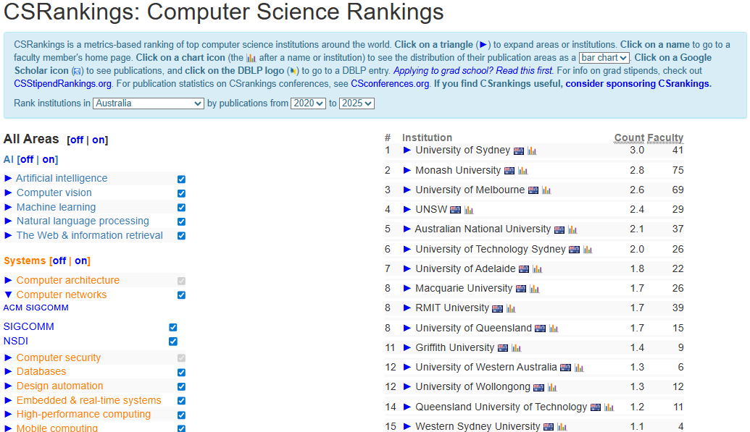
csrankings.org

Slide 4
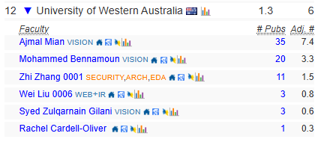

Slide 5
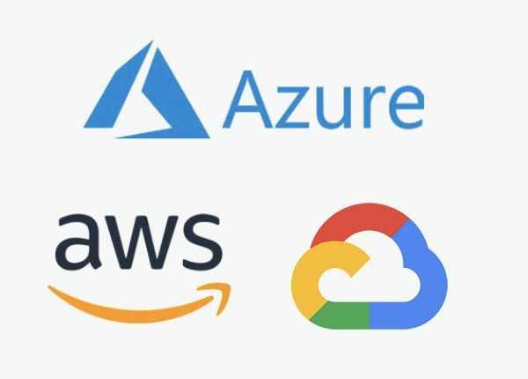
Three main cloud providers

Slide 6
Three main virtual machine monitors (VMM)
?
?
?

Slide 7
Three main virtual machine monitors (VMM)
Hyper-V
Closed-source
Microsoft kernel module
Xen and KVM
KVM
Open-source
Build from scratch
Open-source
Linux kernel module

Slide 8
Three main virtual machine monitors (VMM) What do they have in common?
Hyper-V
Xen and KVM
KVM

Slide 9
KVM, Xen, Hyper-V are bare-metal/type 1 VMM.
Type-1 VMM: VMM is installed directly on hardware.
VM
VM
Hypervisor
Hardware
Type-1 VMM

Slide 10
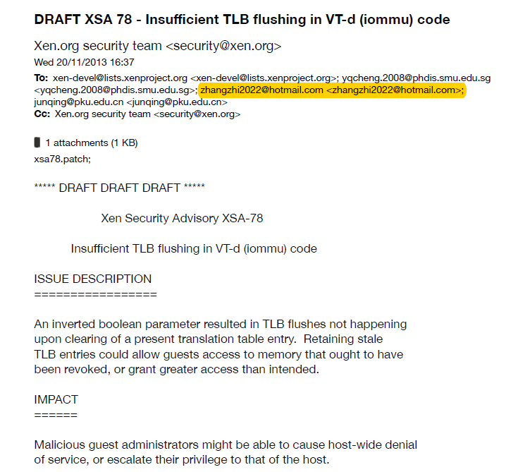
Xen: https://xenproject.org/

Slide 11
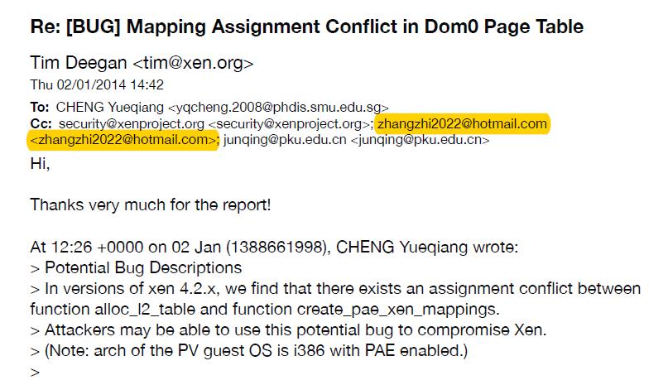

Slide 12
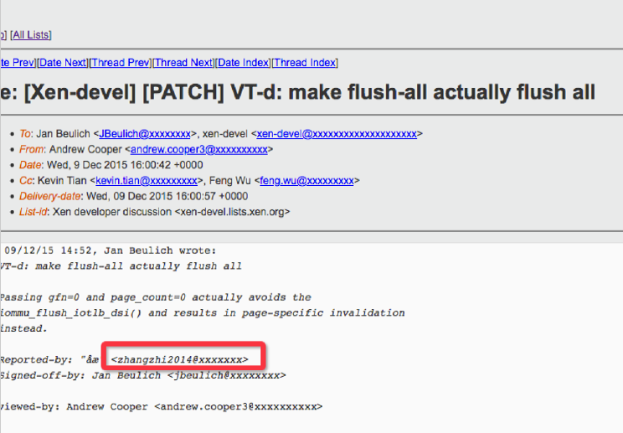

Slide 13
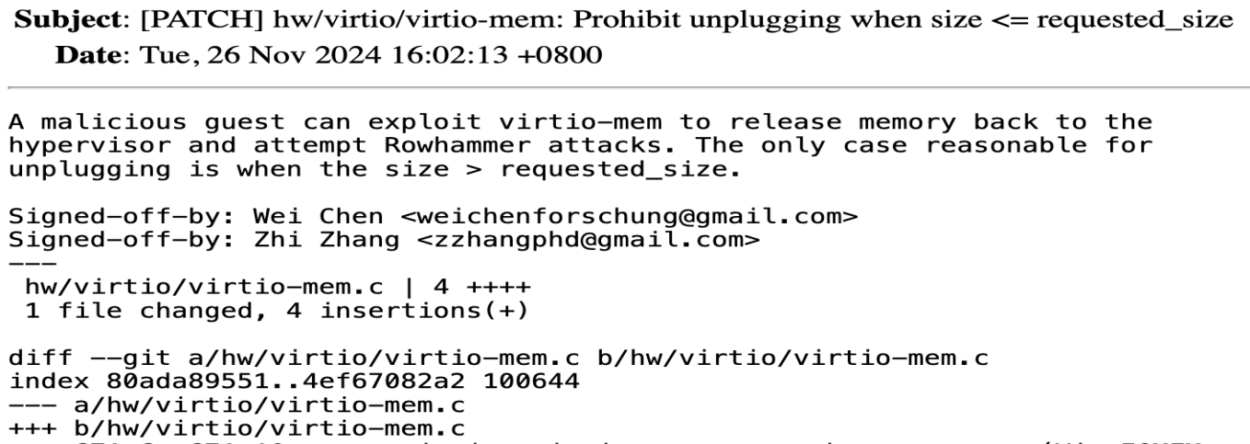
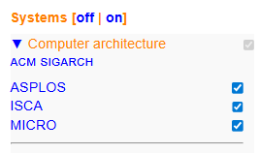
KVM: https://linux-kvm.org

Slide 14
To Get Started
People
Emergency
Items of assessment
Topics
Ethics
Online resources
FAQs
What is Cloud Computing?
Learning outcomes

Slide 15

People
Zhi Zhang
Unit coordinator
Room G.10
cits5503-pmc@uwa.edu.au
Wenxiao Zhang
Lab facilitator
Larry Huynh
Assistant Lecturer
Karla Ivkovic
Lab facilitator
Jichunyang Li
Assistant Coordinator
Fudong Qin
Lab facilitator
Amber Miao
Lab facilitator

Slide 16
Emergency
General emergency: call campus security at 6488 2222
In super emergency: call emergency at 000
For more details, please have a read through our emergency procedure for various potential incidents
http://www.safety.uwa.edu.au/incidents-injuries-emergency/procedures
For more student services:
https://www.uwa.edu.au/students/Support-services
UniAccess: https://www.uwa.edu.au/students/Support-services/Disability-and-accessibility (send me your Uniaccess letters ☺)

Slide 17
Assessments
Labs
Mid-sem Test
Final Exam

Slide 18
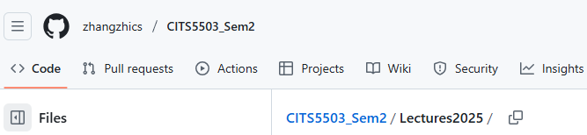
Lectures
For lectures, they will be recorded and uploaded into LMS.
Lectures are about different aspects of cloud computing with exam-style questions included.
Lectures slides are available:
https://github.com/zhangzhics/CITS5503_Sem2

Slide 19
Labs start in week 2
Lab materials
Lab location
Lab computer
Lab assessment
Lab due dates
Lab help
Lab setup

Slide 20
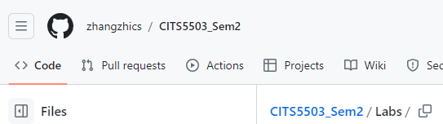
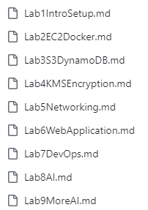
Lab materials
Read through each lab file before starting it.

Slide 21
AWS
Labs focus on AWS resources
AWS login credentials will be sent by the end of this week.
Each AWS user account sent to you is unprivileged and created by the only root user.
The login portal is:
https://489389878001.signin.aws.amazon.com/console
where 489389878001 is an AWS account’s root user id.
Lab 1 provides the portal.
Lab 4 needs the root user id.

Slide 22
Lab Location
Labs
Check your timetable for your lab allocation
You can go to another scheduled lab IF there is a space (normally there is)

Slide 23
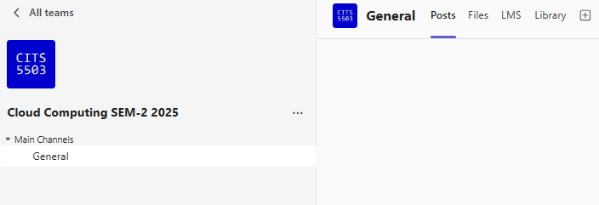
MS Teams

Slide 24
Lab Computer
The labs are related to Linux OS, etc.
If you do not have a laptop that is capable of running the labs, you can arrange to borrow one: https://uwa.qualtrics.com/jfe/form/SV_aVGv1mRwO2tExrE
Else – invest in a decent laptop.
If none of these options are available to you, please come and chat with me.

Slide 25
Lab Assessment
Labs are worth 20% of the unit grade (i.e., 20 points in total).
9 labs in total: Each lab in labs 1-7 is worth 2 points and each lab in labs 8-9 is worth 3 points.
Lab sessions are held every study week Except Weeks 1, 5 and 12.

Slide 26
Lab Assessment
Every lab report is marked as follows:
A structured presentation (15%).
A clear step-by-step with detailed descriptions (85%).

Slide 27
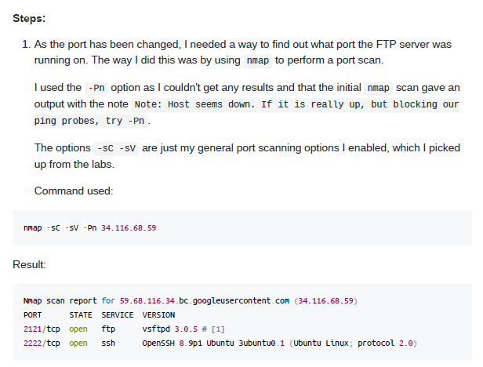
Lab Assessment
Every lab report is marked as follows:
A structured description (15%).
A clear step-by-step with detailed descriptions (85%).

Slide 28
Lab Assessment
Every lab report is marked as follows:
A structured presentation (15%).
A clear step-by-step with detailed descriptions (85%).
More details about marking guidelines and AWS resource usage will come in week 2.

Slide 29
Lab Due Dates
For labs 1-5, due date: 11:59pm 15 September
Report name: studentid_firstname_labs1_5
For labs 6-9, due date: 11:59pm 13 October
Report name: studentid_firstname_labs6_9
No labs on Weeks 1,5 and 12.
Reports will be submitted via LMS and the submission portal will open soon.
Extension: The maximum extension request for a period is 7 calendar days.

Slide 30
Lab Help
For labs, one or two facilitators host one lab session
Please attend scheduled lab sessions for help.
No lab help outside the scheduled lab time.

Slide 31
Other Assessments
Mid-semester test is scheduled in Week 6.
Mid-semester test is worth 30% of assessment (more details later)
Final Exam: 50% of final assessment
Exam overview will be done in Week 11 or 12.

Slide 32
Enquiries
Office hours
Maybe Friday 12 – 2pm (F2F and virtual) -> this is just an arbitrary slot
Other times can be arranged too (email cits5503-pmc@uwa.edu.au)
Lab Enquiries
Ask on Teams (but remember not to share answers)
Ask during the lab session
If all fails, email us

Slide 33
Misconduct
Please do not cheat on any of the assessment items.
Don’t copy your friend’s code/answers/report.
Don’t share your code with your friends
Only share ideas
Consequences are dire!

Slide 34
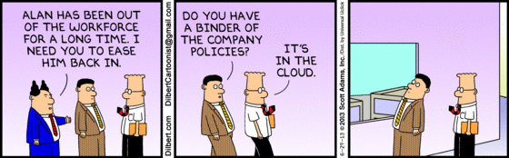
What is cloud computing?
http://www.dilbert.com/fast/2013-06-29/

Slide 35
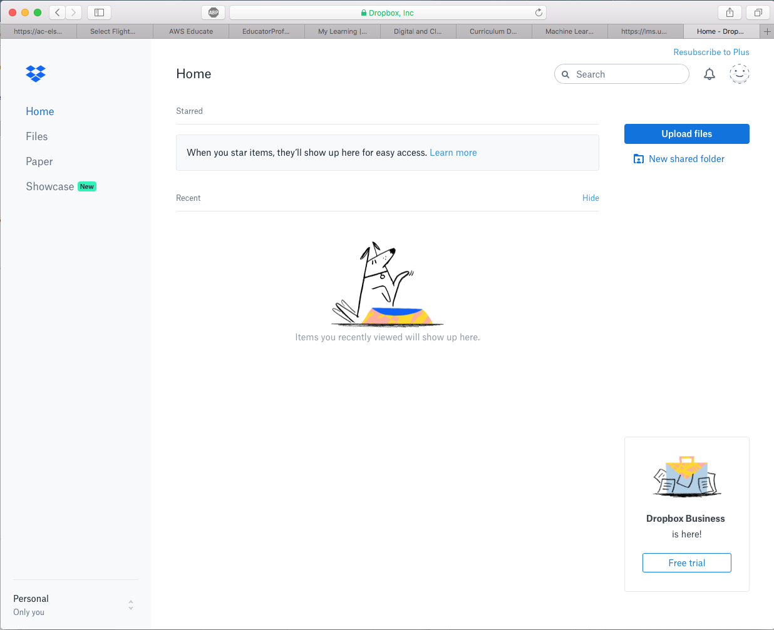
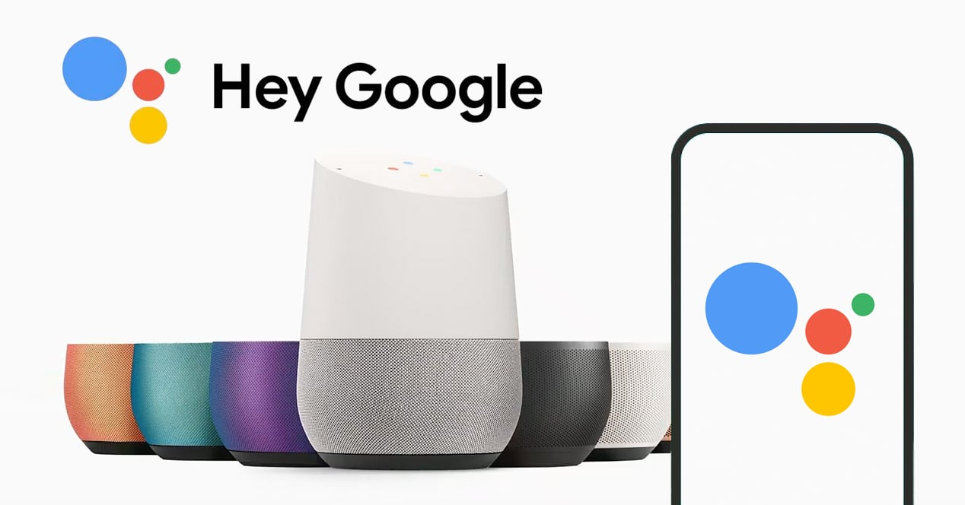
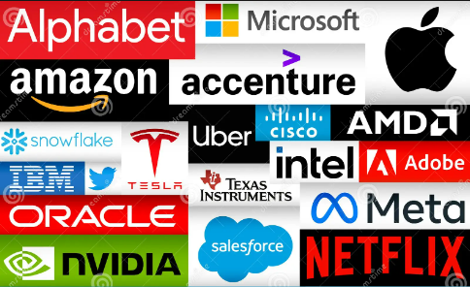
Cloud Services

Slide 36
Formal definition
According to NIST (USA’s National Institute of Standards and Technology):
Cloud computing is a model for enabling convenient, on-demand network access to a shared pool of configurable computing resources (e.g., processors, networks, storage) that can be rapidly provisioned and released with minimal management effort or service provider interaction.

Slide 37
Formal definition
According to NIST (USA’s National Institute of Standards and Technology):
Essential characteristics/benefits:
On-demand self service
Cloud providers allow us to provision computing resources, such as virtual machines, without interacting with them.
Broad network access
cloud services are accessible over a network in various ways.
Cloud computing is a model for enabling convenient, on-demand network access to a shared pool of configurable computing resources (e.g., processors, networks, storage) that can be rapidly provisioned and released with minimal management effort or service provider interaction.

Slide 38
Formal definition
According to NIST (USA’s National Institute of Standards and Technology):
Essential characteristics/benefits:
On-demand self service
Broad network access
Resource pooling
Cloud providers consolidate and share computing resources among many users.
Rapid elasticity
Cloud providers enables the quick and automatic scaling of underlying hardware resources based on workload demands
Cloud computing is a model for enabling convenient, on-demand network access to a shared pool of configurable computing resources (e.g., processors, networks, storage) that can be rapidly provisioned and released with minimal management effort or service provider interaction.

Slide 39
Formal definition
According to NIST (USA’s National Institute of Standards and Technology):
Essential characteristics/benefits:
On-demand self service
Broad network access
Resource pooling
Rapid elasticity
Measured service
Cloud providers allow users to pay as they go
Cloud computing is a model for enabling convenient, on-demand network access to a shared pool of configurable computing resources (e.g., processors, networks, storage) that can be rapidly provisioned and released with minimal management effort or service provider interaction.

Slide 40
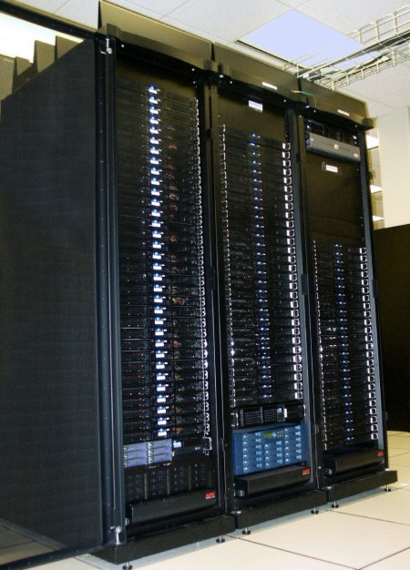
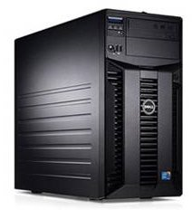
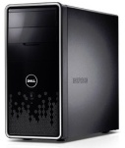
Motivating Cloud Computing
PC
Server
Cluster
What if one computer is not enough?
Buy a better (server-class) computer
What if the best server is not enough?
Buy many servers

Slide 41
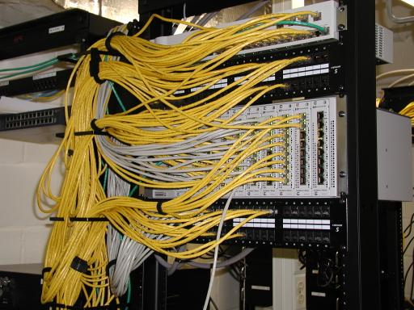
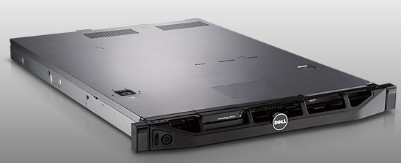
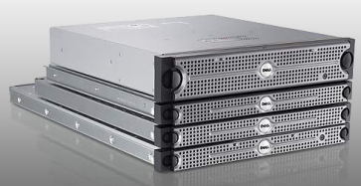
Cluster
Network switch (connects nodes with each other and with other racks)
Rack
Many nodes/blades (often identical)
Storage device(s)
Characteristics of a cluster:
Many similar machines with close interconnection
Special and standardized hardware (racks, blades, etc)

Slide 42
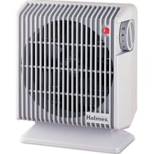
Power and cooling
Clusters need lots of power
Most of power is converted into heat
Large clusters need massive cooling

Slide 43
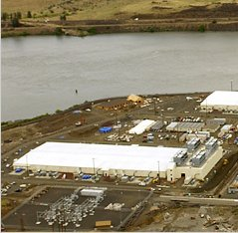
Scaling up
PC
Server
Cluster
Data center
What if a cluster is not enough?
Buy many clusters

Slide 44
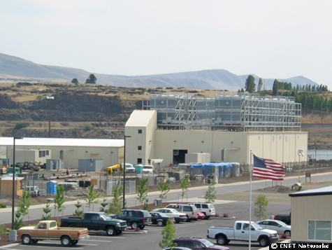
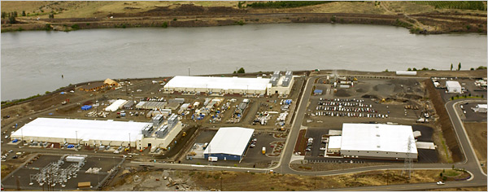
Data center
Cooling plant
Data centers (size of a football field)
Google data center in The Dalles, Oregon

Slide 45


What's inside a data center?
Source: 1&1
Hundreds or thousands of racks

Slide 46
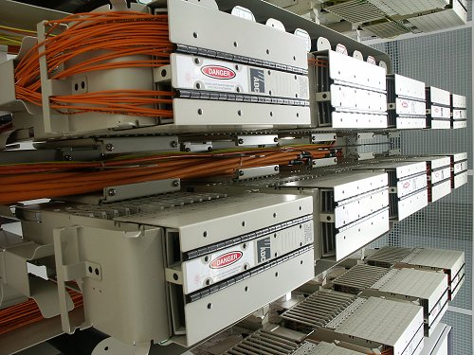
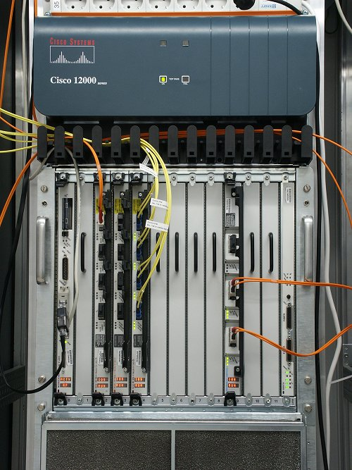
What's inside a data center?
Source: 1&1
Massive networking

Slide 47
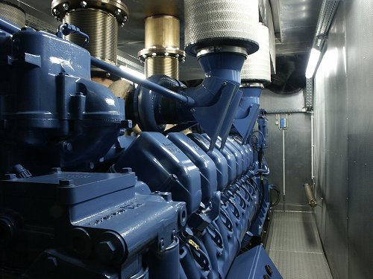
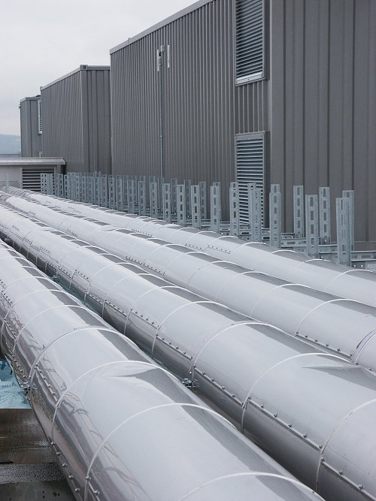
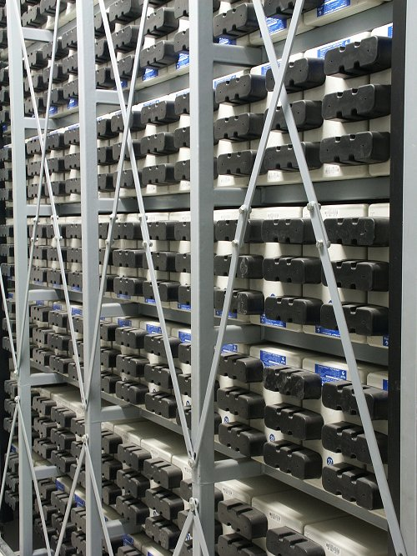
What's inside a data center?
Source: 1&1
Redundant and scalable power supplies

Slide 48
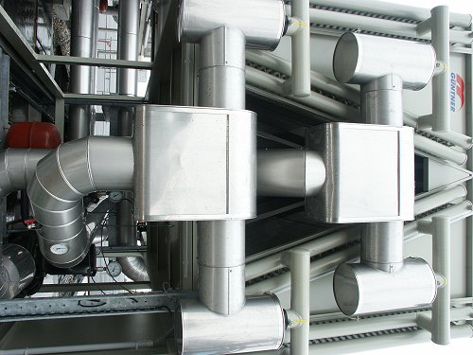
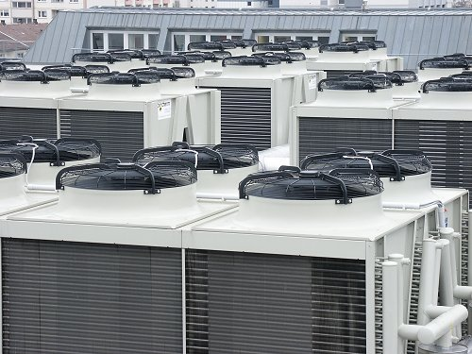
What's inside a data center?
Source: 1&1
Massive cooling

Slide 49
Data Center
Hundreds or thousands of racks
High-capacity networking infrastructure
Redundant and scalable power supplies
Large-scale cooling infrastructure

Slide 50
Scaling up
PC
Server
Cluster
Data center
Network of data centers
What if a data center is not big enough?
Build many data centers

Slide 51
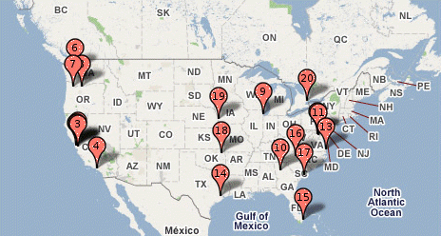
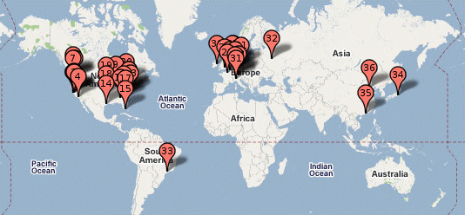
Global distribution
Google data centers
Data centers are globally distributed and networked
Why do we need to distribute the data centers globally?

Slide 52
Global distribution
Google data center in The Dalles, Oregon
Data centers are often globally distributed and networked
Why do we need to distribute the data centers globally?
Reduced Latency
We can bring our cloud services closer to users.
Disaster Recovery
When a data center goes down, other data centers can replicate the data.
Regional Markets
We can deliver our cloud services that are optimized for specific regional markets.

Slide 53

Data center has enabled cloud computing
Big tech companies use existing data centers to provide cloud computing
Benefits:
Economies of scale
Cheaper to run big data centers than many small ones
Statistical resource multiplexing
High utilization of hardware resources
Scalability
Thousands of servers available on demand
Add more within seconds
No up-front commitment
No investment in data centers, enabling pay-as-you-go

Slide 54
Other terms
Utility computing
Services being provided by a cloud
Focuses on the business model (pay-as-you-go), similar to classical utility companies
The Web
The Internet's information sharing model
Most web services run on clouds
The Internet
A network of networks.
Used by the web; connects (most) clouds to their customers

Slide 55
Cloud applications
Application hosting
Backup and Storage
Content delivery
E-commerce
High-performance computing
Media hosting
On-demand workforce
Search engines
Web hosting
…

Slide 56



Some Examples
DreamWorks applies the Cerelink cloud to render animation movies
CERN leverages a "science cloud" to process experimental data
Virgin atlantic hosts their travel portal on Amazon AWS

Slide 57
Practice Questions
Some questions in mid-semester test will be picked from the link below:
github.com/zhangzhics/CITS5503_Sem2/blob/master/assignments.md
Some practice questions will also be picked from the link.
Answers to practice questions will be discussed in the live lecture.
Answers to other questions in the link need your own work.

Slide 58
Practice Questions
[6 marks] Q1: The evolution of Cloud Computing has been compared to the evolution of electricity supply as a utility. Describe 3 specific problems that cloud computing solves as compared to businesses running their own data centers.

Slide 59
Practice Questions
[6 marks] Q1: The evolution of Cloud Computing has been compared to the evolution of electricity supply as a utility. Describe 3 specific problems that cloud computing solves as compared to businesses running their own data centers.
[2 marks] Operational expenses: Cloud computing enables businesses to apply a subscription policy without investing in building and maintaining their own data centers.

Slide 60
Practice Questions
[6 marks] Q1: The evolution of Cloud Computing has been compared to the evolution of electricity supply as a utility. Describe 3 specific problems that cloud computing solves as compared to businesses running their own data centers.
[2 marks] Operational expenses: Cloud computing enables businesses to apply a subscription policy without investing in building and maintaining their own data centers.
[2 marks] Scalability: Cloud computing enables on-demand computing resources by providing virtual machines as instances.

Slide 61
Practice Questions
[6 marks] Q1: The evolution of Cloud Computing has been compared to the evolution of electricity supply as a utility. Describe 3 specific problems that cloud computing solves as compared to businesses running their own data centers.
[2 marks] Operational expenses: Cloud computing enables businesses to apply a subscription policy without investing in building and maintaining their own data centers.
[2 marks] Scalability: Cloud computing enables on-demand computing resources by providing virtualized computing resources.
[2 marks] Resource utilization: Cloud computing provides multi-tenant environments by allocating resources efficiently for different users, e.g., some tasks are computing intensive while some others are memory intensive.

Slide 62
Practice Questions
[6 marks] Q2: An established financial company is about to launch their new banking application. Give 3 reasons why the company should use their own data center rather than cloud computing.

Slide 63
Practice Questions
[6 marks] Q2: An established financial company is about to launch their new banking application. Give 3 reasons why the company should use their own data center rather than cloud computing.
[2 marks] Data Security: Financial institutions must ensure CIA of user data security. By hosting their application in their own data center, the company can better protect their data security.

Slide 64
Practice Questions
[6 marks] Q2: An established financial company is about to launch their new banking application. Give 3 reasons why the company should use their own data center rather than cloud computing.
[2 marks] Data Security: Financial institutions must ensure CIA of user data security. By hosting their application in their own data center, the company can better protect their data security.
[2 marks] Data Sovereignty: For international financial institutions, data sovereignty is critical because user data will be stored and processed in compliance with local laws and regulations.

Slide 65
Practice Questions
[6 marks] Q2: An established financial company is about to launch their new banking application. Give 3 reasons why the company should use their own data center rather than cloud computing.
[2 marks] Data Security: Financial institutions must ensure CIA of user data security. By hosting their application in their own data center, the company can better protect their data security.
[2 marks] Data Sovereignty: For international financial institutions, data sovereignty is critical because user data will be stored and processed in compliance with local laws and regulations.
[2 marks] Optimized Performance: With their own data center, the company can have consistent performance for their application. Besides, they can fine-tune the infrastructure to optimize the application’s performance.

Slide 66
Learning Outcomes
Understandings
Understand cloud services, their motivation, design and implementation
Understand the basics of virtualization of hardware, networks and security
Understand cloud-based web architectures and their applications
Understand how to achieve scalability and security in a cloud
Hands-on skills
Use DevOps to deploy and manage the creation and update of software environments
Use cloud services to carry out specific use cases such as machine learning

Slide 67
Copyright notice
Commonwealth of Australia
Copyright Regulations 1969
WARNING
Materials in this unit have been reproduced and communicated to you by or on behalf of The University of Western Australia pursuant to Part VB of the Copyright Act1968 (the Act).
The material in this communication may be subject to copyright under the Act. Any further reproduction or communication of this material by you may be the subject of copyright protection under the Act.

