Slide 1
CITS5503 AWS API Gateway
Dr Zhi Zhang

Slide 2
Overview
API Gateway
Final Exam

Slide 3
What is API Gateway?
It is an AWS service for creating, publishing, maintaining web APIs at any scale.
What is API?

Slide 4
What is API Gateway?
It is a service for creating, publishing, maintaining, monitoring, and securing web APIs at any scale.
What is API?
An application programming interface defines the rules for a client or an application to communicate with a target application.
e.g., a timesheet application exposes an API that requests for a student’s ID and a range of UWA semesters as inputs.

Slide 5
What is API Gateway?
It is a service for creating, publishing, maintaining, monitoring, and securing web APIs at any scale.
What is API?
An application programming interface defines the rules for a client or an application to communicate with a target application.
Web API: API used for communication on the web
Any example?

Slide 6
What is API Gateway?
It is a service for creating, publishing, maintaining, monitoring, and securing web APIs at any scale.
What is API?
An application programming interface defines the rules for a client or an application to communicate with a target application.
Web API: API used for communication on the web
Examples: REST/RESTful API, WebSocket API

Slide 7
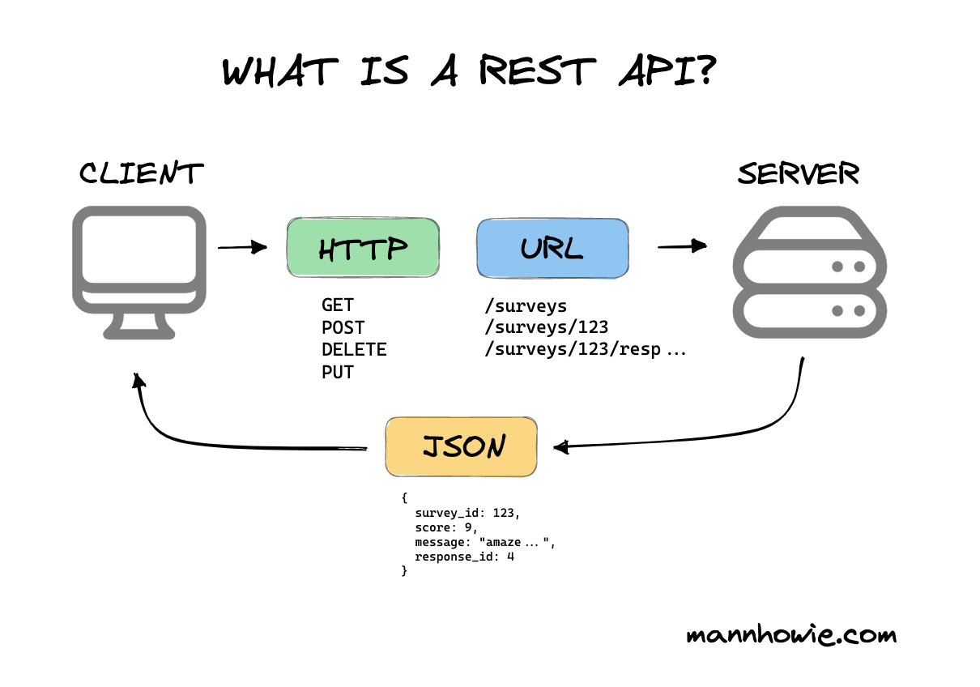
What is REST/RESTful API?
Representational State Transfer (REST) API is a software architecture that manages http(s)-based communications over the web.
HTTP verb
URL endpoint
message
https://mannhowie.com/rest-api

Slide 8
HTTP verbs
GET: make a read only request to view a resource from the server
POST: create a new resource specified in the request
DELETE: destroy a specified resource on the server
PUT: update the resource based on the request or create a new one if not exist
PATCH: update the resource if it exists

Slide 9
URL endpoints
A URL endpoint represents any given resource one HTTP verb can access
e.g., example.com/surveys, example.com/surveys/123/responses

Slide 10
Common HTTP status codes
Status code | Meaning
200 OK | A successful request.
401 Unauthorized | Server requires authentication.
403 Forbidden | Client authenticated but does not have permissions to view certain resources.
404 Not Found | Page not found because no search results or may be out of stock.
500 Internal Server Error | Server side error.
503 Server Unavailable | Server side error.

Slide 11
REST API: employs a request/response model where a client sends a request to a web service and the service responds back synchronously.

Slide 12
REST API: employs a request/response model where a client sends a request to a web service and the service responds back synchronously.
WebSocket API: employs a bidirectional model: clients can send messages to a web service, and the service can also independently send messages to clients.

Slide 13
What is WebSocket?
REST API: employs a request/response model where a client sends a request to a web service and the service responds back synchronously.
WebSocket API: employs a bidirectional model: clients can send messages to a web service, and the service can also independently send messages to clients.
WebSocket: a bidirectional, full-duplex protocol that is also used in the web scenarios.
The differences between HTTP(S) and WebSocket?
Minor: HTTP(S) request starts with http(s)://, WebSocket request starts with ws(s)://
Major: While HTTP(S) is a stateless protocol, WebSocket is stateful.

Slide 14
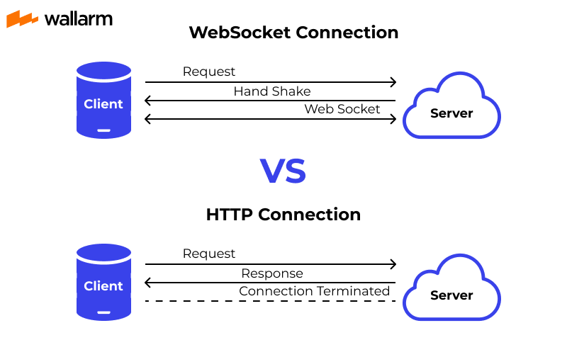
https://www.wallarm.com/what/a-simple-explanation-of-what-a-websocket-is

Slide 15
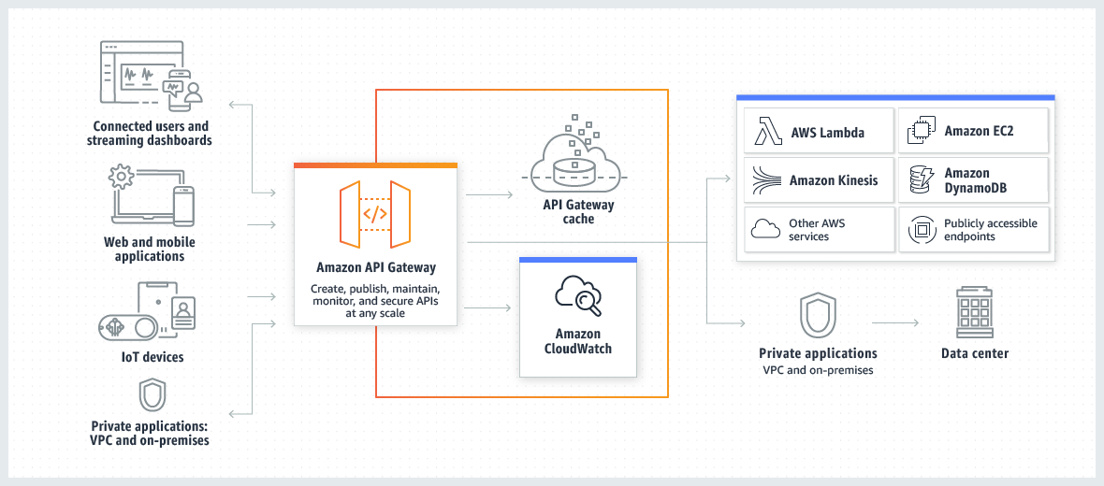
How AWS API Gateway works

Slide 16
An example: HTTP API An example: WebSocket API
API Gateway supports REST APIs, HTTP APIs, WebSocket APIs.

Slide 17
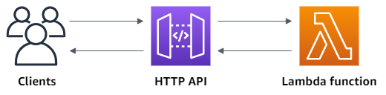
An example: HTTP API

Slide 18
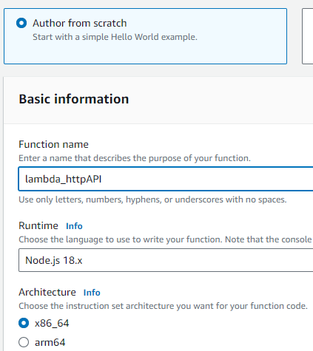
Step1: create a Lambda function

Slide 19
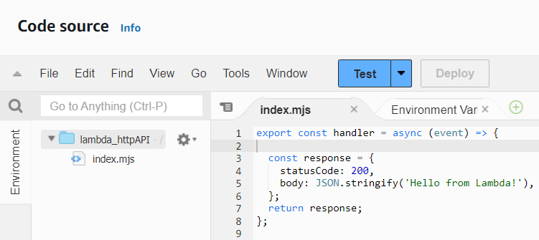
Step1: create a Lambda function

Slide 20
Step1: create a Lambda function
When the handler lambda function is invoked, it returns a status code of 200 and a JSON message of Hello from Lambda.

Slide 21
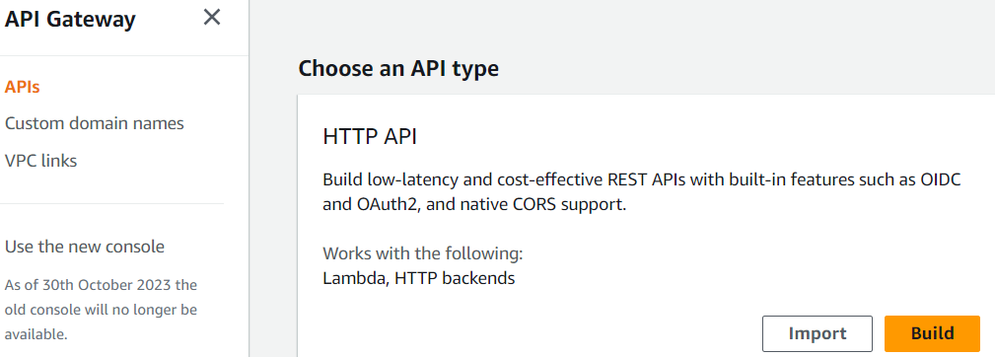
Step2: create an HTTP API

Slide 22
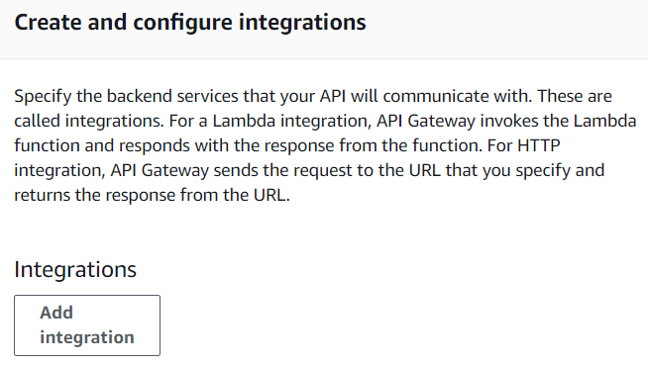
Step2.1: create and configure integrations

Slide 23
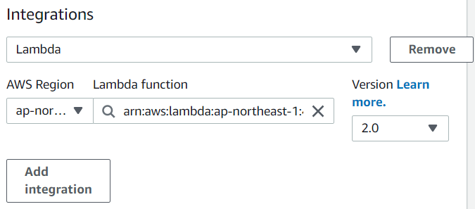
Step2.1: create and configure integrations

Slide 24
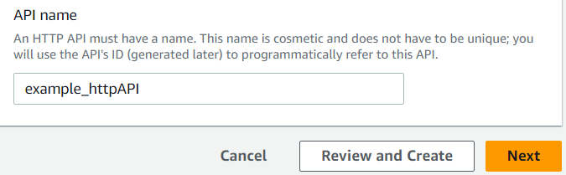
Step2.2: specify the API name

Slide 25
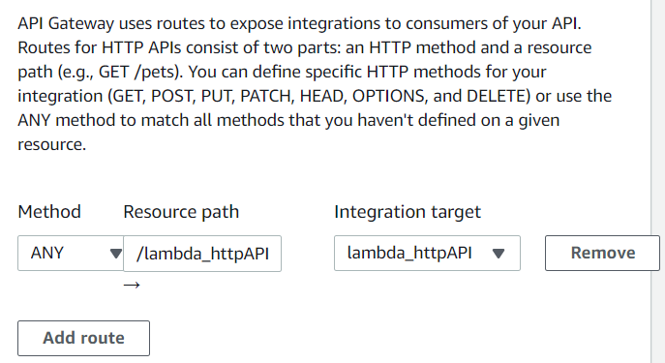
Step2.3: create routes

Slide 26
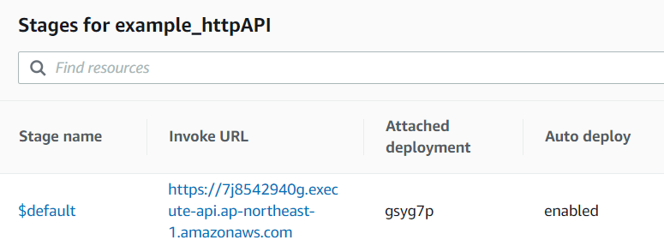
Step3: test the HTTP API
Full URL:
https://7j8542940g.execute-api.ap-northeast-1.amazonaws.com/lambda_httpAPI

Slide 27
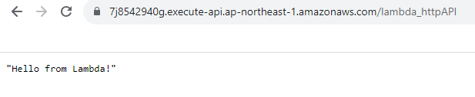
Step3: test the HTTP API

Slide 28
Step4: clean up
delete the HTTP API.
delete the Lambda function, its log group, and execution role.

Slide 29
An example: HTTP API An example: WebSocket API
API Gateway supports REST APIs, HTTP APIs, WebSocket API.

Slide 30
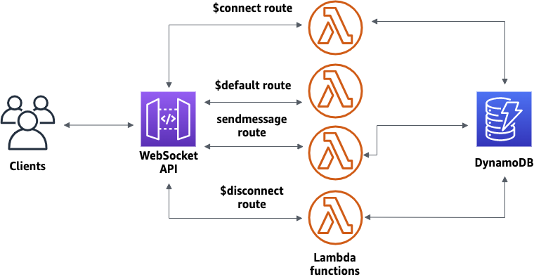
An example: WebSocket API

Slide 31
Step1: create Lambda functions and a DynamoDB table via CloudFormation
CloudFormation: a service that helps us model and set up the AWS resources we need.
A template is used to describe all the AWS resources that are needed.

Slide 32
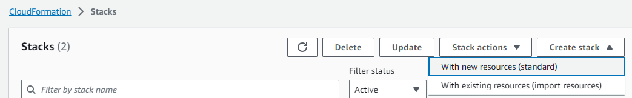
Step1.1: create Lambda functions and a DynamoDB table via CloudFormation
CloudFormation: a service that helps us model and set up the AWS resources we need.

Slide 33
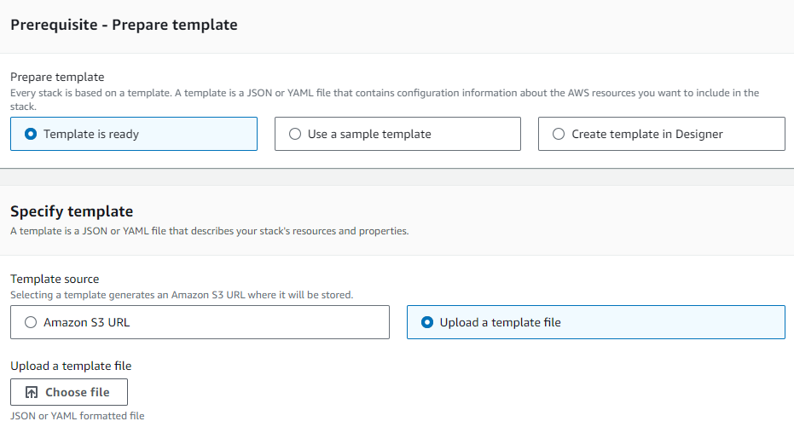
Step1.2: prepare template
template: a JSON or YAML file that contains configuration information about the AWS resources we need.
https://docs.aws.amazon.com/apigateway/latest/developerguide/samples/ws-chat-app-starter.zip

Slide 34
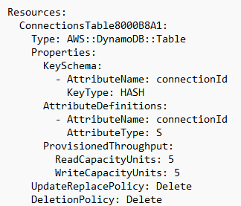
Step1.2: prepare template
An example template that creates a DynamoDB table and Lambda functions.

Slide 35
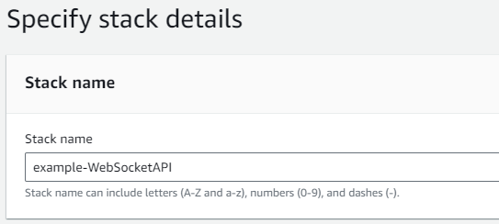
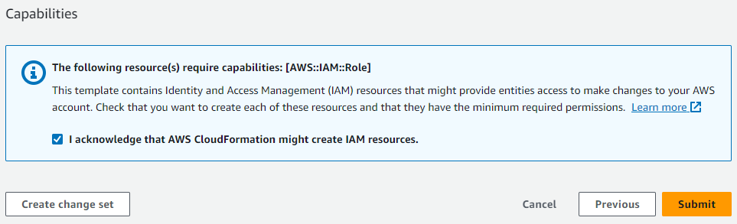
Step1.3: specify stack details

Slide 36
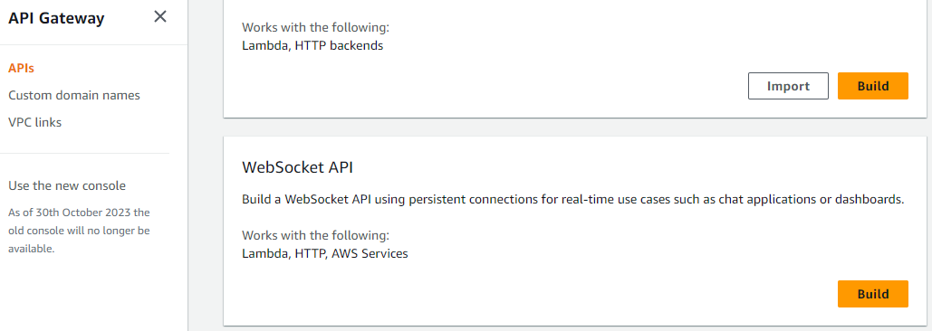
Step2: create a WebSocket API

Slide 37
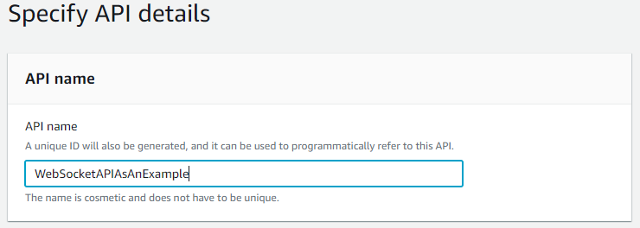
Step2.1: specify API details

Slide 38
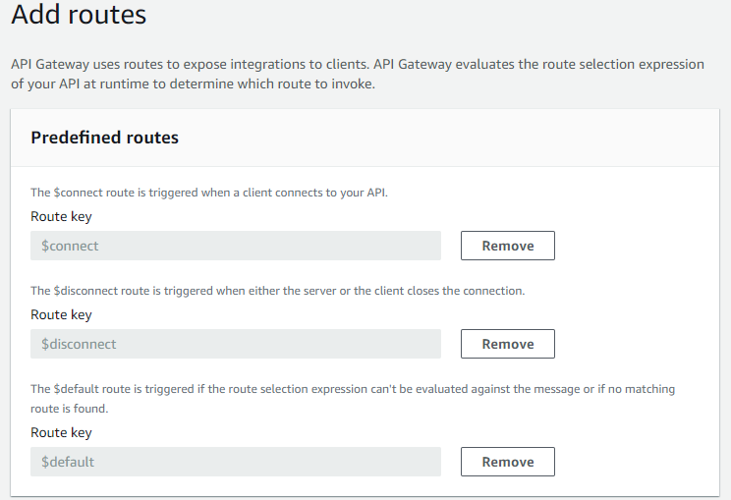
Step2.2: add predefined routes

Slide 39
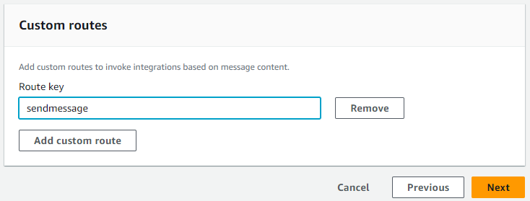
Step2.3: add custom routes

Slide 40
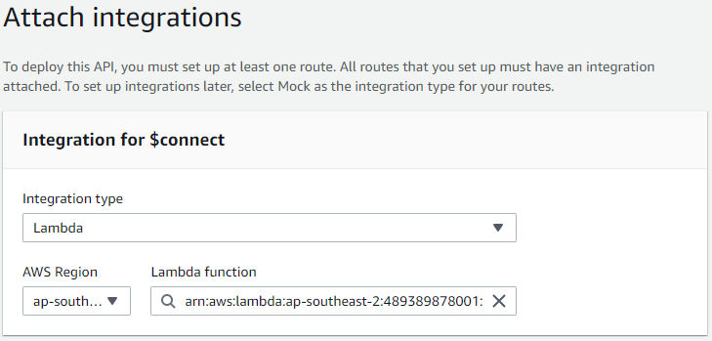
Step2.4: attach integrations

Slide 41
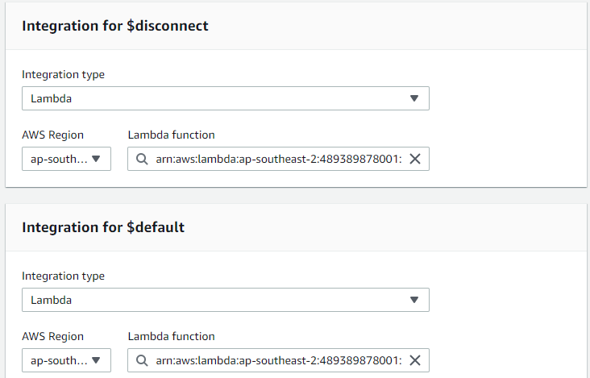
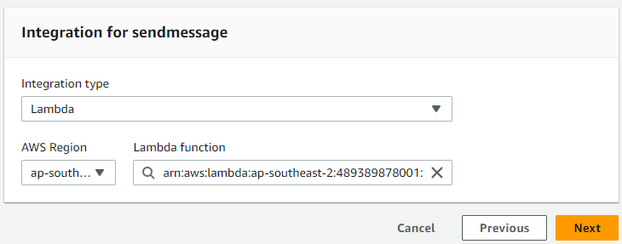
Step2.4: attach integrations

Slide 42

Step3: test the WebSocket API
wscat
sudo apt install nodejs
sudo apt install npm
sudo npm install -g wscat

Slide 43
Step3.1: demo
Demo
connect to the API
send a message
disconnect from the API
wscat -c wss://wcdyw35fn2.execute-api.ap-southeast-2.amazonaws.com/production
{"action": "sendmessage", "message": "hello, CITS5503!"}
CTRL+C

Slide 44
Exam Format
The exam is F2F and has a time limit of 2 hours
The exam is marked out of 100 points and is worth 50% of the overall unit mark.
The exam is open book: any printed or written materials are allowed (no page limit).
UWA approved calculators with stickers are needed.

Slide 45
Exam Instructions
You will be provided with an answer booklet
You should clearly state which questions of the final exam you are answering.
Please do NOT use a pencil or a red pen.
Please use readable handwriting. What cannot be read cannot be marked.

Slide 46
Exam Topics
7 topics within lectures and labs (excluding optional steps)
Networking
IAM
AI
DevOps
Web Application Architecture and Design
Storage
Cloud computing introduction
More than 90% of the questions are from the first 5 topics.

Slide 47
Question Format
7 themed questions in total and each themed question describes a scenario, based on which, some sub-questions are asked.
The format the sub-question is the same as that of part C in the mid-sem test, i.e., short answer questions.
A few sub-questions were picked from the assignments.md of relevant topics, excluding [13][14] in Week 5, [17] in Week 8, [18] in Week 9, [20], [21] in Week 10 and [22] in Week 11.
To prepare for the exam
Carefully review relevant slides (recordings), labs (excluding optional steps), and assignments.md.

Slide 48
Good Luck in all your final exams!!!

