Slide 1
Week 5 AWS Identity Access Management
Dr Zhi Zhang

Slide 2
Mid-sem test updates
The test is at 3:30pm-4:30pm on 29/08/23, and thus better arrive at 3:15pm.
For students in the two main venues: if your student ID is greater than 23460000, please proceed to ARTS[159]. For other students, please proceed to ARTS[G59].
For students with UAAP, sit in CSSE: [228] Tutorial Room.

Slide 3
Create Entries
1
2
3
4
5
6
7
8
9
10
11
aws dynamodb put-item \
--table-name MusicAlbum \
--item \ '{"Artist": {"S": "Tom"}, "Song": {"S": "Call Me Today"},
"AlbumTitle": {"S": "Somewhat Famous"}}' \
--return-consumed-capacity TOTAL --endpoint-url=http://localhost:8000
aws dynamodb put-item \
--table-name MusicAlbum \
--item '{"Artist": {"S": "Jerry"}, "Song": {"S": "Happy Day"}}' \
--return-consumed-capacity TOTAL --endpoint-url=http://localhost:8000
Demo: what a table will be like if we create the first entry with 3 attributes and the second entry with 2 attributes?

Slide 4
Overview
Cryptography
IAM (Identity Access Management)

Slide 5
Cybersecurity
It is about the protection of digital information from unauthorised access, harm or misuse.
This is done by preserving the CIA triad of the information, i.e., Confidentiality, Integrity and Availability.
Confidentiality: keeps sensitive information private and ensures that only authorized individuals or entities have access to it.
Integrity: maintains the accuracy, consistency, and reliability of information.
Availability: ensures that information such as services and data are accessible and operational for authorized users.

Slide 6
Other three cybersecurity terminology
CIA can be extended to include such as Authentication, Authorization Non-Repudiation, etc.
Authentication: verifies the identity of a user, system, or entity trying to access a resource or system.
Authorization: determines what actions or resources an authenticated user or system is allowed to access or perform.
Non-Repudiation: prevents individuals or entities from denying their involvement in a particular digital transaction.

Slide 7
Cryptography
It is the practice and study of techniques for secure communication and data protection in the presence of adversaries or potential threats.
It is mainly about the use of mathematical algorithms to transform plain, readable data (i.e., plaintext) into an unintelligible data (i.e., ciphertext) and vise versa
The transformations involve encryption and decryption.
Encryption: takes plaintext as input and converts it into ciphertext
Decryption: reverses this process above

Slide 8
Cryptography
It is the practice and study of techniques for secure communication and data protection in the presence of adversaries or potential threats.
It is mainly about the use of mathematical algorithms to transform plain, readable data (i.e., plaintext) into an unintelligible format (i.e., ciphertext) and vise versa
The transformations involve encryption and decryption.
Encryption: takes plaintext and converts it into ciphertext
Decryption: reverses this process above
Caesar cipher: an old-fashion substitution cipher where each letter in the plaintext is shifted a certain number of positions down the alphabet.
ROT3
PT : abcdefghijklmnopqrstuvwxyz
CT : defghijklmnopqrstuvwxyzabc

Slide 9
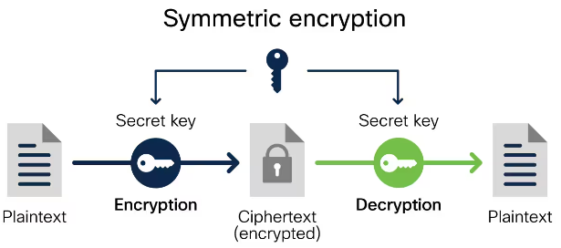
Cryptography today
Symmetric key cryptography: the same key is used for encryption and decryption of data.
Examples?

Slide 10
Cryptography today
Symmetric key cryptography: the same key is used for encryption and decryption of data.
Examples: DES, 3DES, AES.
Applications: data (file, disk, network packets) encryption
https://www.cisco.com/c/en/us/products/security/encryption-explained.html#~encryption-algorithms

Slide 11
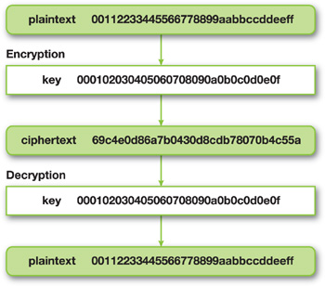
AES (Advanced Encryption Standard)
AES encrypts a block of 128 bits (16 bytes) at one time.
Why does the plaintext consist of numeric values only?
Plaintext is originally a piece of human readable sentences and can be encoded into blocks of numeric values via mainstream encoders such as ASCII.
https://developer.nvidia.com/gpugems/gpugems3/part-vi-gpu-computing/chapter-36-aes-encryption-and-decryption-gpu

Slide 12
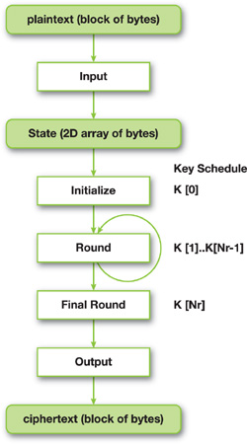

AES (encryption)
AES-128, AES-192, AES-256
A longer key provides stronger security
Encryption
https://developer.nvidia.com/gpugems/gpugems3/part-vi-gpu-computing/chapter-36-aes-encryption-and-decryption-gpu

Slide 13
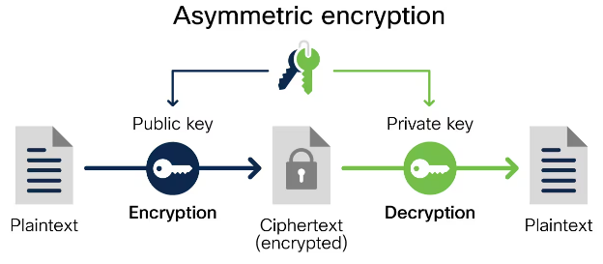
Cryptography today
Symmetric key cryptography: the same key is used for encryption and decryption of data.
Asymmetric key cryptography (public key cryptography): a pair of distinct keys is used for encryption and decryption.
Examples?
https://www.cisco.com/c/en/us/products/security/encryption-explained.html#~encryption-algorithms

Slide 14
Cryptography today
Symmetric key cryptography: the same key is used for encryption and decryption of data.
Asymmetric key cryptography (public key cryptography): a pair of distinct keys is used for encryption and decryption.
Examples: Diffie-Hellman key exchange, ECC, RSA
Applications: remote access (e.g., SSH communication), authentication (e.g., digital signatures), etc.
https://www.cisco.com/c/en/us/products/security/encryption-explained.html#~encryption-algorithms

Slide 15




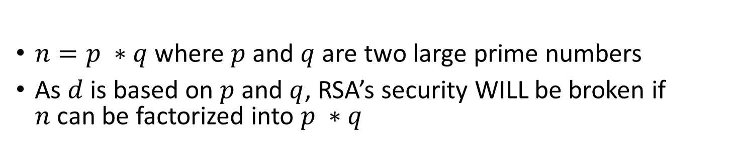
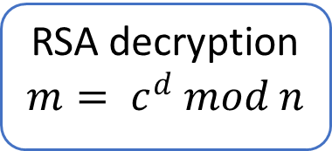
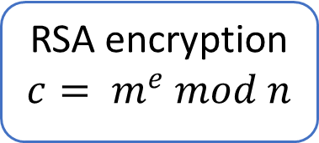
RSA
Bob’s Public Key ($e$, $n$)
Bob’s Private key ($d$)
Plaintext
m
Plaintext
m
Ciphertext
c
RSA encryption
$$c= m^{e} mod n$$
RSA decryption
$$m= c^{d} mod n$$
Alice
Bob
Attacker
$n=p ∗q$ where $p$ and $q$ are two large prime numbers
As $d$ is based on $p$ and $q$, RSA’s security WILL be broken if $n$can be factorized into $p ∗q$

Slide 16
RSA
Bob’s Public Key ($e$, $n$)
Bob’s Private key ($d$)
Plaintext
m
Plaintext
m
RSA encryption
$$c= m^{e} mod n$$
RSA decryption
$$m= c^{d} mod n$$
Alice
Ciphertext
c
Bob
Symmetric key cryptography is much faster than asymmetric key cryptography. When asymmetric key cryptography achieves key exchange, symmetric key cryptography is in place for secure data transmission.

Slide 17
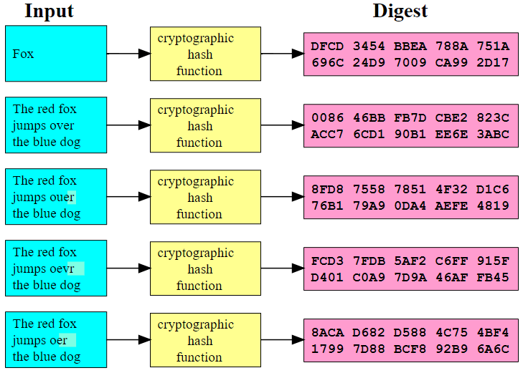
Cryptography today
Symmetric key cryptography, Asymmetric key cryptography,
Hash functions: take an input (e.g., a large block of text) and transform it into a fixed-size value (i.e., hash digest/checksum). The hash value serves as a ‘fingerprint’ of the input.
Examples: ?
https://upload.wikimedia.org/wikipedia/commons/2/2b/Cryptographic_Hash_Function.svg

Slide 18
Cryptography today
Symmetric key cryptography, Asymmetric key cryptography,
Hash functions: take an input (e.g., a large block of text) and transform it into a fixed-size value (i.e., hash digest/checksum). The hash value serves as a ‘fingerprint’ of the input.
Examples: MD5, SHA-1, SHA-2 (e.g., SHA-256)
https://upload.wikimedia.org/wikipedia/commons/2/2b/Cryptographic_Hash_Function.svg

Slide 19
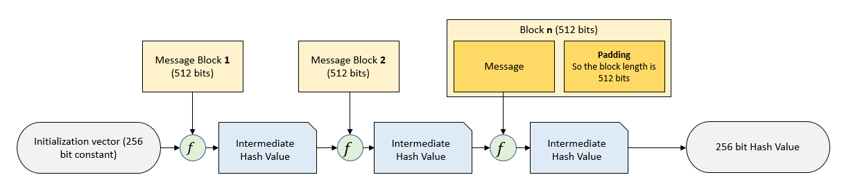
SHA256 (Secure Hash Algorithm 256-bit)
It is a series of mathematical operations that takes an input message and produces a fixed-size 256-bit hash value.
https://steemit.com/cryptocurrency/@f4tca7/introduction-to-the-sha-256-hash-function

Slide 20
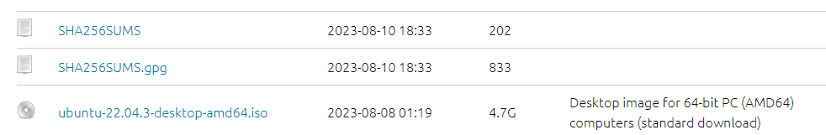
SHA256
A real-world example: verifying file integrity
SHA256SUMS: contains a checksum/hash digest for the iso image to verify the image’s integrity.
SHA256SUMS.gpg: contains a signature for the SHA256SUMS file to verify the image’s authenticity.

Slide 21
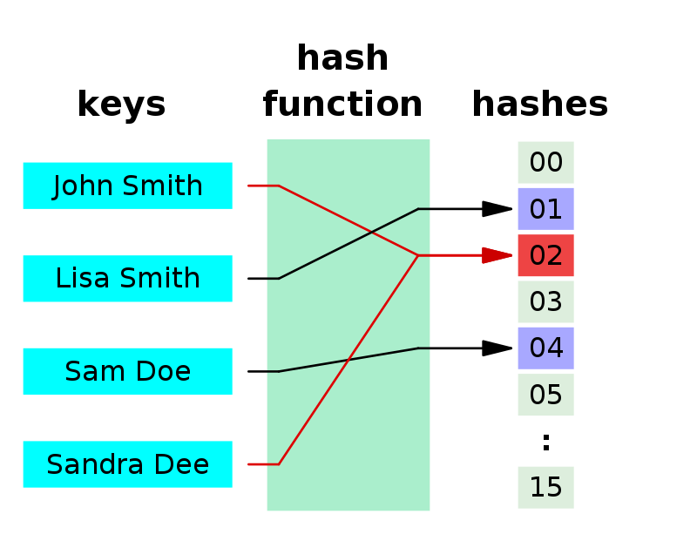
Properties of hash functions
The same message results in the same hash digest
Small changes to a message result in large changes to its hash digest
Hash collision
While two different messages are very unlikely to generate the same hash, such a possibility still exists, so-called hash collision (e.g., MD5 and SHA-1)
Why?
https://en.wikipedia.org/wiki/Hash_collision

Slide 22
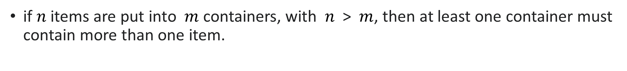
Pigeonhole principle
if $n$items are put into $m$ containers, with $n$ > $m$, then at least one container must contain more than one item.
https://en.wikipedia.org/wiki/Pigeonhole_principle

Slide 23
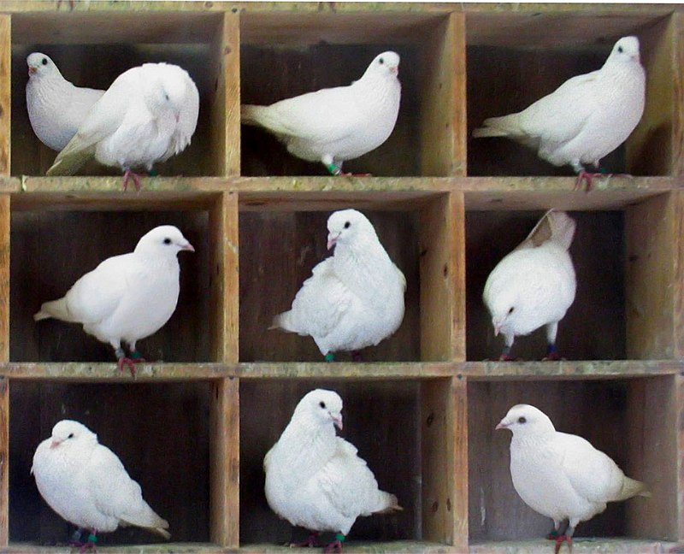
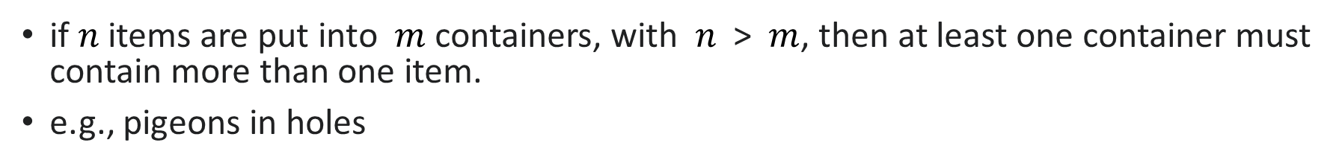
Pigeonhole principle
if $n$items are put into $m$ containers, with $n$ > $m$, then at least one container must contain more than one item.
e.g., pigeons in holes
https://en.wikipedia.org/wiki/Pigeonhole_principle

Slide 24
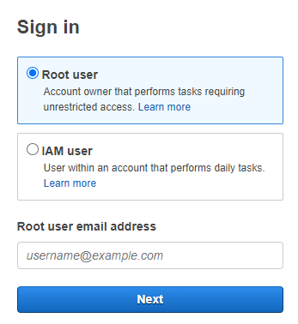
What is IAM (identity access management)?
It is a web service that helps us securely control access to AWS resources.
It is used to control who is authenticated (signed in) and authorized (has permissions) to use AWS resources.
Root user: complete access to all AWS services and resources in the account

Slide 25
IAM identity
IAM user: an identity within a root user account that has specific permissions for a single person or application:
Each user has an ARN:
e.g., arn:aws:iam::489389878001:user/12345678@student.uwa.edu.au
IAM user group: an identity that specifies a collection of IAM users:
Users within the same group are given the same set of permissions.
Users can belong to different groups.
Each group has an ARN, e.g., arn:aws:iam::489389878001:group/admins
IAM role: an identity that has specific permissions, similar to IAM user but not relevant to a specific person/application.
Any users/applications can assume a role to complete a specific task.
User case: an IAM role grants permissions to applications running on EC2 instances
Each role has an ARN, e.g., arn:aws:iam:: 489389878001 :role/apps4ec2

Slide 26
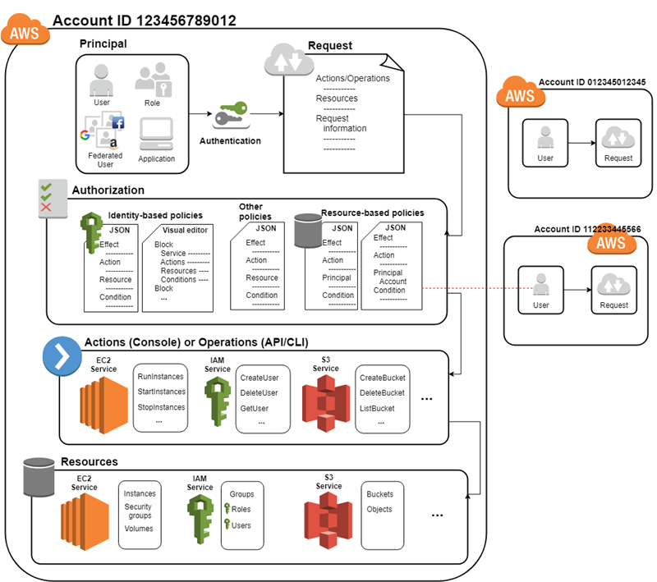
How IAM works
Step 1: Authenticate a principal.
Principal: a person or application that uses an IAM user, a root user, or an IAM role to sign in and make requests to AWS.

Slide 27
How IAM works
Step 1: Authenticate a principal.
Step 2: Authorize a principal.

Slide 28
How IAM works
Step 1: Authenticate a principal.
Step 2: Authorize a principal.
Step 3: Take actions/operations on AWS resources.

Slide 29
Main features of IAM
Shared access to AWS root user account
Grant other people permission to use resources in our root user account without having to share our password or access key.
Granular permissions
Grant different permissions to different people for different resources.
e.g., some users have complete access to specified EC2 instances while some have read-only access to specified S3 buckets.

Slide 30
Policies and permissions
Access permissions (authorization) are managed by creating policies and attaching them to IAM identities (users, groups of users, or roles) or AWS resources.
Note: IAM policies only define permissions for an action regardless of the method that we use to perform the action
e.g., if a policy allows the GetUser action, then a user with that policy can get user information with all three methods.

Slide 31
Policies and permissions
Access permissions (authorization) are managed by creating policies and attaching them to IAM identities (users, groups of users, or roles) or AWS resources.
Note: IAM policies only define permissions for an action regardless of the method that we use to perform the action
e.g., if a policy allows the GetUser action, then a user with that policy can get user information with all three methods.
Policy types (most frequently used):
Identity-based policy
Resource-based policy
permissions boundary

Slide 32
Identity-based policy
It’s in a JSON format that controls what actions an identity can perform.
Managed policy: standalone identity-based policy that we can attach to multiple users, groups, and roles.
Inline policy: it maintains a strict one-to-one relationship between a policy and an identity. If the identity is deleted, the policy is deleted as well.

Slide 33
Identity-based policy
It’s in a JSON format that controls what actions an identity can perform.
Managed policy: standalone identity-based policy that we can attach to multiple users, groups, and roles.
AWS managed policy: created and managed by AWS
Customer managed policy: created and managed by AWS users.
Inline policy: it maintains a strict one-to-one relationship between a policy and an identity. If the identity is deleted, the policy is deleted as well.

Slide 34
AWS managed policy
full-access managed policy: defines permissions for administrators by granting full access to services.
power-user managed policy: provides full access to services and resources, but disallows managing users and groups, i.e., a subset of full-access managed policy.
partial-user managed policy: provides specific access to specified services, i.e., a subset of power-user managed policy.

Slide 35
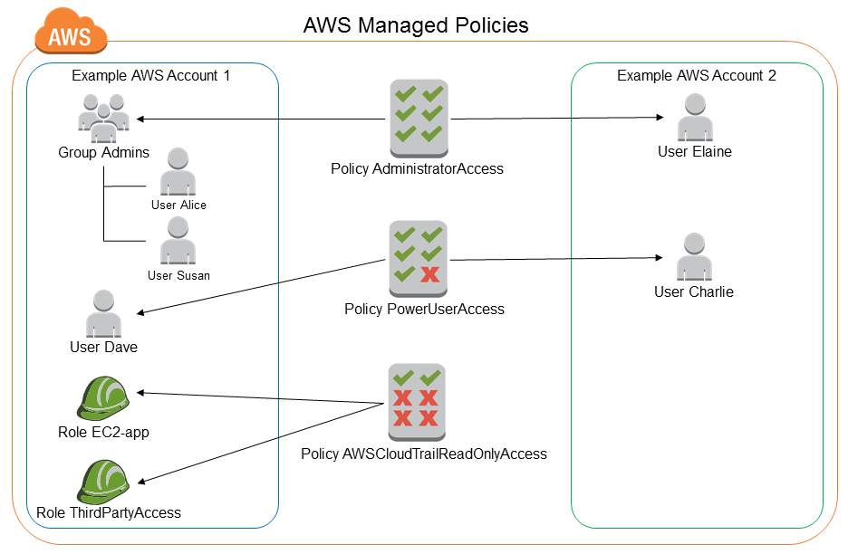
AWS managed policy
https://docs.aws.amazon.com/IAM/latest/UserGuide/access_policies_managed-vs-inline.html#aws-managed-policies

Slide 36
AdministratorAccess
Version: indicates the language version of the policy language.
Statement: represents a permission rule.
Effect: what the effect will be when a user requests the specific action—this can be either ’Allow’ or ’Deny’.
Action: defines a set of resource operations a user/application is allowed (or denied) to perform.
Resource: specifies AWS resources for which a user is allowed or denied to take actions. ARN is often used.
{
"Version": "2012-10-17",
"Statement": [
{
"Effect": "Allow",
"Action": "*",
"Resource": "*"
}
]
}

Slide 37
PowerUserAccess
{
"Version": "2012-10-17",
"Statement": [
{ "Effect": "Allow",
"NotAction": [
"iam:*",
"organizations:*",
"account:*"
],
"Resource": "*"
},
{ "Effect": "Allow",
"Action": [
"iam:ListRoles",
"organizations:DescribeOrganization",
"account:GetAccountInformation"
],
"Resource": "*"
}
]
}
Organizations: are a service that allows us to consolidate multiple AWS accounts into an organizational structure.
This policy allows actions against all resources except management of IAM, organizations and account.

Slide 38
AWSCloudTrail_ReadOnlyAccess
{
"Version": "2012-10-17",
"Statement": [
{
"Effect": "Allow",
"Action": [
"cloudtrail:Get*",
"cloudtrail:Describe*",
"cloudtrail:List*",
],
"Resource": "*"
}
]
}
CloudTrail is a service that provides visibility into user activity and resource usage.
records and stores AWS Management Console actions, AWS SDK calls, AWS CLI commands, and other AWS service activity.
A trail records the resources to be monitored, the storage locations for log files, and other log data.
e.g., GetTrail, DescribeTrails, ListTrails
https://docs.aws.amazon.com/awscloudtrail/latest/APIReference/API_Operations.html

Slide 39
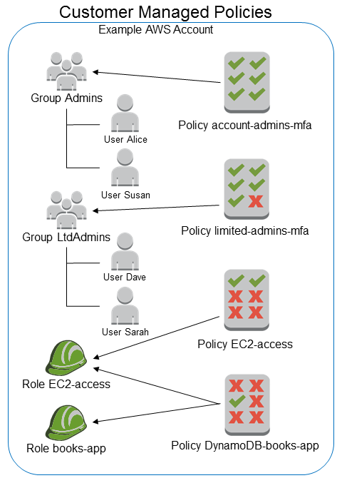
Customer managed policy
https://docs.aws.amazon.com/IAM/latest/UserGuide/access_policies_managed-vs-inline.html#aws-managed-policies

Slide 40
cits5503StudentPolicy
{
"Effect": "Allow",
"Action": [
"iam:CreateAccessKey",
"iam:DeleteAccessKey",
"iam:ListAccessKeys",
"iam:UpdateAccessKey",
"iam:GetAccessKeyLastUsed",
"iam:DeleteSSHPublicKey",
"iam:GetSSHPublicKey",
"iam:ListSSHPublicKeys",
"iam:UpdateSSHPublicKey",
"iam:UploadSSHPublicKey",
"account:ListRegions",
"account:GetAccountInformation",
],
"Resource": "*"
}
Based on PowerUserAccess.

Slide 41
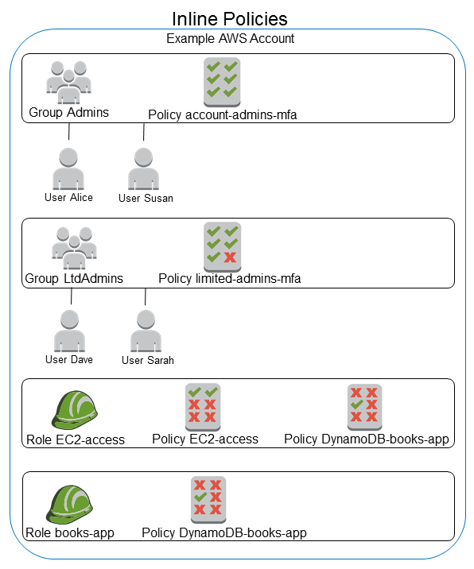
Inline policy
The DynamoDB-books-app policy is used by both roles. Is it shared?
https://docs.aws.amazon.com/IAM/latest/UserGuide/access_policies_managed-vs-inline.html#aws-managed-policies

Slide 42
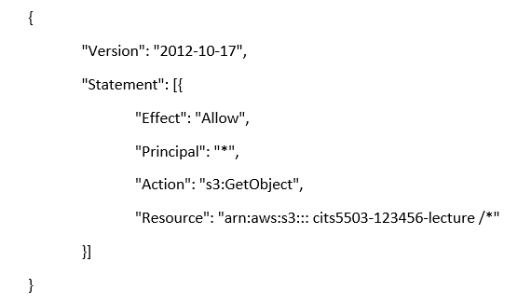
Resource-based policy
It’s in a JSON format that grants specified principals specific permissions to perform specific actions on specific resources under specific conditions.
Note: it is an inline policy.
e.g., bucket policy:

Slide 43
Permissions boundary
It is an advanced feature for using a managed policy to set the maximum permissions that an identity-based policy can grant.
e.g., The permissions boundary is attached to an IAM user named Alice.
{
"Version": "2012-10-17",
"Statement": [
{
"Effect": "Allow",
"Action": [
"s3:*",
"ec2:*"
],
"Resource": "*"
}
]
}

Slide 44
Permissions boundary
identity-based policy
Permissions boundary
{
"Version": "2012-10-17",
"Statement": {
"Effect": "Allow",
"Action": "iam:CreateUser",
"Resource": "*"
}
}
{
"Version": "2012-10-17",
"Statement": [
{
"Effect": "Allow",
"Action": [
"s3:*",
"ec2:*"
],
"Resource": "*"
}
]
}
Both policies are attached to Alice.
Can Alice really create a user?
Can Alice really create S3 buckets and EC2 instances?

Slide 45
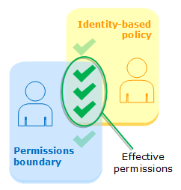
Permissions boundary
Both answers are NO.
Effective permissions are in the intersection of Identity-based policies and permissions boundaries.

Slide 46
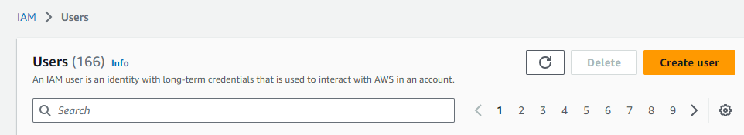
Attach customer managed policy to an IAM user

Slide 47
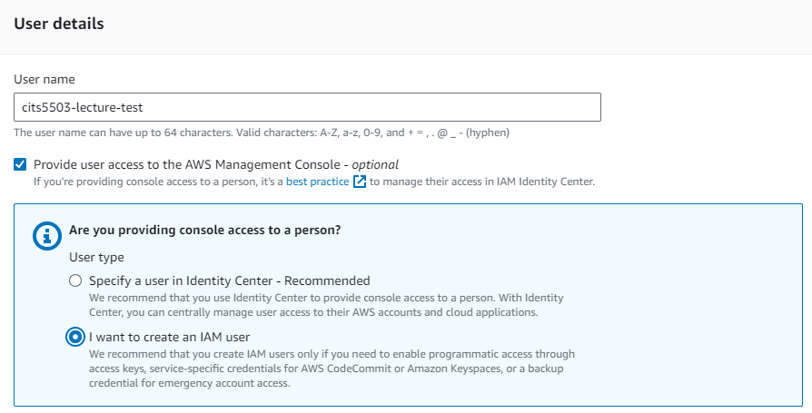
Specify user details

Slide 48
IAM identity center
It is a place where an administrator can create or connect workforce users and centrally manage their access across all their AWS accounts and applications.
Workforce users/identities refer to users who are members within the same organization.
The admin can use multi-account permissions to assign their workforce users access to multiple AWS accounts.
IAM user
It is an identity within a root user account that has specific permissions for a single person or application.
It is unlikely for an IAM user to have multi-account access unless explicitly specified.

Slide 49
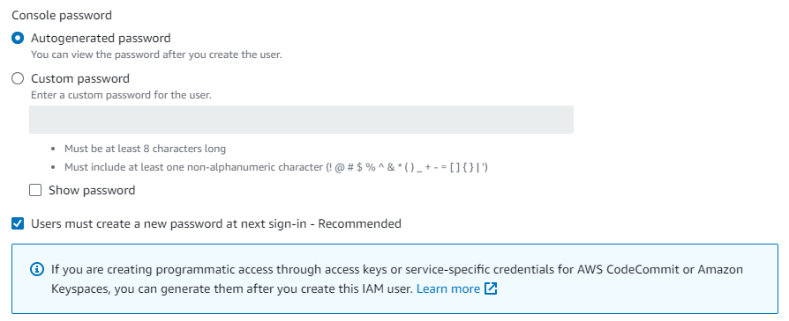
Specify user details

Slide 50
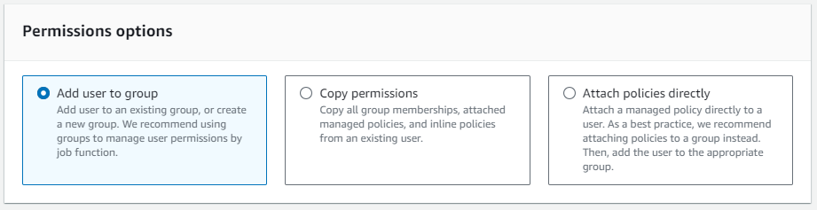
Set permissions

Slide 51
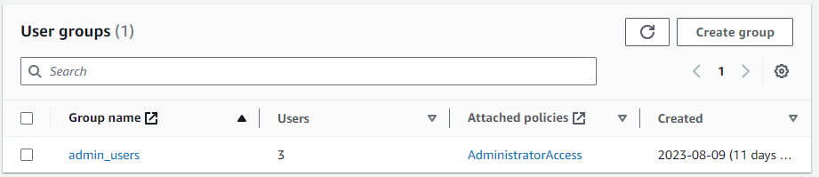
Add user to group

Slide 52
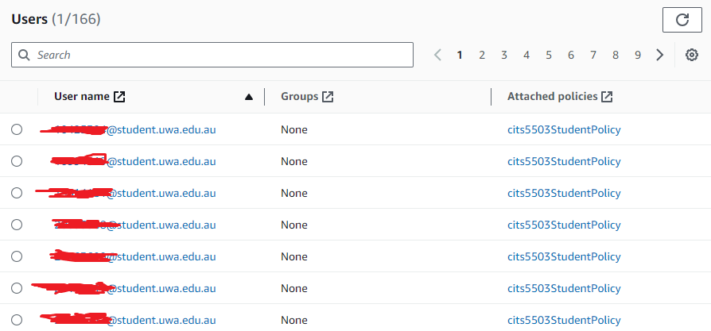
Copy permissions

Slide 53
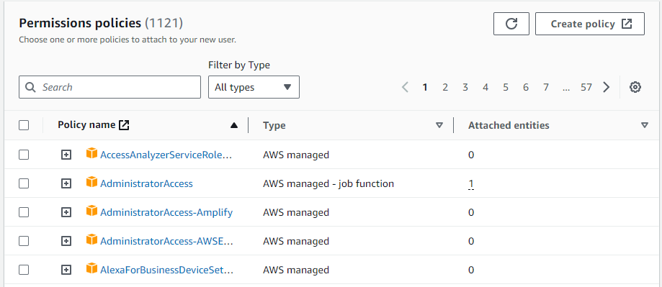
Attach policies directly

Slide 54
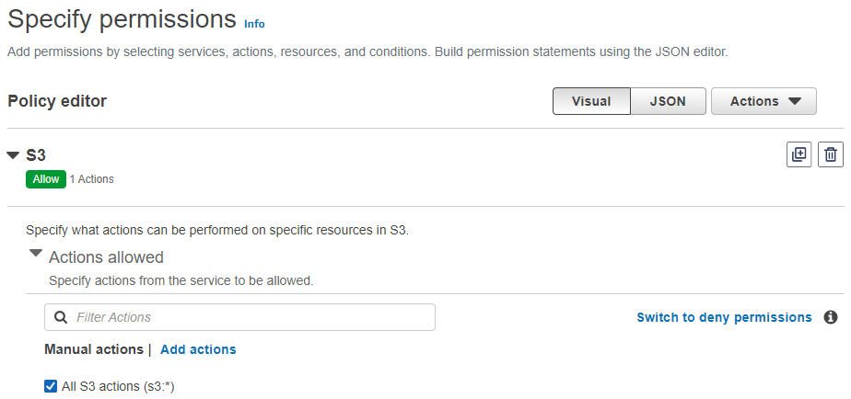
Create customer managed policy
A policy allows the IAM user to access a specified S3 bucket only.

Slide 55
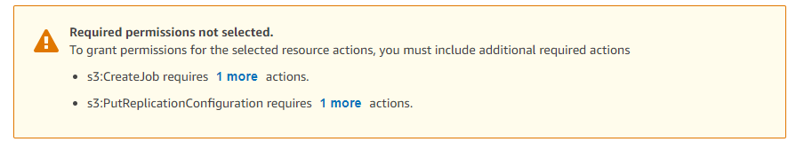
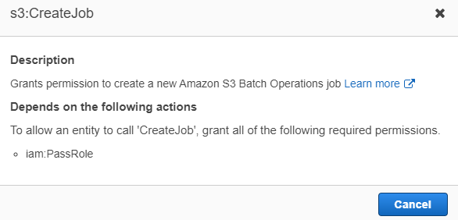
Create customer managed policy
A policy allows the IAM user to access a specified S3 bucket only.

Slide 56
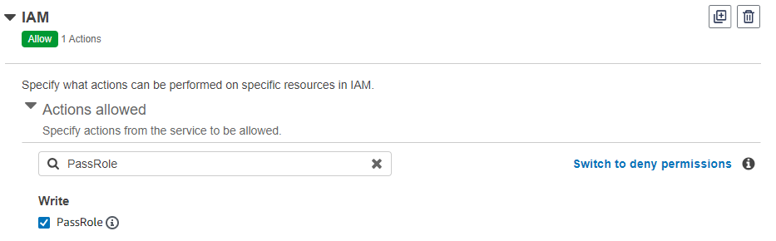
Create customer managed policy
A policy allows the IAM user to access a specified S3 bucket only.

Slide 57
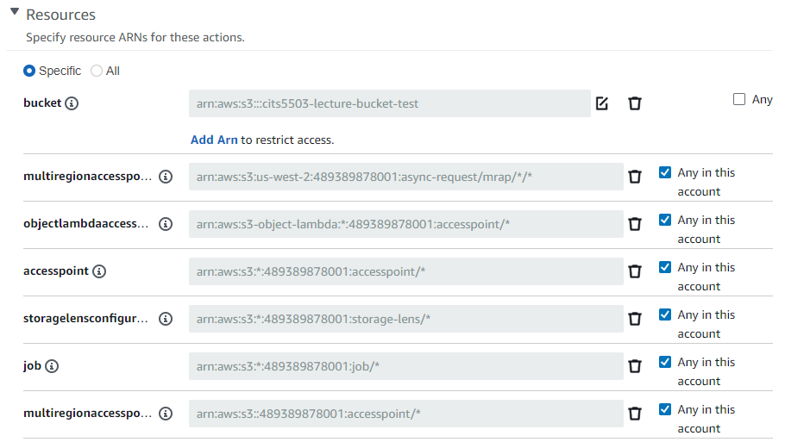
Create customer managed policy
A policy allows the IAM user to access a specified S3 bucket only.

Slide 58
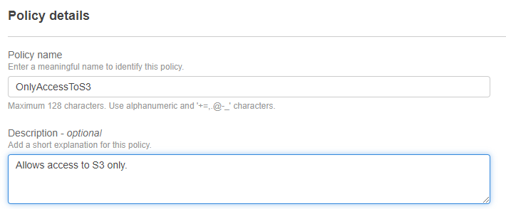
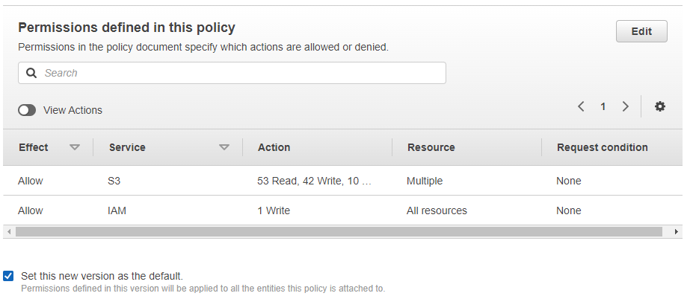
Create customer managed policy
Review.

Slide 59
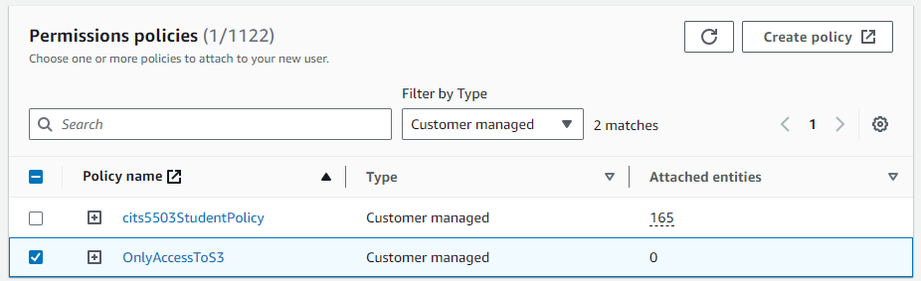
Attach policies directly
Select permission policy.

Slide 60
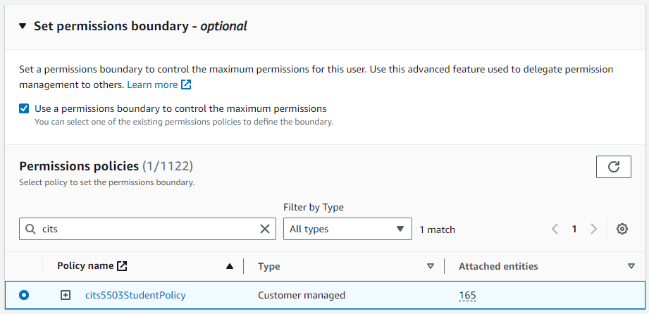
Attach policies directly
Set permissions boundary.

Slide 61
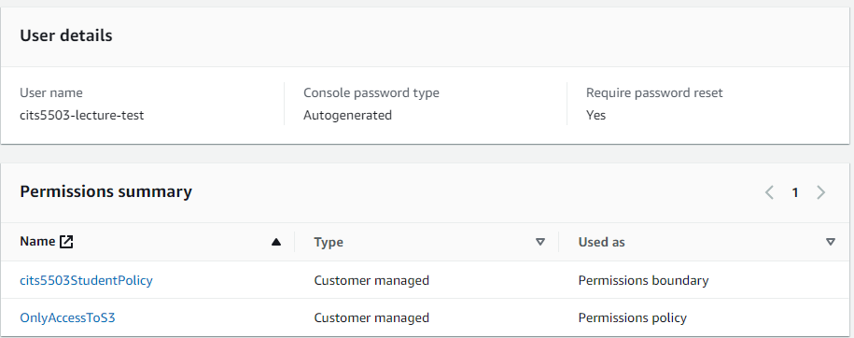
Attach policies directly
Review.

Slide 62
Demo
Check if an IAM user is created.
Check if their permissions are restricted to S3 access only.
Check if the user is prevented from accessing S3 resources of other users.
Check if the user is allowed to manage an S3 bucket.

Slide 63
Practice Questions
[6 marks] Q1: Name 3 of the keys in a Policy. Explain their role. An example of a key is “Version” that specifies the version of the policy syntax and is normally “Version”: “2012-10-17”

Slide 64
Practice Questions
[6 marks] Q1: Name 3 of the keys in a Policy. Explain their role. An example of a key is “Version” that specifies the version of the policy syntax and is normally “Version”: “2012-10-17”
[2 marks] Statement: represents a permission rule.
[2 marks] Effect: what the effect will be when a user requests the specific action—this can be either Allow or Deny.
[2 marks] Action: defines a set of resource operations a user/application is allowed (or denied) to perform.
[2 marks] Resource: specifies AWS resources for which a user is allowed or denied to take actions.

