Slide 1
Week 9 Web Application Architecture and Design
Dr Zhi Zhang

Slide 2
Overview
Web Application Architecture
Web Application Design
Django Framework

Slide 3
What is a web application architecture
A web application architecture is a layout that displays the interactions between different software components, such as frontend, and backend.

Slide 4
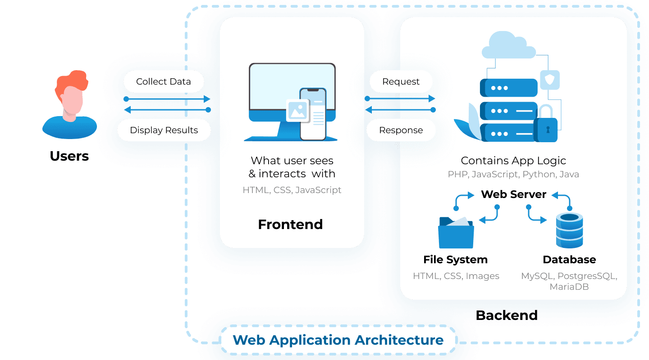
What is a web application architecture
A web application architecture is a layout that displays the interactions between different software components, such as frontend, and backend.
https://litslink.com/blog/web-application-architecture#types-of-web-application-architecture

Slide 5
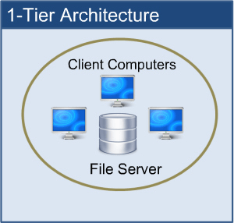
1-Tier web application architecture
1-Tier Architecture/Monolithic Architecture: all the software components are available on the same machine.
https://www.perfmatrix.com/software-architecture-and-its-types/

Slide 6
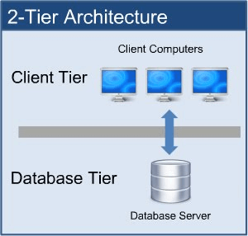
2-Tier web application architecture
2-Tier Architecture/Client-Server Architecture: The client sends the request to the server and the server system processes the request and sends the response back to the client.
https://www.perfmatrix.com/software-architecture-and-its-types/

Slide 7
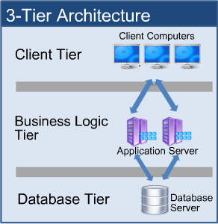
3-Tier web application architecture
3-Tier Architecture: a common web application architecture. The intermediate application server receives client requests and processes them by applying the business logic. The communication between the client and the database is managed by the intermediate application layer.
https://www.perfmatrix.com/software-architecture-and-its-types/

Slide 8
3-Tier web application architecture
Presentation Layer: displays the user interface and manages user interaction.
Application Layer/Business Layer: has all the business logic, rules and policies.
Data Layer: stores and maintains the data.
https://www.perfmatrix.com/software-architecture-and-its-types/

Slide 9
Distributed web application architecture
Presentation Layer: displays the user interface and manages user interaction.
Application Layer/Business Layer: has all the business logic, rules and policies.
Data Layer: stores and maintains the data.
Layers of different services: defines separate components or modules that perform specific tasks or provide functionality to the overall web application.

Slide 10
Distributed web application architecture
Presentation Layer: displays the user interface and manages user interaction.
Application Layer/Business Layer: has all the business logic, rules and policies.
Data Layer: stores and maintains the data.
Layers of different services: defines separate components or modules that perform specific tasks or provide functionality to the overall web application.
Any example?

Slide 11
Distributed web application architecture
Presentation Layer: displays the user interface and manages user interaction.
Application Layer/Business Layer: has all the business logic, rules and policies.
Data Layer: stores and maintains the data.
Layers of different services: defines separate components or modules that perform specific tasks or provide functionality to the overall web application.
Examples: Caching service, Job Server, Full-Text Search Service, Datawarehouse.

Slide 12
Web application architecture
It is the skeleton: outlining how different software components are organized, and interact with each other.
Web application design
It is the code-level design of the components and their interaction. It is the level of modules, functions, classes, interfaces, etc, which are used to implement each component and the interaction.

Slide 13
A popular design pattern
Model—View—Controller (MVC):
Model: maintains the application data, e.g., interacts with the database.
View: provides templates for visualizing the application data retrieved from the model.
Controller: acts as an intermediary between the Model and the View, e.g., reads/writes data via the Model component, and interacts with the View component to render the output.

Slide 14
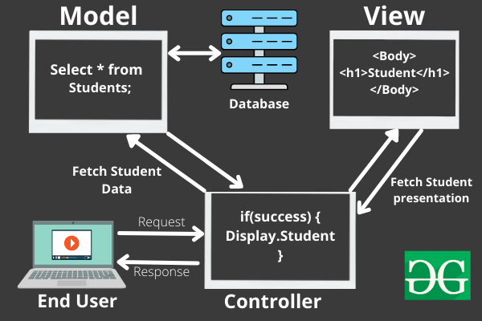
Model—View—Controller (MVC)
An example:
2
1
https://www.geeksforgeeks.org/mvc-framework-introduction/

Slide 15
Model—View—Controller (MVC)
An example:
3
2
4
1
https://www.geeksforgeeks.org/mvc-framework-introduction/

Slide 16
Model—View—Controller (MVC)
An example:
3
2
4
5
6
1
7
https://www.geeksforgeeks.org/mvc-framework-introduction/

Slide 17
A short summary
Model—View—Controller:
Model: interacts with data.
View: visualizes data.
Controller: tells the model and view of what to do.
Django
Django is an open-source web application framework written in Python.
Django customizes the MVC design pattern.

Slide 18
Django customizes MVC as MVT (Model—View—Template)
M — — — ->For data interaction— — — — — ->M V — — — -> For data visualization— — — — — ->T C — — — -> For component interaction— — — —>V
Any real-world Django-based web application?

Slide 19
Django customizes MVC as MVT (Model—View—Template)
M — — — ->For data interaction— — — — — ->M V — — — -> For data visualization— — — — — ->T C — — — -> For component interaction— — — —>V
Any real-world Django-based web application?
Instagram, Spotify, Youtube

Slide 20
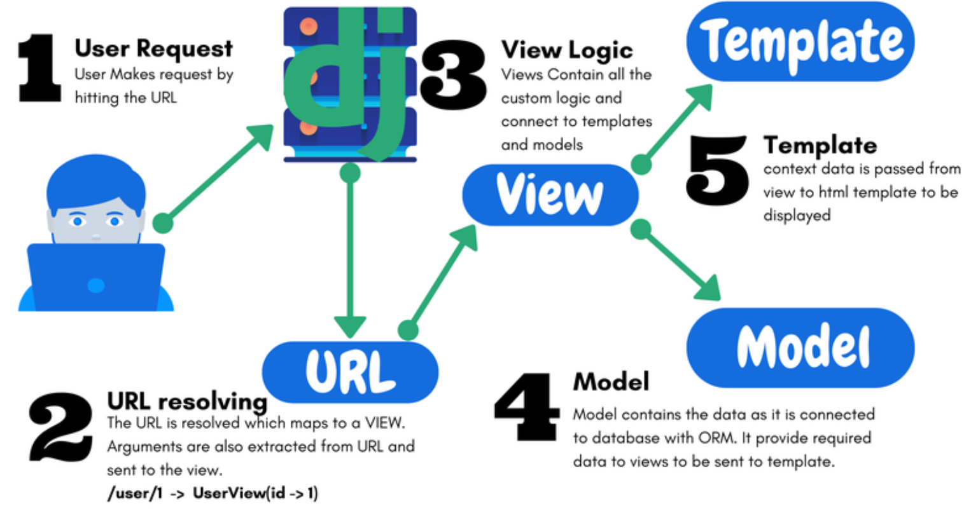
A Django-based web application:
URL: resolves a request from a given URL
Extracts specific patterns of strings and/or digits in the URL and sends them to the VIEW function.

Slide 21
A Django-based web application:
View: it is an HTTP request handler function that receives and responds to HTTP requests.
Interacts with templates and models as needed.

Slide 22
A Django-based web application:
Model: interacts with the application data in a database, e.g., creating a database table.

Slide 23
A Django-based web application:
Template: defines the structure or layout of web pages, with placeholders for actual content.

Slide 24
Sending a request to a Django web application: example code
urls.py: implements the URL component
1
2
3
4
5
6
7
8
from django.urls import path
from django.contrib import admin
from music import views
urlpatterns = [
path('', views.home, name='home'),
path('admin/', admin.site.urls),
]

Slide 25
Handling the request: example code
views.py: implements the View component
1
2
3
4
5
6
from django.shortcuts import render, redirect
from django.http import HttpResponse
# Create our views here.
def home(request):
return render(request, 'home.html')

Slide 26
html template for data rendering: example code
1
2
3
4
5
6
7
8
9
10
<h1>Main Page:</h1>
<ul>
<li><a href="{% url 'home' %}">Home Page</a></li>
</ul>
<p>MVT means:</p>
<ul>
<li>Model</li>
<li>View</li>
<li>Template</li>
</ul>

Slide 27
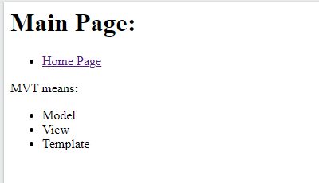
html template for data rendering: example code

Slide 28
Managing the application data: example code
models.py: implements the Model component
1
2
3
4
5
6
from django.db import models
# Define your models here.
class Artist(models.Model):
name = models.CharField(max_length=100)
song = models.CharField(max_length=25)

Slide 29
Example: Create a Django web application called music

Slide 30
Step 1: Setting up a virtual environment
mkdir ~/cits5503_django
cd cits5503_django
python3 -m venv cits5503venv
source cits5503venv/bin/activate
Question: /opt/wwc/ is not a good path for deploying a Django application. Why?

Slide 31
Step 1: Setting up a virtual environment
mkdir ~/cits5503_django
cd cits5503_django
python3 -m venv cits5503venv
source cits5503venv/bin/activate
Question: /opt/wwc/ is not a good path for deploying a Django application:
While this path requires the root privilege, the application itself does not require it.

Slide 32
Step 1: Setting up a virtual environment
mkdir ~/cits5503_django
cd cits5503_django
python3 -m venv cits5503venv
source cits5503venv/bin/activate
Question: Why do we need to setup a virtual environment in python?

Slide 33
Step 1: Setting up a development environment
mkdir ~/cits5503_django
cd cits5503_Django
python3 -m venv cits5503venv
source cits5503venv/bin/activate
Question: Why do we need to setup a virtual environment in python?
Isolation: Virtual environments provide a way to isolate the python package dependencies of different Python projects.
Ease of Deployment: Virtual environments make it easier to deploy a python project to different systems. All the installed packages in a virtual environment can be copied onto another machine or virtual environment.

Slide 34
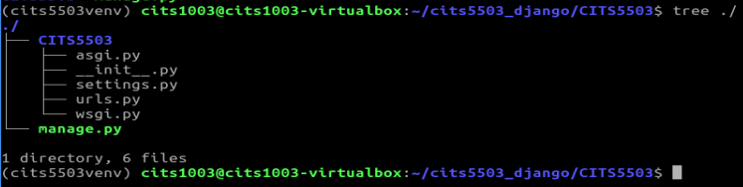
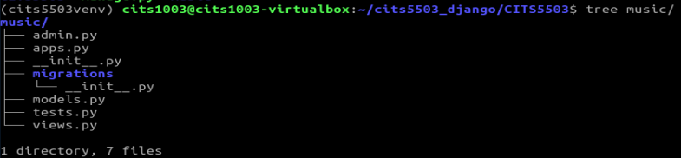
Step 2: Setting up a Django project and app
pip install django
django-admin startproject CITS5503
cd CITS5503
python3 manage.py startapp music

Slide 35
Step 2: Setting up a Django project and app
pip install django
django-admin startproject CITS5503
cd CITS5503
python3 manage.py startapp music
Question: What's the difference between the outputs of
django-admin startproject CITS5503
django-admin startproject CITS5503 .

Slide 36
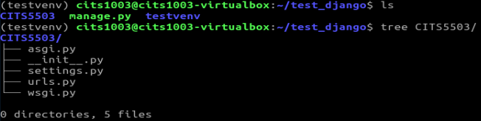
django-admin startproject CITS5503
django-admin startproject CITS5503 .

Slide 37
Step 2: Setting up a Django project and app
pip install django
django-admin startproject CITS5503
cd CITS5503
python3 manage.py startapp music
Question: What's the difference between the outputs of
django-admin startproject CITS5503: Django creates a new directory named "CITS5503" , inside which another subdirectory named "CITS5503" is created: the python project files is placed inside the subdirectory.
django-admin startproject CITS5503 . : Django creates a new directory named "CITS5503".

Slide 38
Step 3: Starting the Django application server
python manage.py check
python manage.py runserver
Question: Which default port is the Django application server is listening on?

Slide 39
Step 3: Starting the Django application server
python manage.py check
python manage.py runserver
Question: Which default port is the Django application server is listening on?
Port: 8000
Question: What if the port is taken by another process in our system?

Slide 40
Step 3: Starting the Django application server
Question: What if the port is taken by another process in our system?
python manage.py runserver 9000
#ngnix
proxy_pass http://127.0.0.1:8000;

Slide 41
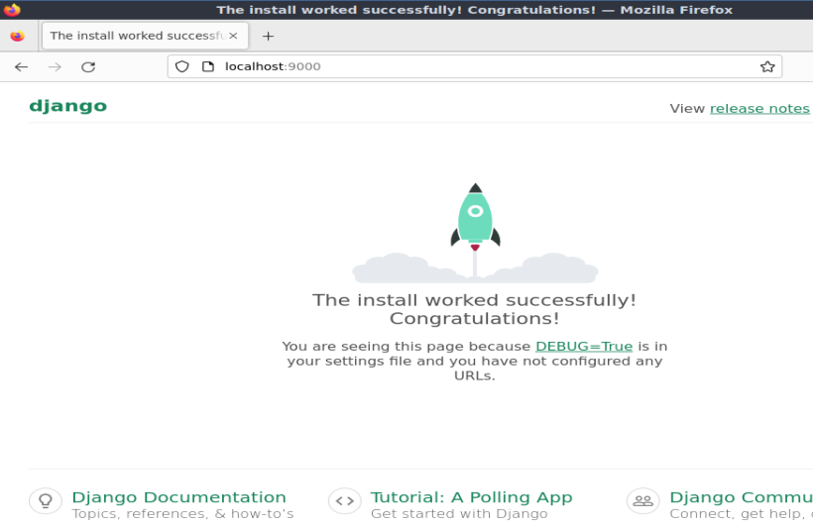
Open a browser and go to: http://localhost:9000

Slide 42
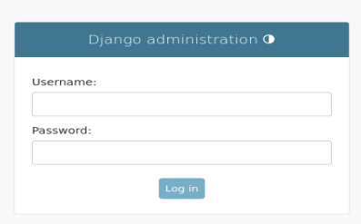
If we go to: http://localhost:9000/admin/

Slide 43
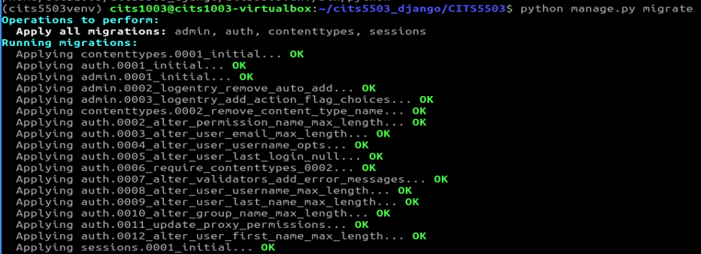
Step 4: Setting up an admin
python manage.py migrate

Slide 44
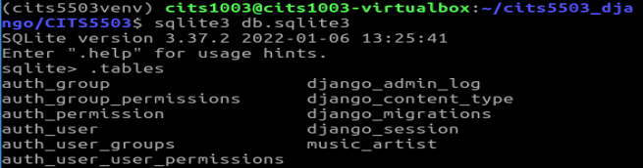
Step 4: Setting up an admin
python manage.py migrate

Slide 45
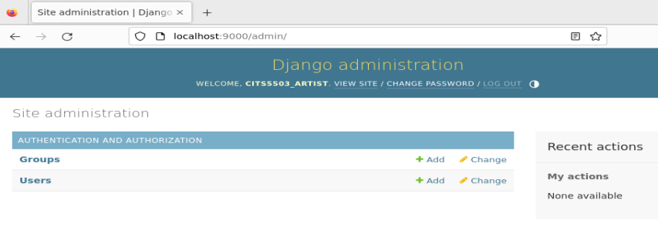
Step 4: Setting up an admin
python manage.py createsuperuser

Slide 46
Step 5: Setting up the music app
# inside CITS5503/settings.py
INSTALLED_APPS = [
'django.contrib.admin’, #The admin site 'django.contrib.auth’, #Authentication 'django.contrib.contenttypes’, #A framework for content types 'django.contrib.sessions’, #A session framework 'django.contrib.messages’, #A messaging framework 'django.contrib.staticfiles’, #A framework for managing static files
#new app below: ‘music.apps.MusicConfig', ]

Slide 47
Step 6: Updating the url component in the project
# inside CITS5503/urls.py
from django.contrib import admin from django.urls import path from music import views # added
urlpatterns = [ path('', views.home, name='home'), # added path('admin/', admin.site.urls),
]

Slide 48
Step 7: Updating the view component in the app
# inside music/views.py
from django.shortcuts import render from django.http import HttpResponse #added
#added
def home(request): return HttpResponse('This is the home page.')

Slide 49
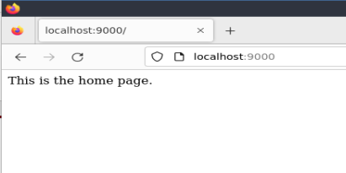
go to: http://localhost:9000

Slide 50
Step 8: Creating html templates in the project and the app
Inside the current working directory of the project
mkdir templates mkdir music/templates mkdir music/templates/music
touch templates/home.html touch music/templates/music/main.html touch music/templates/music/artist.html

Slide 51
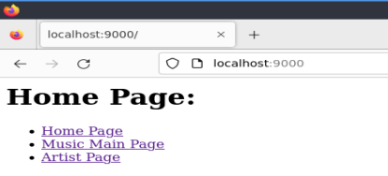
templates/home.html
<h1>Home Page:</h1> <ul> <li><a href="{% url 'home' %}">Home Page</a></li> <li><a href="{% url 'music:main' %}">Music Main Page</a></li> <li><a href="{% url 'music:artist' %}">Artist Page</a></li> </ul>

Slide 52
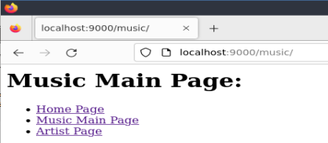
music/templates/music/main.html
<h1>Music Main Page:</h1> <ul> <li><a href="{% url 'home' %}">Home Page</a></li> <li><a href="{% url 'music:main' %}">Music Main Page</a></li> <li><a href="{% url 'music:artist' %}"> Artist Page </a></li> </ul>

Slide 53
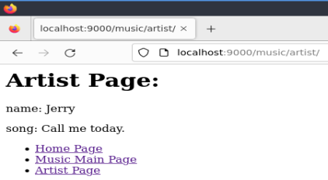
music/templates/music/artist.html
<h1>Artist Page:</h1> <p>name: Jerry</p>
<p>song: Call me today</p> <ul> <li><a href="{% url 'home' %}">Home Page</a></li> <li><a href="{% url 'music:main' %}">Music Main Page</a></li> <li><a href="{% url 'music:artist' %}"> Artist Page </a></li> </ul>

Slide 54
Step 9: Updating the url component in the project
# inside CITS5503/urls.py
from django.contrib import admin from django.urls import path from music import views # added
urlpatterns = [ path('', views.home, name='home'), # added path('admin/', admin.site.urls),
path('music/', include('music.urls')), # added
]

Slide 55
Step 10: Creating the url component in the app
touch music/urls.py
# inside music/urls.py
from django.urls import path from . import views app_name = 'music'
urlpatterns = [ path('', views.main, name='main'), path('artist/', views.artist, name='artist'), ]
Question: What is the url pattern for the first path?

Slide 56
Step 10: Creating the url component in the app
touch music/urls.py
# inside music/urls.py
from django.urls import path from . import views app_name = 'music'
urlpatterns = [ path('', views.main, name='main'), path('artist/', views.artist, name='artist'), ]
Question: What is the url pattern for the first path?
localhost:9000/music

Slide 57
Step 11: Updating the view component in the app
# inside music/views.py
from django.shortcuts import render
#updated def home(request): return render(request, 'home.html')
def main(request): return render(request, 'music/main.html')
def artist(request): return render(request, 'music/artist.html')

Slide 58
Step 12: Specifying the templates in the project
# inside CITS5503/settings.py
import os #added
TEMPLATES = [ {
(...)
'DIRS': [os.path.join(BASE_DIR, 'templates')], #added
(...)
} ]

Slide 59
Go to the home page
Go to the main page
Go to the artist page

Slide 60
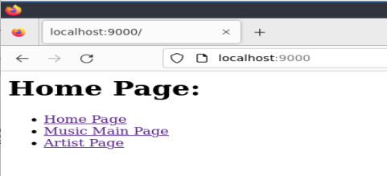
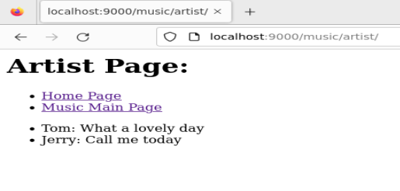
Automatically generated data

Slide 61
Step 13: Updating the model component in the app
# inside music/models.py
from django.db import models
class Artist(models.Model):
name = models.CharField(max_length=200)
song = models.CharField(max_length=200)
def __str__(self):
return self.name

Slide 62
Step 14: Creating the Artist table and registering it into the admin interface
# inside music/admin.py
from django.contrib import admin from .models import Artist
admin.site.register(Artist)
python manage.py makemigrations
python manage.py migrate

Slide 63
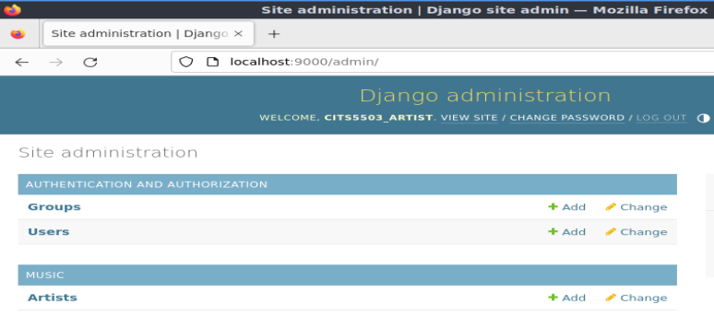
Go to the admin interface

Slide 64
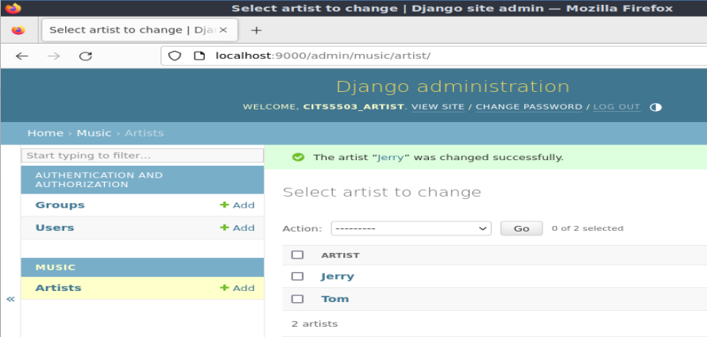
Step 15: Populating the artist table
def __str__(self):
return self.name

Slide 65
Step 16: Updating the view component in the app
# inside music/views.py
from django.shortcuts import render
from .models import Artist #added
def home(request): return render(request, 'home.html')
def main(request): return render(request, 'music/main.html')
#updated
def artist(request): title = 'Artist Page Info'
artist_list = Artist.objects.all()
context = {'title': title, 'artist_list': artist_list}
return render(request, 'music/artist.html', context)

Slide 66
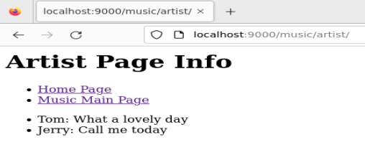
Step 17: Updating music/templates/music/artist.html
<h1>{{title}}</h1> <ul> <li><a href="{% url 'home' %}">Home Page</a></li> <li><a href="{% url 'music:main' %}">Music Main Page</a></li> </ul>
<ul>
{% for artist in artist_list %} <li> {{artist.name}}: {{artist.song}}</li>
{% endfor %} </ul>

Slide 67
Question: What if 'title' in context is replaced by 'titlectx'?
def artist(request): title = 'Artist Page Info'
artist_list = Artist.objects.all()
context = {'title': title, 'artist_list': artist_list}
return render(request, 'music/artist.html', context)
def artist(request): title = 'Artist Page Info'
artist_list = Artist.objects.all()
context = {'titlectx': title, 'artist_list': artist_list}
return render(request, 'music/artist.html', context)

Slide 68
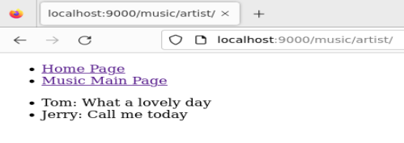
<h1>{{titlectx}}</h1> <ul> <li><a href="{% url 'home' %}">Home Page</a></li> <li><a href="{% url 'music:main' %}">Music Main Page</a></li> </ul>
<ul>
{% for artist in artist_list %} <li> {{artist.name}}: {{artist.song}}</li>
{% endfor %} </ul>
Otherwise

