Slide 1





R&D environment.
OS |  | WINDOW7
Language |  | Java,php sql
Flatform |  | Android,apache,php Mysql
Programing |  | Android

Slide 2
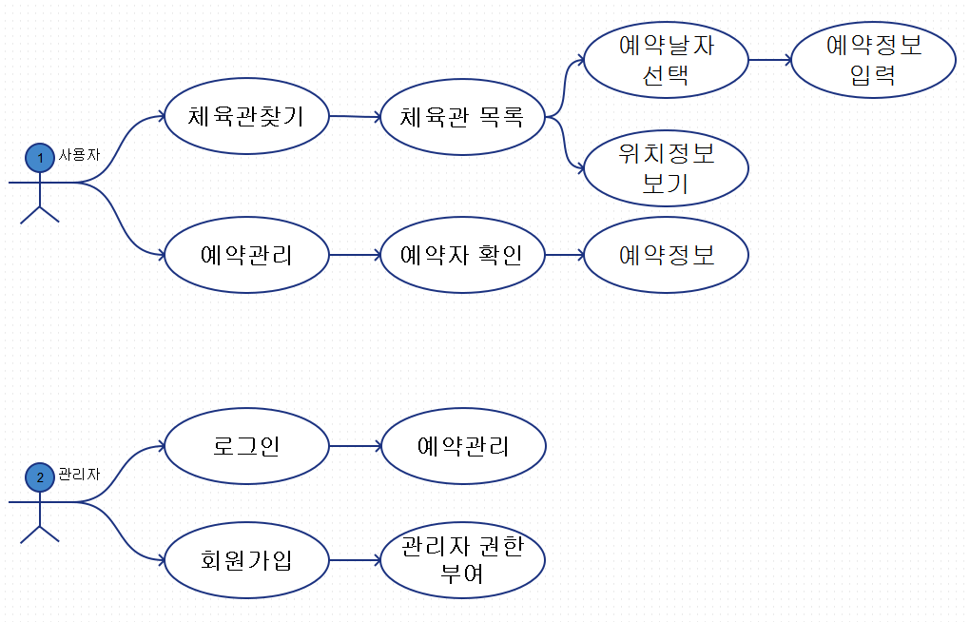
Use Case Diagram

Slide 3
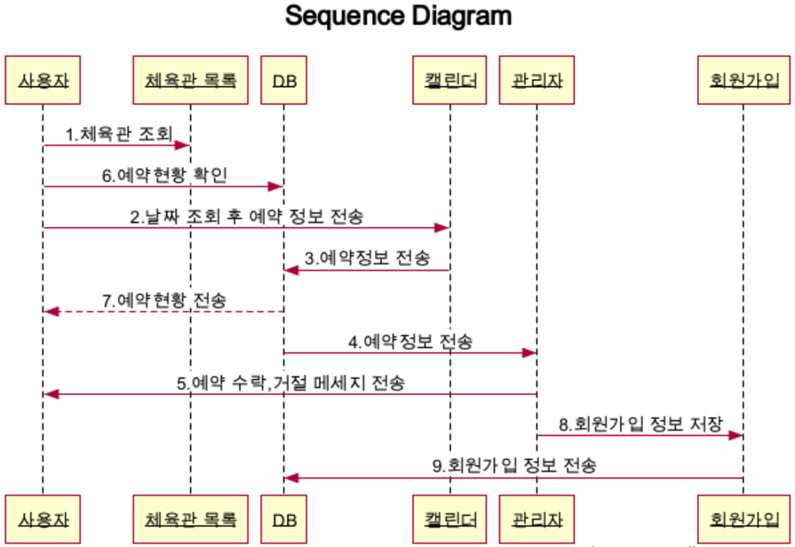
Sequence Diagram

Slide 4
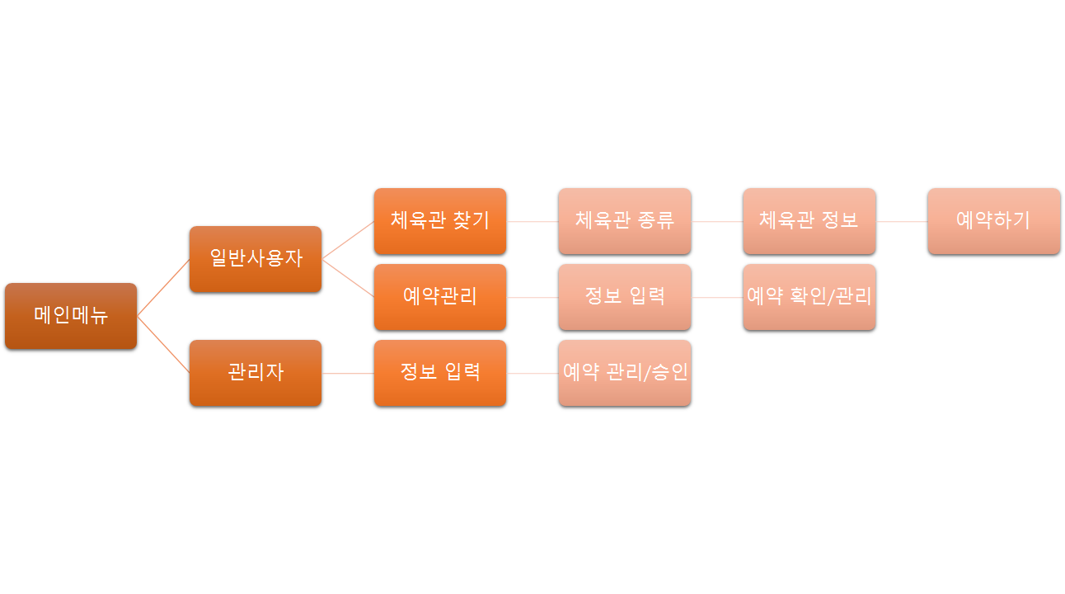
Activity Diagram

Slide 5
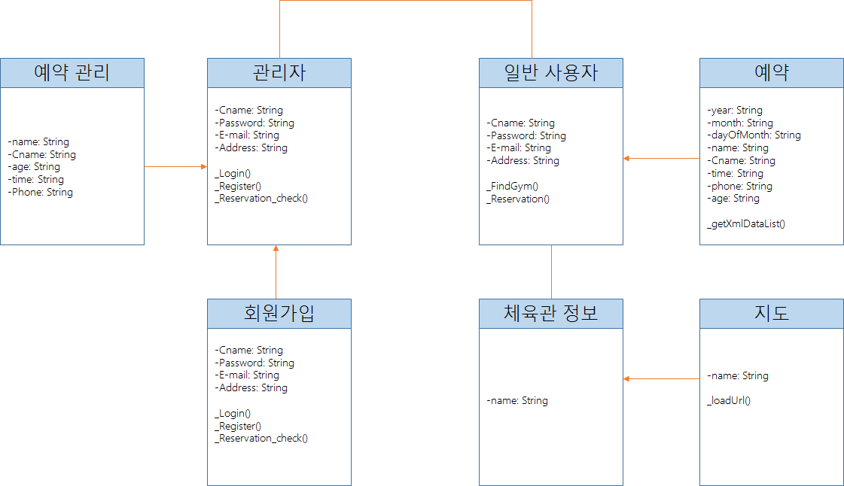
Class Diagram

