Slide 1
Building a Pet Tracker App with React Native and Amplify
​

Slide 2
MEET OUR TEAM
Aniket Sharma
Mentor
Yogesh khairnar
Saniya Gawas
Akash Lagad​
Kunal MAte
Backend Monitoring
Backend
Frontend Developer
Frontend Developer

Slide 3
Contents
Introduction​
Architecture
Project Setup
App Appearance
Features/Modules
Get Started
​Conclusion

Slide 4
Introduction
This starter automatically provisions a Serverless infrastructure with authentication, authorization, image storage, API access and database operations. It also includes user registration. The sample use case is a "Pet Tracker" where after a user registers and logs in they can upload pictures of their pet to the system along with information like the birthday or breed.
This can be used by Vets and Pet-Shop owners to keep records of different pets or animals. And can also track their current Location as well.
Overall, the pet tracker app aims to enhance the safety and well-being of pets by empowering owners with the ability to track their pets' location, take proactive measures when needed, and ensure a swift and efficient reunion in case of any unexpected situations.

Slide 5
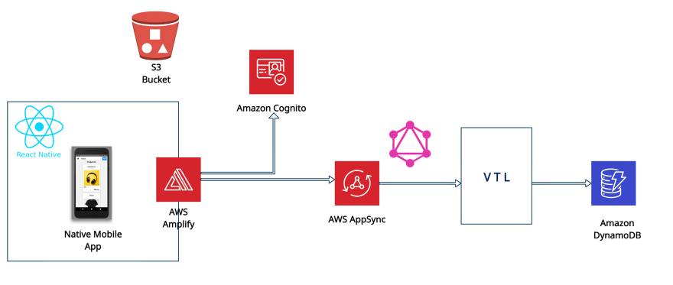
Architecture

Slide 6
Project Setup.
Prerequisites:
Node.js, npm
React Native CLI,
AWS account
Android Studio
AWS Services used :
Amazon S3
Amazon Cognito User Pools.
Amazon API Gateway.

Slide 7
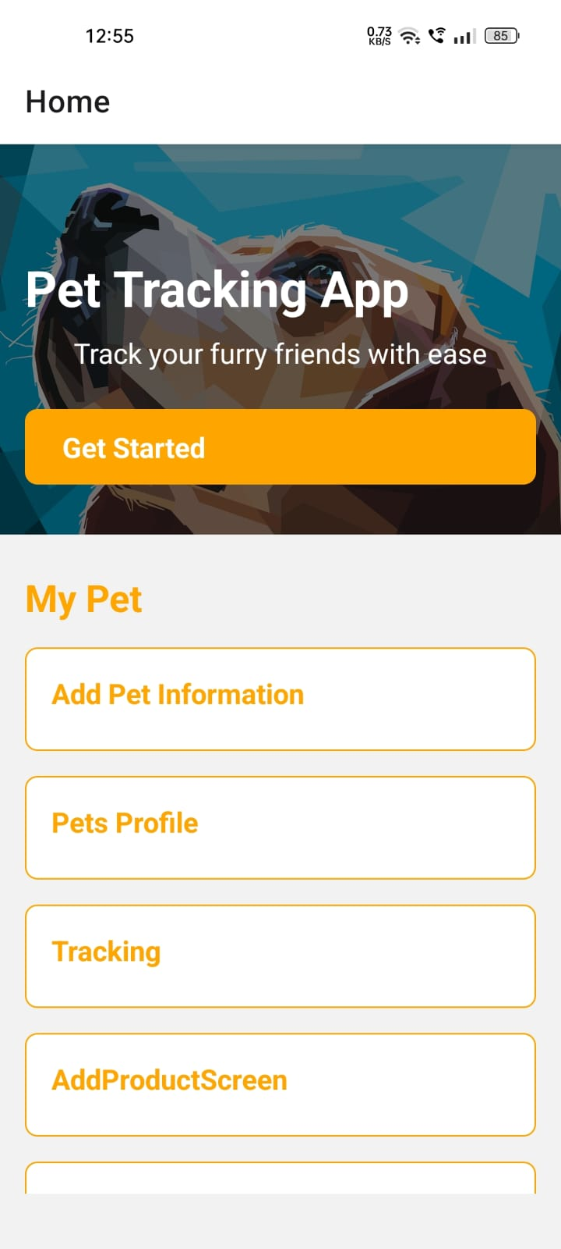
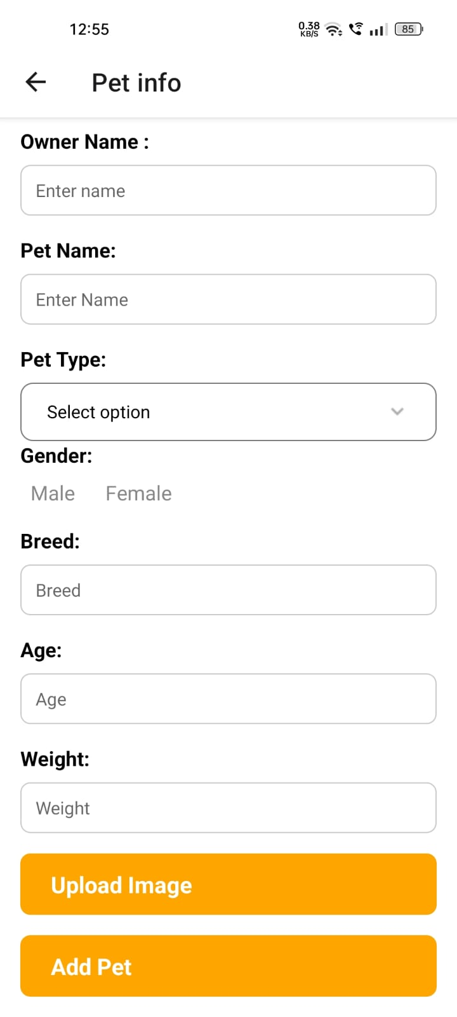
App Appearance.

Slide 8
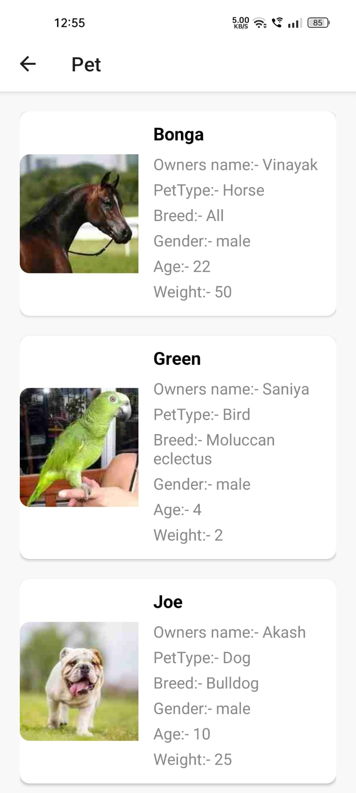
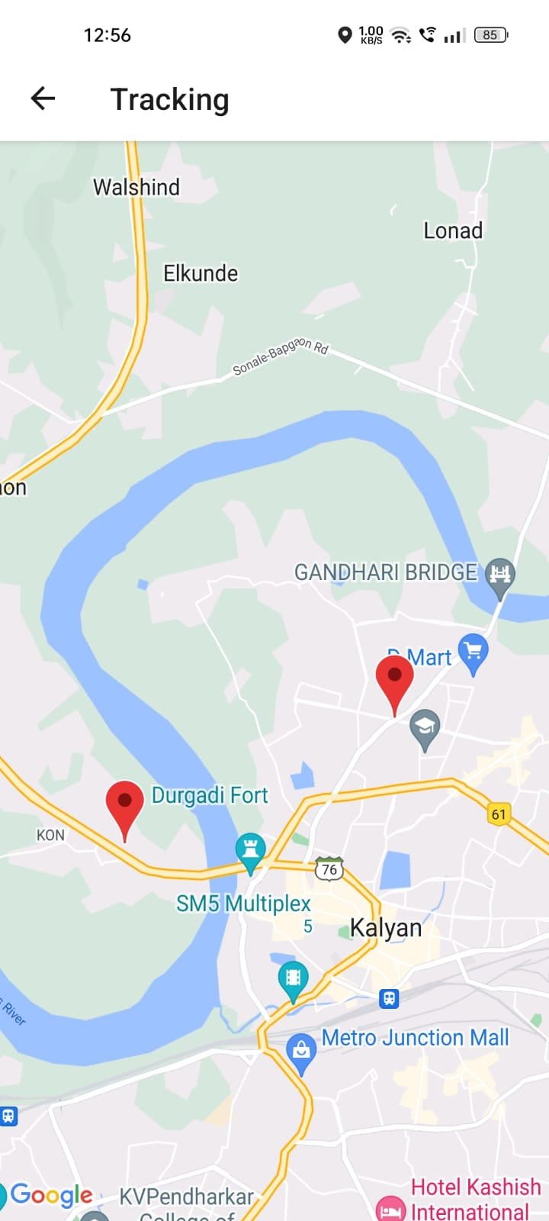

Slide 9
Features/Modules.
Login and Logout Page.
Pet registration page.
Pet tracking Page.

Slide 10
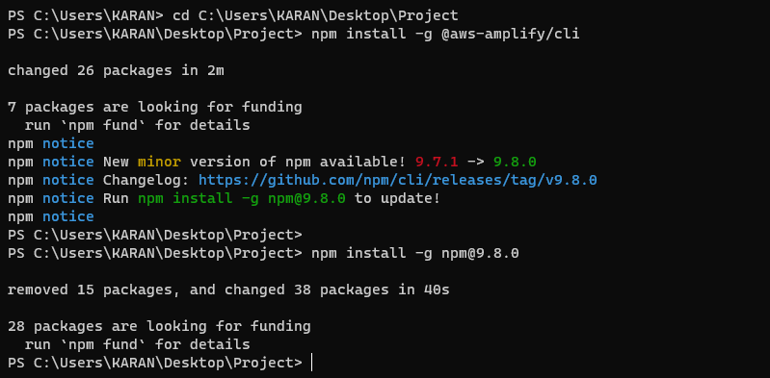
Start Setup
Get started. Setting up the project installing and configuring amplify cli. Install amplify cli by using this command in cmd (before this you should install node js). npm install -g @aws-amplify/cli

Slide 11
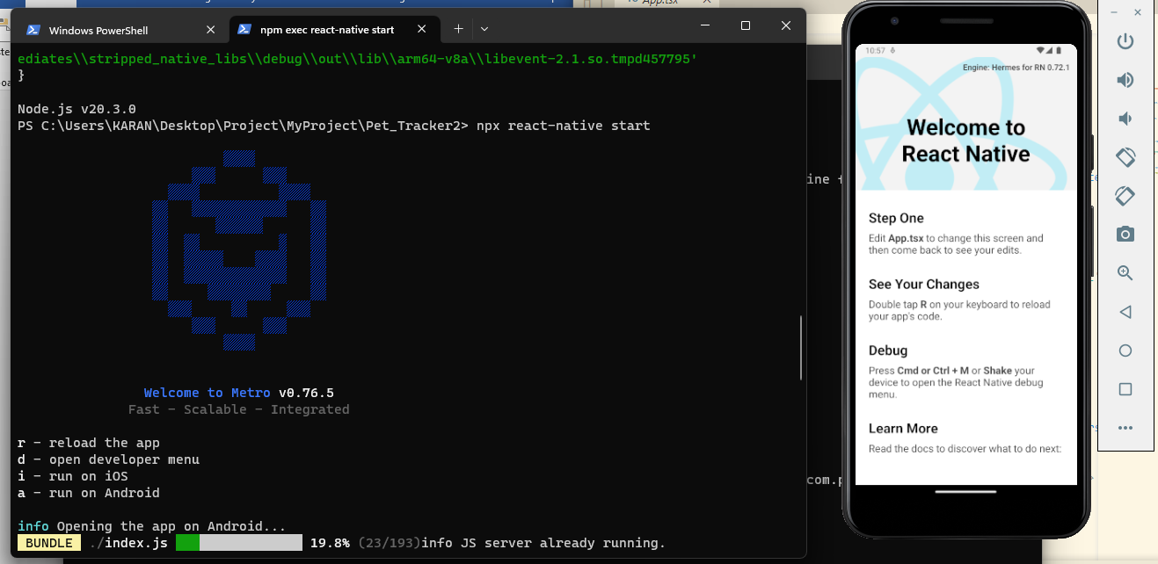
Create a new application.
npx react-native init pettracker
(Instead of amplify shop give your project name)
Change the directory to the project directory and then use the following command to open the project with the help of android studio.
npx react-native start
npx react-native run-android

Slide 12
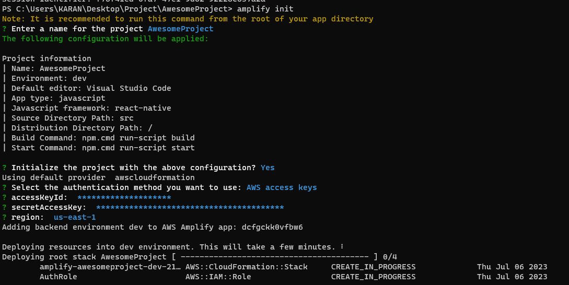
Initializing the amplify backend
amplify init
Then you will be prompted for the following information regarding the project you initialize.
When you initialize your Amplify Project.

Slide 13
It creates a file called aws-exports.js in the src directory. This file will store all the relevant information to identify the AWS resources/services that will allocate in the future.
It creates a directory called amplify. We will use this directory to store the templates and configuration details of the services that we will use in the future. In this directory, amplify will hold our backend schema as well.
It creates a Cloud Project. That project can be viewed using the amplify console command.

Slide 14
Next, we need to install all the necessary dependencies by running the following command.
npm install aws-amplify aws-amplify-react-native amazon-cognito-identity-js @react-native-community/netinfo
Configuring amplify backend.
To complete setting up our Amplify project, we need to configure amplify in a higher-order component. Adding the following lines of code in your App.js or index.js file will do the job.
import Amplify from 'aws-amplify’;
import awsconfig from './aws-exports’;
Amplify.configure({
...awsconfig,
Analytics: {
disabled: true,
},
});

Slide 15
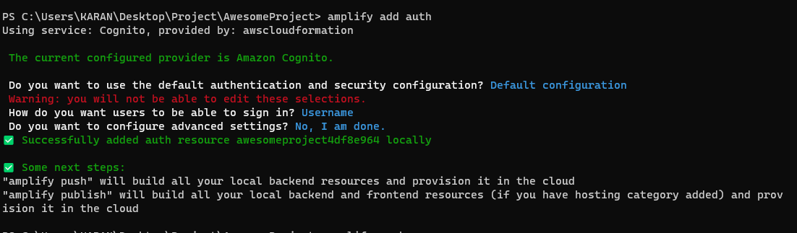
Adding cognito authentication.: Add a Userpool for users to login and log-out
Amplify add auth
Adding AppSync API.: Add a API to fetch the App data
amplify add api
Adding S3 Storage.: Adding this to store Details and Images of Pets
npm install react-native-image-picker
amplify add storage

Slide 16
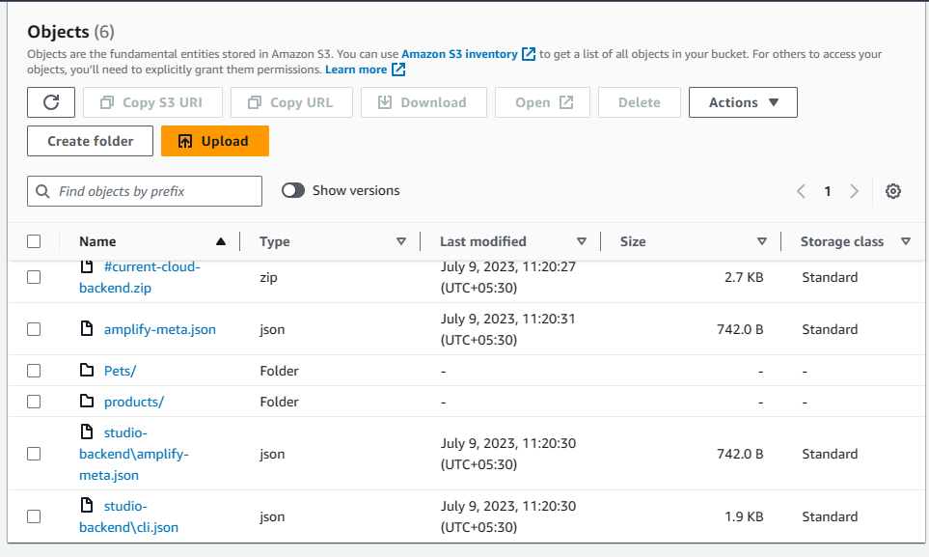
S3 Storage Bucket created at Backend

Slide 17
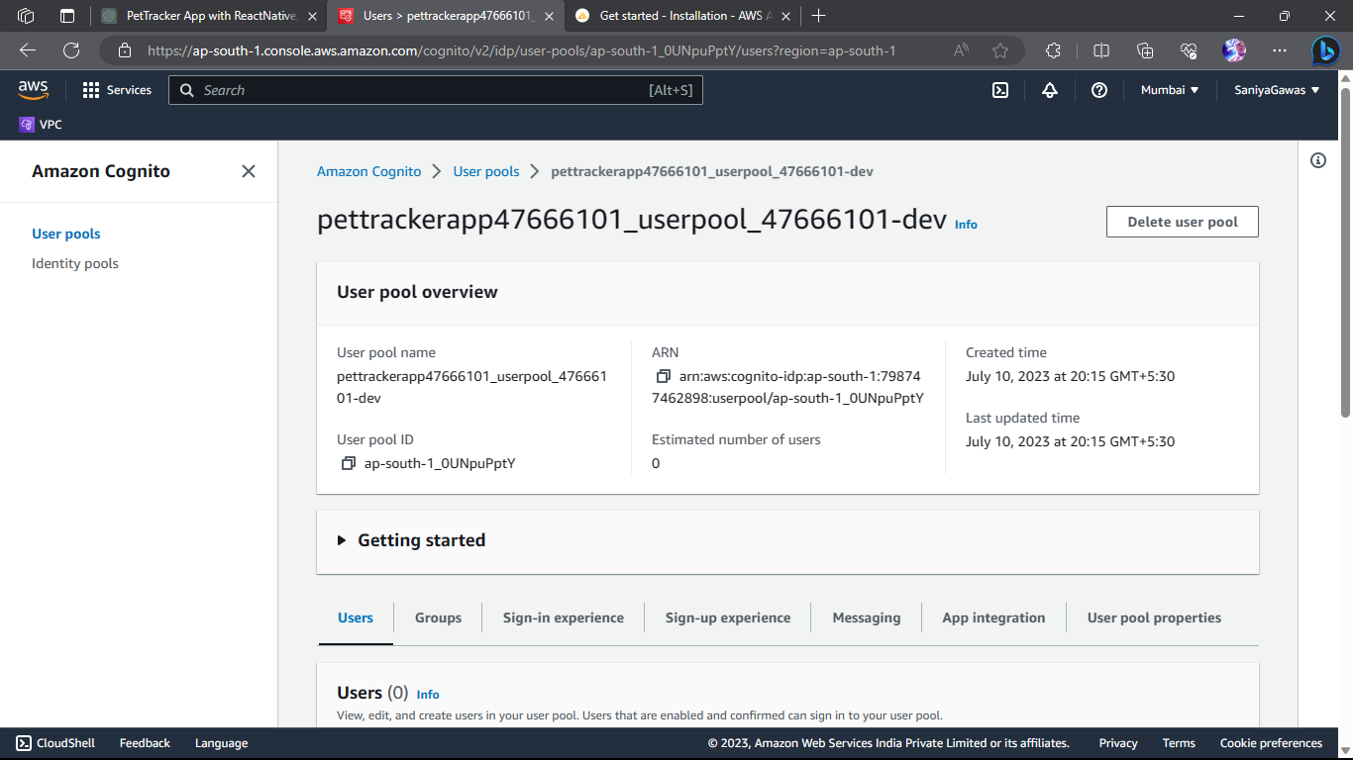
Added Cognito Userpool at backend.

Slide 18
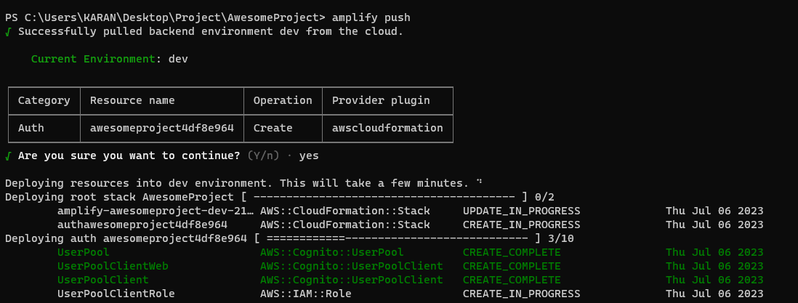
Push Code on Aws Amplify: This will Deploy our application to the cloud and can be retrieve easily along with all the Backend Data.
Amplify push

Slide 19
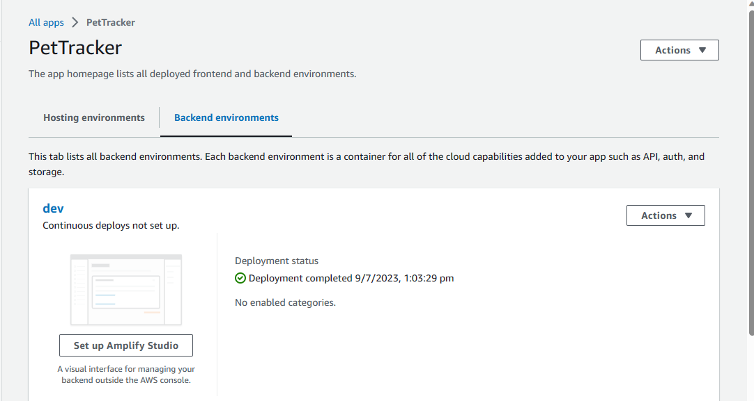
Pushed Amplify App

Slide 20
SUMMARY
So, this App can be used to Store Pet Data and Owner Info & Images in S3 so that it can be fetched online from any source. It will be Used by Vets and Pet Shop Owners to Store and Maintain their Data and Pet Info.
They Can also Track the Location Using the Location Service Added to the Application.

Slide 21
THANK YOU
Everyone for your Patience and Time.

