Slide 1

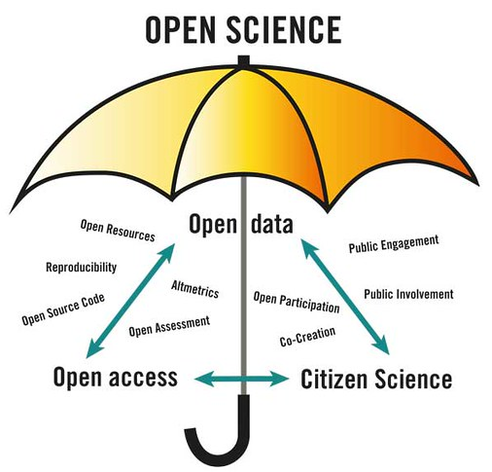




https://openscience-nijmegen.nl
Community of scholars / academic workers at Nijmegen campus
Aim is to share knowledge, experience and best practices related to open science
We organize events on a wide range of open science topics
We have a bottom-up organization: the agenda is determined by researchers
We work cross-disciplinary and inter-faculty
Want to join?
Sign up for our mailinglist: https://openscience-nijmegen.nl/_pages/contact/
E-mail ideas, suggestions and questions to contact@openscience-Nijmegen.nl
Follow us on Twitter: @OSCNijmegen
Image by Lotta Tomasson, VA

