Slide 1


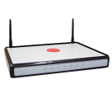
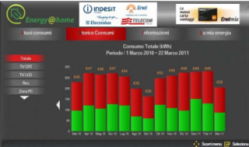

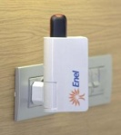




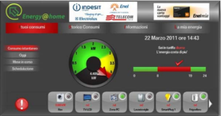

Open Energy Awareness
JEMMA allows you to deploy Energy Monitoring and Management Applications in homes via a low-power gateway device running Linux
DRAFT – for explanatory purposes only DRAFT – for explanatory purposes only
JEMMA

