Slide 1
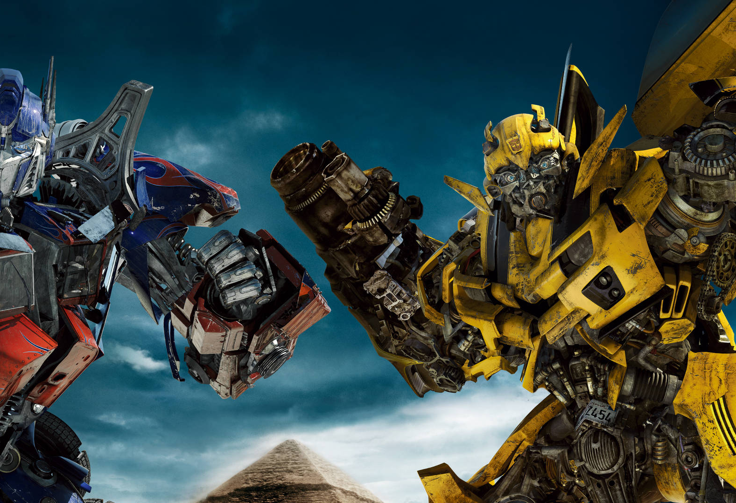
transformers and beyond
GESIS Fall Seminar 2023
“From Embeddings to Transformers: Advanced Text Analysis in Python”
[day 3, afternoon: contextualization]

Slide 2
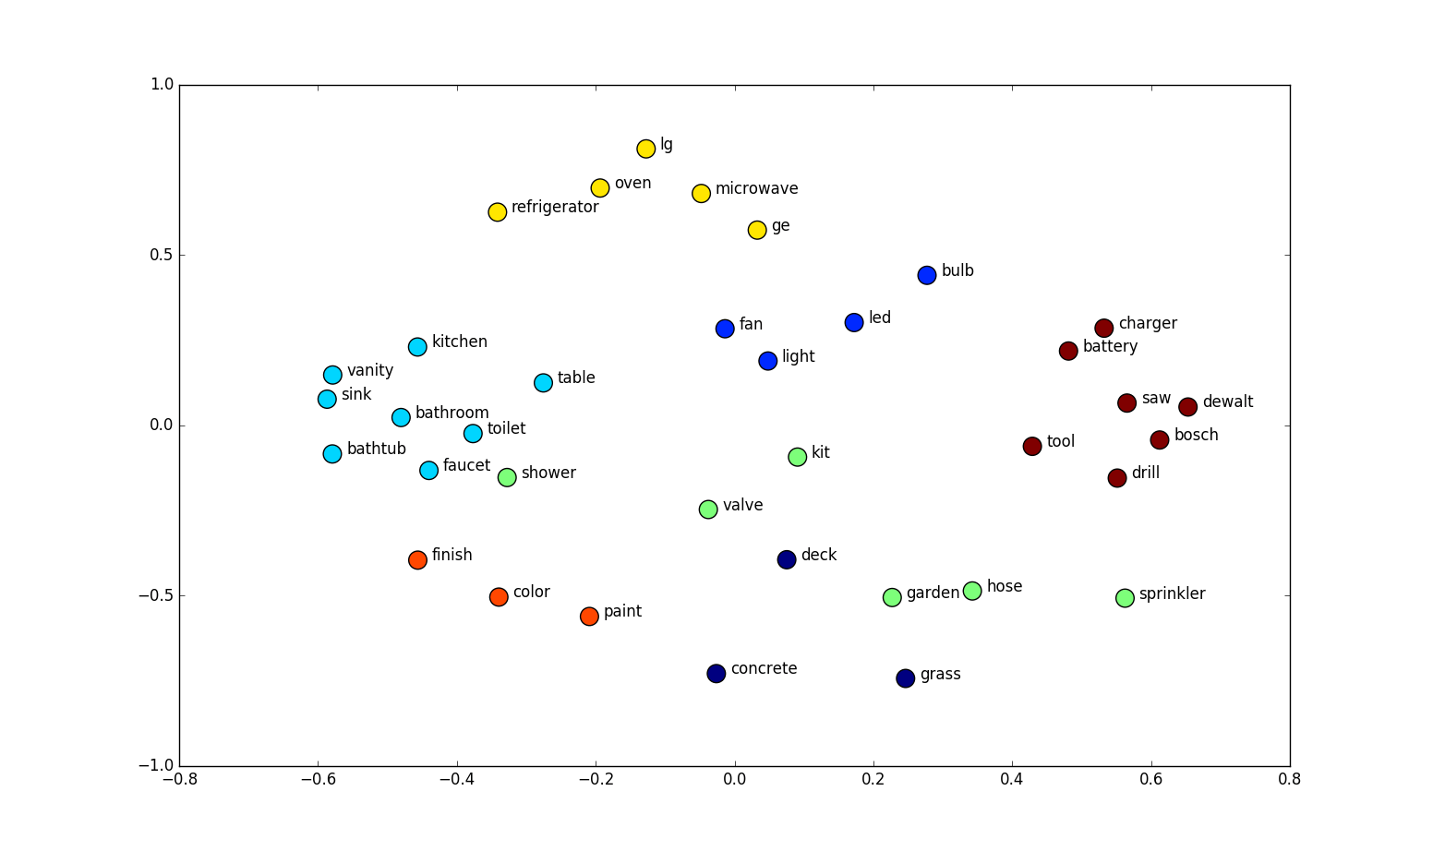
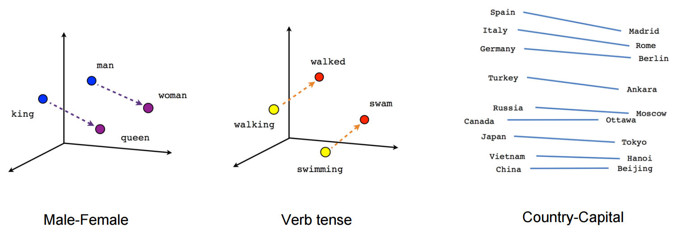
word embedding
the vector representing a word
in a d-dimensional, real-valued space
[Mikolov et. al. (2013)]
[Creating Word Embeddings | TDS]

Slide 3

limitations of […] word embeddings
[classic, traditional, static]
lack of context
semantic similarity challenges
out-of-vocabulary words
language dependency

Slide 4
what’s the problem here?
Bank
Open
Bat

Slide 5
polysemy […is a common linguistic phenomenon where a single word can have several senses or interpretations depending on the context in which it is used.]
Bank
Open
Bat

Slide 6



polysemy […is a common linguistic phenomenon where a single word can have several senses or interpretations depending on the context in which it is used.]
Bank
Open
Bat

Slide 7
what’s the solution?
Words don’t appear in isolation.
The word use (syntax and semantics) depends on its context.
Why not learn the representations for each word in its context?

Slide 8
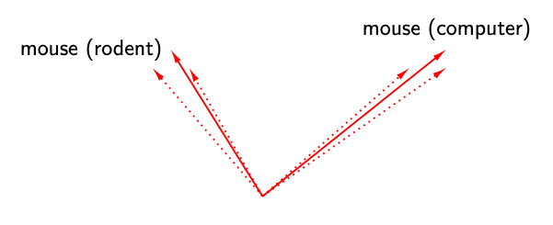
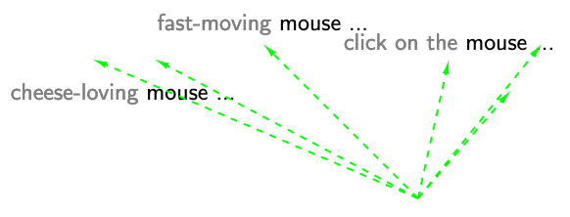
contextualized word embeddings
[dynamic]
[The Standford AI Lab Blog]

Slide 9
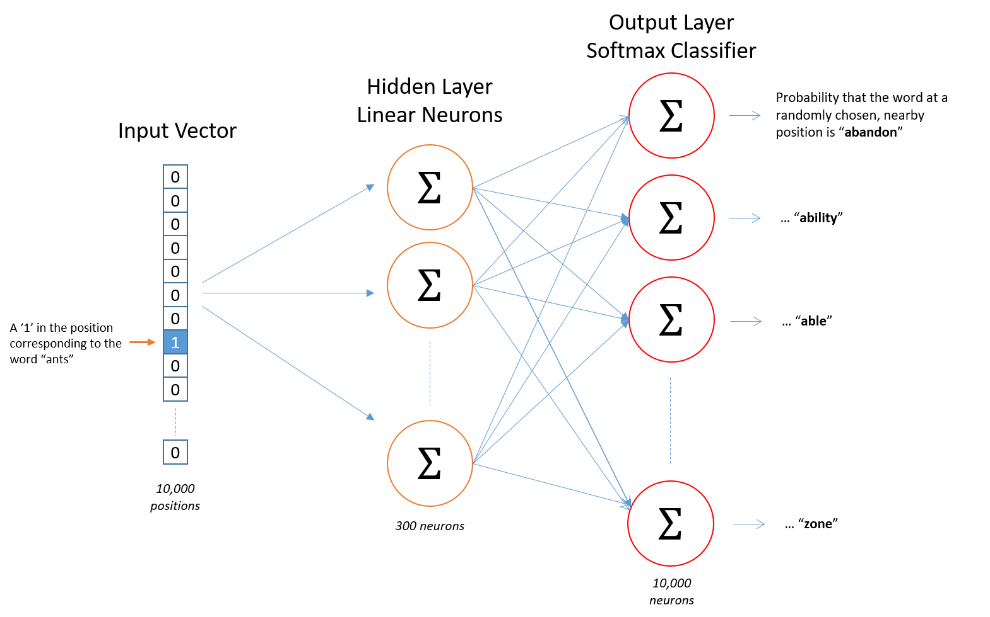
how?
[McCormick 2016]

Slide 10
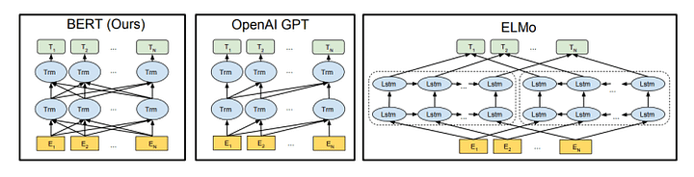
contextualized word embeddings | how?
LSTM
Transformers

Slide 11
notebook: 03_BERT_word_embeddings

Slide 12
a comparison
 | word embeddings [Word2Vec, GloVe] | contextualized word embeddings [ELMo, BERT, GPT]
representation | static | dynamic
context- | agnostic | aware
models | pre-trained, non-adaptable | finetuning

