Slide 1
BUILDING
ENERGY CONSUMPTION PREDICTOR (BECP)
Jose Correa

Slide 2
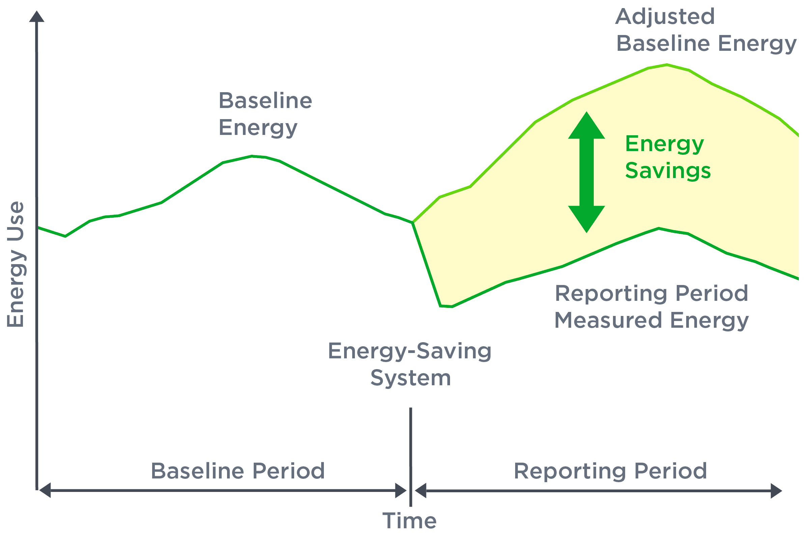
PROBLEM
Problem statement / opportunity you identified
Inaccuracy evaluating the effectiveness of building retrofits and their impact on energy consumption.
Subject area
Built environment
Building energy efficiency retrofits.
Incentives\Services related to 'pay- for-performance financing.'
Source: https://resourcekraft.com/measurement-and-verification-epcs-ipmvp/

Slide 3
SOLUTION
Implement the BECP Machine Learning model to evaluate the effectiveness of building retrofits by:
ACCURATE PREDICTIONS
Predicts building energy consumption for categories, such as: chilled water, electric, hot water, and steam meters.
PERFORMANCE ASSESSMENT
Gives a clear understanding of whether the retrofits are delivering the anticipated reduction in energy usage.
INVESTMENT DECISION SUPPORT
Offers stakeholders a reliable tool to make informed decisions about retrofit investments.

Slide 4
SOLUTION IMPACT
REAL STATE MARKETABILITY
CLIMATE CHANGE
9 out of 10 homebuyers prefer a home with energy-efficient features that lower energy costs²
Home value increases by $20 for every $1 saved on energy bills³
Buildings account for 30% of global energy consumption and 26% of global energy-related emissions¹
ENERGY EFFICIENCY
Higher-efficiency equipment can reduce energy use by 50% for electric heating and cooling systems⁴
¹ International Energy Agency
² EnergyLogic
³ National Renewable Energy Laboratory (NREL)
⁴ eeCompass

Slide 5
BECP DATASET
An introduction to the dataset, including data quality concerns and findings from preliminary EDA
MAIN FEATURES
DATA QUALITY CONCERNS
Data collected from more than 1,000 buildings over three years.
Information stored in three CSV files
The raw dataset comprises of 20 million rows, filtered down to a subset of 397,992 rows and 17 columns.
Most columns contain numeric data, with only three categorical.
?
FIRST TO MARKET
First beautifully designed building that's both stylish and functional

Slide 6
preliminary EDA
CONTOSO
COMPETITORS
Our product is priced below that of other architecture companies on the market
Simple and easy to build, compared to the complex building materials of the competitors
Affordability is the main draw for our consumers to our product
Company A
Product is more expensive
Companies B & C
Product is expensive and inconvenient to use
Companies D & E
Product is affordable, but inconvenient to use

Slide 7
NEXT steps
DATA PROCESSING
FEATURE ENGINEERGING
BASELINE MODELING
Apply log transformation to energy consumption, heavily positive skew.
Perform time-series analysis to uncover patterns, seasonality, or trends.
Create derived variables: EUI (Wh/m2).
Extract temporal features such as time of day, day of the week, seasonality, or holidays, which can impact energy usage.
Group temperature ranges, humidity levels and other weather variables.
Validate newly engineered features by assessing their correlation with the target variable.
Handling missing values
Train the time-series model
Evaluate the model's performance
Understand model’s predictive capability and limitations

Slide 8
THANK YOU
Jose Correa​

