Slide 1
Deconstruction of a science paper’s data evidence basis
Kelsey Malloy
Due: Jan 30, 2018
MPO 624
Spring 2018

Slide 2
My Paper
More frequent intense and long-lived storms dominate the springtime trend in central US rainfall
Zhe Feng, L. Ruby Leung, Samson Hagos, Robert A. Houze, Casey D. Burleyson & Karthik Balaguru
Feng, Z. et al. More frequent intense and long-lived storms dominate the springtime trend in central US rainfall. Nat. Commun. 7, 13429
Size of evidence set:
4 figures, 0 tables
4 in-text results

Slide 3
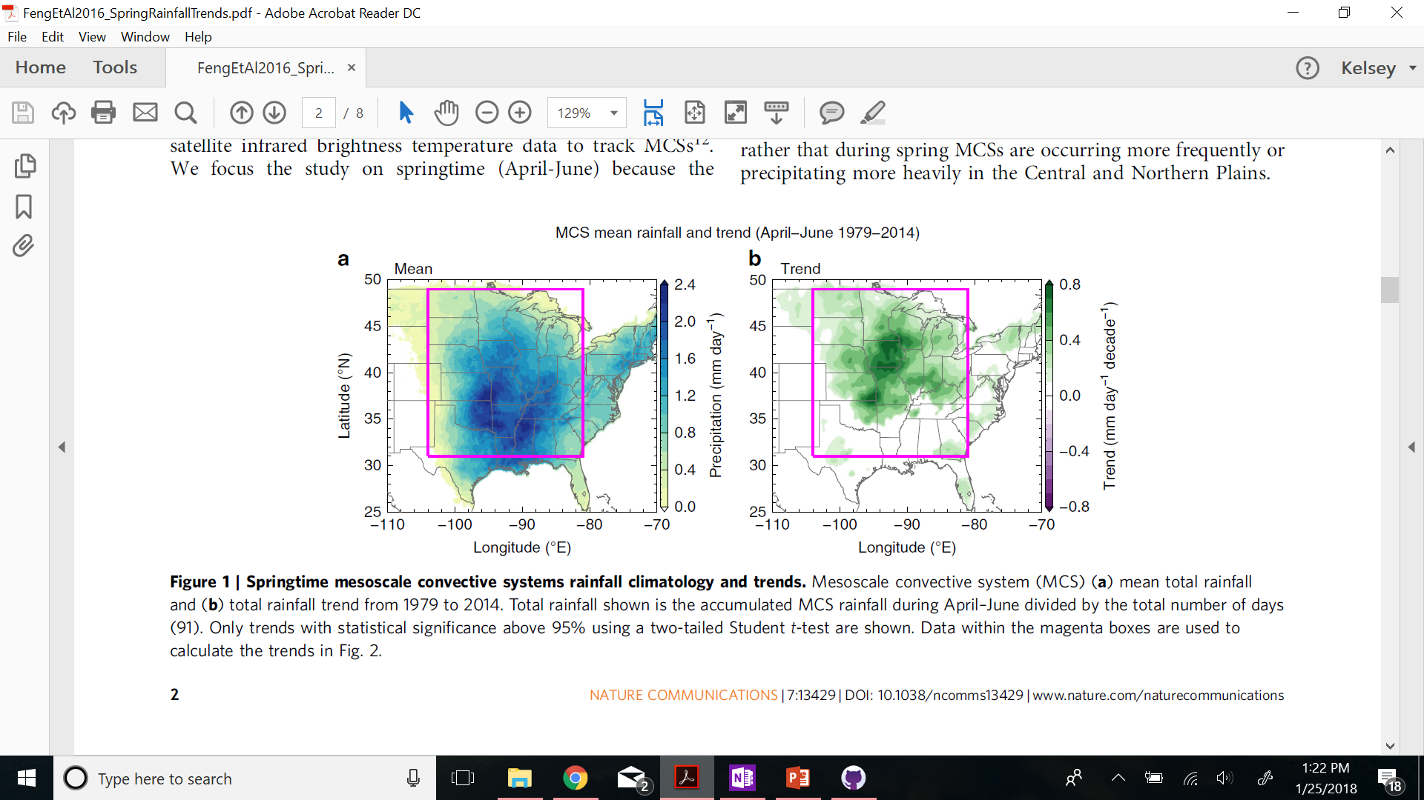
Figure 1
Summary display of raw data
Increasing springtime MCS rainfall

Slide 4
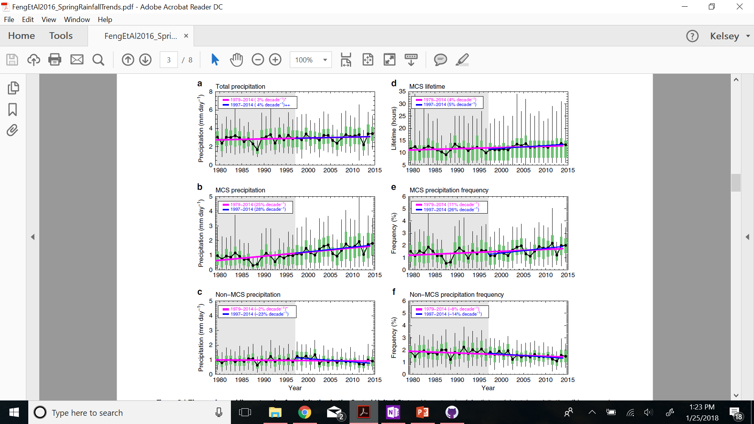
Figure 2
Feature claimed to exist
MCS precipitation increasing in precipitation, lifetime, and frequency
Non-MCS precipitation not showing same trend

Slide 5
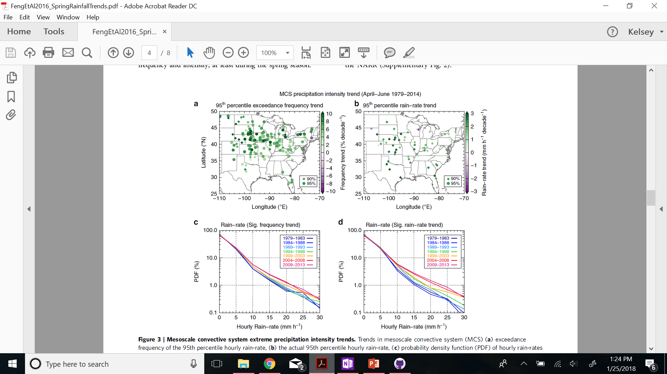
Figure 3
Feature claimed to exist
MCS 95th percentile events increasing
MCS rain-rate increasing

Slide 6
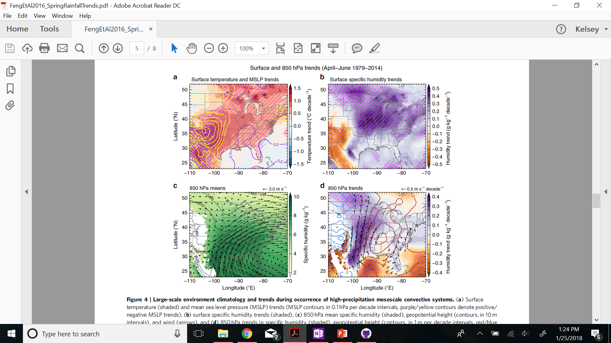
Figure 4
Relationship claimed to exist
Causality interpretation
Strengthening of jet → increased moisture transport → increased rainfall in central US

Slide 7
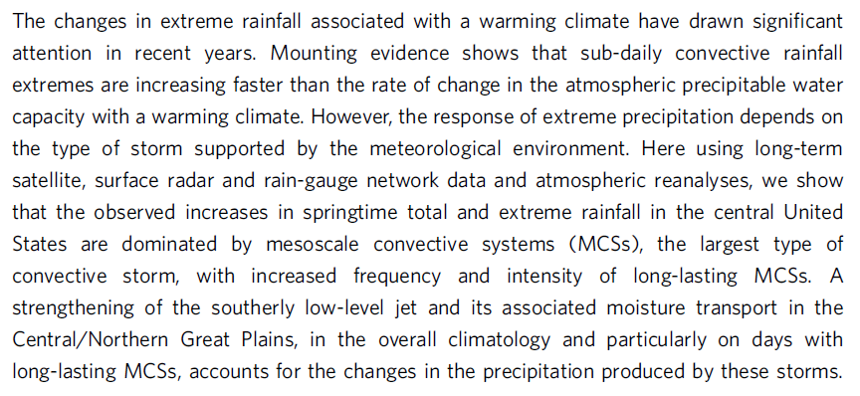
Abstract & its claims

