Slide 1
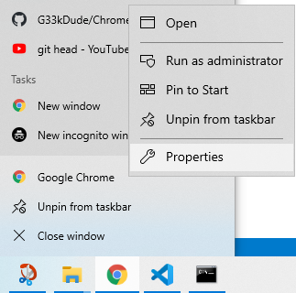
3. Left Click
2. Right Click
1. Right Click

